Slide 1





Where does plastic come from?
KS1 Lesson - Lesson 1 of 4

Slide 2
LO: To understand how plastic is made
  I can say where plastic comes from.
  I can talk about the steps to make plastic.
  I can put the steps to make plastic in the right order

Slide 3






Lesson Prep
Vocabulary
Discussion
Keywords that children need to understand and use during the lesson.
An opportunity for children to practice the knowledge learnt.
Big question
Task
To assess learning and give children time to practise independently.
A central question that sparks curiosity and frames the lesson’s theme.
The knowledge
Extension
Essential facts and concepts children need to know.
Optional tasks to deepen or stretch learning beyond the core lesson.

Slide 4
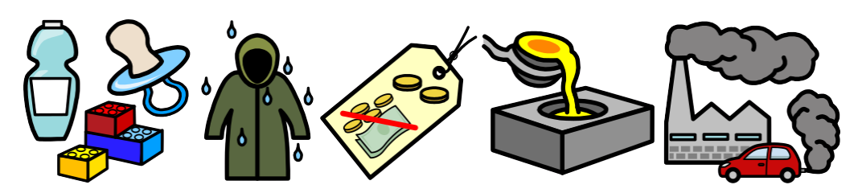
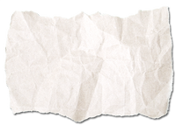
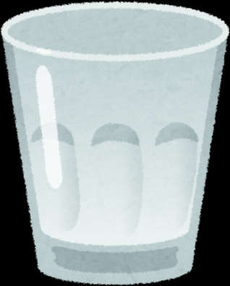
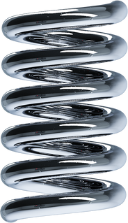
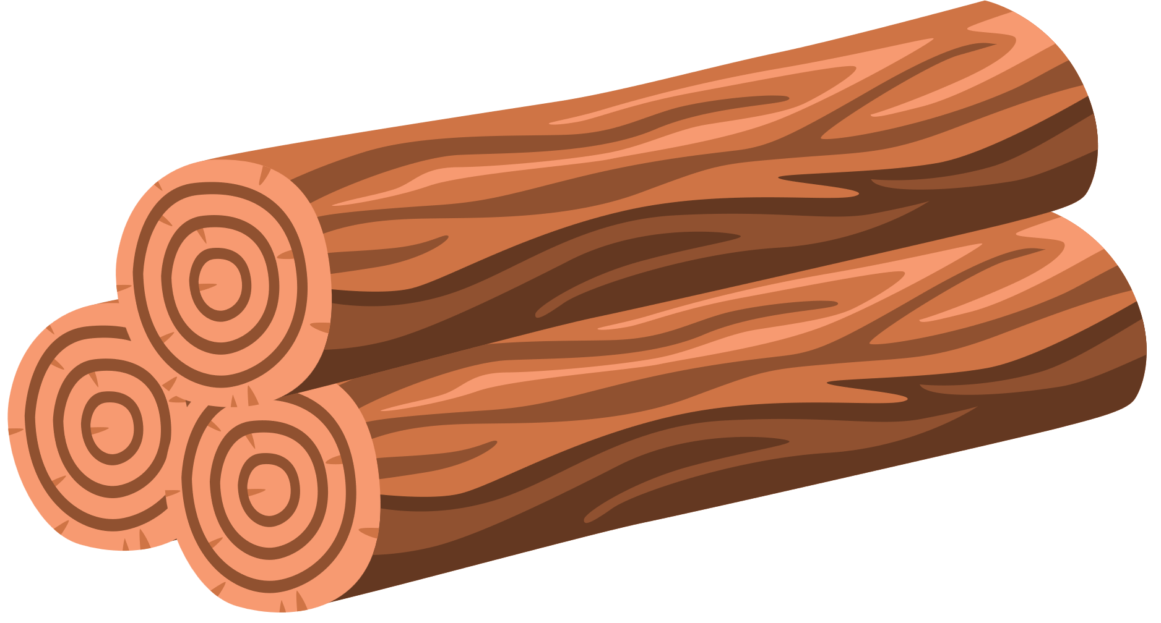
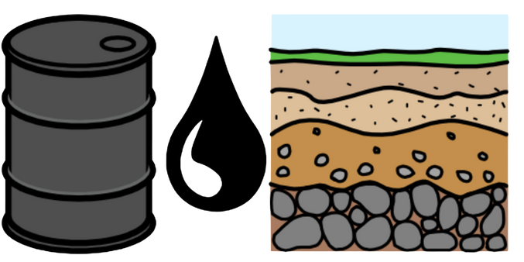
Key Words
material
plastic
waterproof
malleable
oil
pollution
Notes:
Material: A material is what something is made of.
Plastic: Plastic is a man-made material used to make things like bottles and toys.
Waterproof: Waterproof means water can’t get in.
Malleable: Malleable means you can bend or shape it without it breaking.
Oil: Oil is a thick liquid from deep underground. It’s used to make plastic.
Pollution: Pollution is when the Earth gets dirty and it can hurt people, animals, and plants.

Slide 5
Vocabulary task
  2. 3. 4. 5. 6.
waterproof
plastic
malleable
material
oil
pollution
Challenge: Write a sentence using a new vocabulary word.
Notes:
1 = Plastic
2= Malleable
3= Waterproof
4 = Pollution
5 = Material
6 = Oil

Slide 6








Hi Ned! I saw a plastic bottle on the playground and wondered—what’s the big deal? Isn’t plastic just something we throw away?
Ah, not quite! Plastic is made from limited resources deep underground. Once we use them up, they’re gone for good. We’ve got to use it carefully. Let’s find out!

Slide 7


How is plastic made?
Step 1
Plastic is a material made from oil.
Oil is found underground.

Slide 8
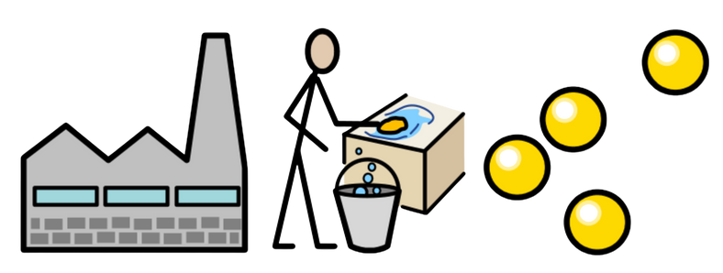
How is plastic made?
Step 2
The oil is taken to a factory.
It is cleaned.
It is changed into small pellets.

Slide 9
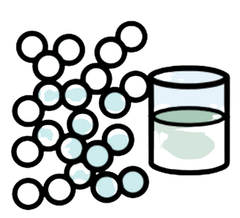
How is plastic made?
Step 3
The pellets are heated until they melt.

Slide 10
Tell your partner the steps so far
oil
factory
clean
pellets
melt
To make plastic, first you __________________.

Slide 11
How is plastic made?
Step 4
The melted plastic is poured into moulds.

Slide 12
How is plastic made?
Step 5
The plastic cools and goes hard.
It is ready to use!

Slide 13

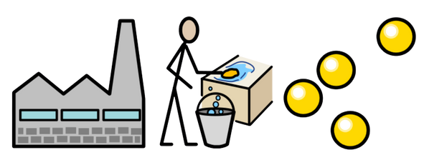
Task 1: Order the steps
The pellets are melted and put in a mould.
Oil is taken to the factory.
Oil is taken from underground.
Oil is changed to pellets.
Notes:
1 = Oil is taken from underground
2= Oil is taken to the factory
3= Oil is changed to pellets
4= The pellets are melted and put in a mould

Slide 14
Problems...
Plastic is made from oil.
It takes millions of years to form.
Do you think we can keep digging up oil forever?
How would life be different if we couldn’t make more plastic?
Notes:
Discussion 1: Do you think we can keep digging up oil forever?
- Read question to children twice
- Give children a moment to think about the question
- Ask children to agree or disagree with the statement using hand gestures
- In partners, get children to share their thoughts using sentence stem 'I think we can/cannot keep digging up oil forever because.....'
-Give children 2 minutes in partners to discuss their opinions
- Listen in to discussion. Spotlight two children
Repeat with question 2

Slide 15

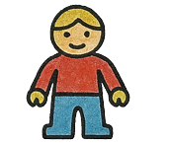
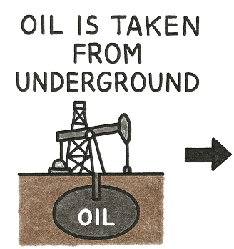
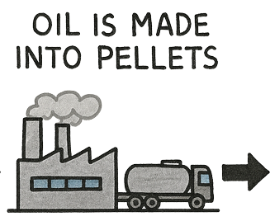
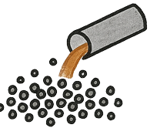
Extension activity 1
Art activity: Children create a poster or comic strip showing the journey of plastic from oil underground to a finished product, using drawings, labels, and arrows to show each step.
E.g.
Oil is taken from underground
Oil is taken to the factories
Oil is made into pellets and then melted
The melted pellets are poured into a mould.
A new toy is made!
Notes:
This is because we throw away the things we used to make an item. These are precious resources and will run out if we take too much.
Ask, what else could we do?
Mention that recycling is a great way of helping reuse the materials in a different way.

Slide 16

Extension activity 2
Discussion activity: Sit in a circle and ask children to bring or describe a plastic item from home, then discuss where it might have come from, how it was made, and what could happen to it after it's used.
Notes:
This is because we throw away the things we used to make an item. These are precious resources and will run out if we take too much.
Ask, what else could we do?
Mention that recycling is a great way of helping reuse the materials in a different way.

Slide 17
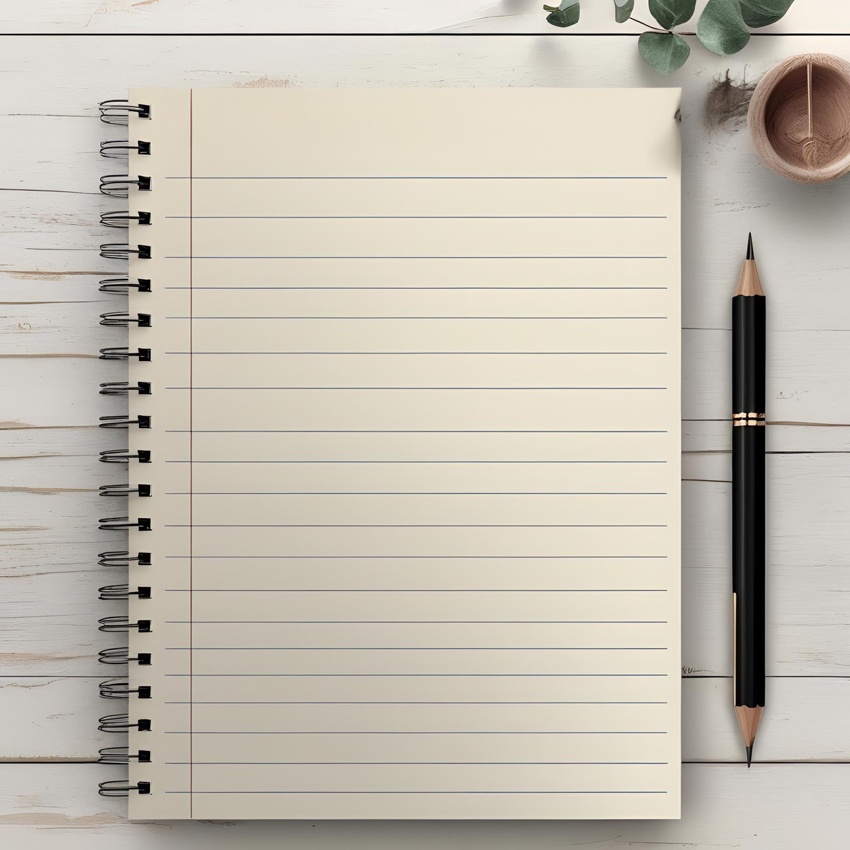
Extension activity 3
Writing activity: Children to write the steps of how plastic is made.
Date
How plastic is made
Step 1: Oil is a material that is found underground.
Step 2: Oil is taken to the factories.
It is cleaned and made into pellets.
Step 3: The pellets are heated until they melt.
Step 4: The pellets are poured into a mould.
Step 5: The melted plastic is cooled.
A new toy is made!
Notes:
This is because we throw away the things we used to make an item. These are precious resources and will run out if we take too much.
Ask, what else could we do?
Mention that recycling is a great way of helping reuse the materials in a different way.

