Slide 1




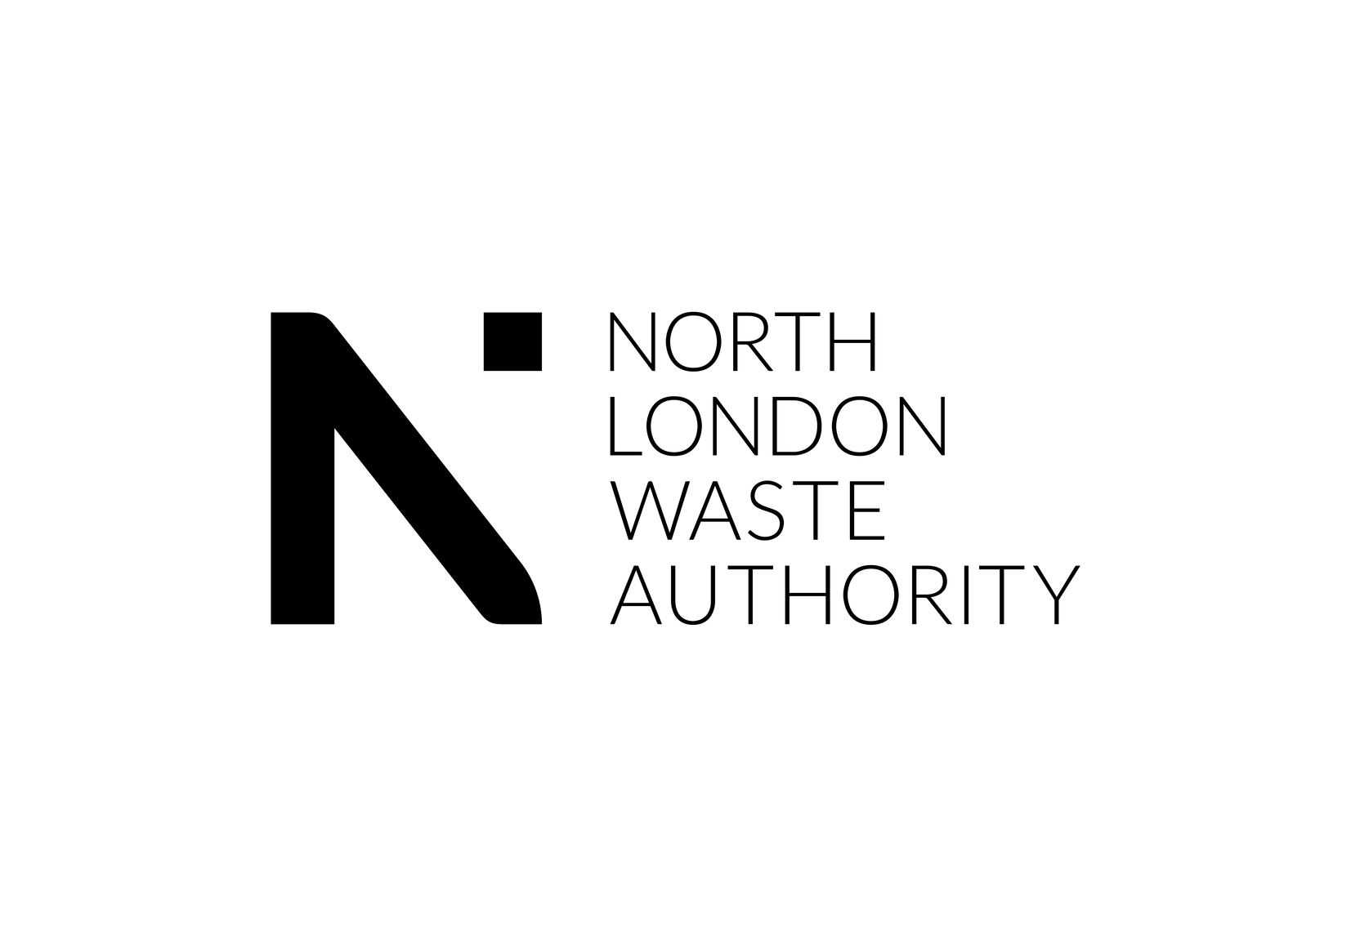
How does plastic affect our
environment?
KS1 Lesson - Lesson 2 of 4

Slide 2
LO: To understand the impact of plastic waste on animals and their habitats.
  I can give examples of how plastic waste affects animals and habitats.
  I can suggest ways to reduce plastic waste in everyday life.

Slide 3




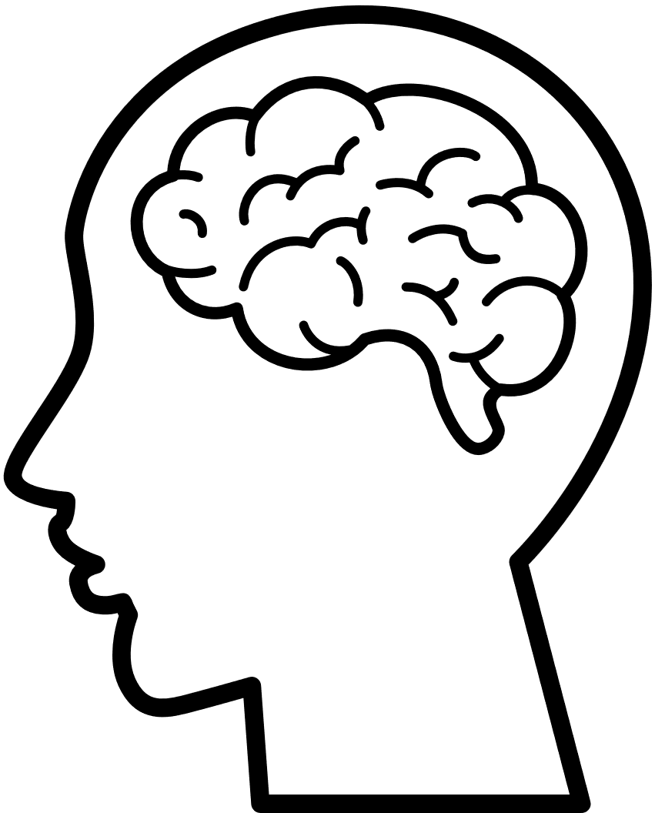

Lesson Prep
Vocabulary
Discussion
Keywords that children need to understand and use during the lesson.
An opportunity for children to practice the knowledge learnt.
Big question
Task
To assess learning and give children time to practise independently.
A central question that sparks curiosity and frames the lesson’s theme.
The knowledge
Extension
Essential facts and concepts children need to know.
Optional tasks to deepen or stretch learning beyond the core lesson.

Slide 4
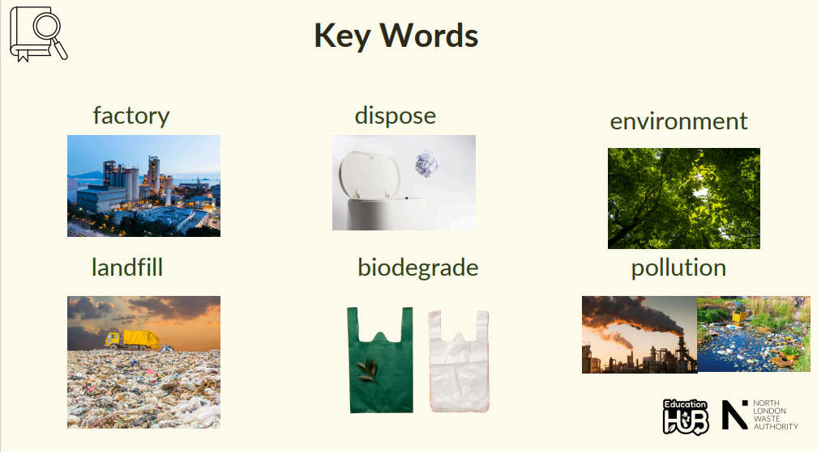
Key Words
Notes:
Factory: A factory is a building where people and machines make things.
Dispose: Dispose means to get rid of something when you don’t need it anymore.
Environment: The environment is everything around us—like air, water, animals, and plants.
Landfill: A landfill is a big place where rubbish is buried under the ground.
Biodegrade: Biodegrade means something can break down naturally and safely into the earth.
Pollution: Pollution is when the Earth gets dirty and it can hurt people, animals, and plants.

Slide 5
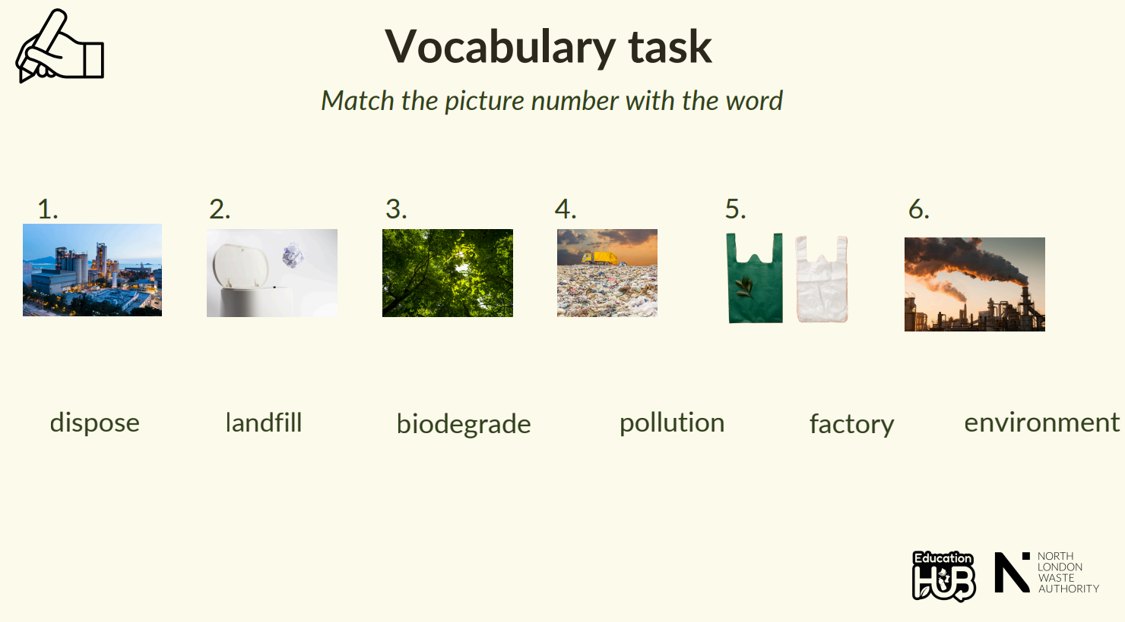
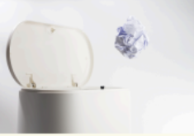
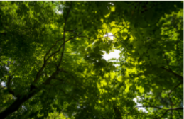
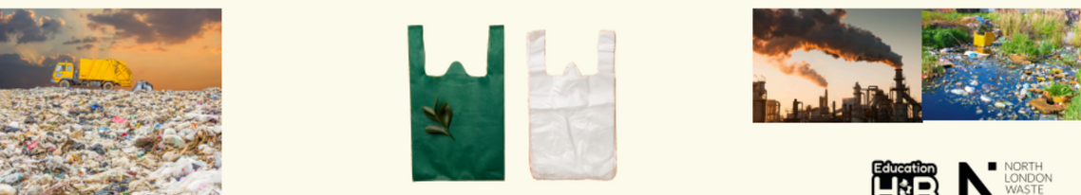

Vocabulary task
Match the picture number with the word
  2. 3. 4. 5. 6.
dispose
landfill
biodegrade
pollution
factory
environment
Notes:
1 = Factory
2 = Dispose
3 = Environment
4 = Landfill
5 = Biodegrade
6 = Pollution

Slide 6








Hey Ned, I just threw my plastic bottle in the bin. It’s gone now, right? How does plastic even affect the environment?
Oh no, Nancy! That bottle might end up in the ocean where a turtle could mistake it for food—or it could sit in a landfill for hundreds of years, polluting the Earth. Let’s find out!

Slide 7
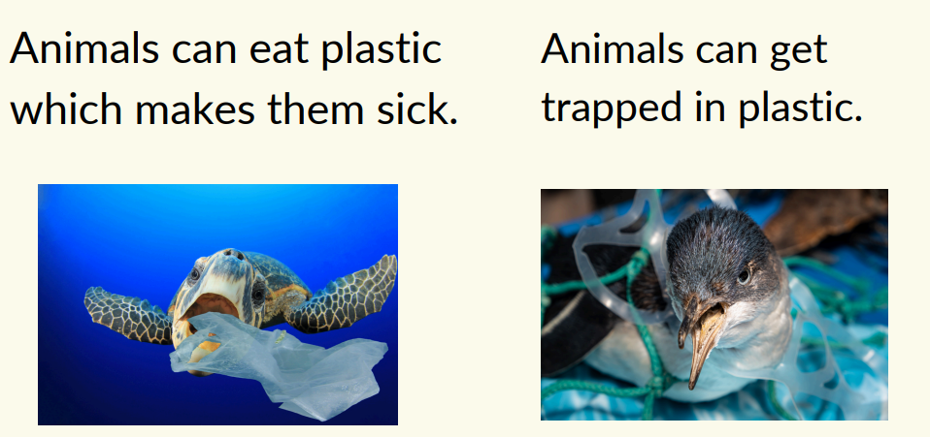

How plastic affects our environment
1.Animals

Slide 8
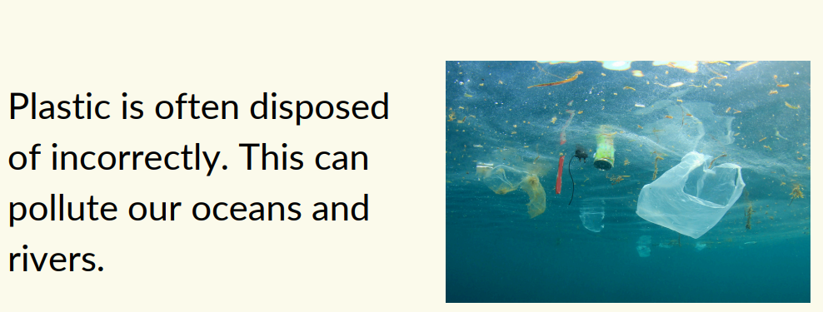
How plastic affects our environment
2. Ocean pollution

Slide 9
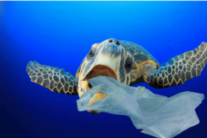
Tell your partner two ways plastic pollution affects our environment
Two ways plastic pollution affects our environment are ________.

Slide 10
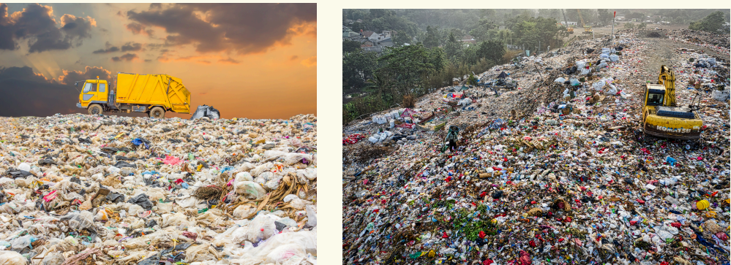
How plastic affects our environment
3. Landfill
Only a little bit of our plastic is recycled. If plastic is sent to landfill, it can take up to 500 years to biodegrade

Slide 11
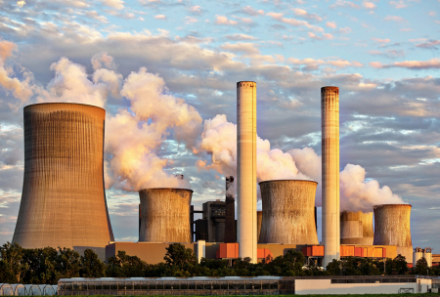
How plastic affects our environment
4. Limited natural resource
Plastic is made from oil. Turning oil to plastic uses lots of energy in factories that pollutes our air.

Slide 12
Tell your partner four ways plastic pollution affects our environment
Four ways plastic pollution affects our environment are ________.

Slide 13
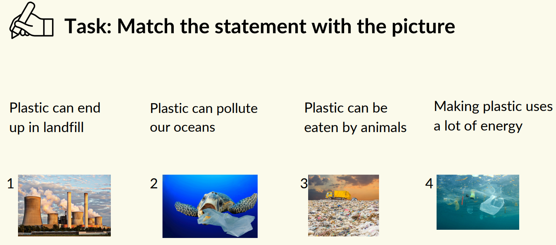

Slide 14
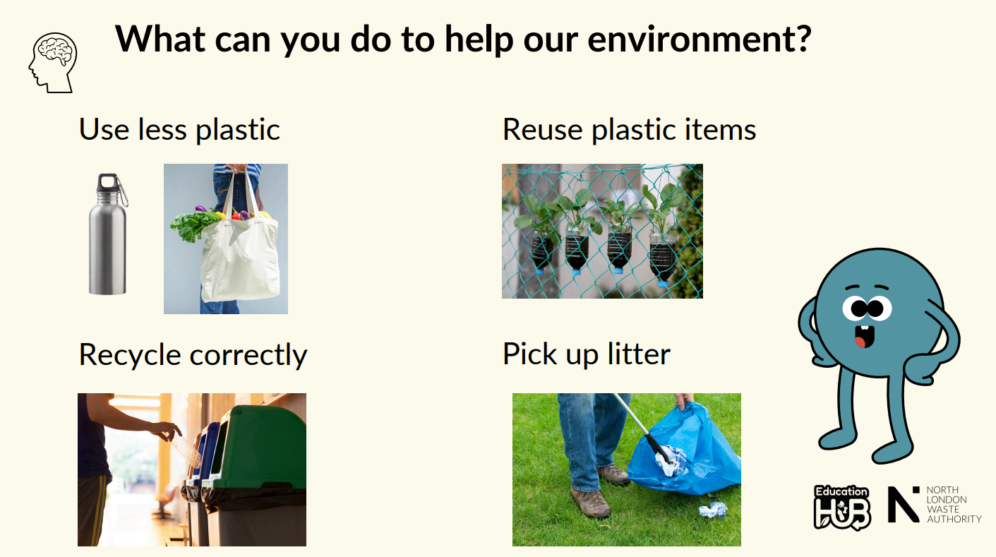

Slide 15
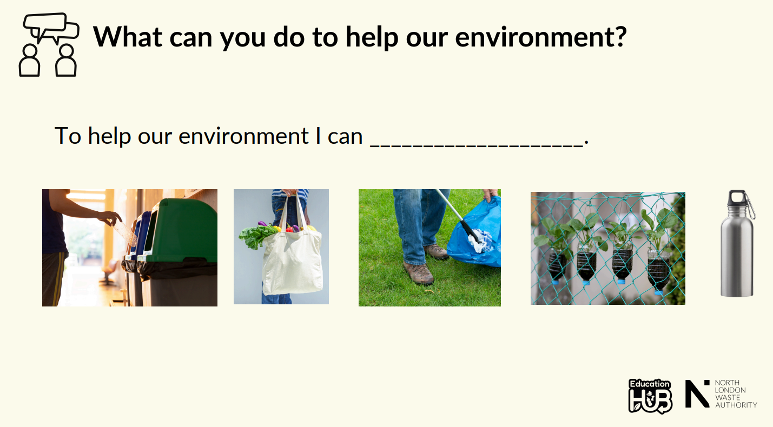

Slide 16
Plastic harms our environment.
What can you do to stop using plastic?
Why do you think we use so much plastic even though it harms our planet?
Notes:
Discussion 1: What can you do to stop using plastic?
- Read question to children twice
- Give children a moment to think about the question
- In partners, get children to share their thoughts using sentence stem 'To stop using plastic I could...'
-Give children 2 minutes in partners to discuss their ideas.
- Listen in to discussion. Spotlight two children
Repeat with question 2

Slide 17
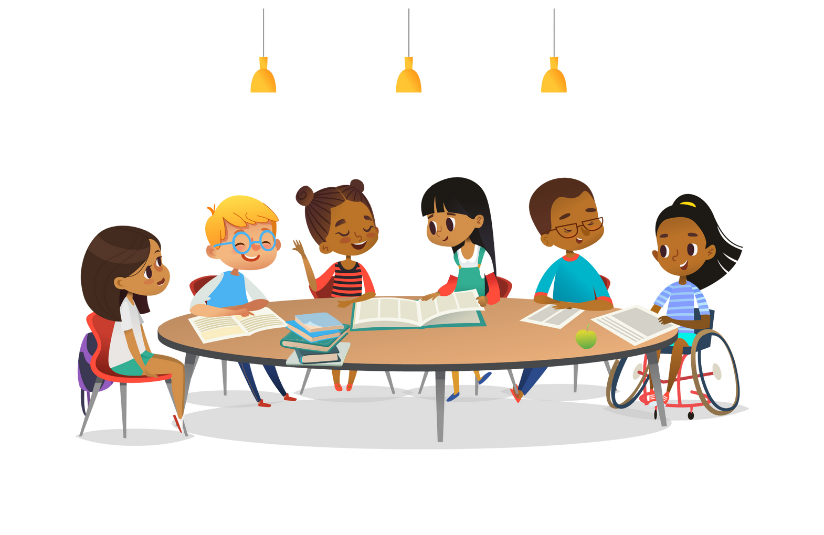
Extension activity 1
Debate activity: “Do you think we should ban single use plastic?” Why or why not?
I think we should/should not ban single use plastic because....

Slide 18
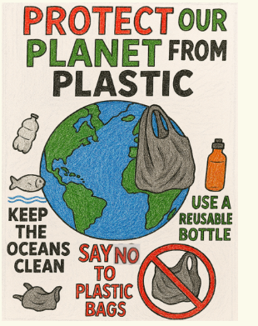
Extension activity 2
Art/Writing activity: Poster campaign: Protect our planet from plastic. Children can design posters showing the dangers of plastic and ways to reduce it.

Slide 19
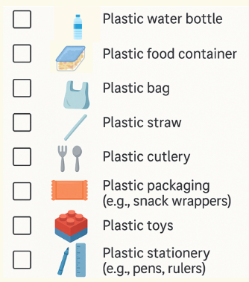
Extension activity 3
Science activity: Give students a checklist to find plastic items at home or school and suggest eco-friendly swaps.

