Slide 1





How does plastic affect our
environment?
KS2 Lesson - Lesson 2 of 4

Slide 2
LO: To understand how plastic waste affects animals and their habitats, and explore ways to reduce its impact.
  I can explain what biodegradable and non-biodegradable mean
  I can give examples of plastic pollution
  I can describe how plastic harms animals and their habitats
  I can suggest ways to reduce plastic pollution

Slide 3






Lesson Prep
Vocabulary
Discussion
Keywords that children need to understand and use during the lesson.
An opportunity for children to practice the knowledge learnt.
Big question
Task
To assess learning and give children time to practise independently.
A central question that sparks curiosity and frames the lesson’s theme.
The knowledge
Extension
Essential facts and concepts children need to know.
Optional tasks to deepen or stretch learning beyond the core lesson.

Slide 4

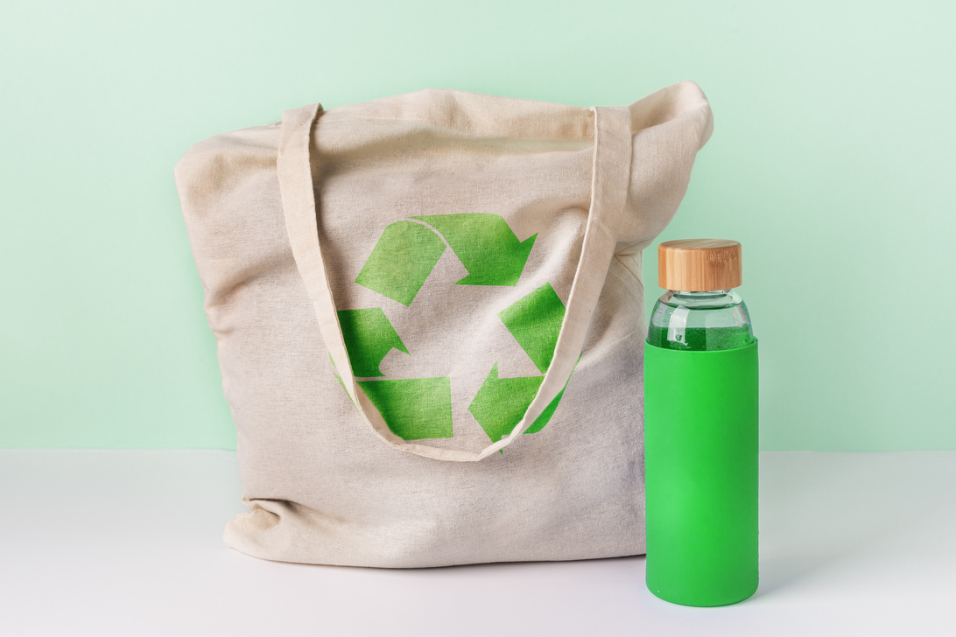
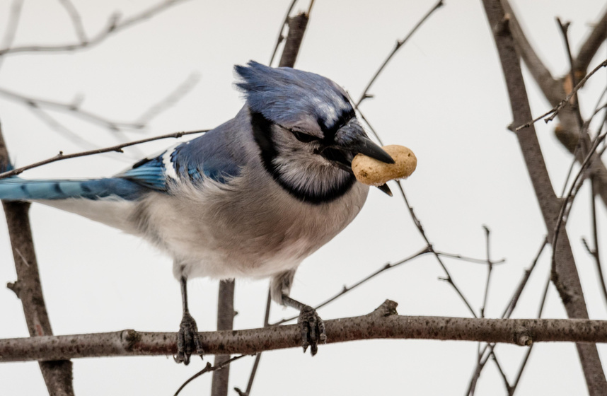
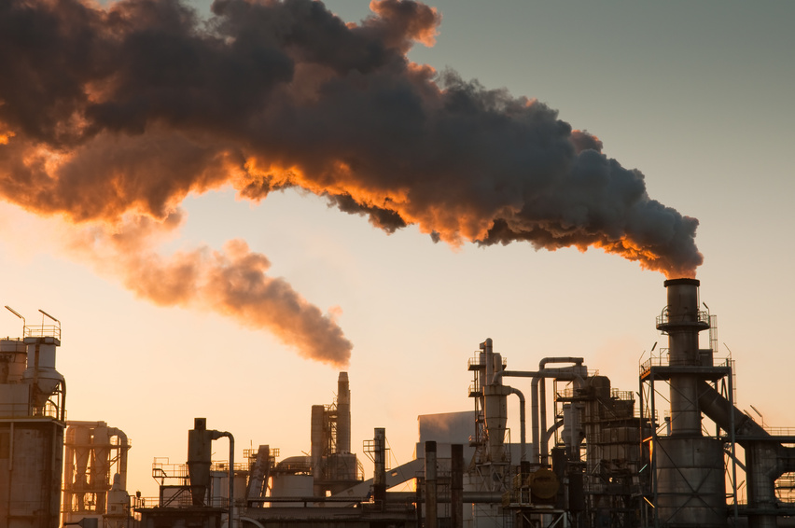
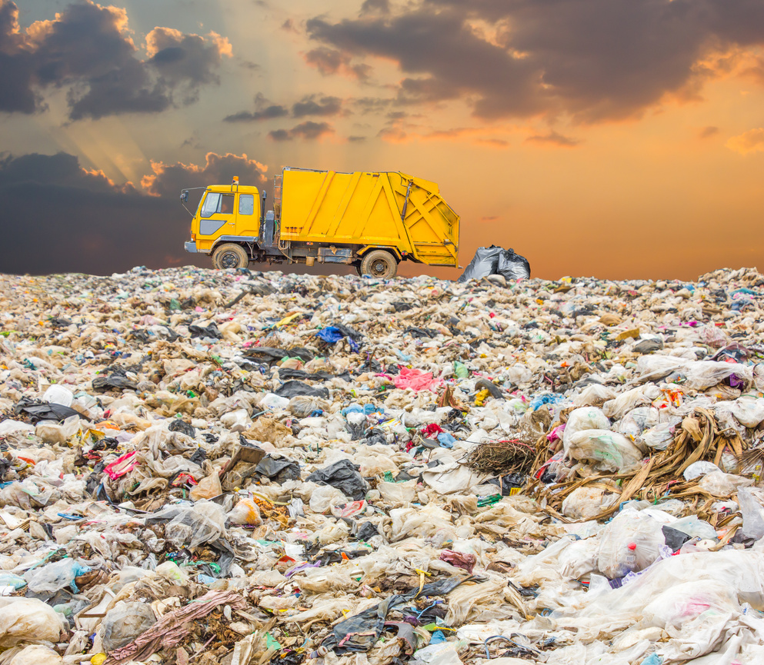
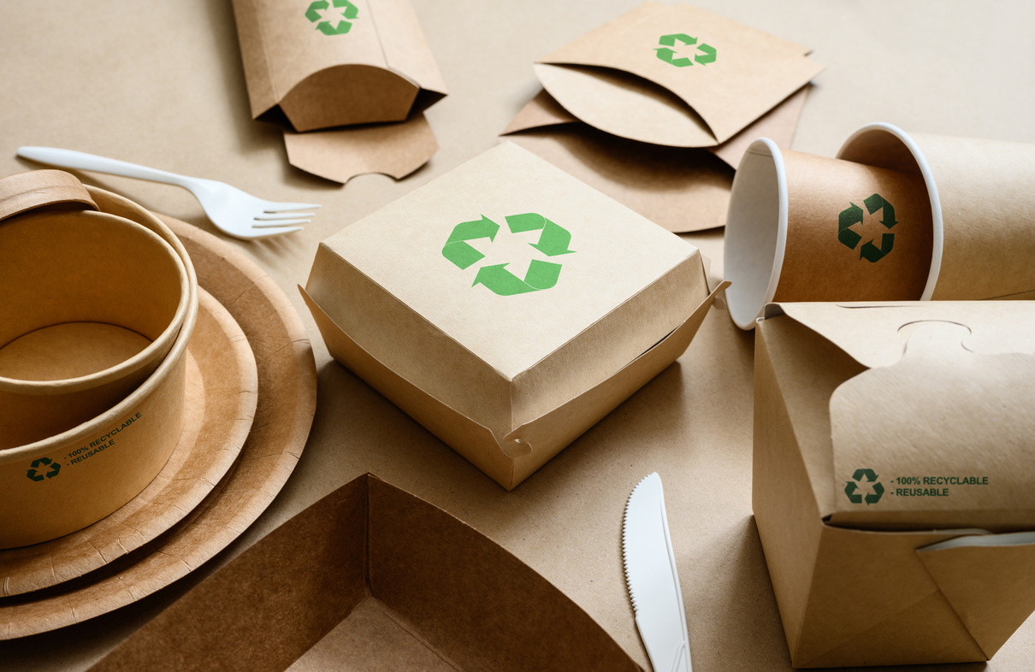
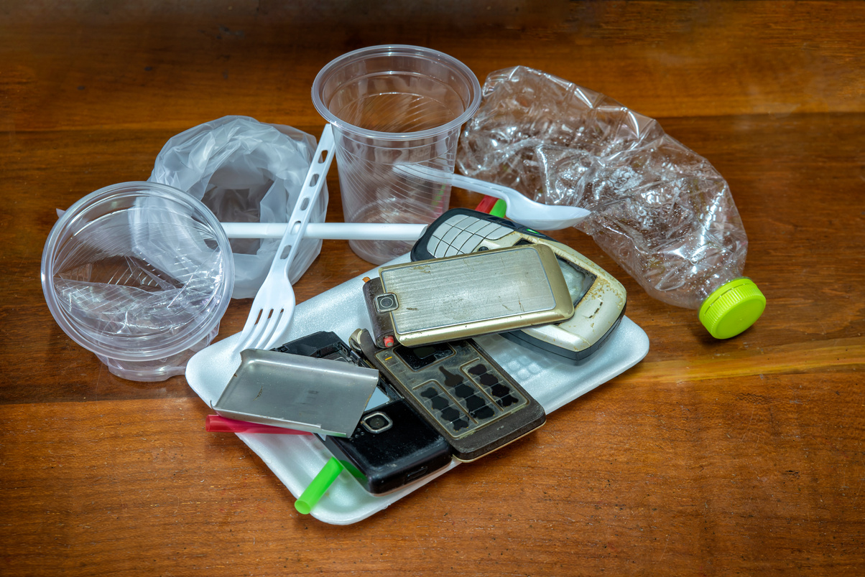
Key Words
recycle
reuse
ingest
pollution
landfill
biodegradable
non- biodegradable
Notes:
Recycle: Recycle means turning old or used materials into something new instead of throwing them away.
Reuse: Reuse means using something again instead of throwing it away.
Ingest: Ingest means to take something into the body, usually by eating or swallowing it.
Pollution: Pollution is when the Earth gets dirty and it can hurt people, animals, and plants.
Landfill: A landfill is a big place where rubbish is buried under the ground.
Biodegradable: Biodegradable means something can break down naturally and safely into the earth.
Non-biodegradable: Non-biodegradable means something does not break down naturally and stays in the environment for a very long time

Slide 5
Vocabulary task
1) Some rubbish goes to a _____ where it is buried.
2) We _____ old bottles to make new ones.
3) The turtle ______ed a plastic bag because it looked like food.
4) I ______ my lunchbox every day instead of throwing it away.
recycle
reuse
ingest
pollution
Notes:
1) Landfill
2) Recycle
3) Ingest
4) reuse

Slide 6
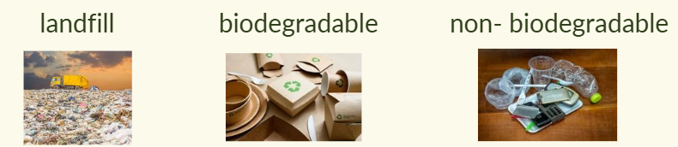
Vocabulary task
1) ____________ packaging is better for the environment.
2) Rubbish that cannot be recycled sometimes goes to ________.
3) __________________ materials cannot break down naturally.
Notes:
1) biodegradable
2) landfill
3) non-biodegradable

Slide 7








I still don’t get it—how can something as small as a plastic wrapper hurt animals?
It might seem small, Nancy, but there are many ways in which that can harm an animal or our environment. Let’s find out!

Slide 8

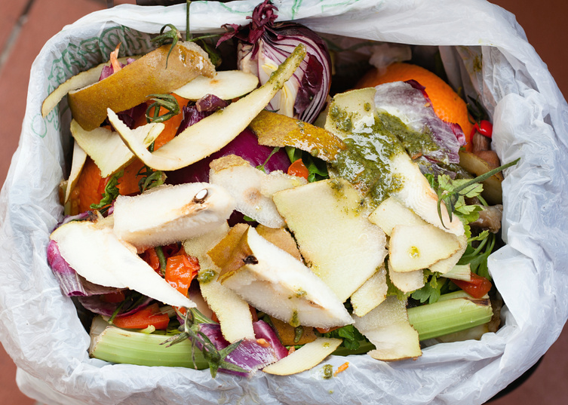

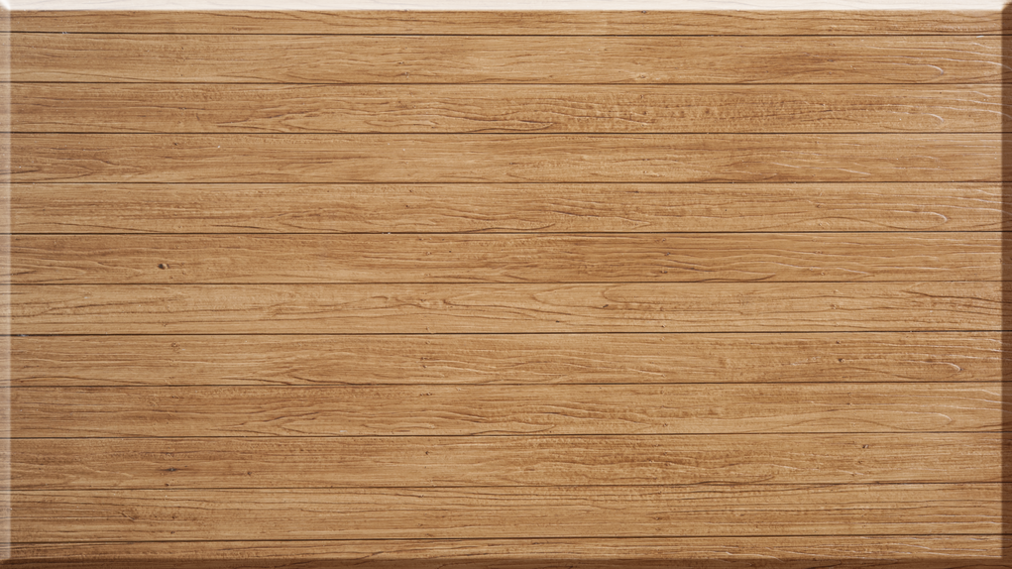
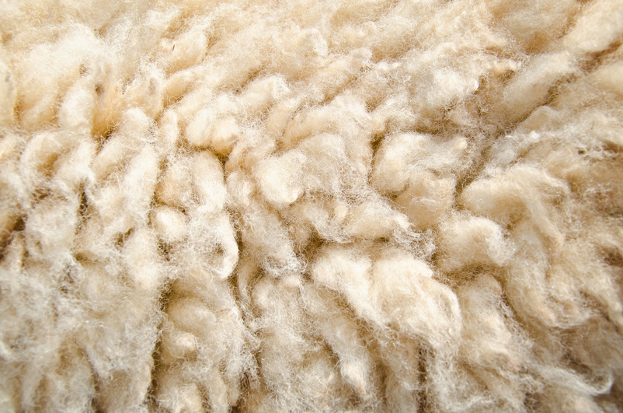
Biodegradable vs non-biodegradable
Some materials can biodegrade.
These materials are biodegradable.
They’re better for the planet because they break down and don’t leave harmful waste.
food scraps
paper
wood
wool

Slide 9
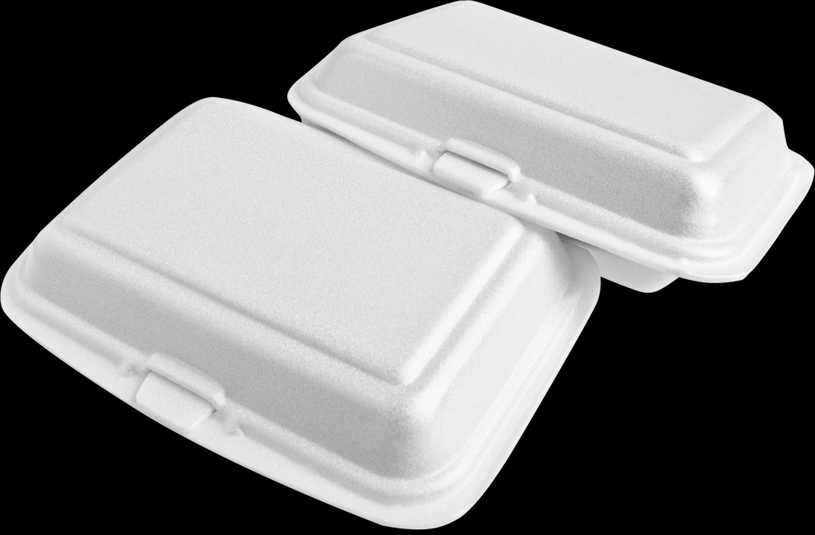
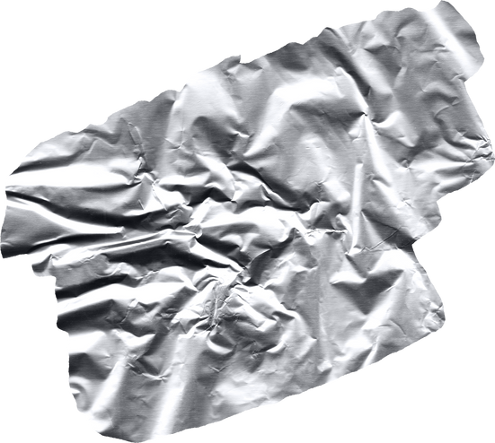
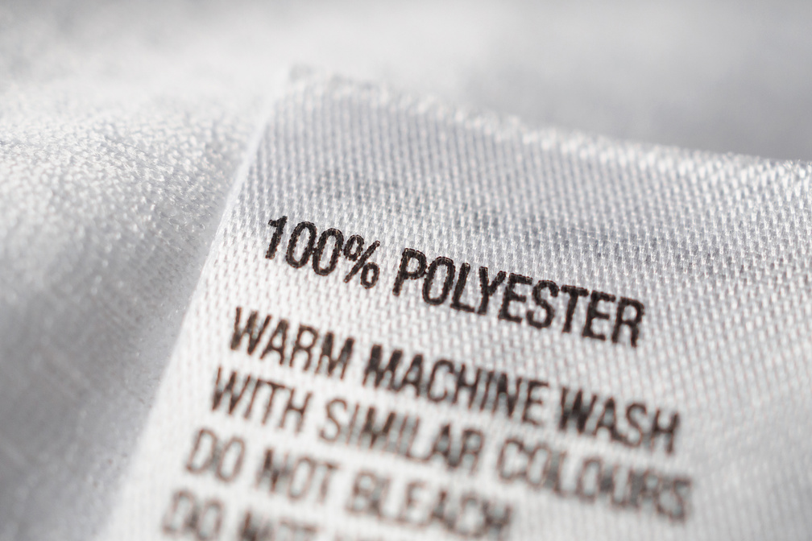
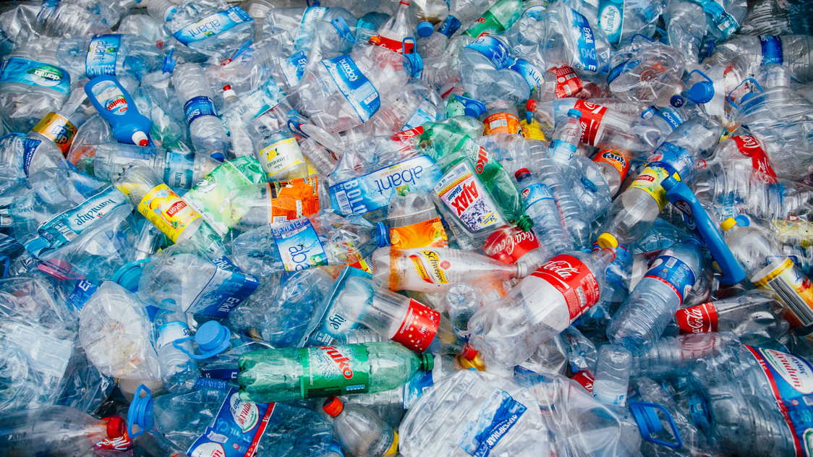
Biodegradable vs non-biodegradable
Some materials are not biodegradable.
This means they don’t break down naturally and can harm the planet by creating long-lasting waste.
plastic
styrofoam
foil
polyester

Slide 10
What materials are biodegradable and non-biodegradable?
plastic
wood
food scraps
polyester
styrofoam
foil
paper
wool

Slide 11
Plastic is non-biodegradable.
This means it cannot break down naturally.
Let me show you some problems of this.

Slide 12
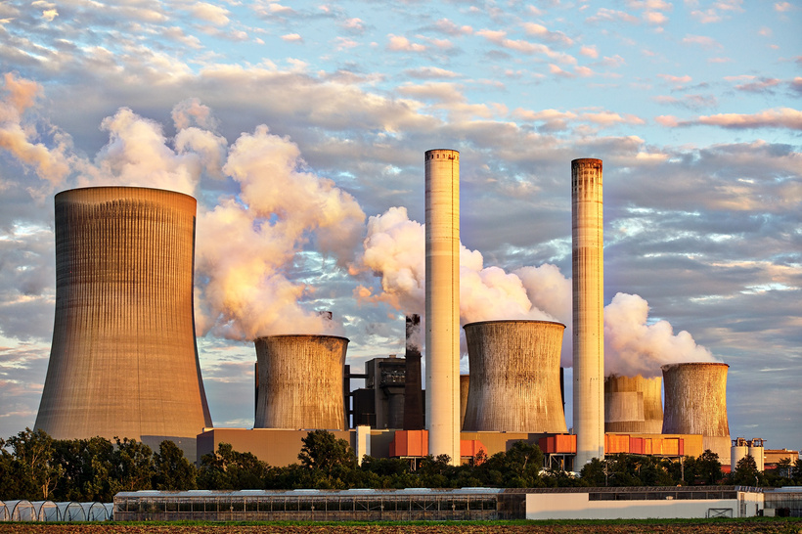
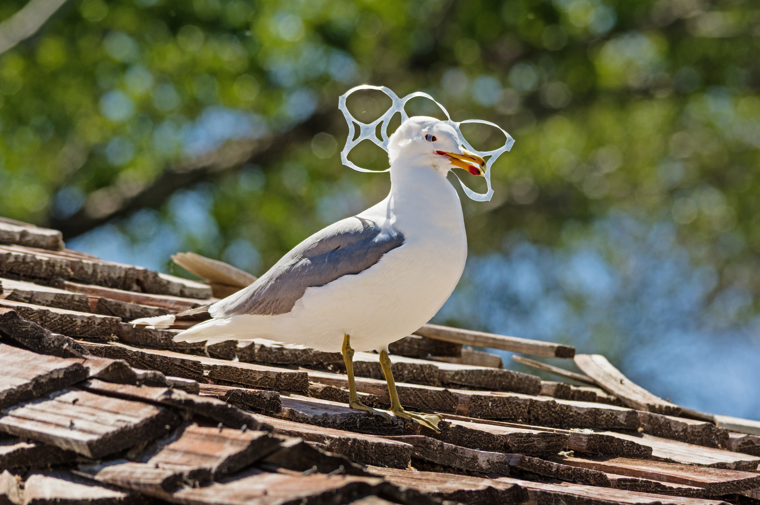
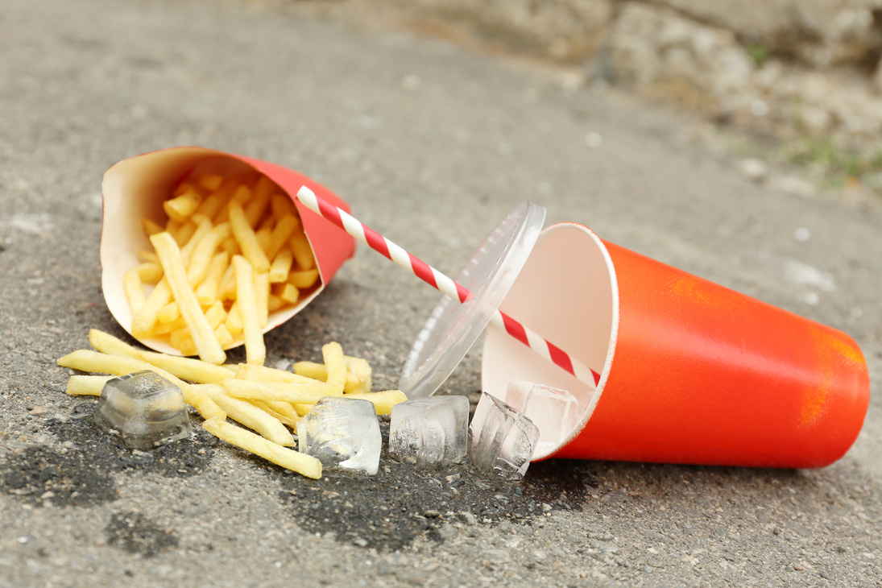
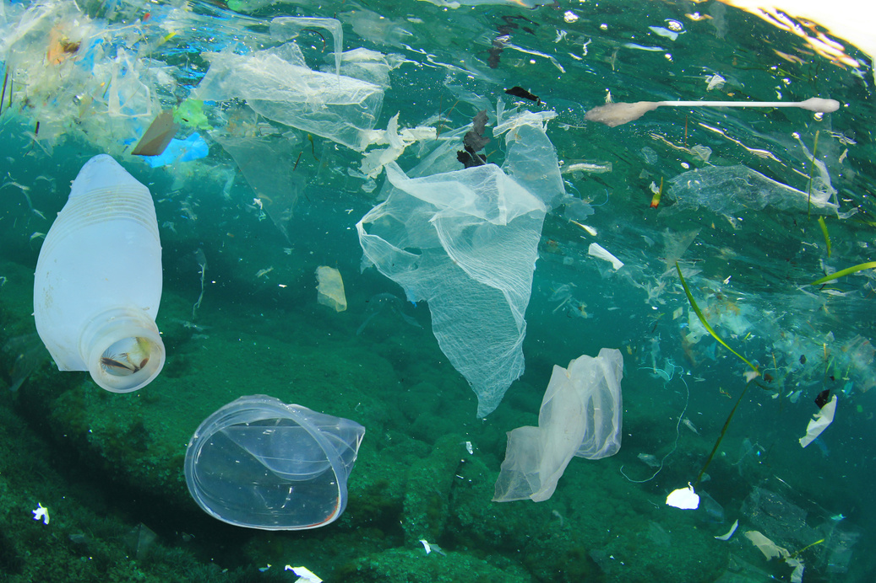
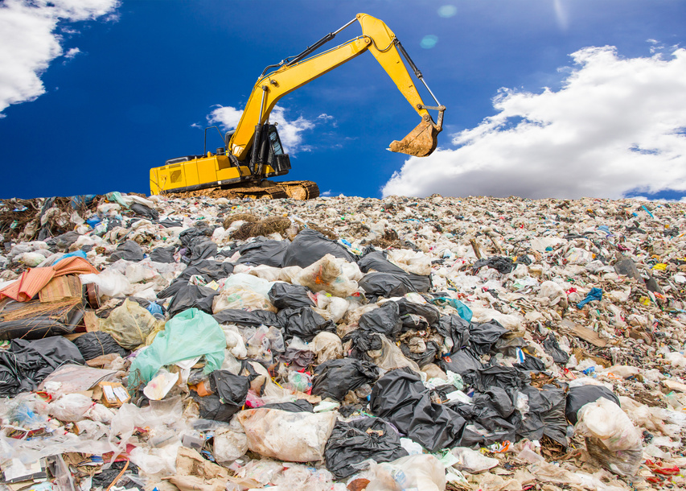
Examples of plastic pollution
Litter in parks and streets
Plastic in rivers and oceans
Non-biodegradable plastic in landfills
Burning plastic releases pollution
Animals ingest plastic by mistake

Slide 13
What are examples of plastic pollution?
Examples of plastic pollution are _______________.

Slide 14
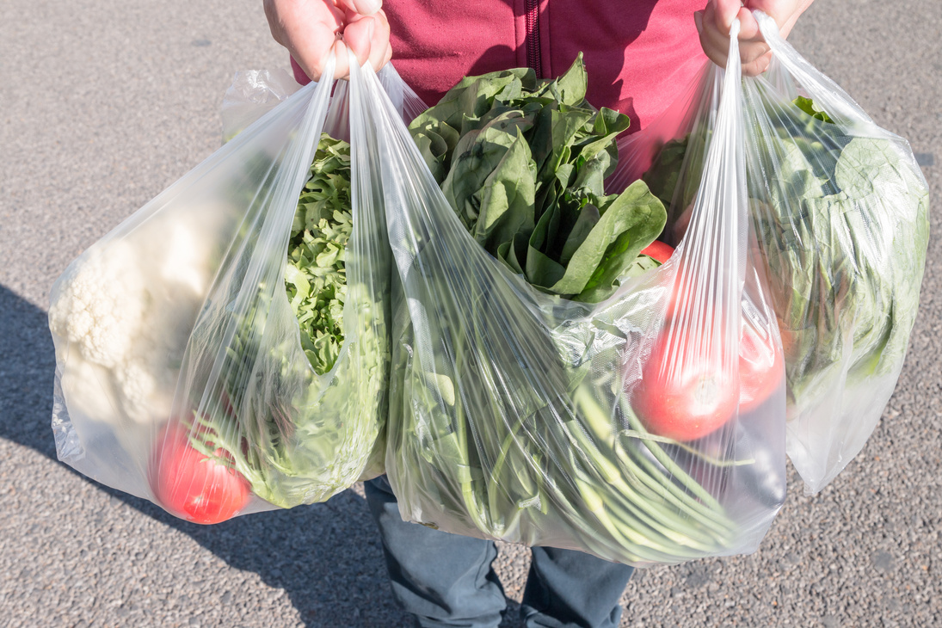
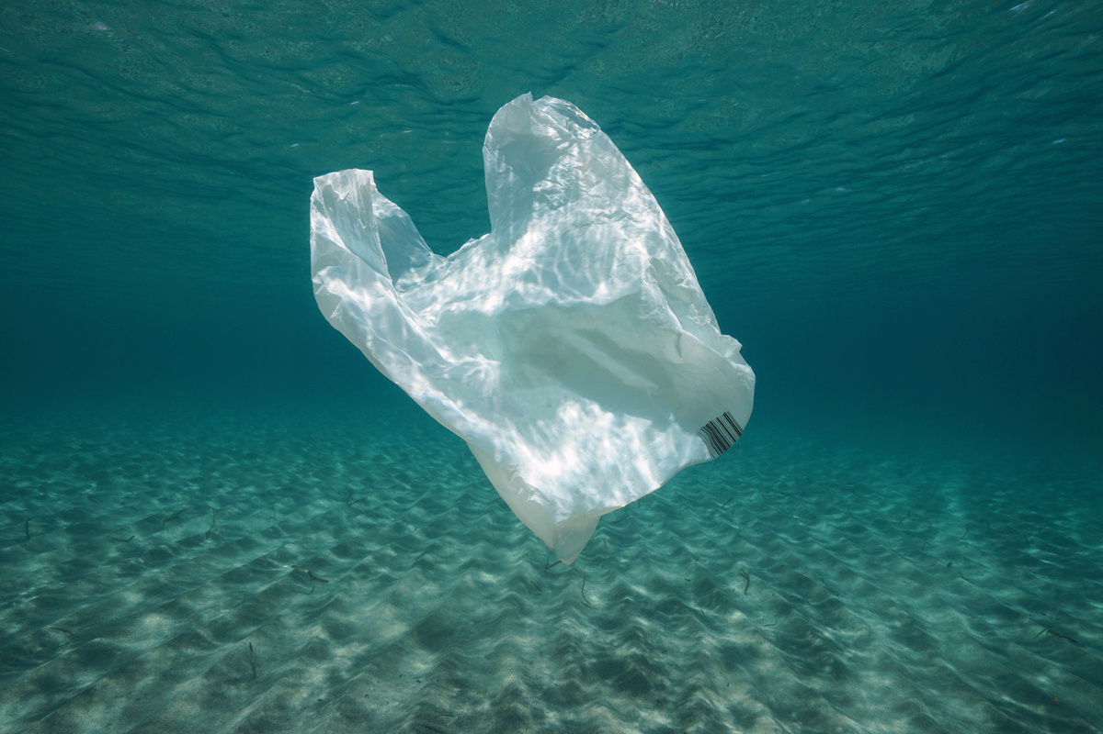
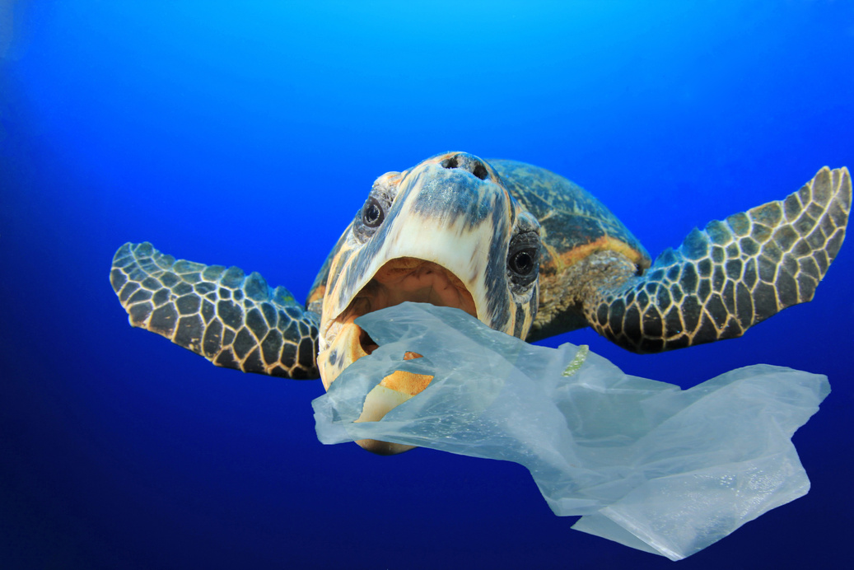
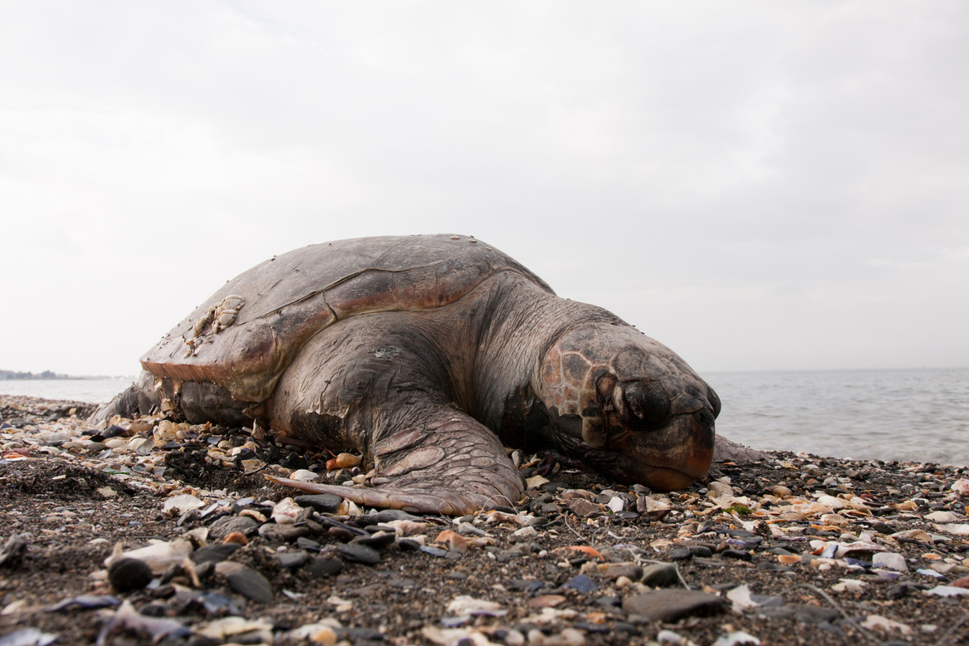

Plastic pollution
Sarah and the plastic bag
Read story from notes
Notes:
One day, Sarah went shopping but forgot to bring her reusable bag. At the checkout, she took two plastic bags to carry her things. When she got home, she threw the bags away instead of recycling them. Later, the wind blew one of the bags out of the bin and it floated all the way to the ocean. A turtle swimming nearby saw the bag and thought it was a jellyfish—its favourite food. The turtle ate the plastic bag and became very sick because it couldn’t digest it. The bag got stuck in its stomach, and the turtle couldn’t eat real food anymore.

Slide 15
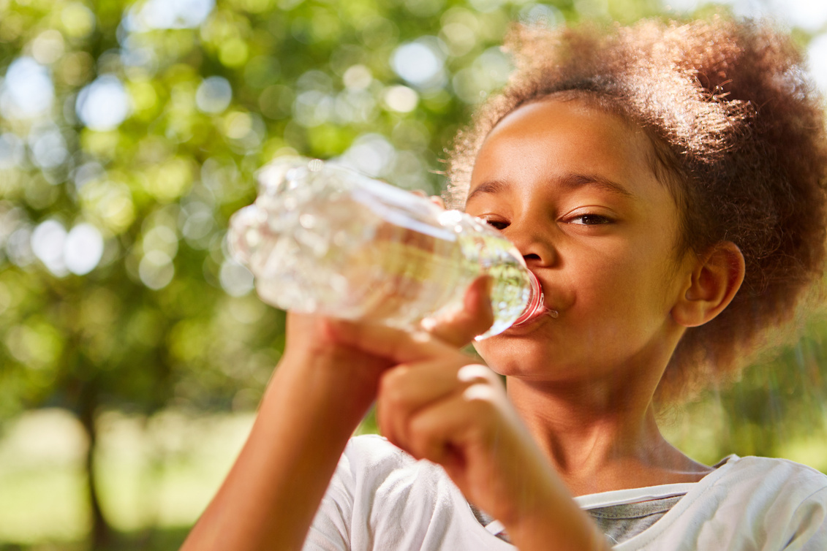
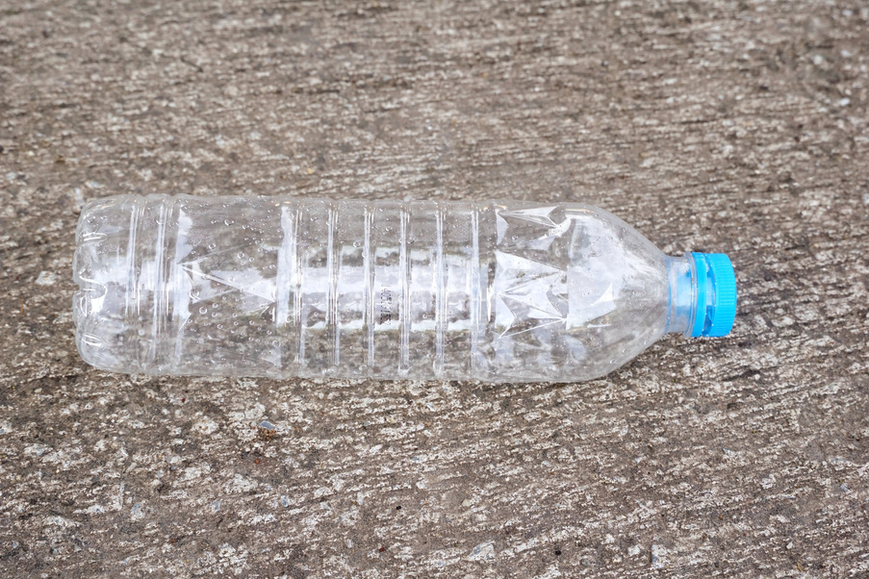
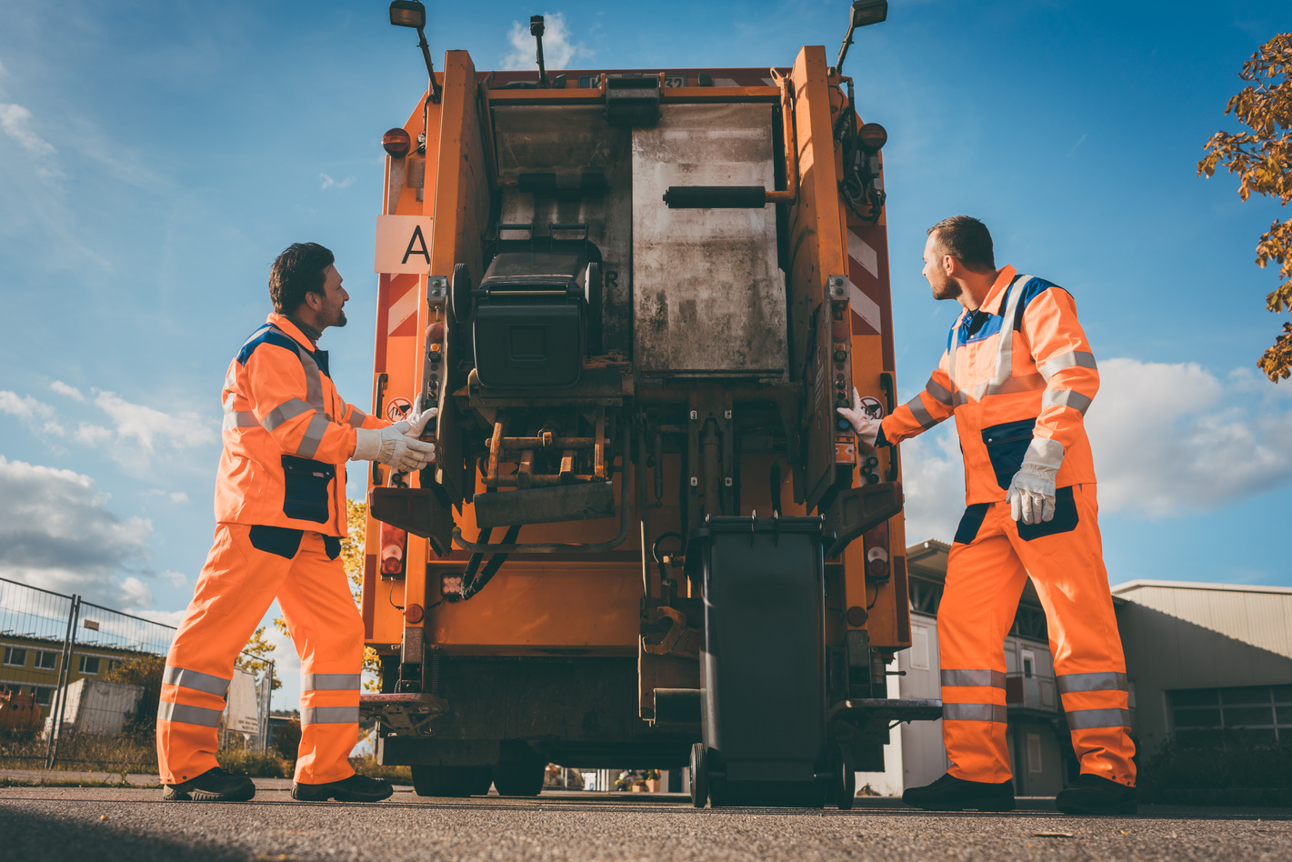
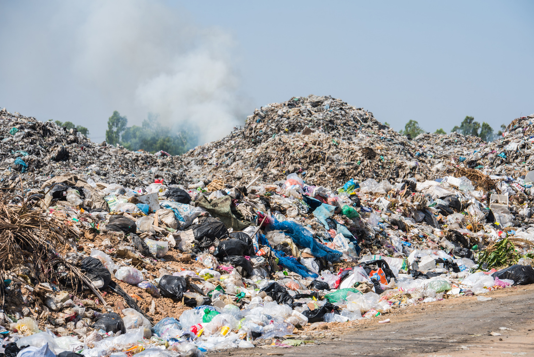
Plastic pollution
Emma and the plastic bag
Read story from notes
Notes:
Emma was feeling thirsty after school, but she forgot her reusable water bottle. So she bought a plastic one from the shop. After finishing her drink, she dropped the bottle on the ground instead of recycling it.
Later, the bottle was picked up and taken to a landfill. Because plastic doesn’t biodegrade, the bottle stayed buried in the ground. It didn’t break down or disappear—it could stay there for hundreds or even thousands of years, taking up space and harming the environment.

Slide 16
Tell your partners the stories of plastic pollution
Partner 1
Partner 2
Notes:
Emma was feeling thirsty after school, but she forgot her reusable water bottle. So she bought a plastic one from the shop. After finishing her drink, she dropped the bottle on the ground instead of recycling it.
Later, the bottle was picked up and taken to a landfill. Because plastic doesn’t biodegrade, the bottle stayed buried in the ground. It didn’t break down or disappear—it could stay there for hundreds or even thousands of years, taking up space and harming the environment.

Slide 17
Don’t worry! There is lots we can do to prevent plastic pollution. Let’s find out what you can do!

Slide 18
Reducing plastic pollution
Always have a reusable bottle and bag with you to prevent plastic use. The less plastic we use, the less plastic pollution we have!

Slide 19
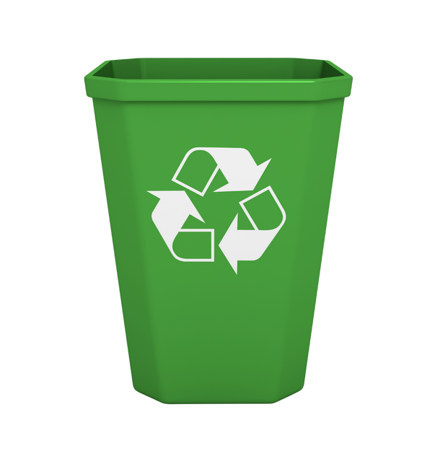
Reducing plastic pollution
If you do have plastic, recycle it correctly. Plastic bottles can be recycled at home. Plastic bags can be recycled at big supermarkets. If we recycle plastic, we use less crude oil - a limited natural resource!

Slide 20
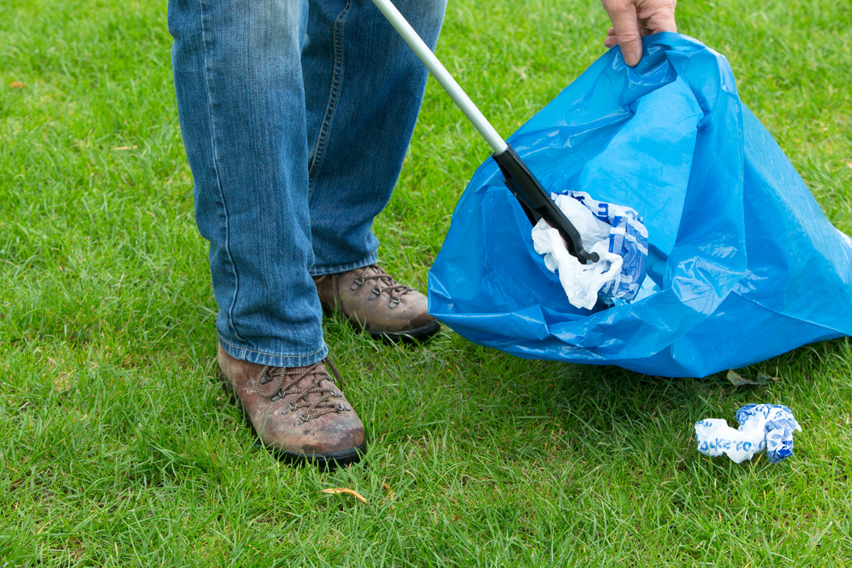
Reducing plastic pollution
If you do see litter, help our planet and pick it up. Put it in the recycle bin if it is recyclable. This will stop animals eating it and getting sick!

Slide 21
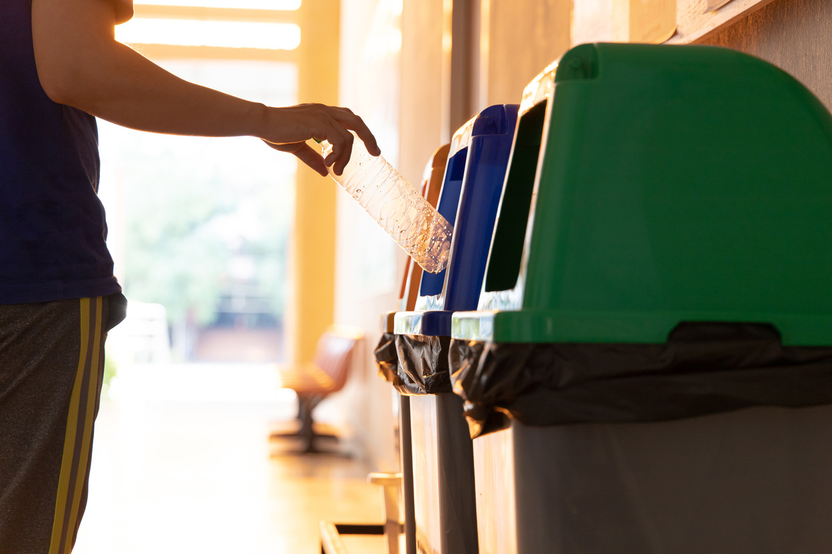
What can you do to help our environment?

Slide 22
Plastic harms our environment.
What do you think would happen if all plastic was biodegradable?
Do you think we can live without plastic? Why or why not?
Notes:
Discussion 1: What do you think would happen if all plastic was biodegradable?
- Read question to children twice
- Give children a moment to think about the question
- In partners, get children to share their thoughts using sentence stem 'If all plastic was biodegradable...'
-Give children 2 minutes in partners to discuss their ideas.
- Listen in to discussion. Spotlight two children
Repeat with question 2

Slide 23
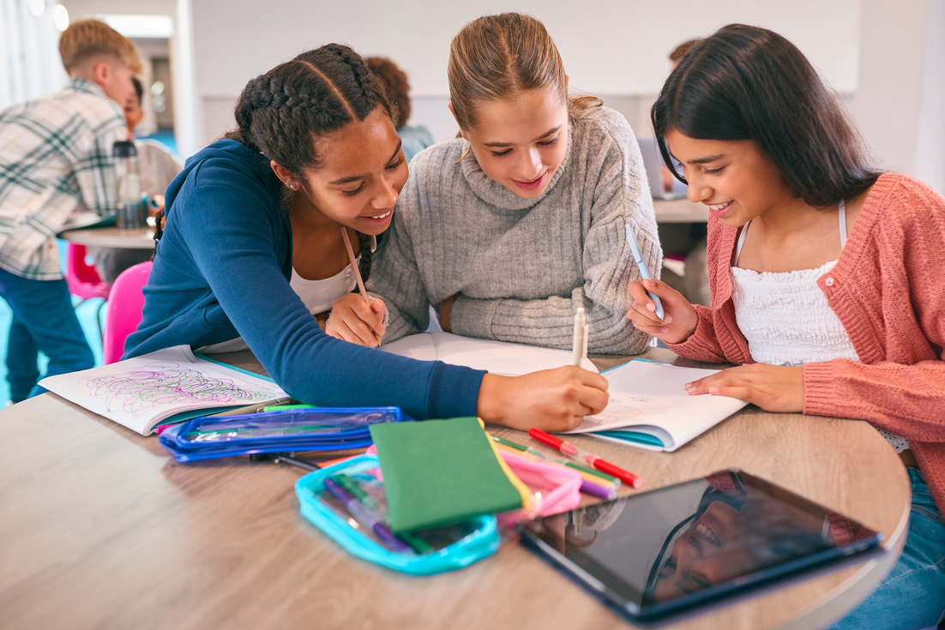
Extension activity 1
Persuasive writing activity: Children create a persuasive poster with a strong message like “Say No to Plastic!” or “Protect Our Oceans!” using facts from the lesson to convince others to reduce plastic use.

Slide 24
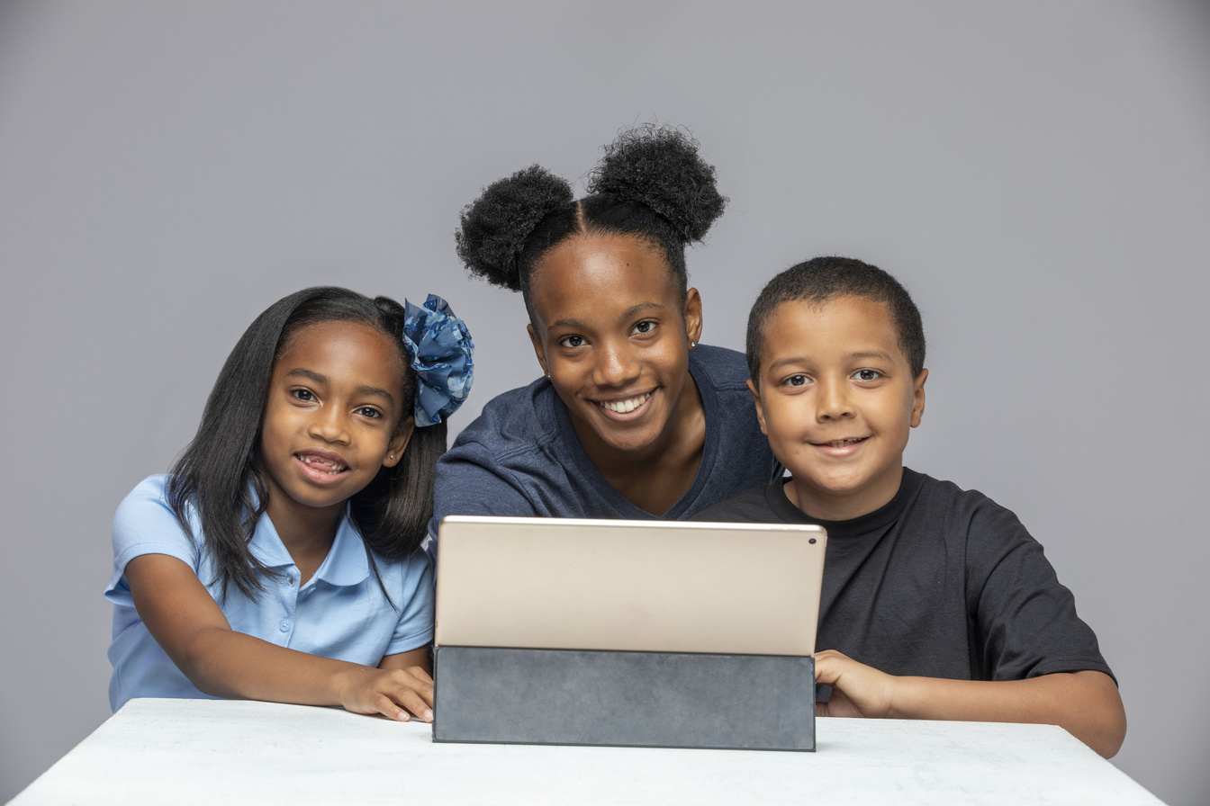
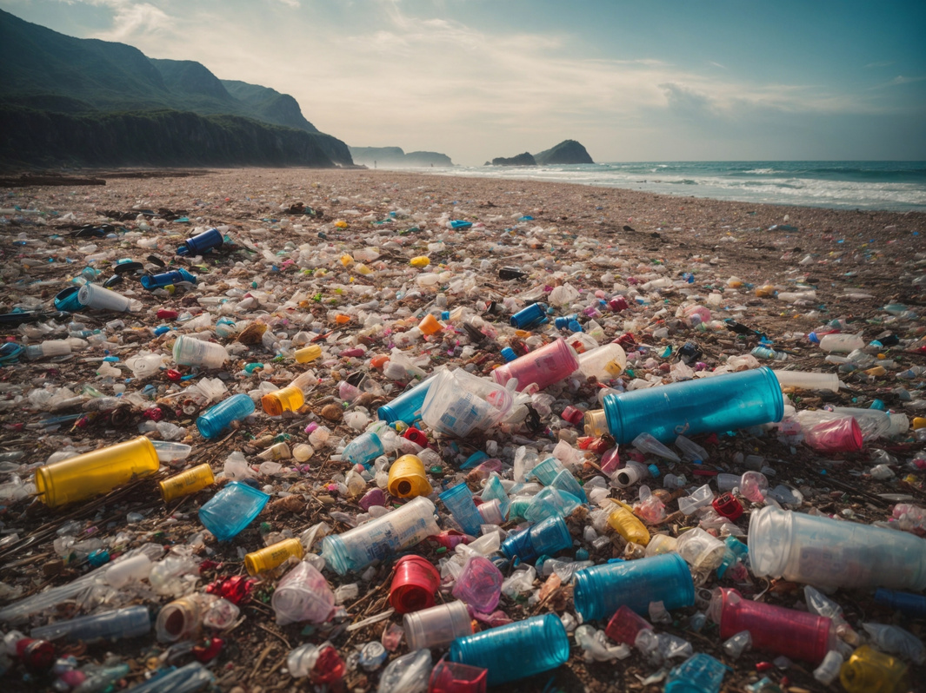
Extension activity 2
Geography activity: Children research where plastic pollution is worst around the world (e.g. oceans, rivers, cities) and mark these places on a map. They discuss why these areas are affected and what can be done.

Slide 25
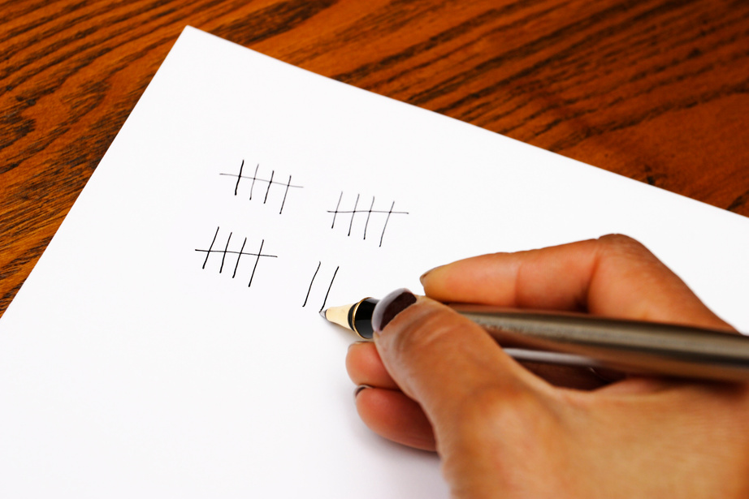
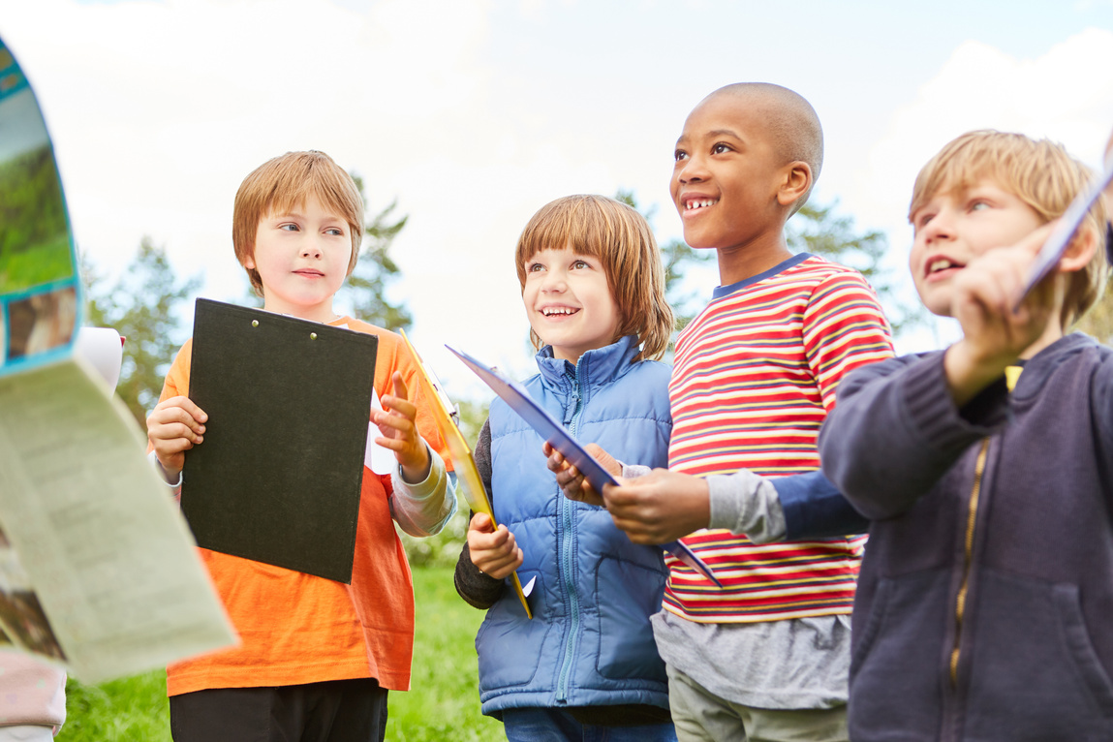
Extension activity 3
Maths activity: Children count how many plastic items they use in a day or week (e.g. bottles, wrappers). They record the data in a table or bar chart and discuss ways to reduce their plastic use.

