Slide 1





Can plastic be recycled?
KS1 Lesson - Lesson 3 of 4

Slide 2
LO: To know the steps of plastic recycling
  I can say what can be and cant be recycled
  I can state the steps to how plastic is recycled

Slide 3






Lesson Prep
Vocabulary
Discussion
Keywords that children need to understand and use during the lesson.
An opportunity for children to practice the knowledge learnt.
Big question
Task
To assess learning and give children time to practise independently.
A central question that sparks curiosity and frames the lesson’s theme.
The knowledge
Extension
Essential facts and concepts children need to know.
Optional tasks to deepen or stretch learning beyond the core lesson.

Slide 4
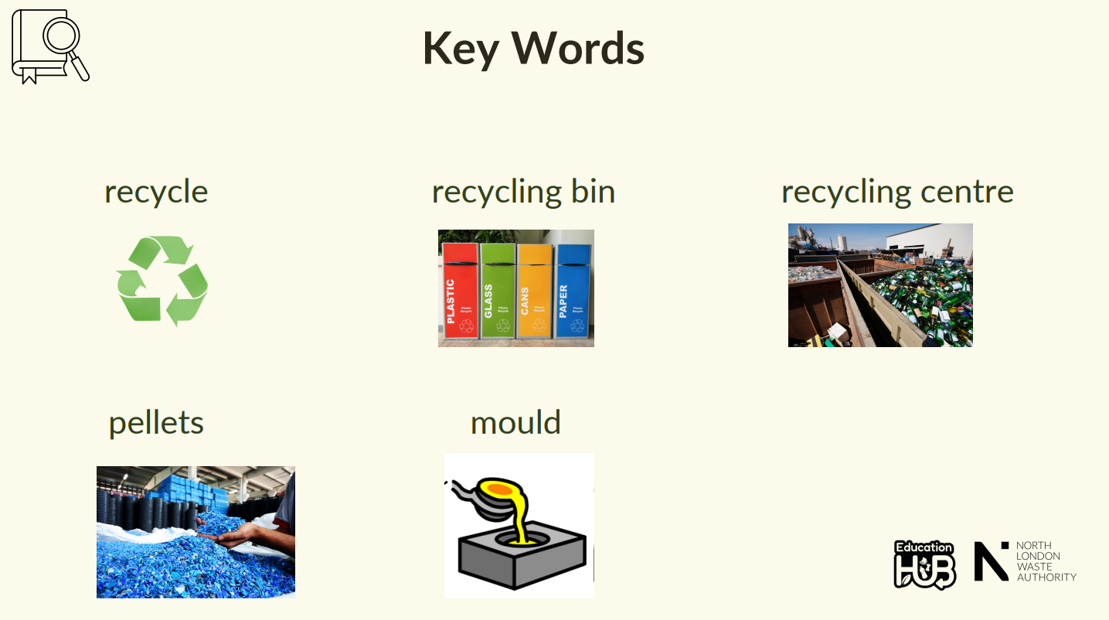
Notes:
Landfill: A big hole in the ground where rubbish is buried when it can't be reused or recycled.
Carbon Emissions: Invisible gases released when things like oil or coal are burned, which can be harmful to our planet.
Reduce: To use less of something.
Natural Resource: Something we get from nature, like water, trees, or oil, that we use to make things.
Crude Oil: A thick, black liquid found underground that is used to make plastic.
Contaminants: Bits of dirt, food, or other things that can spoil recycling.
Chemicals: Special product used to clean things - some can be harmful if not used carefully.
Energy: Power that makes machines work—electricity is one kind of energy we use every day.

Slide 5
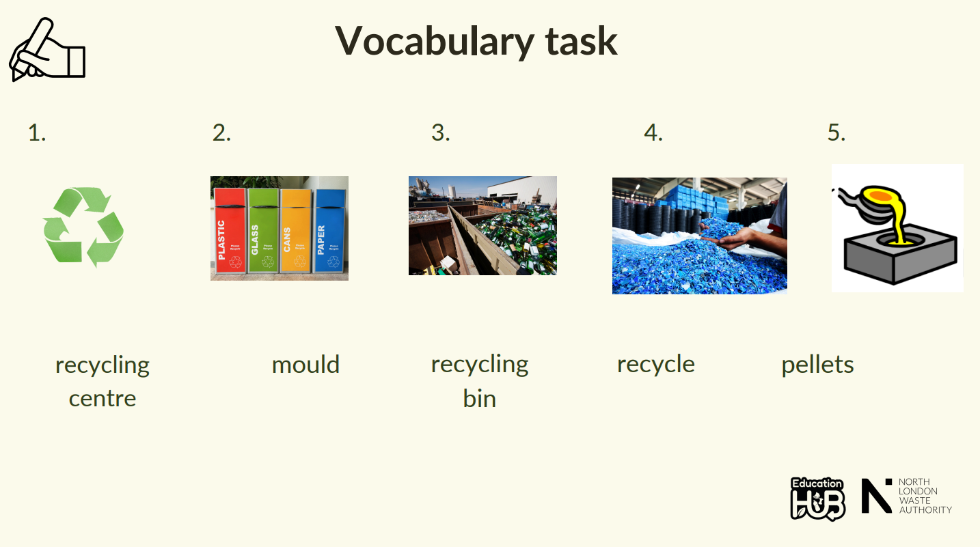
Notes:
1 = energy
2 = natural resource
3 = reduce
4 = chemicals

Slide 6








Ned, I put my plastic bottle in the recycling bin—does that mean it disappears and turns into something new right away?
Not quite, Nancy! First, it goes on a big journey—it's sorted, cleaned, melted down, and then turned into something brand new. Let’s find out!

Slide 7
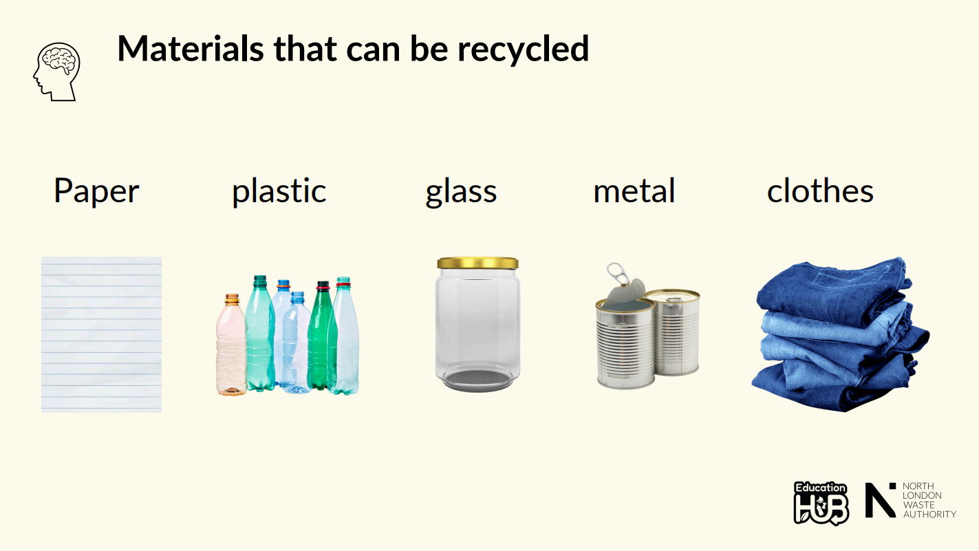

Slide 8
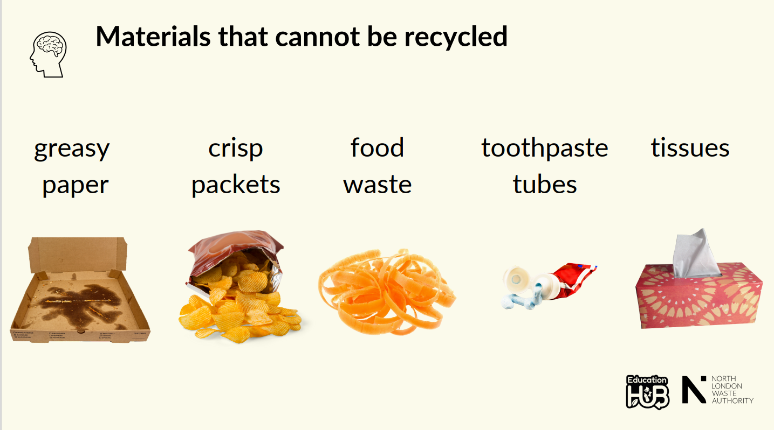

Slide 9
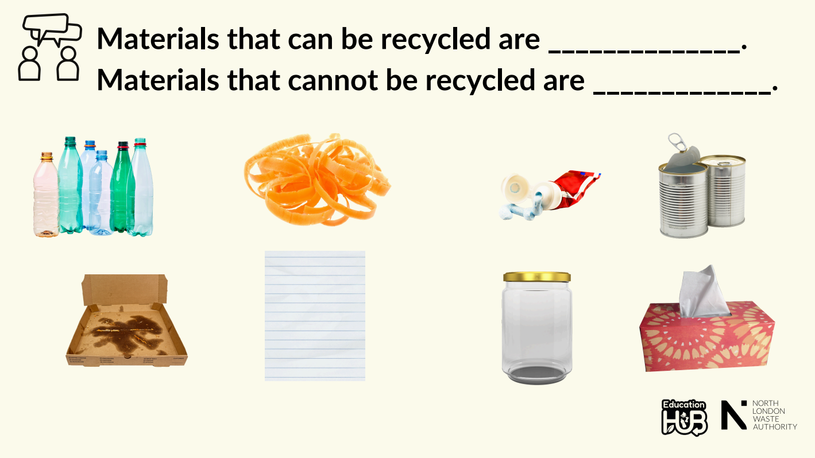

Slide 10
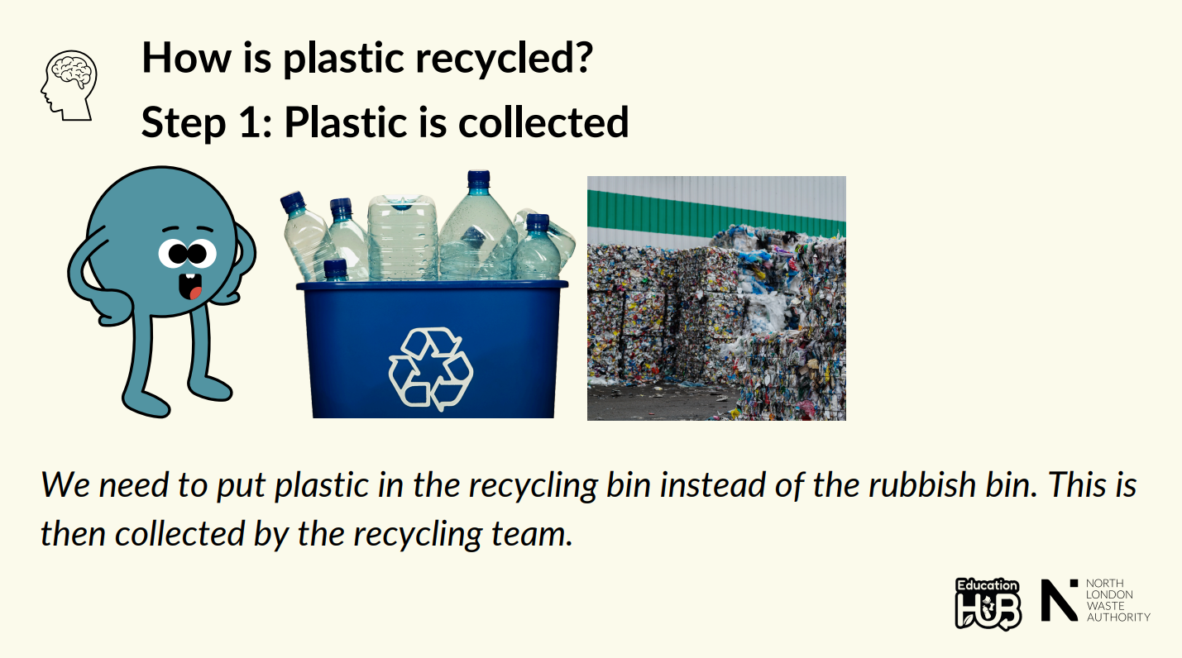

Slide 11
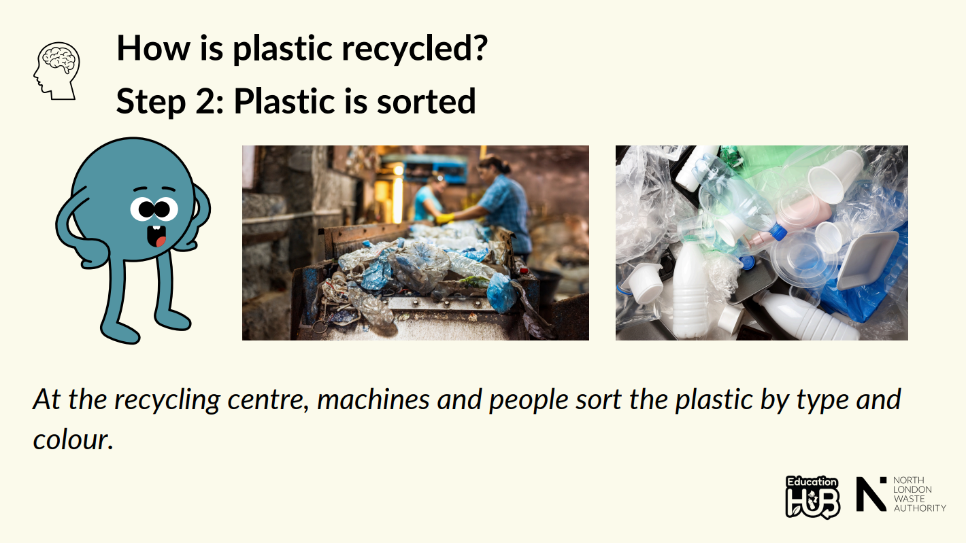

Slide 12
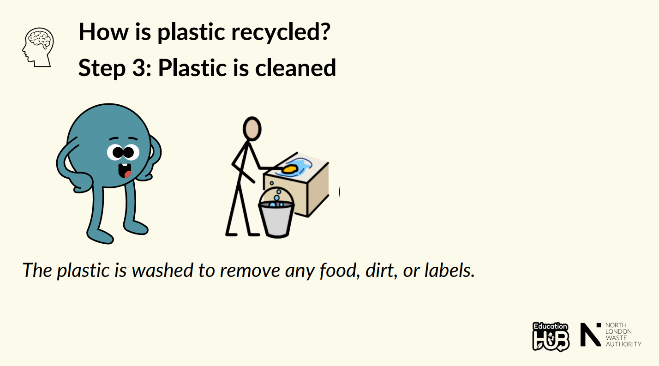

Slide 13
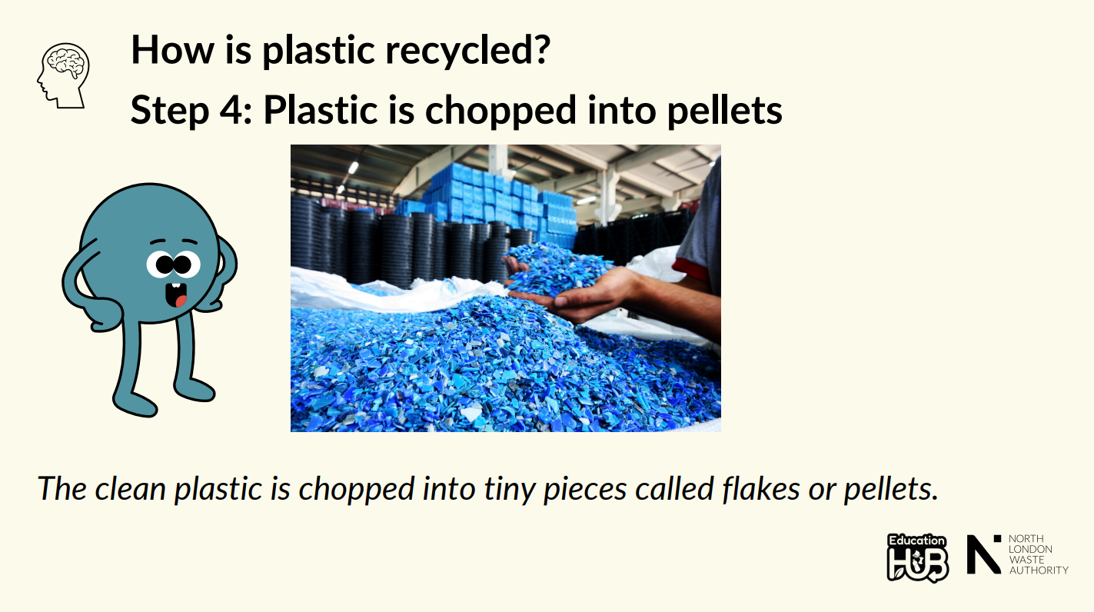

Slide 14
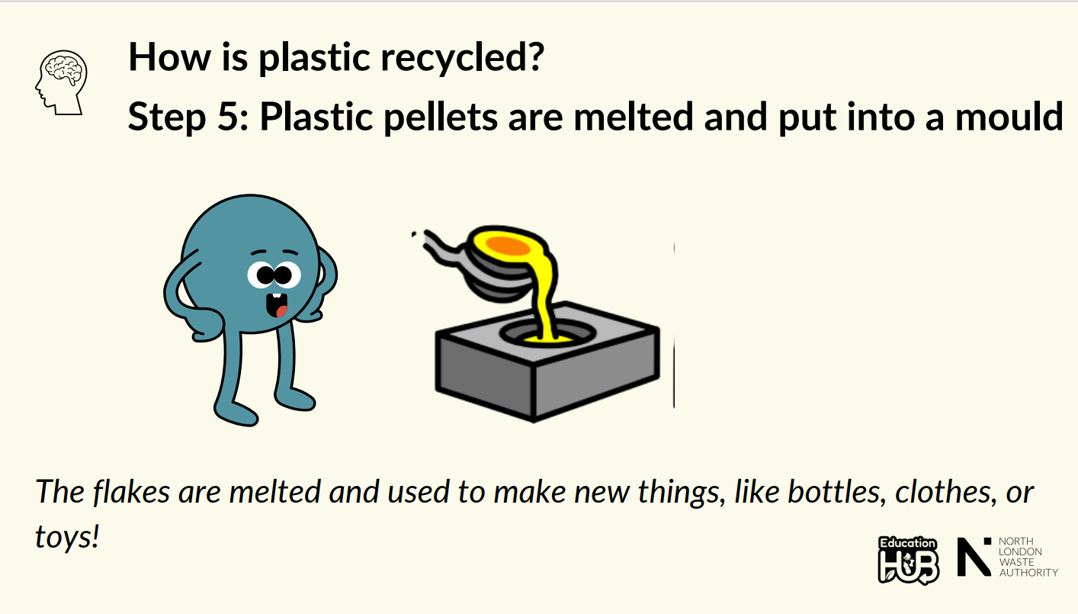

Slide 15
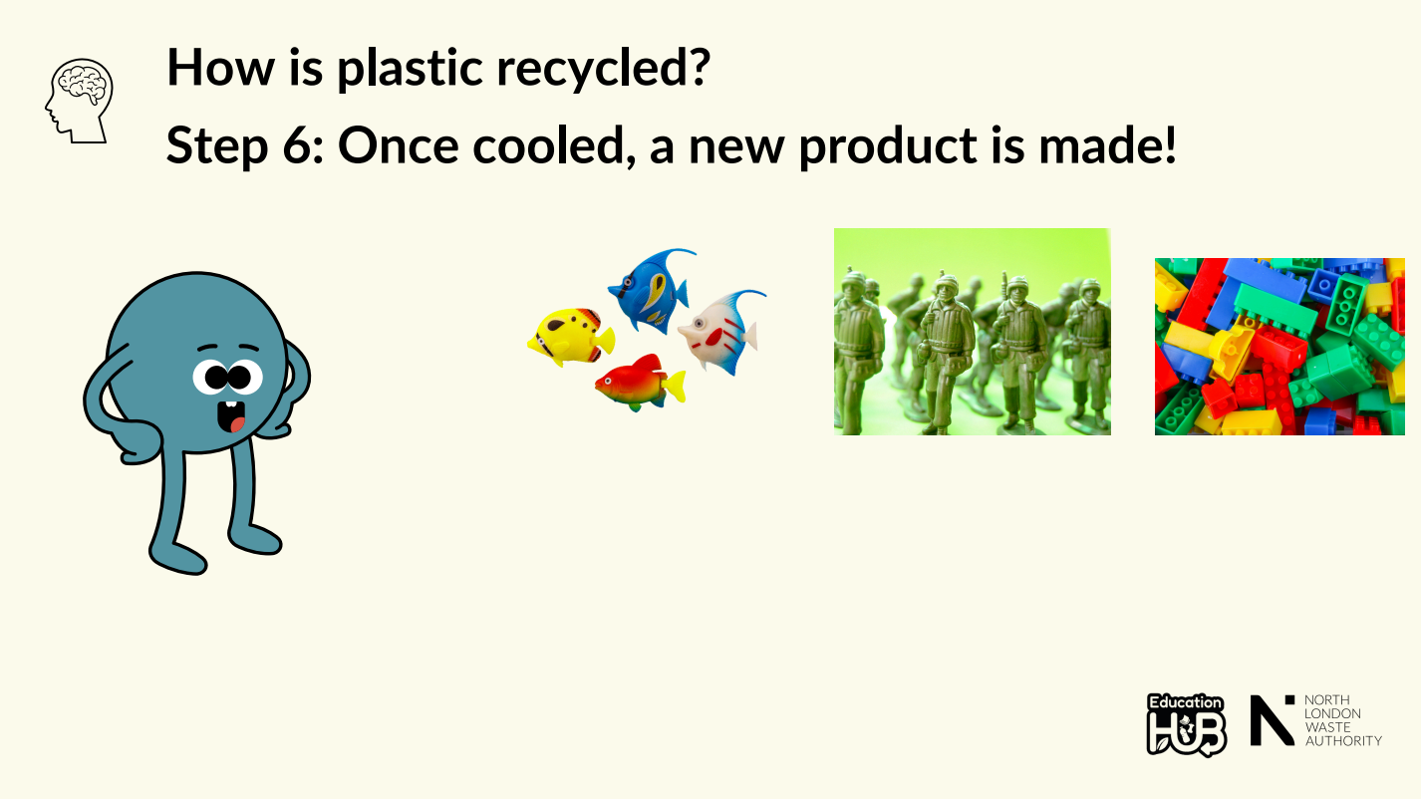

Slide 16
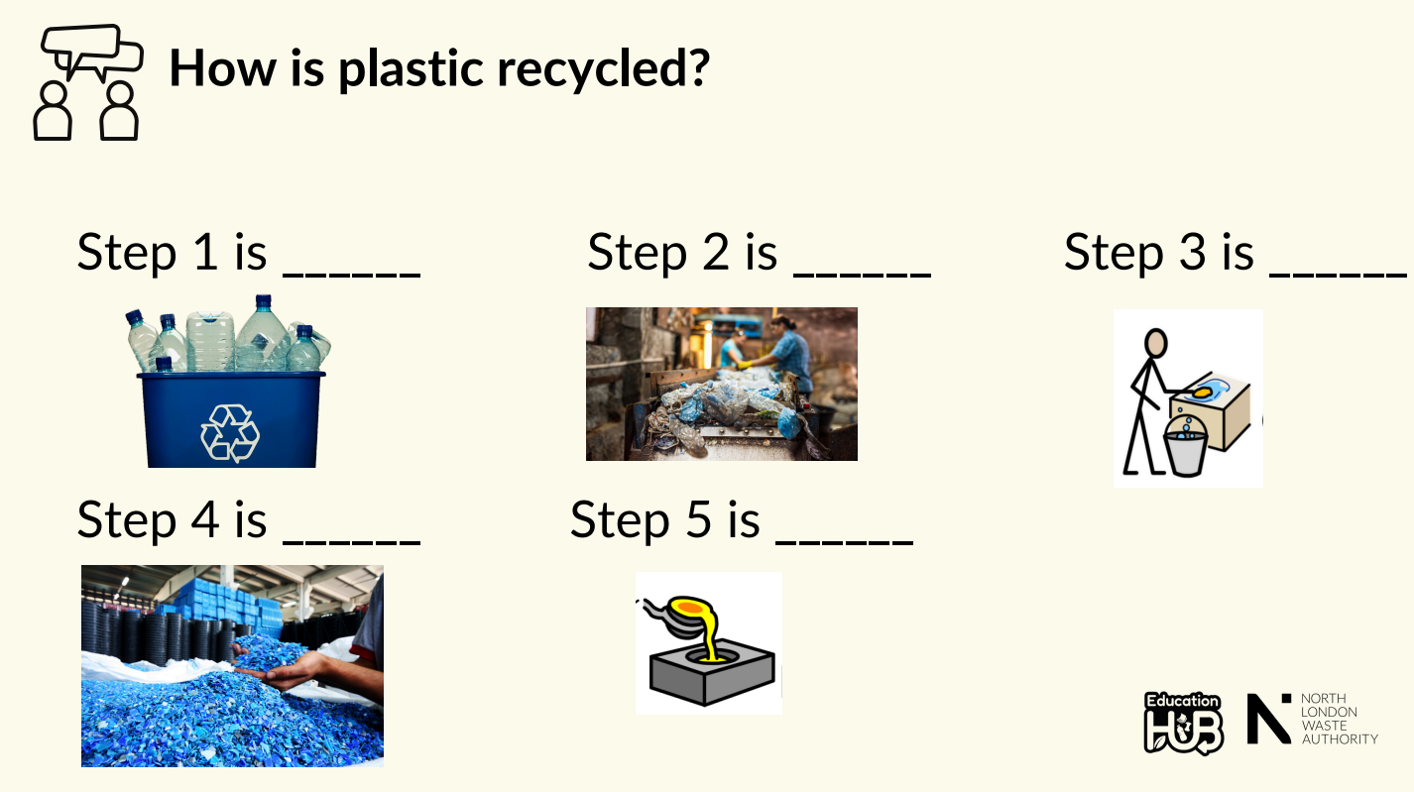

Slide 17
Plastic takes a lot of energy to recycle.
What is better, recycling plastic or using less plastic?
If we banned single use plastic, what would happen to the recycling rates?
Notes:
Discussion 1: What is better, recycling plastic or using less plastic?
- Read question to children twice
- Give children a moment to think about the question
- In partners, get children to share their thoughts using sentence stem 'I think that XXX is better because .......'
-Give children 2 minutes in partners to discuss their ideas.
- Listen in to discussion. Spotlight two children
Repeat with question 2

Slide 18
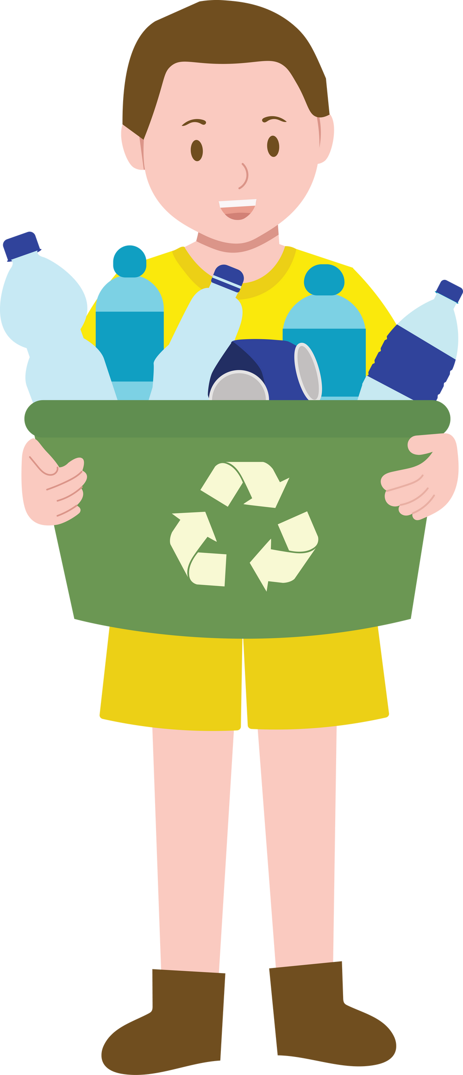
Extension activity 1
Oracy activity: Find something plastic in the classroom. Get partners to teach each other the steps to recycling that piece of plastic.

Slide 19
Extension activity 2
Writing activity: Ask children to write or act out a short story from the point of view of a plastic bottle going through the recycling process. What does it see, feel, and become?
Hi there! I’m Bouncy, a bright blue plastic bottle.
I used to hold fizzy orange pop, and I lived on a supermarket shelf until a kind girl named Amina picked me up and took me home. I felt proud to be chosen!
But after the last sip… I was empty. I thought my life was over. I was tossed into a bin with banana peels and sandwich crusts. It was dark, smelly, and lonely.
Then—light! Amina’s mum sorted the rubbish and popped me into the recycling bin. I felt hopeful again.
Next stop: the recycling centre.
I was squished, squashed, and melted down with other bottles. It was hot and sticky, but I knew it was for a good cause. I was changing—transforming! Guess what I became?
A shiny new park bench! Now I sit in the sunshine, watching children play and squirrels chase each other. I feel useful, strong, and proud.

Slide 20
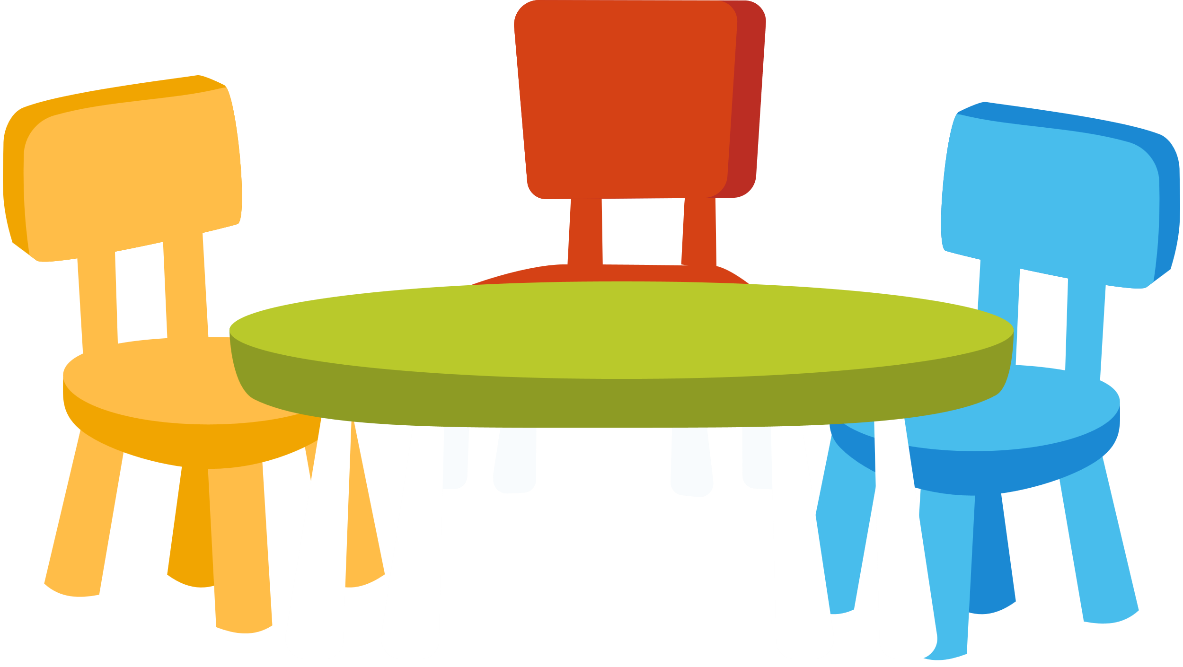
Extension activity 3
Science activity: Set up stations that represent each step of the recycling process. Children complete a task at each station. Collection – Pick up recyclable items and place them in the correct bin.
  Sorting – Sort items by material type (plastic, metal, paper).
  Cleaning – Wash or wipe plastic items to make them clean.
  Melting – Pretend to melt plastic by placing it in a container and swapping it for beads or shapes.
  Remaking – Use the new plastic pieces to create something new (e.g., a badge or decoration).

