Slide 1





How can we reduce and reuse our plastic?
KS2 Lesson - Lesson 4 of 4

Slide 2
LO: To know how plastic affects our planet and how we can help by using less plastic and finding ways to reuse it.
  Explain the difference between a linear economy, a recycling economy, and a circular economy using simple examples.
  Describe which economy is most and least preferable.
  Identify at least three creative ways they can reuse plastic items in their daily lives.
  Design or suggest a reuse project or idea that helps reduce plastic waste in their school or home.

Slide 3






Lesson Prep
Vocabulary
Discussion
Keywords that children need to understand and use during the lesson.
An opportunity for children to practice the knowledge learnt.
Big question
Task
To assess learning and give children time to practise independently.
A central question that sparks curiosity and frames the lesson’s theme.
The knowledge
Extension
Essential facts and concepts children need to know.
Optional tasks to deepen or stretch learning beyond the core lesson.

Slide 4
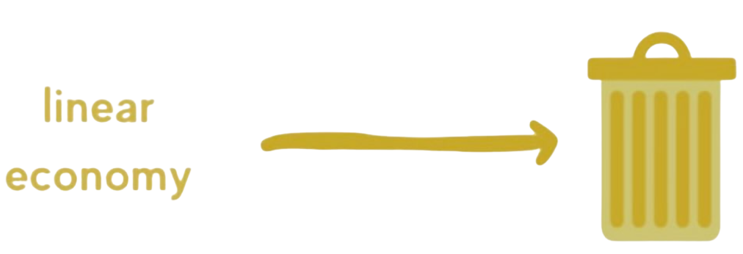


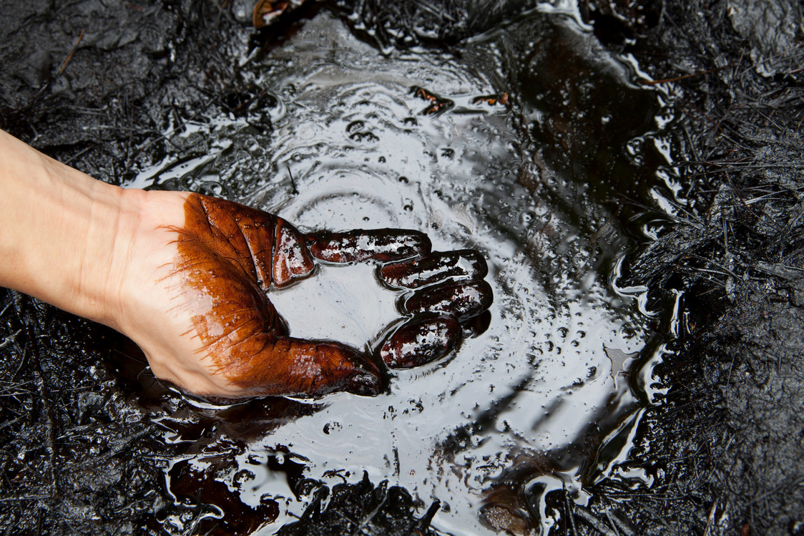
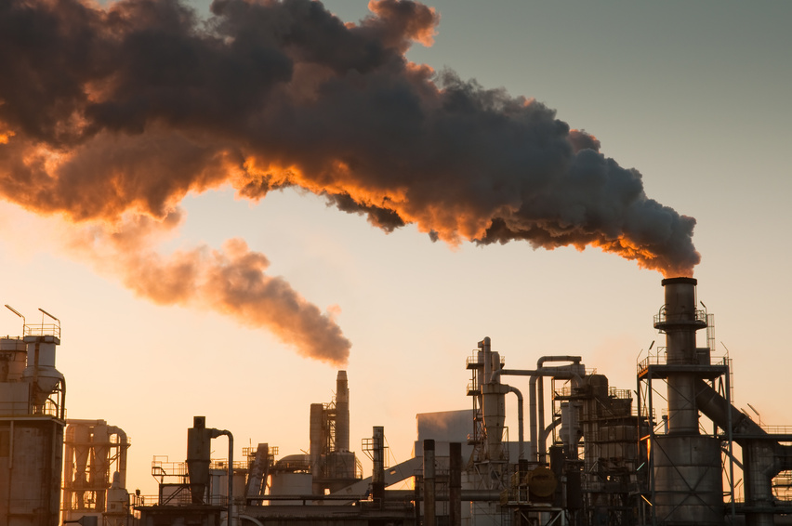
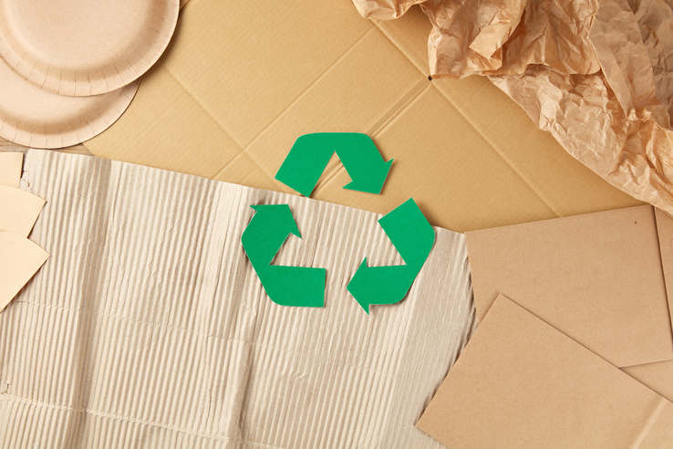
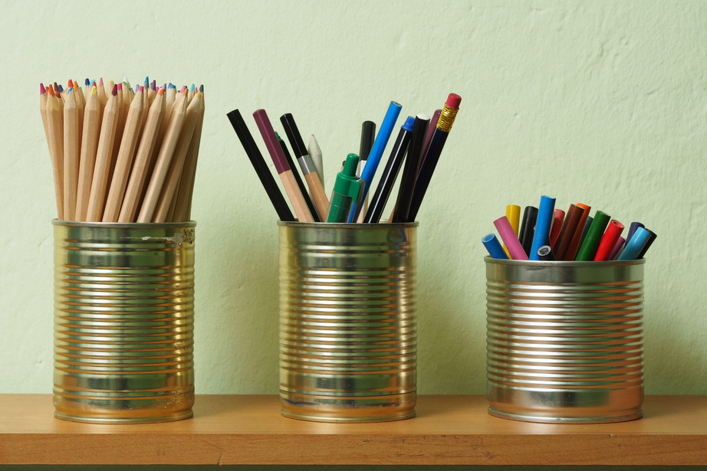
Key Words
linear economy
recycling economy
circular economy
natural resource
pollution
recycle
reuse
Notes:
Linear economy: Using resources to make products, then throwing them away after use.
Recycling economy: An economy where used materials are collected and turned into new products.
Circular economy: An economy where products and materials are reused and repaired.
Natural resource: Something found in nature that people use, like water, trees, or oil.
Pollution: Harmful substances in the air, water, or land that damage the environment.
Recycle: To turn used items into new products instead of throwing them away.
Reuse: To use something again instead of throwing it away.

Slide 5
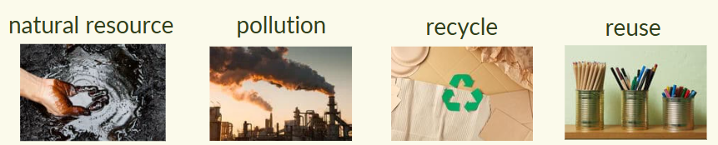
Vocabulary task
1) Trees are a _______ because they grow in nature and we use them.
2) I ______ my shopping bags instead of getting new ones each time.
3) We ______ plastic bottles so they don’t end up in the bin.
4) ______ makes the air, water, or land dirty and unsafe.
Challenge: Write a sentence using a new vocabulary word.
Notes:
1 = natural resource
2 = reuse
3 = recycle
4 = pollution

Slide 6
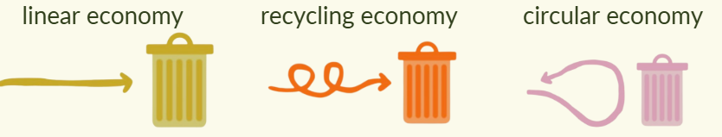
Vocabulary task
1) A _________ economy turns old things into new ones.
2) In a _________ economy, we keep using things again and again.
3) In a _________ economy, people make things, use them, and then throw them away.
Challenge: Write a sentence using a new vocabulary word.
Notes:
1 = recycling
2 = circular
3 = linear

Slide 7








Hi Ned! I always forget my reusable bag—does it even matter that much?
It really does, Nancy! But don’t worry—I'll show you why it's important and this will help you to remember next time.

Slide 8
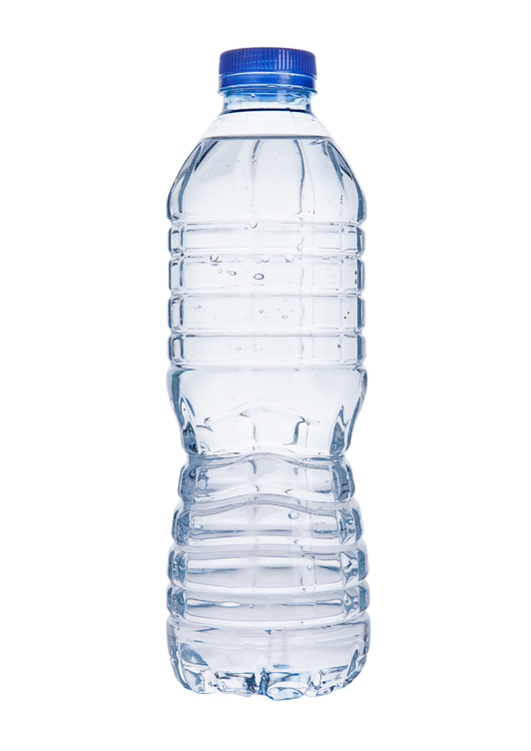
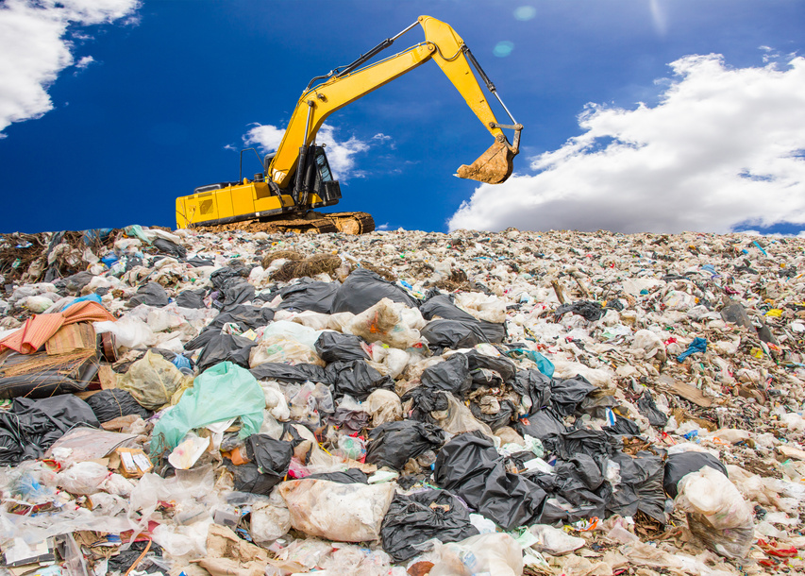

Linear economy
A linear economy is when we make something, use it, then throw it away.
Hmm. We can do better! Plastic does not biodegrade. It takes hundreds of years to break down. We don’t want plastic sitting in landfill...

Slide 9


Linear economy
A linear economy is when we make something, use it, then throw it away.
It is easy and fast to make things.
It uses up natural resources (crude oil).
It creates lots of waste and pollution .
It harms animals and nature.
It takes lots of energy to produce plastic.

Slide 10
Linear economy
A linear economy is when we _______ something, _______ it, then _____ it away.
throw use make

Slide 11
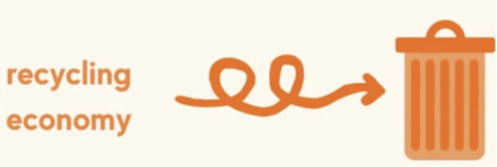
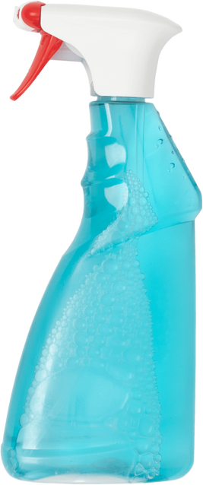


Recycling economy
A recycling economy means we send materials to recycling centres to be turned into new things.
A much better option! We save natural resources like crude oil, and stop some rubbish going to landfill!

Slide 12
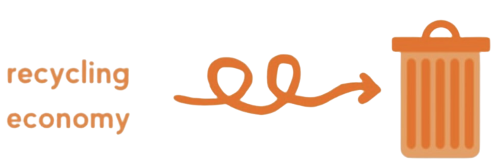
Recycling economy
A recycling economy means we send _________ to _________ centres to be turned into ____________.
recycling new things materials

Slide 13
Recycling economy
A recycling economy means we send materials to recycling centres to be turned into new things.
Helps reduce waste and saves some materials.
Not everything can be recycled.
Recycling still uses energy.
The quality of recycled materials is less than new materials.

Slide 14


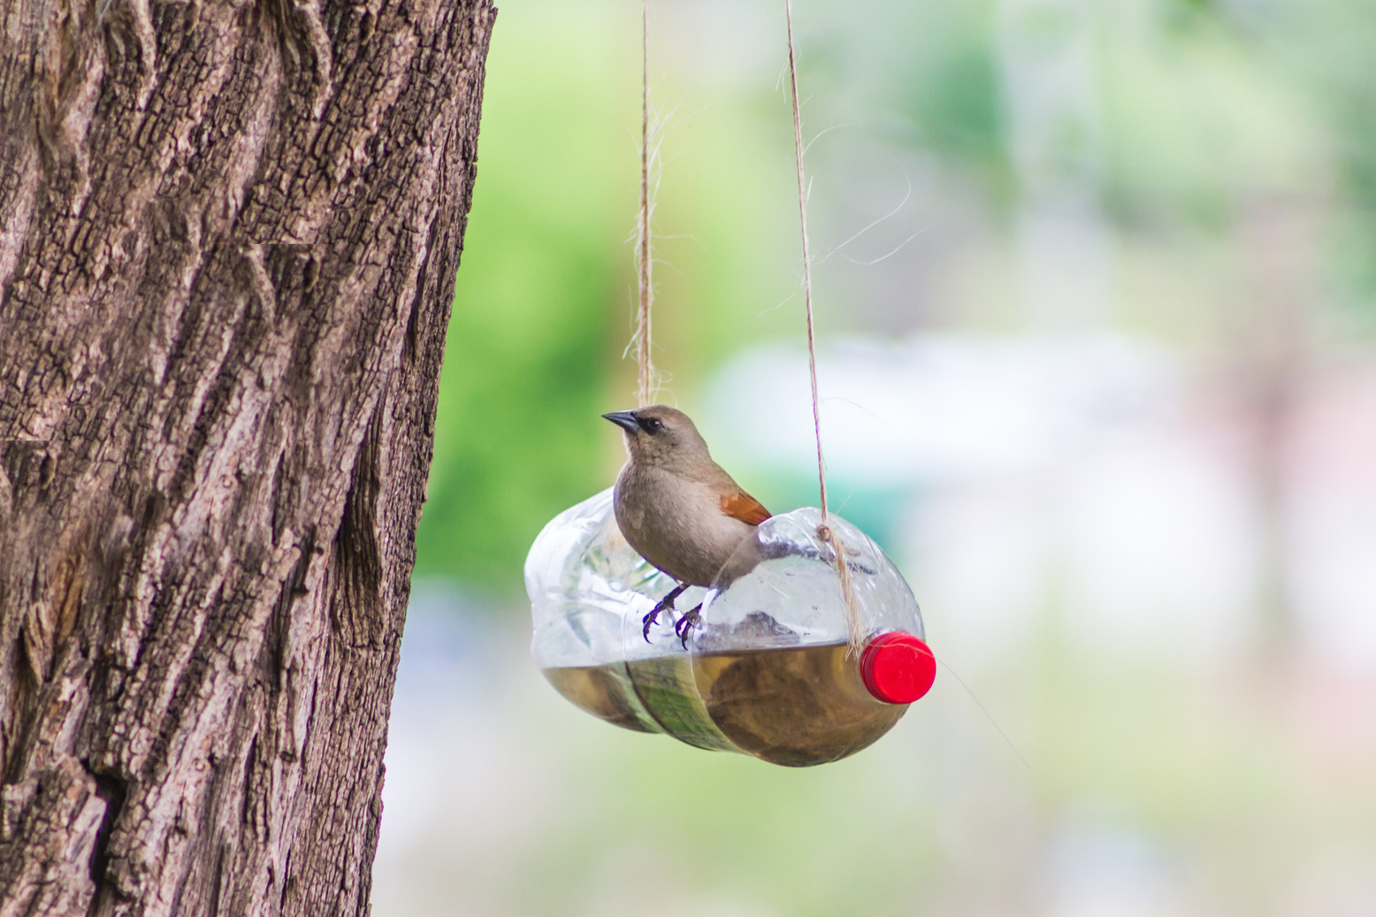
Circular economy
A circular economy is about designing products and systems so we do not create waste in the first place.
This is an excellent idea!

Slide 15
Circular economy
A circular economy is about designing products and systems so we do not create ______ in the _______ place.
first waste

Slide 16
Circular economy
A circular economy is about designing products and systems so we do not create waste in the first place.
Less waste - we do not throw away as much
We use fewer natural resources like trees, oil and water
Saves money by fixing things
Our planet is clear as there is less rubbish and pollution
It needs teamwork. Everyone (factories, shops and people) need to work together to make it work.

Slide 17
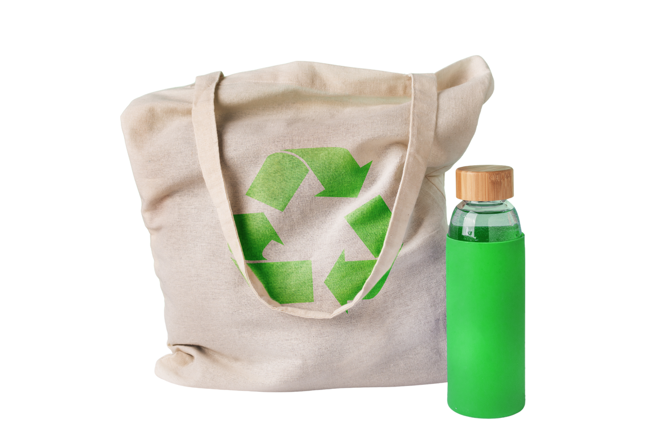
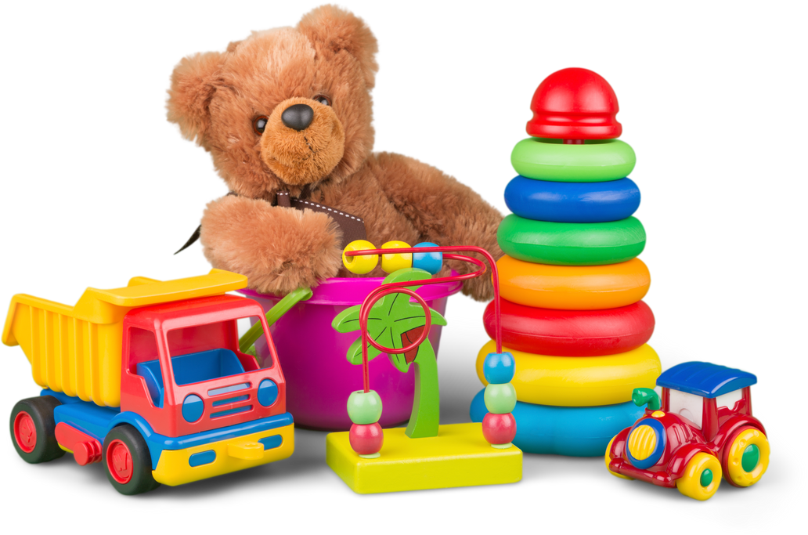
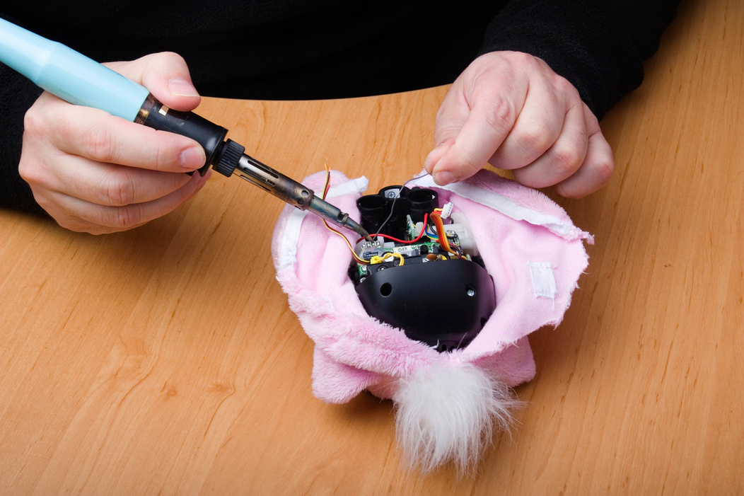
Examples of a circular economy
Reusable items
Toy libaries
Upcycling
Repairing
Wow, all of these things don’t create any waste at all. They’re brilliant for our environment!
Notes:
Reusing a bag or water bottle:
Instead of throwing it away, we use it again and again to help the planet.
Setting up toy libraries:
Kids can borrow toys and return them, so everyone shares and wastes less.
Turning a plastic bottle into a bird feeder:
We give old things a new job instead of throwing them away.
Fixing and repairing things:
When something breaks, we fix it so we don’t have to buy a new one.

Slide 18
What are some examples of a circular economy?
Examples of a circular economy are _______.

Slide 19
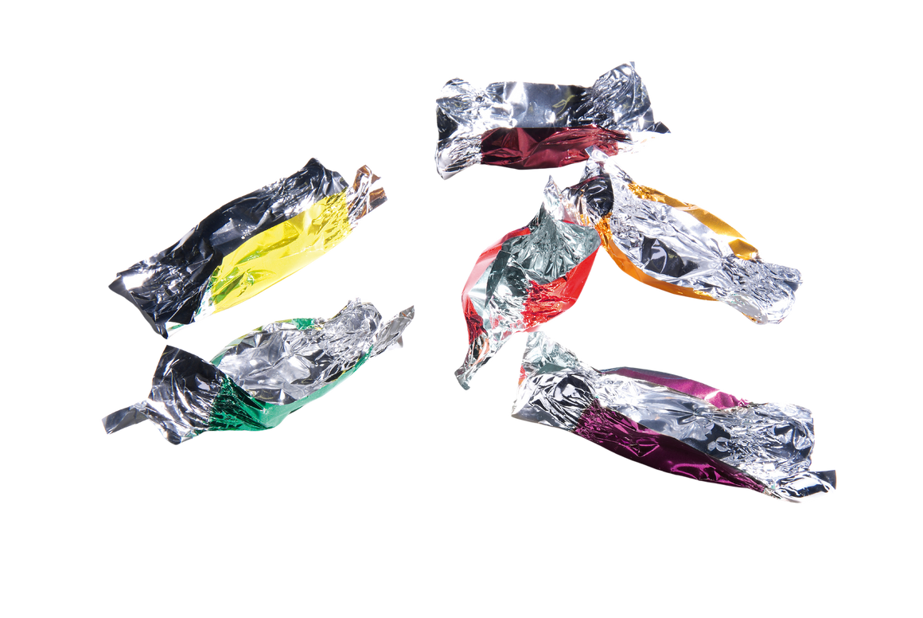
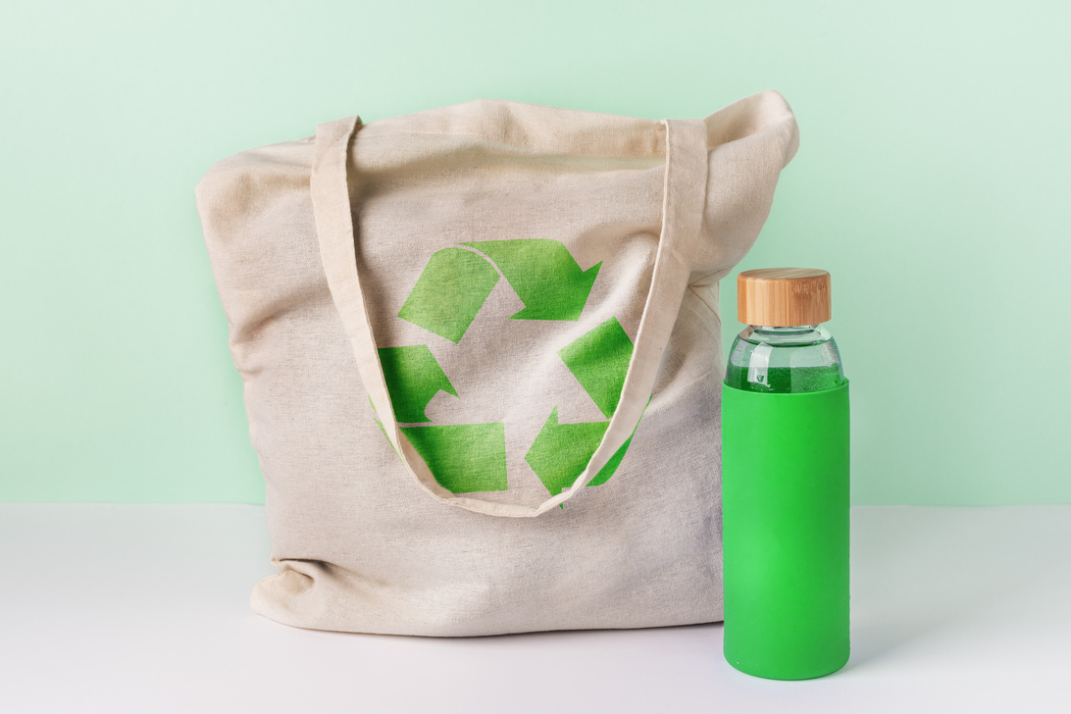

As a class, how can we reduce our plastic waste?

Slide 20
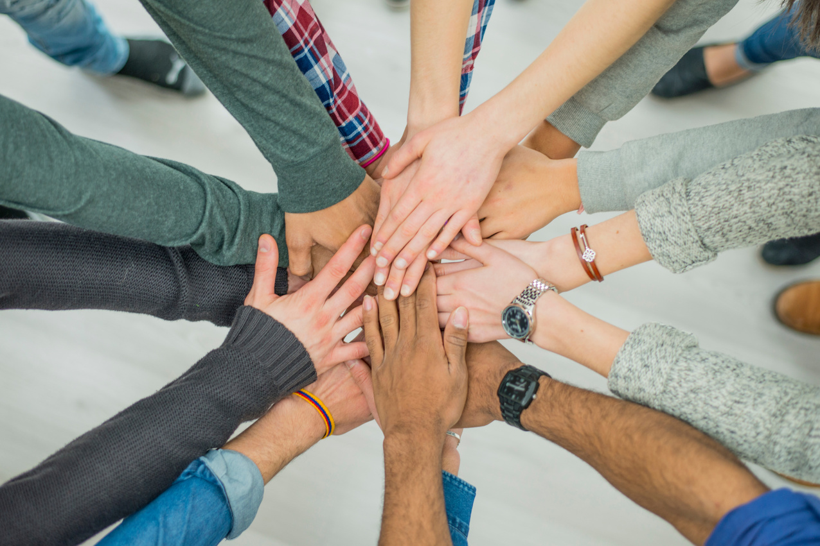
Problems...
It requires everyone to work as a team to encourage a circular economy.
Why do you think supermarkets use so much packaging, and what could we do to help reduce it?
If you were designing a new toy, how would you make sure it could be reused or recycled?
Notes:
Discussion 1: Why do you think supermarkets use so much packaging, and what could we do to help reduce it?
- Read question to children twice
- Give children a moment to think about the question
- In partners, get children to share their thoughts using sentence stem 'To help reduce plastic packaging in supermarkets, I think we can....'
-Give children 2 minutes in partners to discuss their opinions
- Listen in to discussion. Spotlight two children
Repeat with question 2

Slide 21
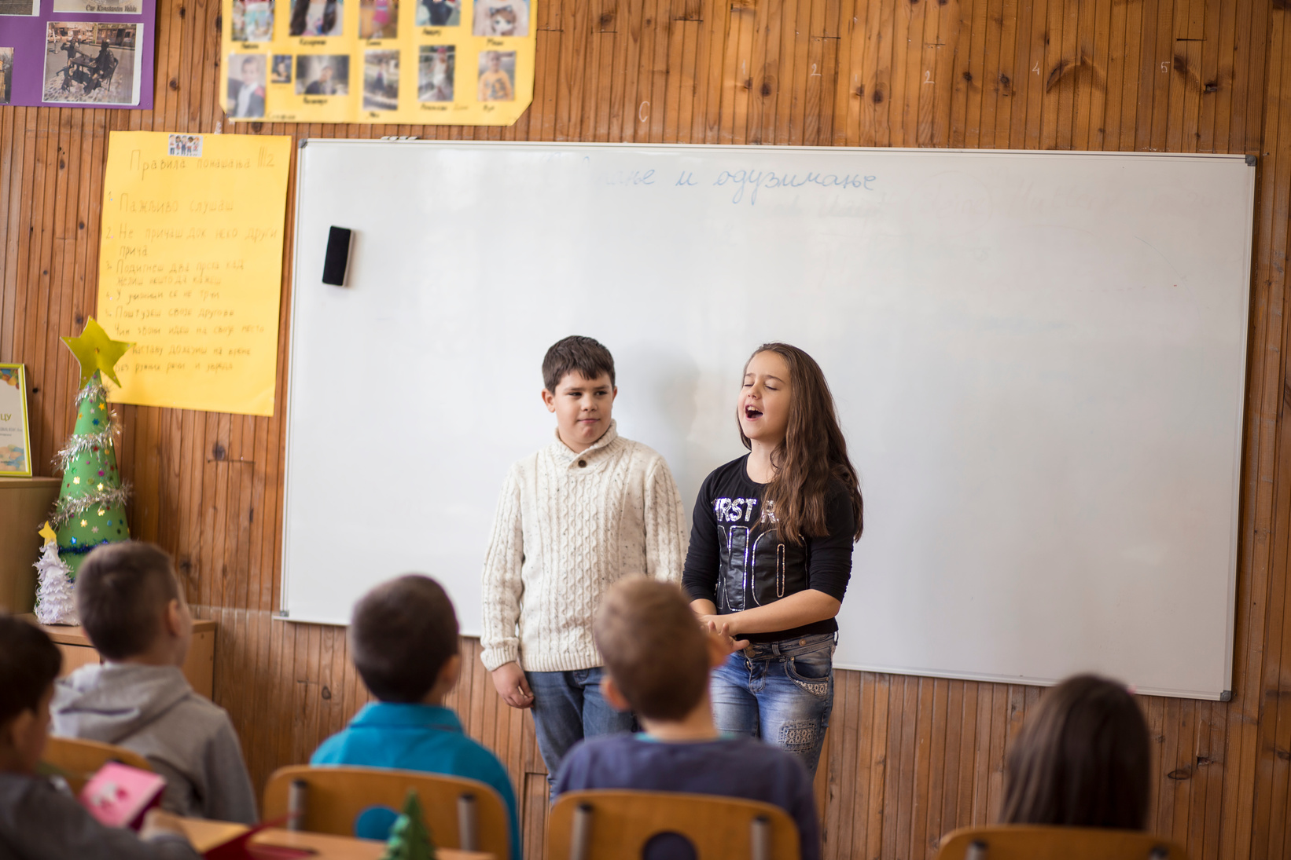
Extension activity 1
Science/Art/Writing activity: Making a difference in school. Children choose one way to reduce waste in school—like cutting down on plastic snack wrappers or starting a reusable water bottle campaign.
Children create a poster, write a short speech, or start a petition to share their idea with classmates and teachers.

Slide 22

Extension activity 2
Design activity: Juice pouches are currently not recyclable as they are made from layers of plastic and metal stuck together. Can students redesign a juice pouch so it is easier to recycle or reuse?
  Could it be made from just one material?
  Could it be refillable?
  Could it turn into something useful after it's empty?

Slide 23
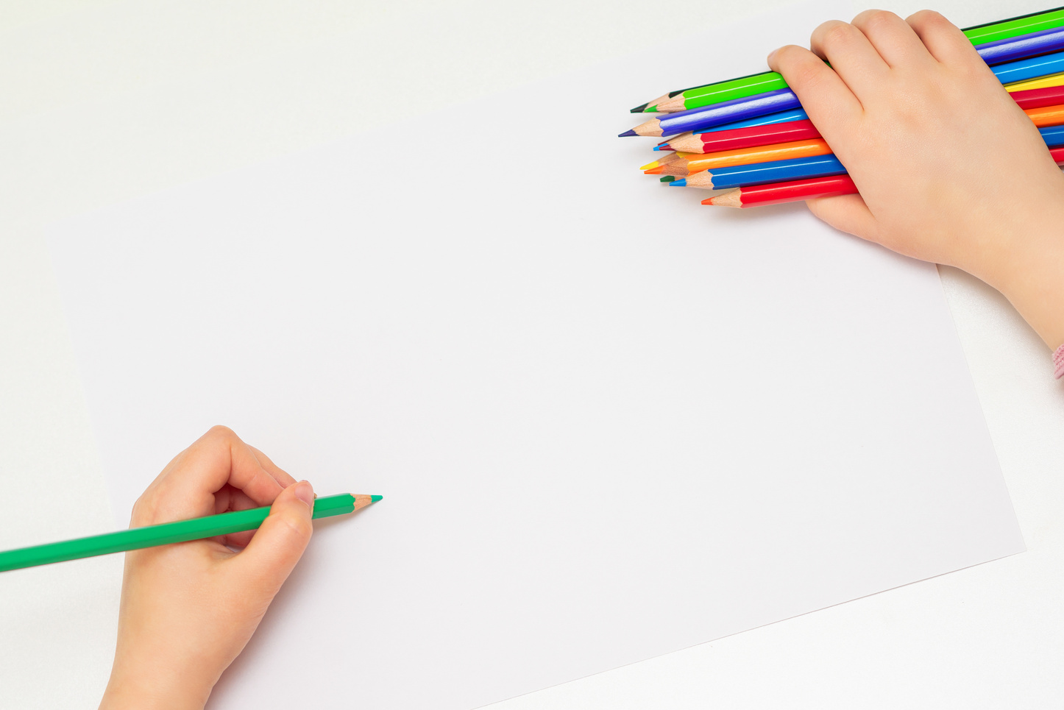
Extension activity 3
Writing activity: "The Life of an Item"
Get children to tell the story of an everyday item (like a T-shirt or toy) from when it’s made to when it’s reused or recycled. Children can write a short story or create a comic strip showing how the item avoids going to the bin and gets a second life.

