Slide 1
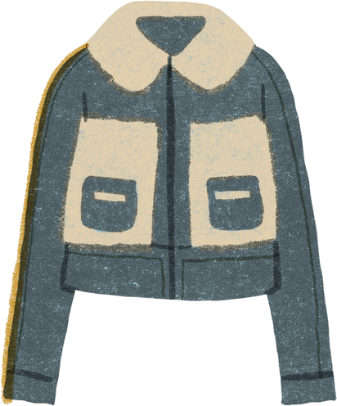
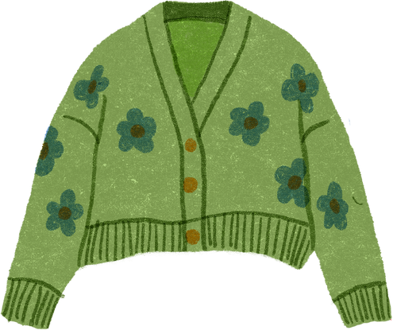
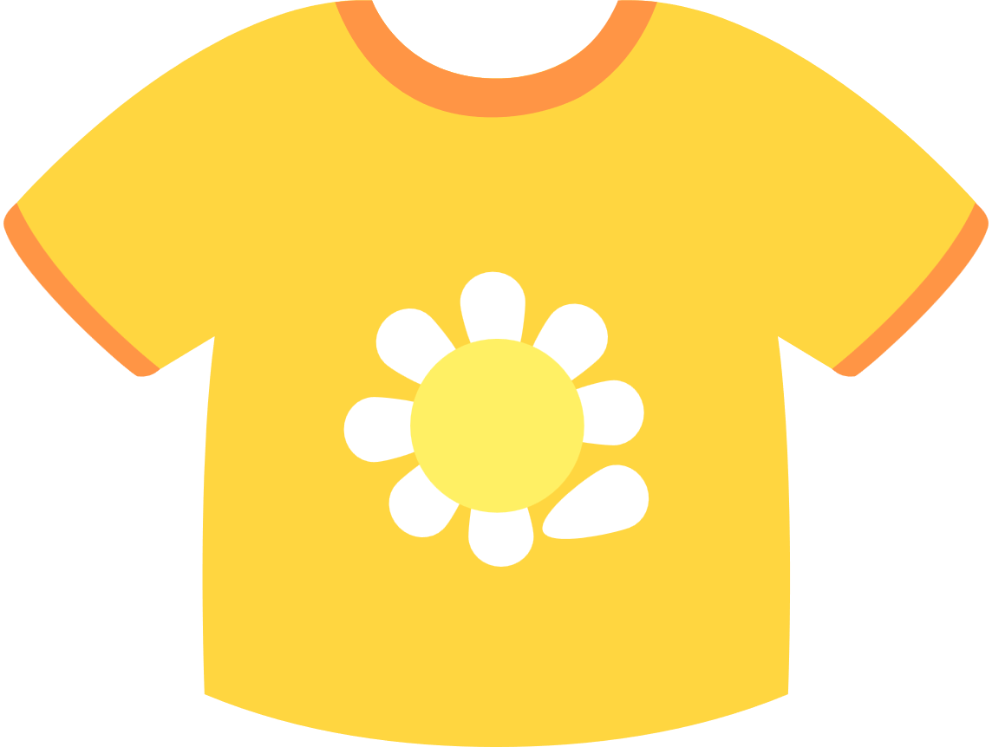

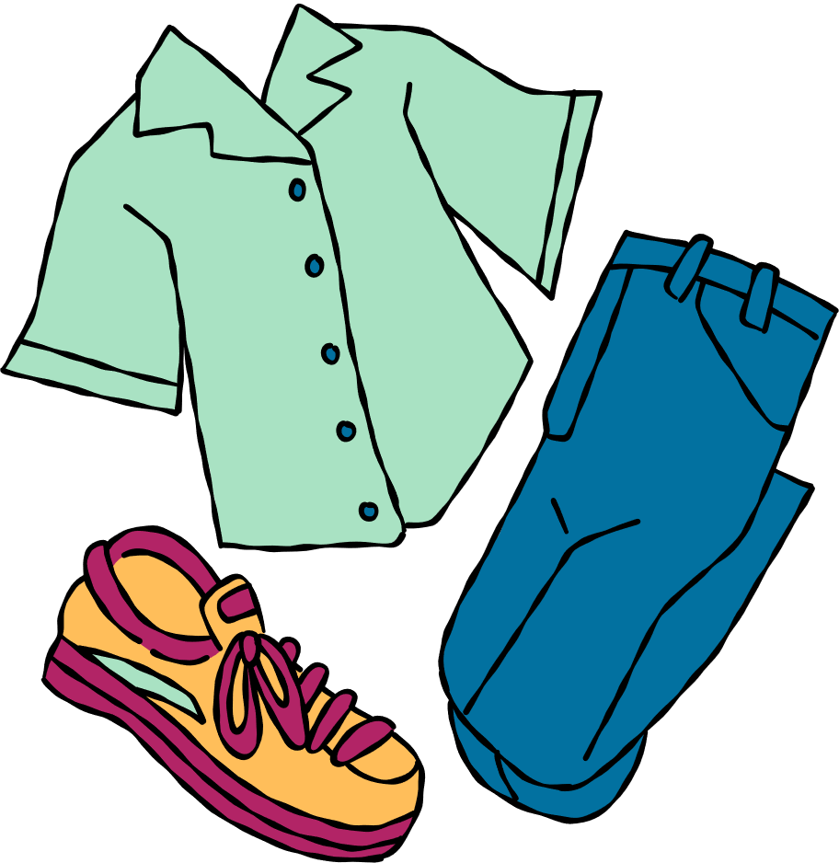
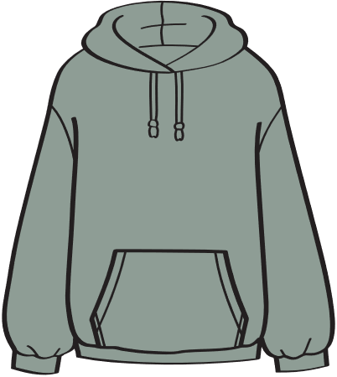
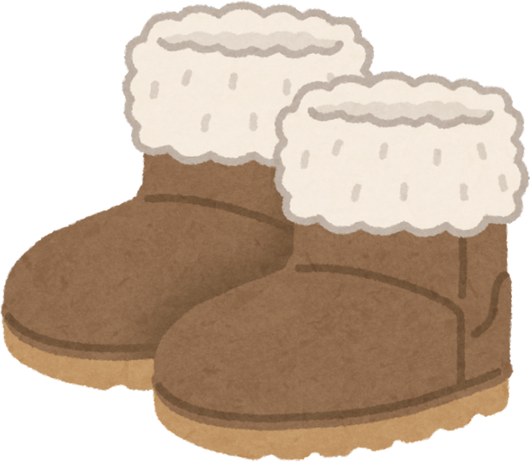
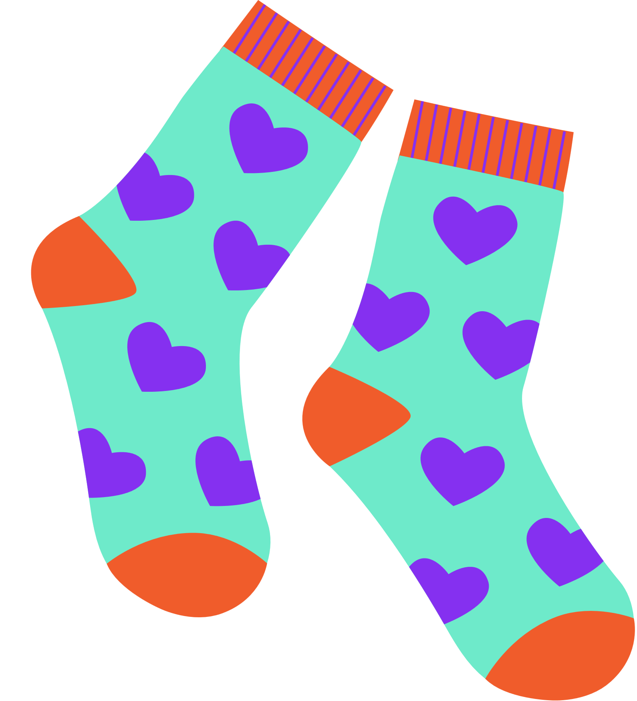


Where have your clothes come from?
Notes:
These things are all made of plastic.

Slide 2

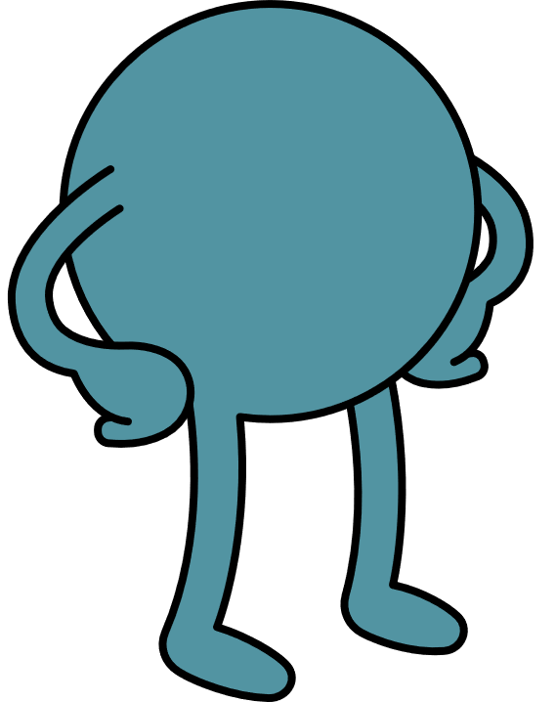

An introduction to clothing

Slide 3
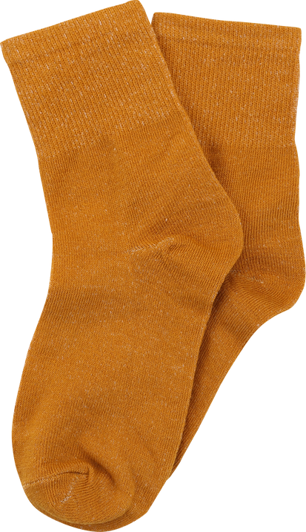
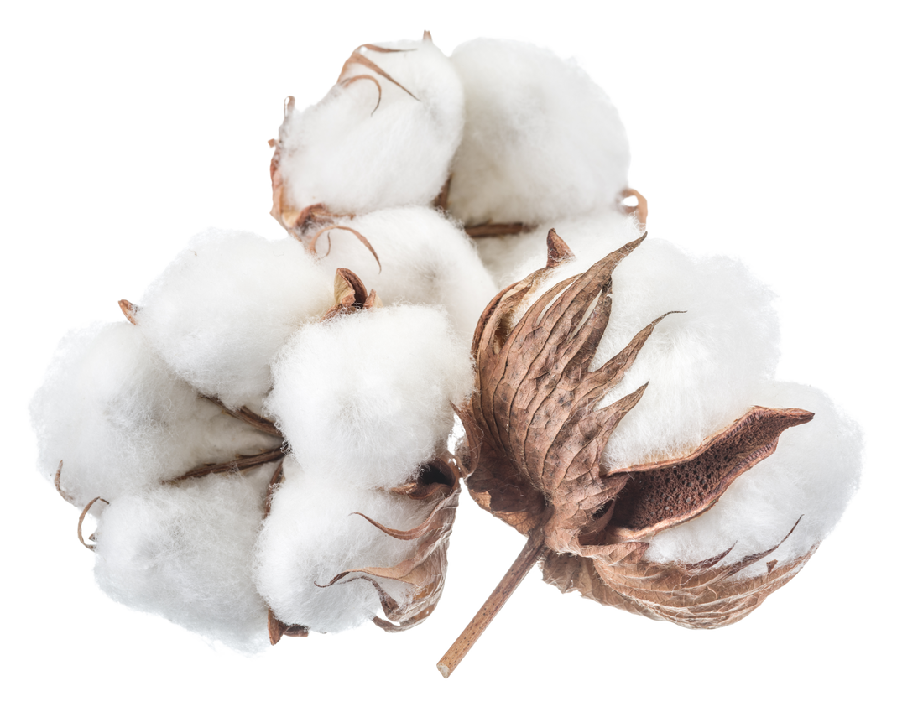
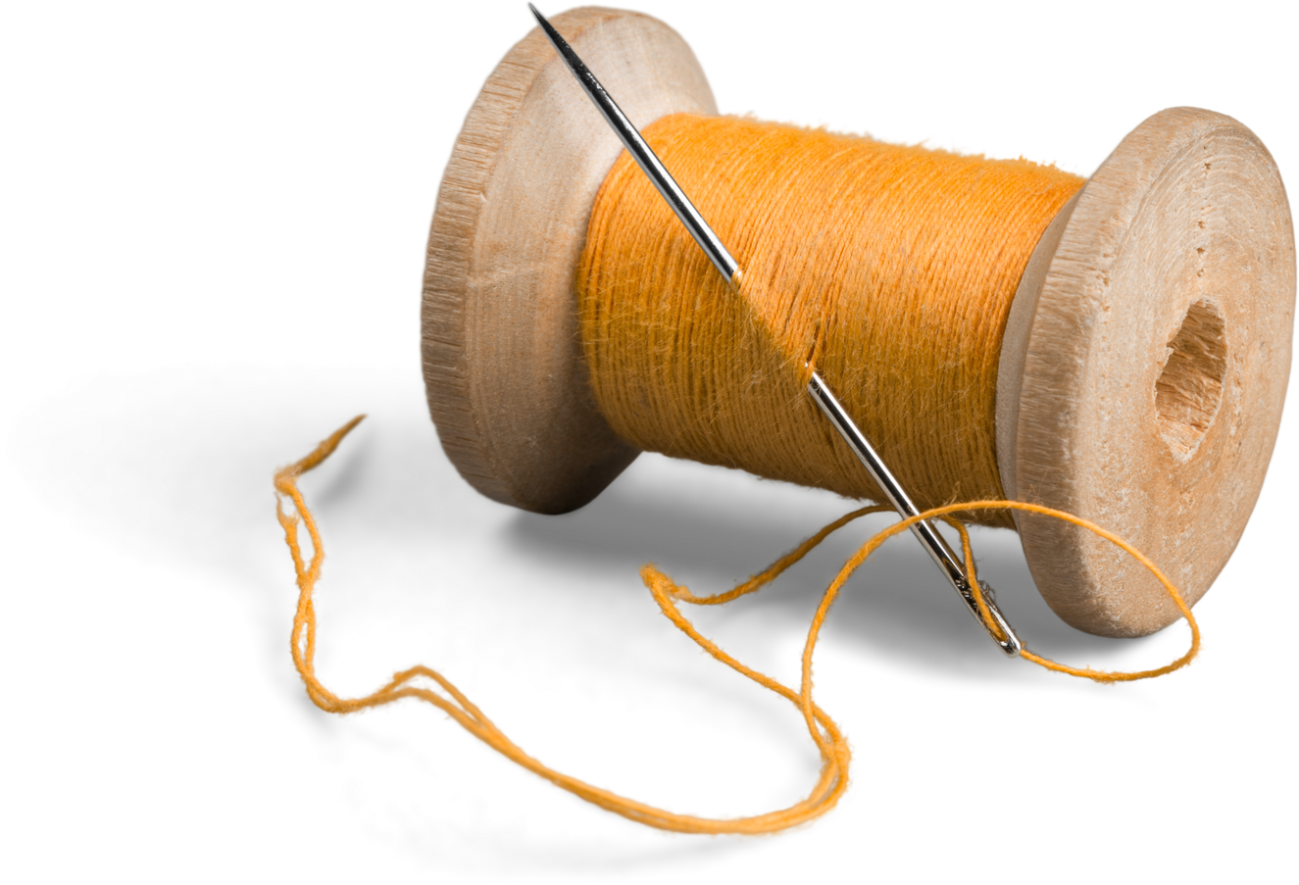
Clothes go on a journey...
take
natural resources
make thread
use
the socks

Slide 4

Have you ever thought how much energy goes into making a pair of socks? Let’s find out!
Notes:
Talk partner task.
"When I say go, you have 30 seconds to tell your partner why is plastic everywhere using the sentence starter 'plastic is everywhere because...' - Go!

Slide 5

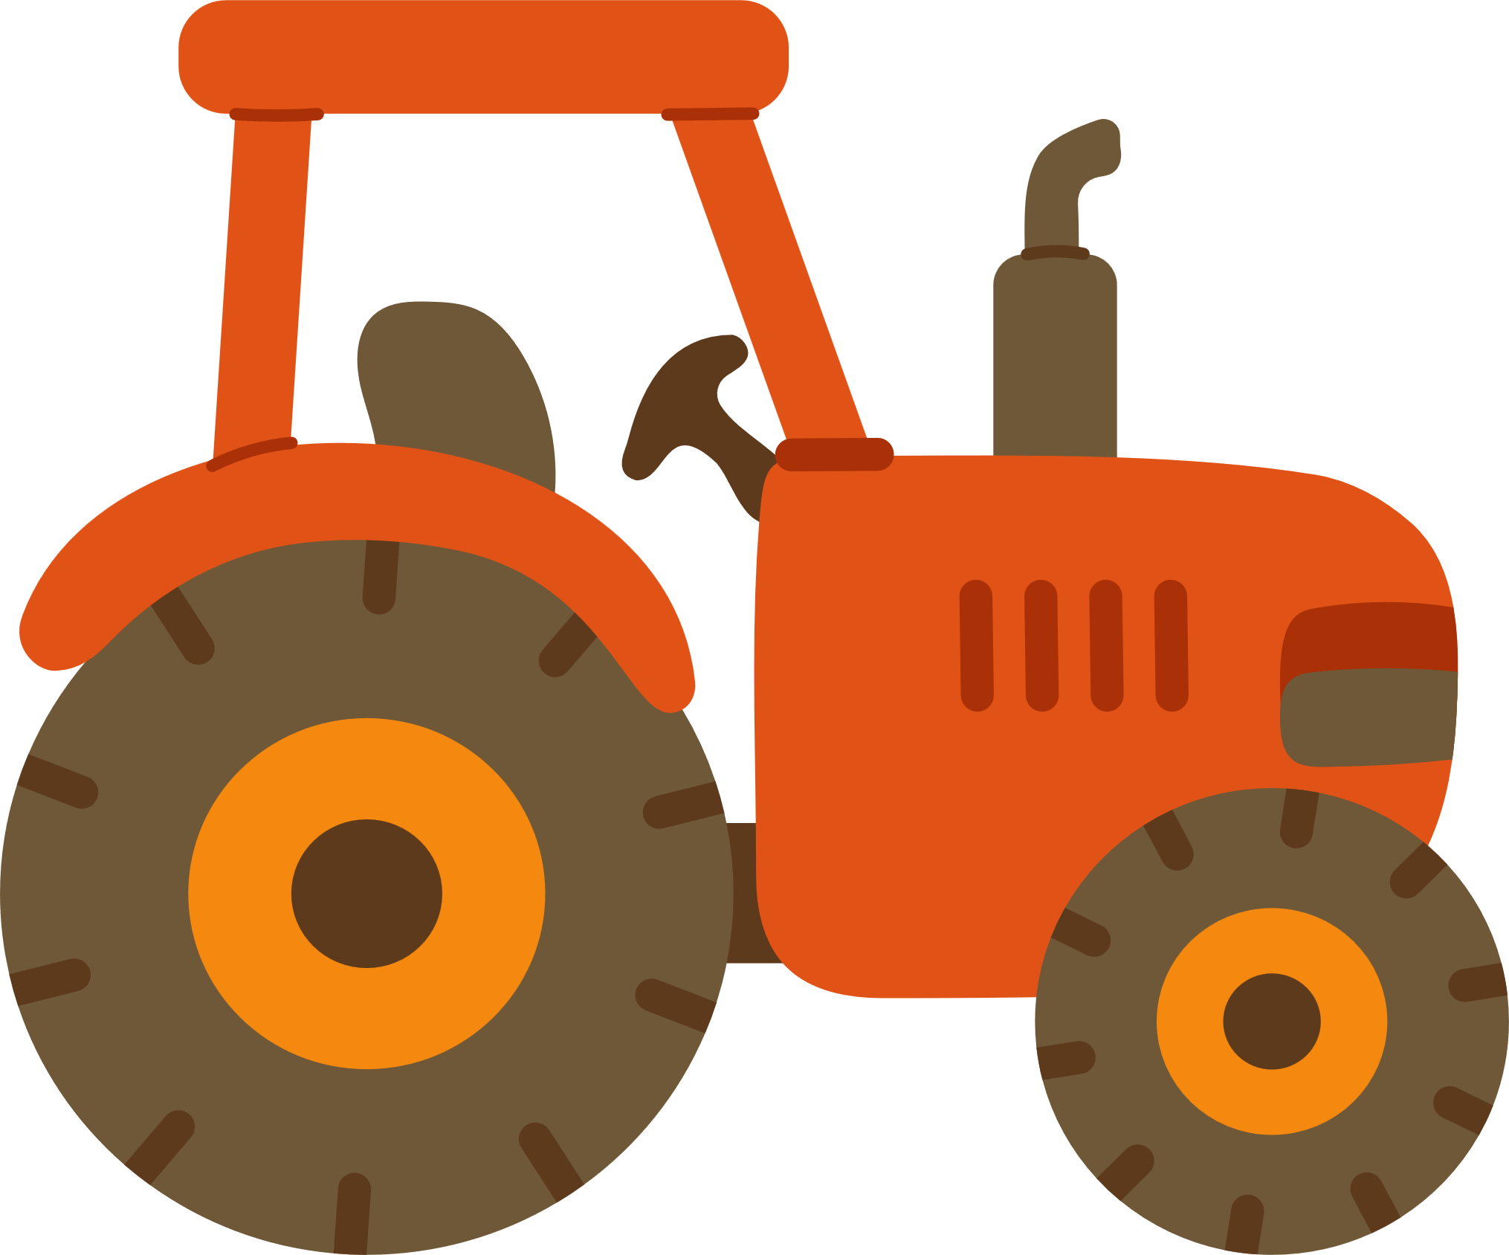


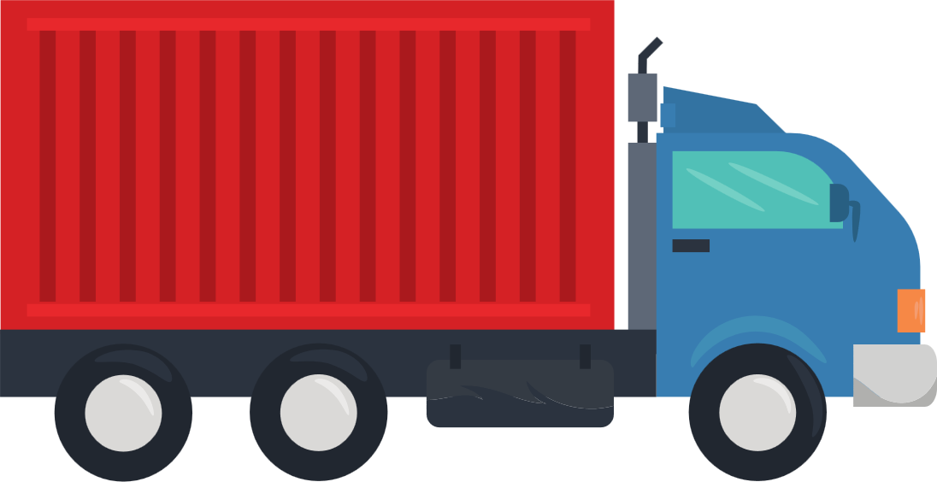
To take cotton, we need:
water
labour
sun
fertiliser
transportation (to the factory)

Slide 6

What do we need to take cotton?
We need _____________ to take cotton.

Slide 7



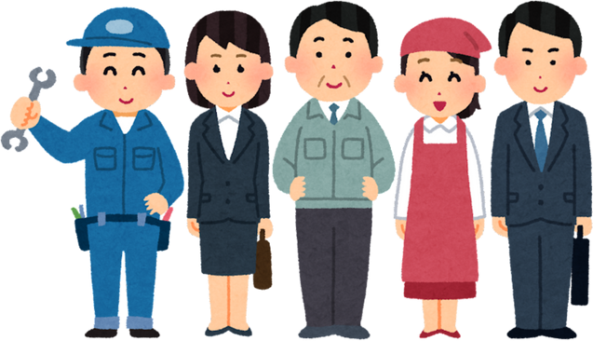
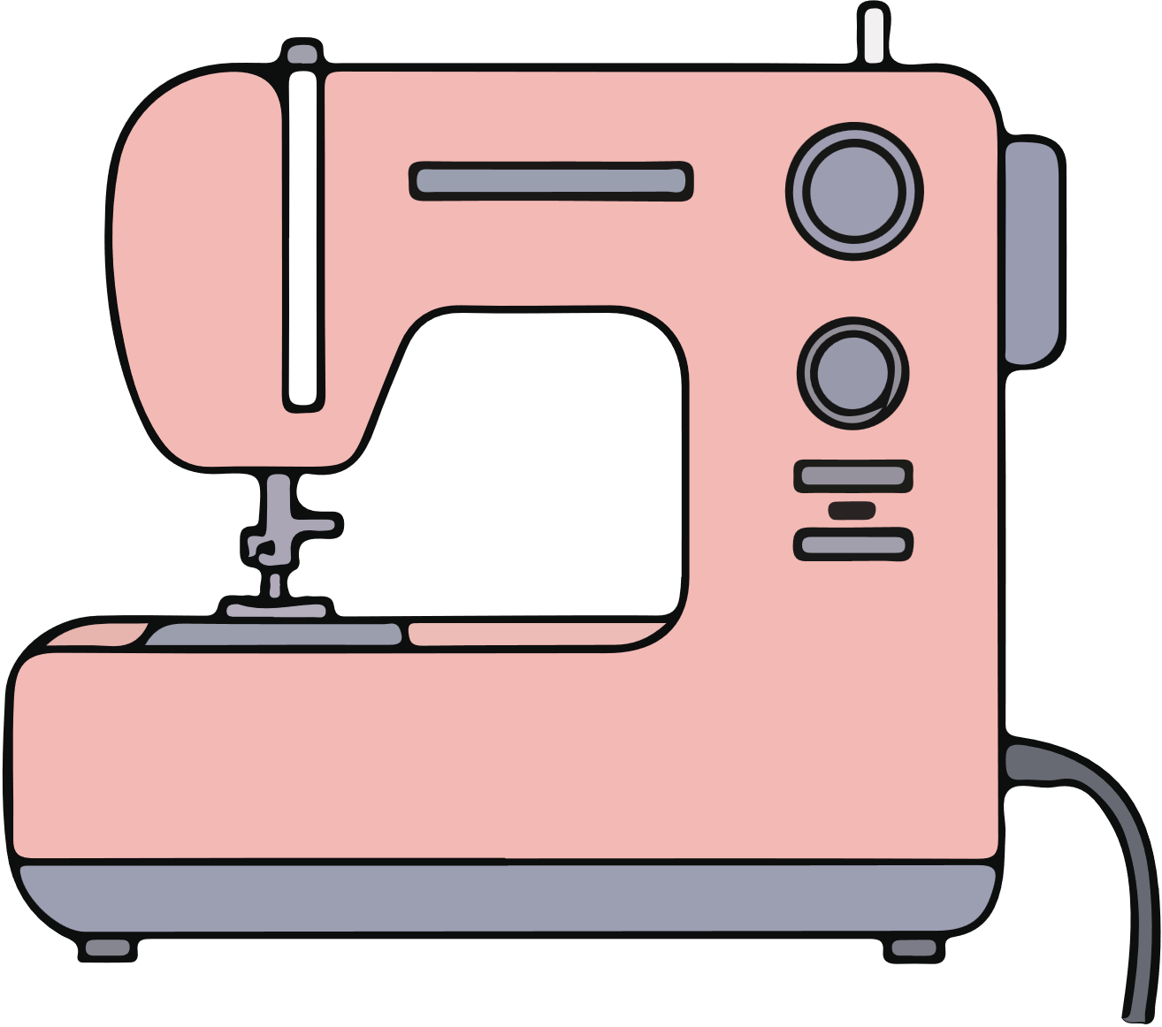
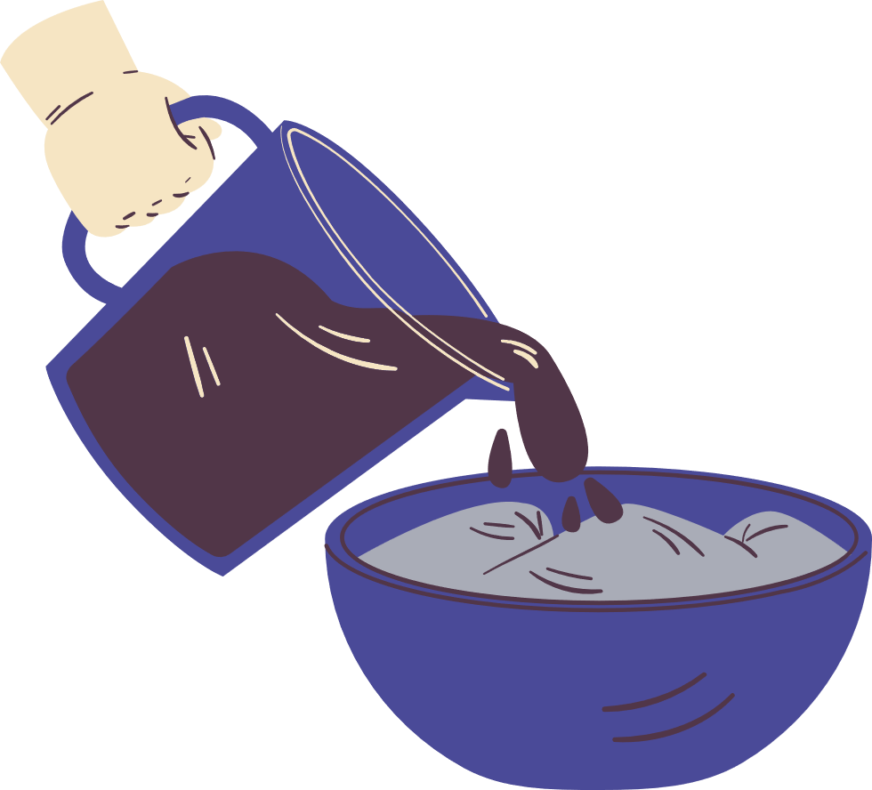
To make clothes, we need:
a factory
electricity
workers
machines
dye
transportation (to shops)

Slide 8
What do we need to make clothes?
To make clothes we need _____________..

Slide 9


The problem = A linear economy
take
make
use
waste
When we bin clothes, we have to go back to the start to get more natural resources which takes a lot of energy.

Slide 10

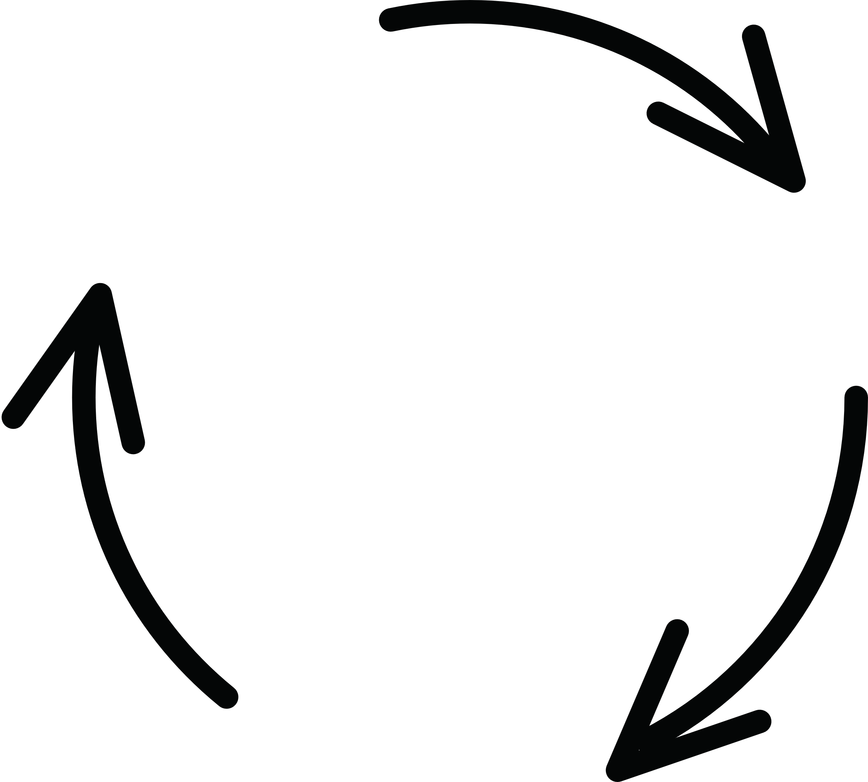
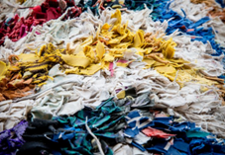
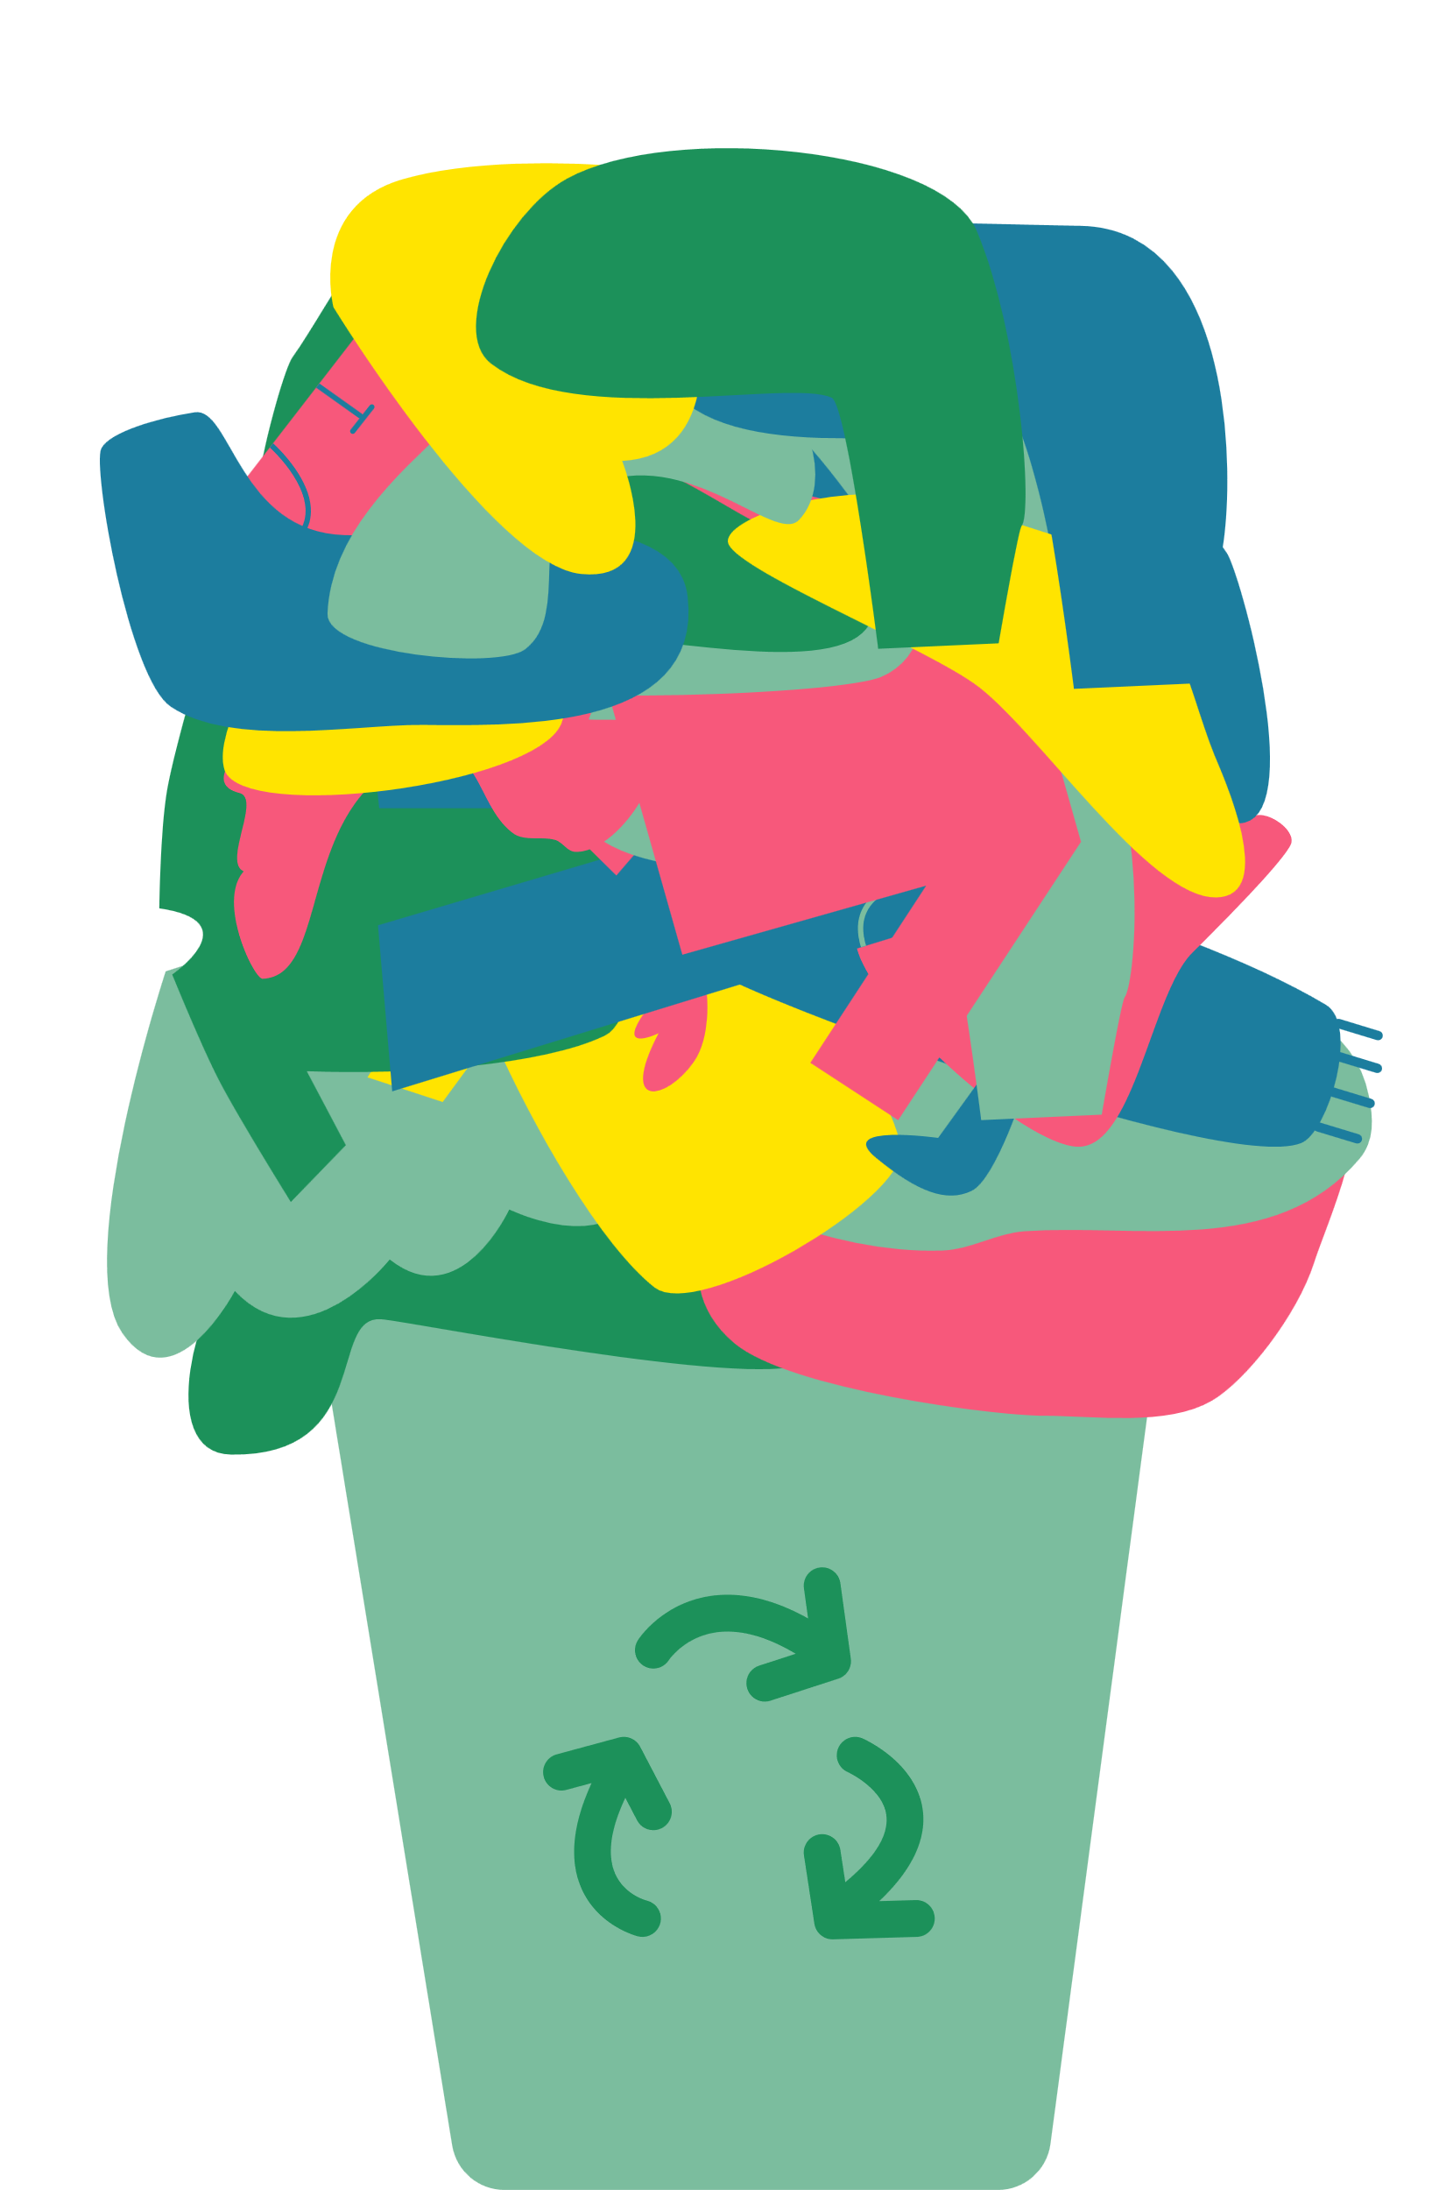

The solution = A circular economy
take
make
use
recycle
in clothes
banks
repair

Slide 11
What are the steps to a circular economy?
take
make
use
recycle
in clothes
banks
repair

Slide 12
Most items of clothing we wear has been on a long journey. Here are some tips to reduce waste and help our environment.
Notes:
Talk partner task.
"When I say go, you have 30 seconds to tell your partner why is plastic everywhere using the sentence starter 'plastic is everywhere because...' - Go!

Slide 13
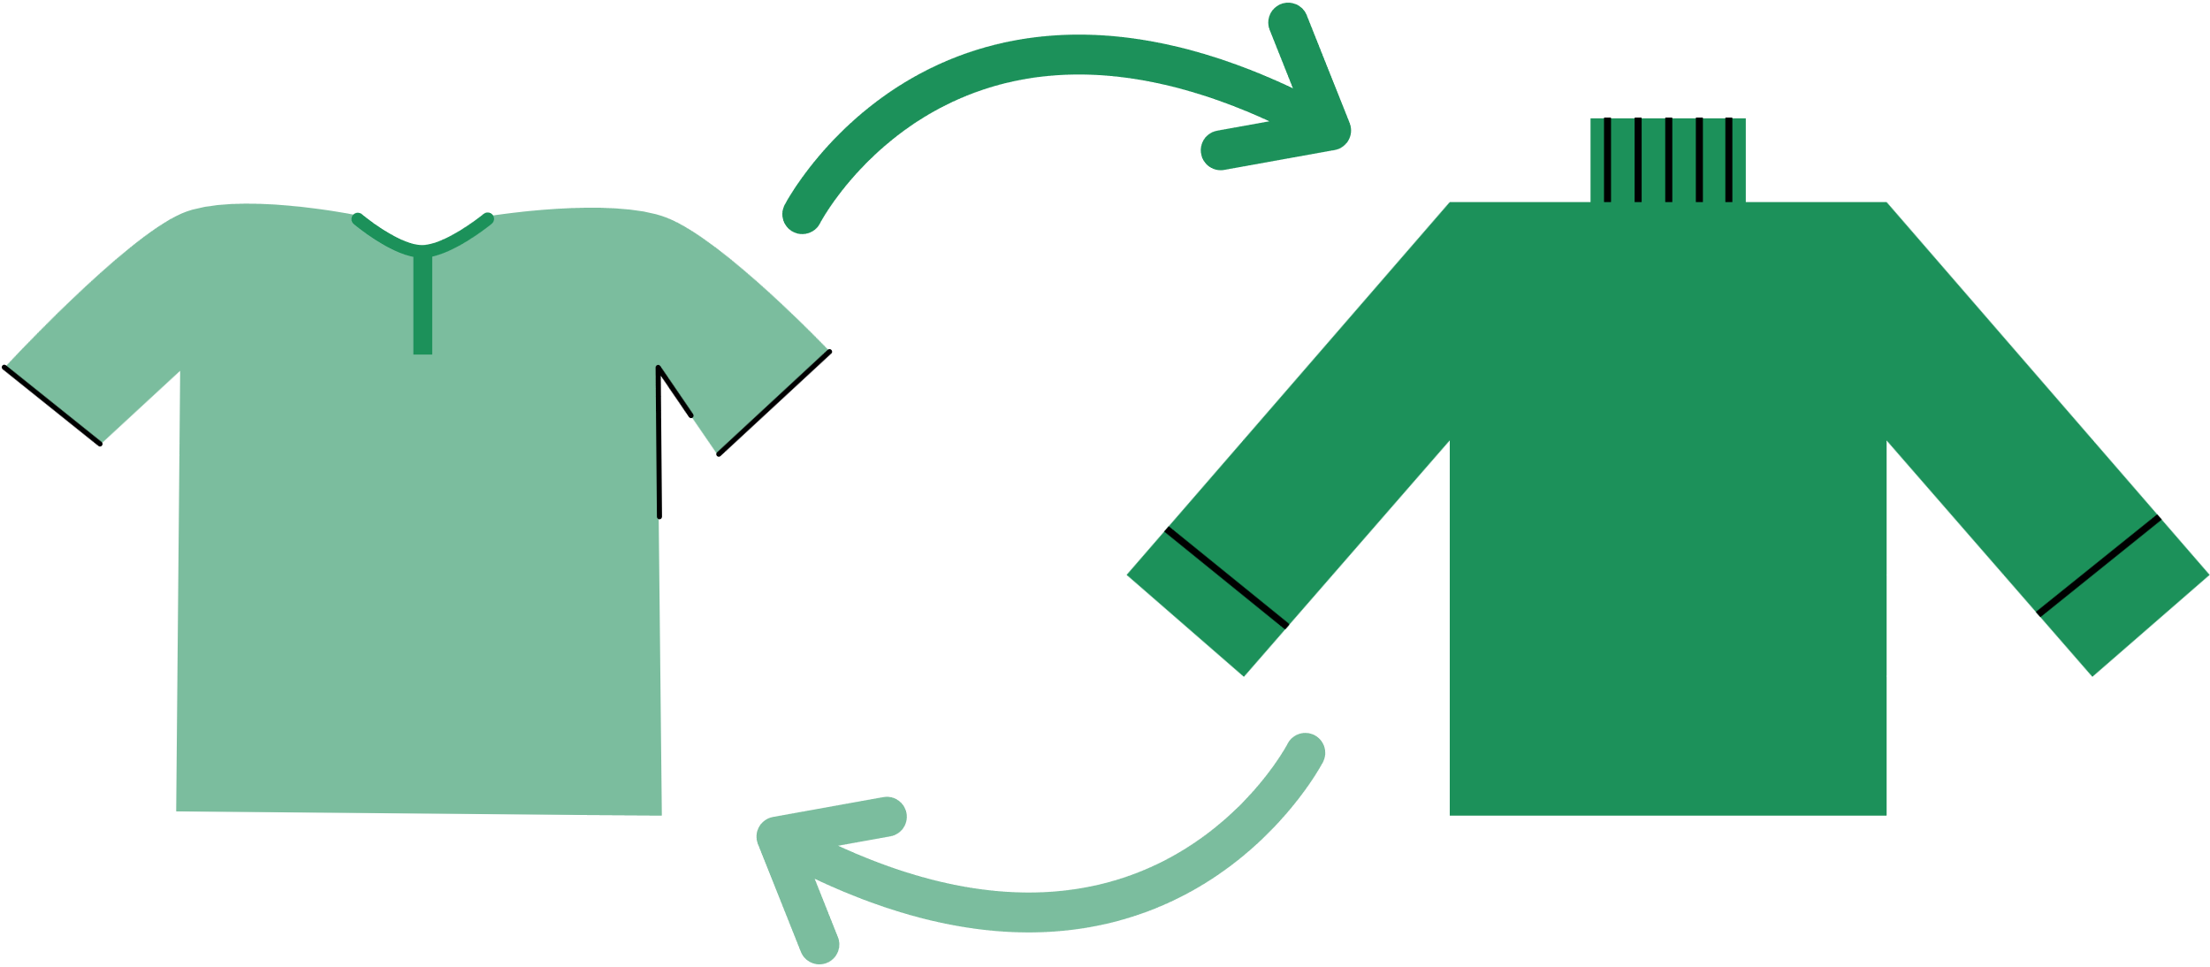
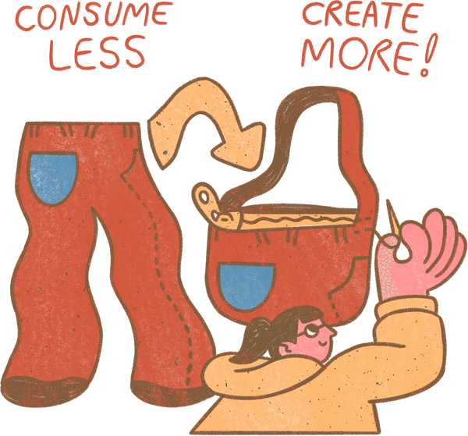
To reduce our clothing waste we can:
1) Fix clothes when they are broken
2) Swap clothes or buy second hand
3) Turn our clothes into something new

Slide 14
What can we do to reduce clothing waste?
We can ___________ to reduce clothing waste.

Slide 15
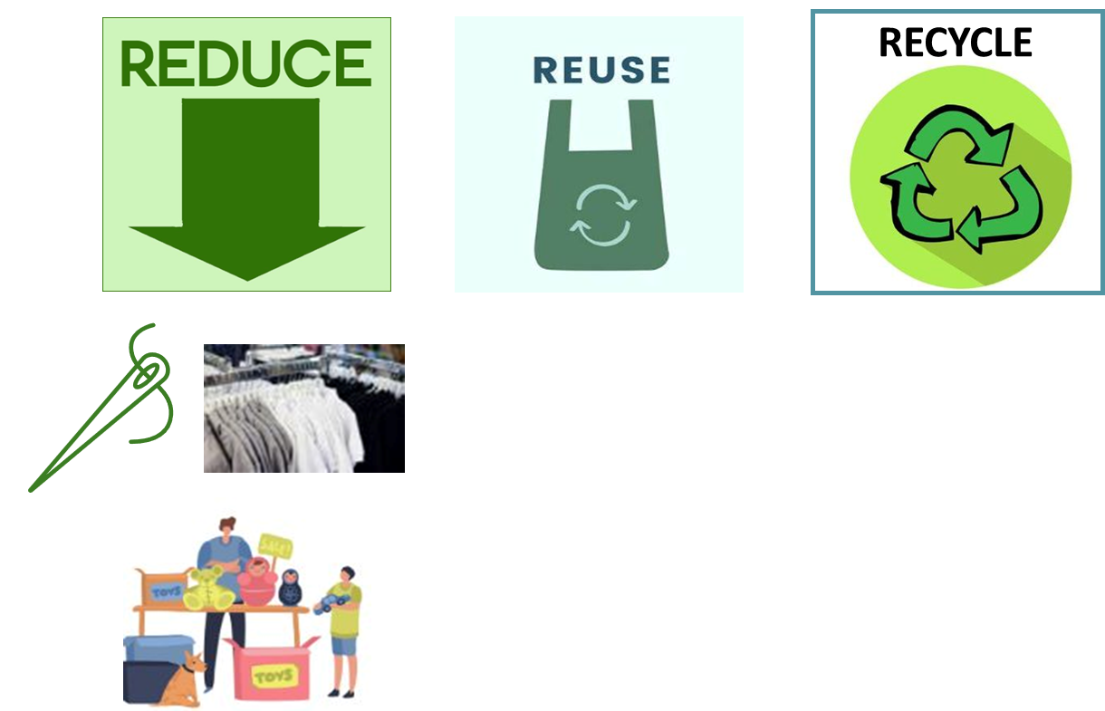
My top tip!
Reduce how many clothes you buy.
Reuse clothes by swapping with friends or buying second hand.
Recycle your clothes in the clothing bank when they can’t be used again.

Slide 16


Great start!
Your teacher will now use my clothing lessons to teach you all the details about clothing to become an expert!

