Slide 1

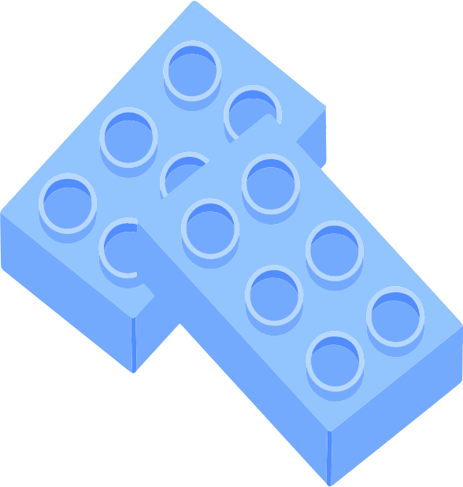


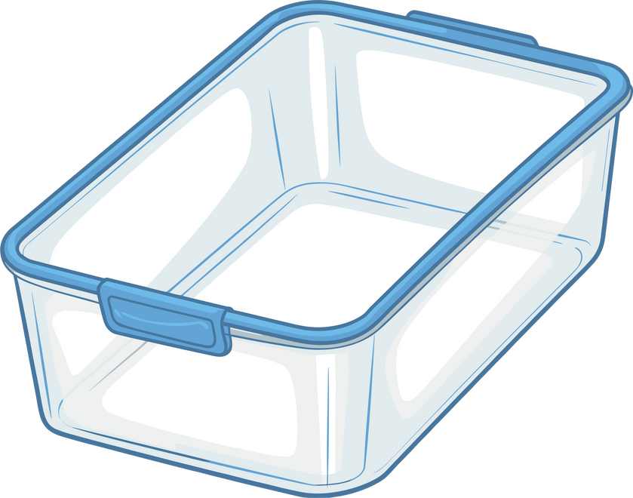


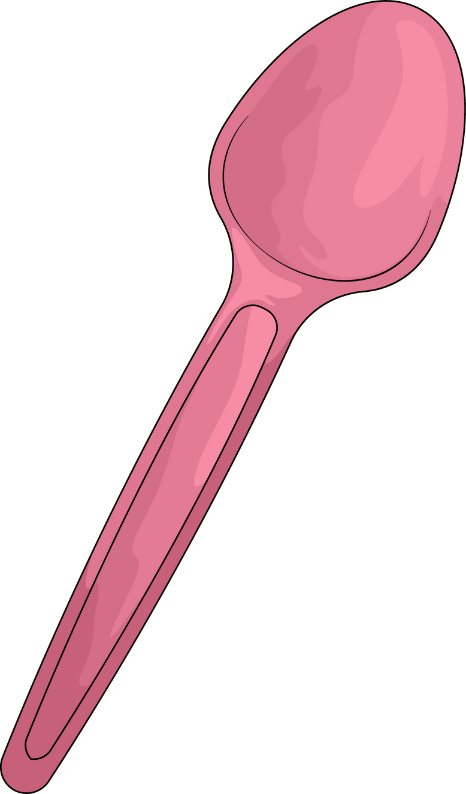
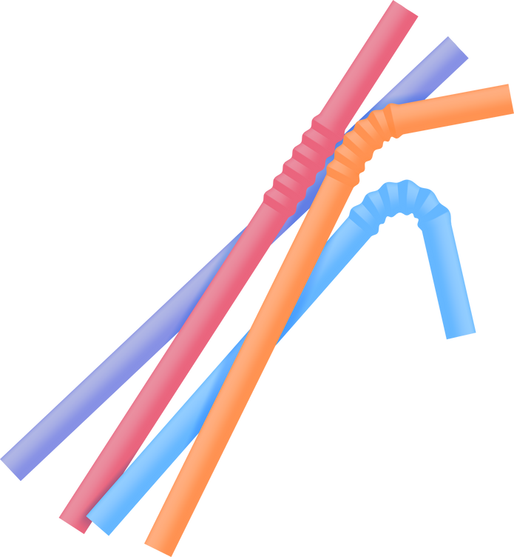


What do all these things have in common?
Notes:
These things are all made of plastic.

Slide 2



An introduction to plastic

Slide 3
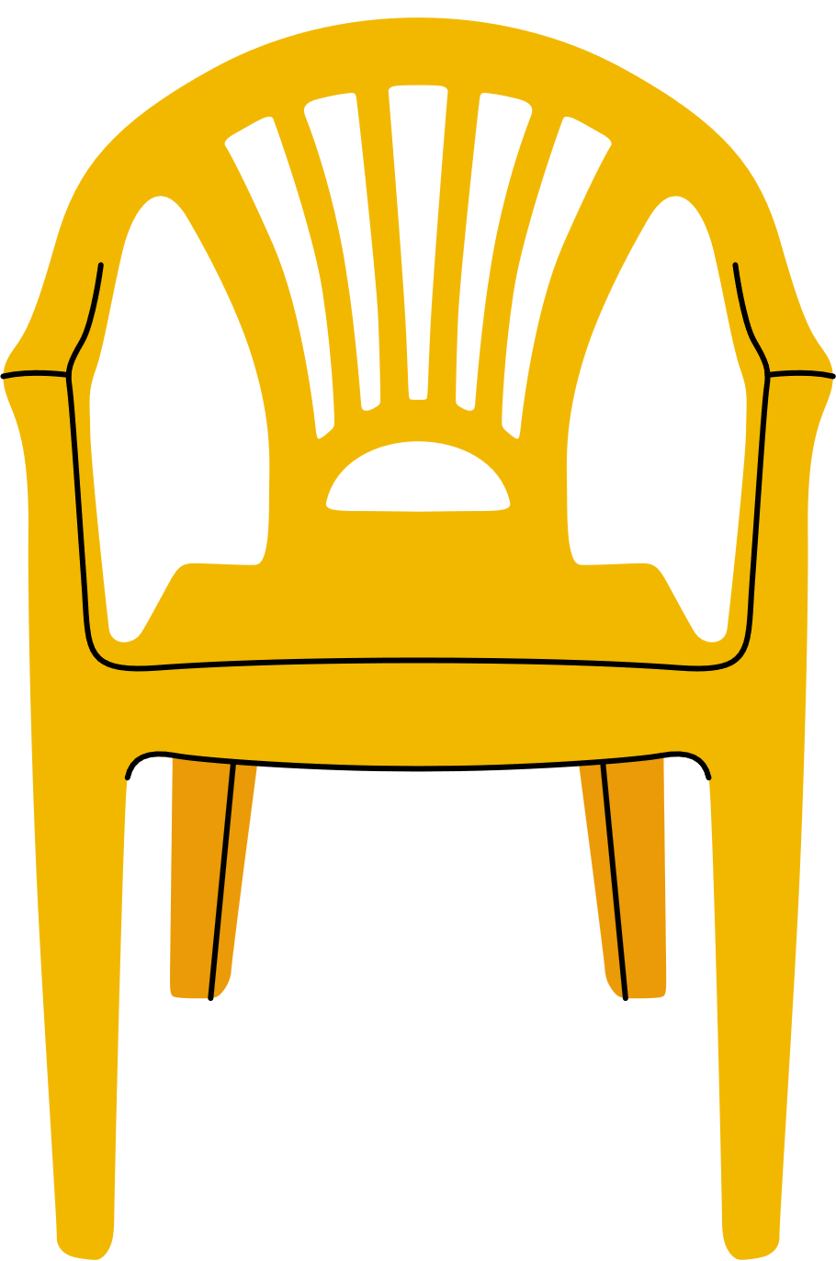

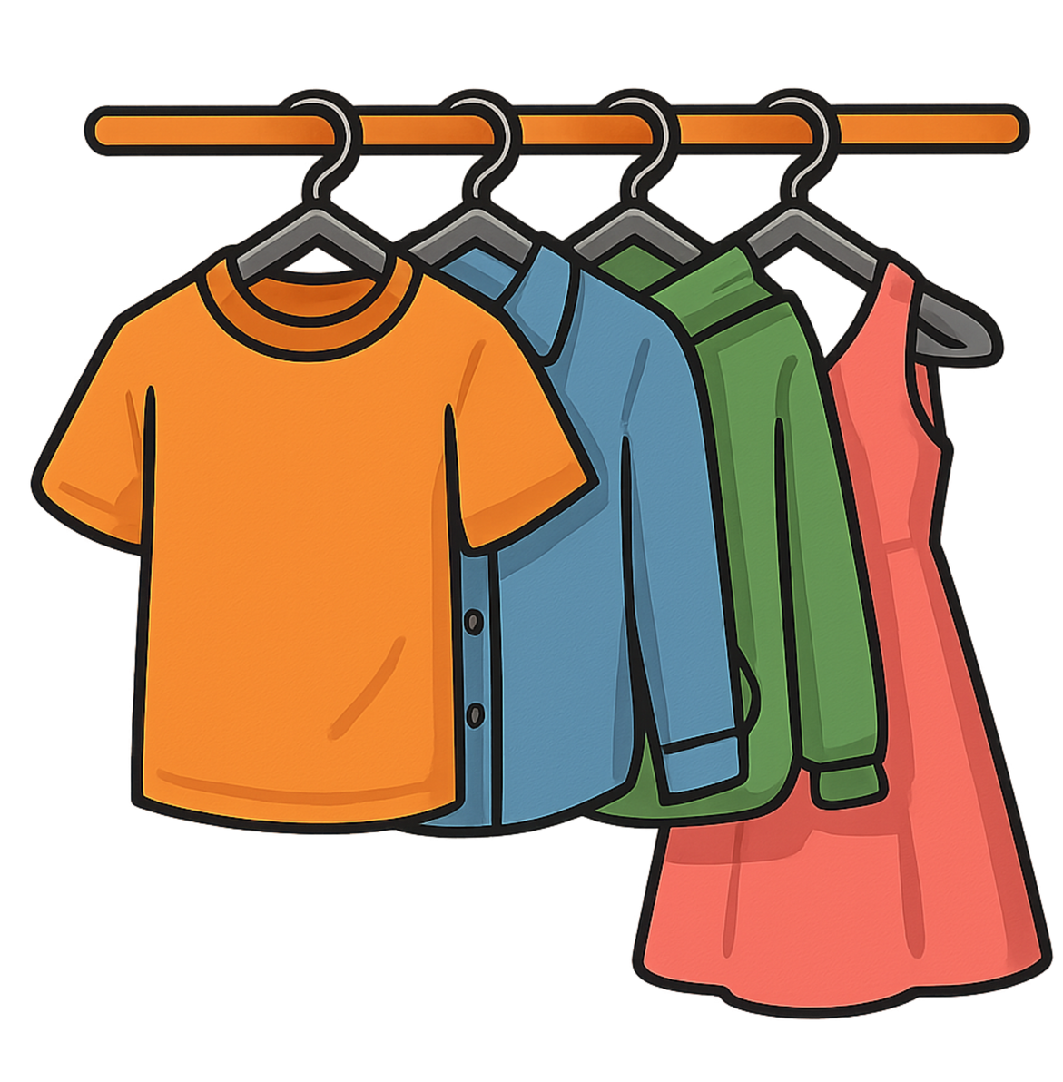
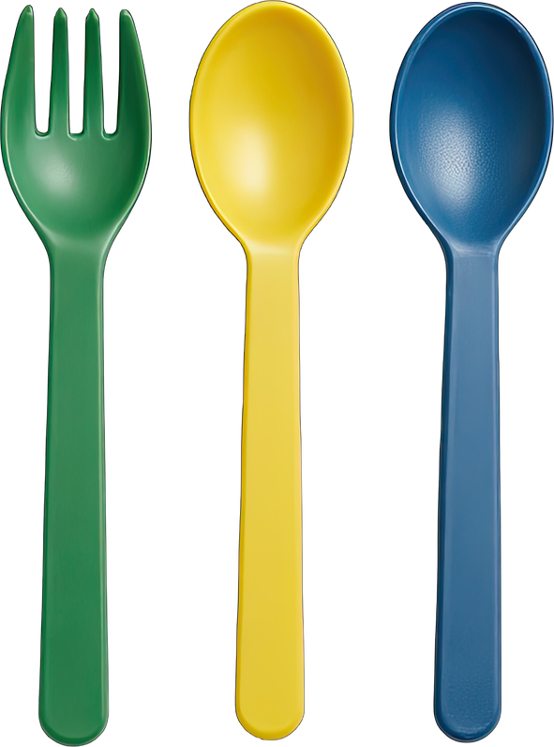
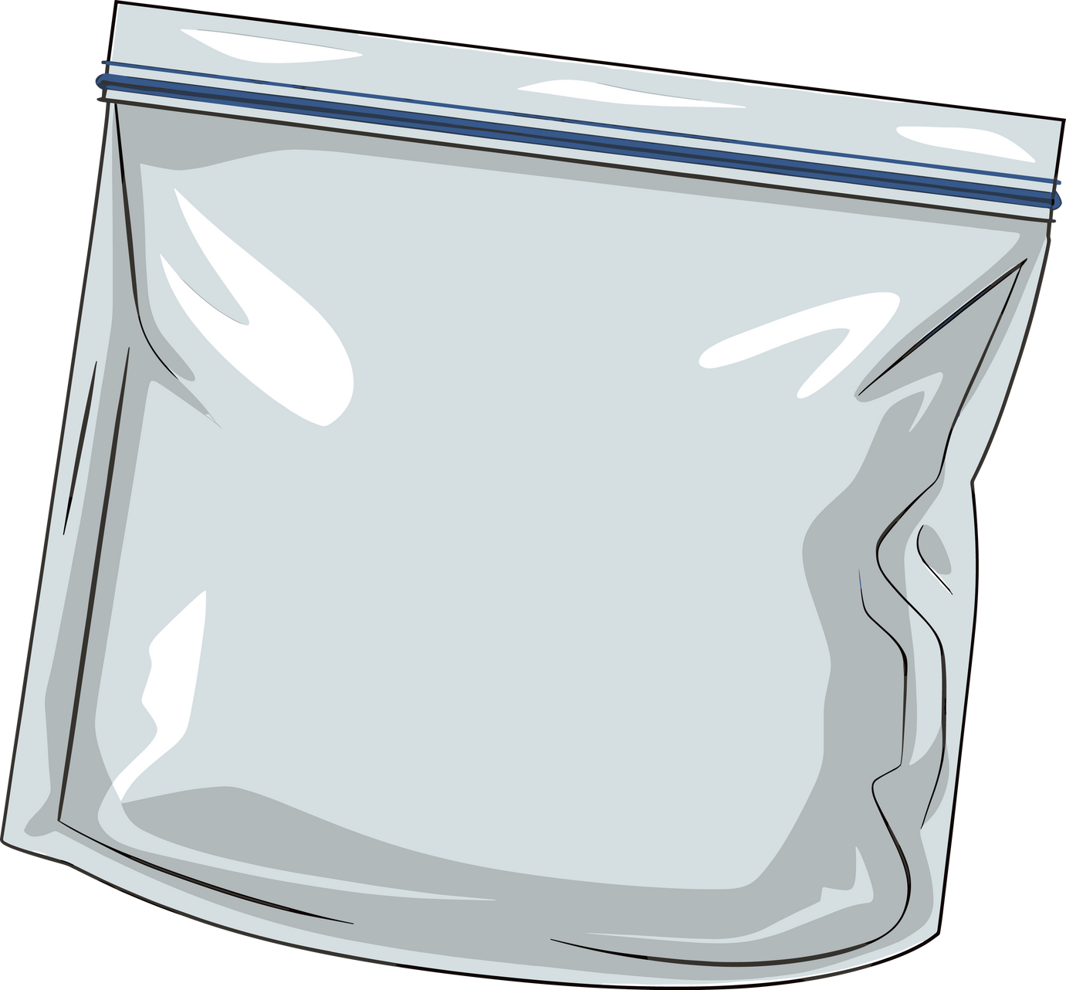
Plastic is everywhere
plastic furniture
plastic packaging
plastic toys
plastic materials
plastic
utensils

Slide 4

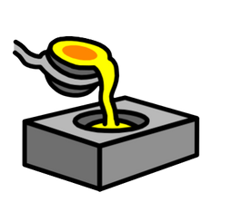

Plastic is everywhere because...
It is cheap
2. It can be made to any shape
3. It is light but also strong

Slide 5


Why is plastic everywhere?
Plastic is everywhere because ______, ______ and ______.
Notes:
Talk partner task.
"When I say go, you have 30 seconds to tell your partner why is plastic everywhere using the sentence starter 'plastic is everywhere because...' - Go!

Slide 6
What happens to plastic after we use it?

Slide 7
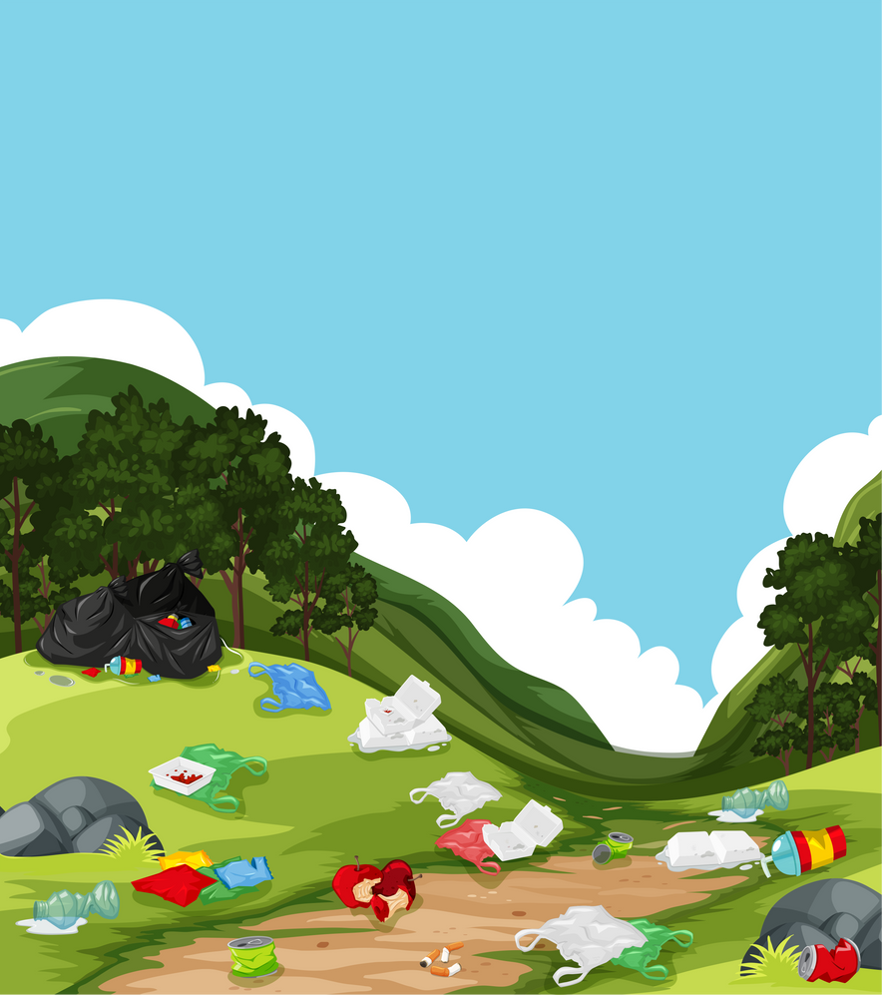
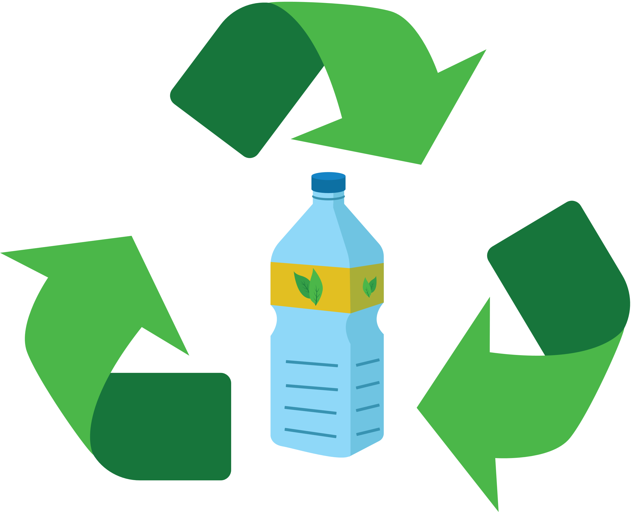
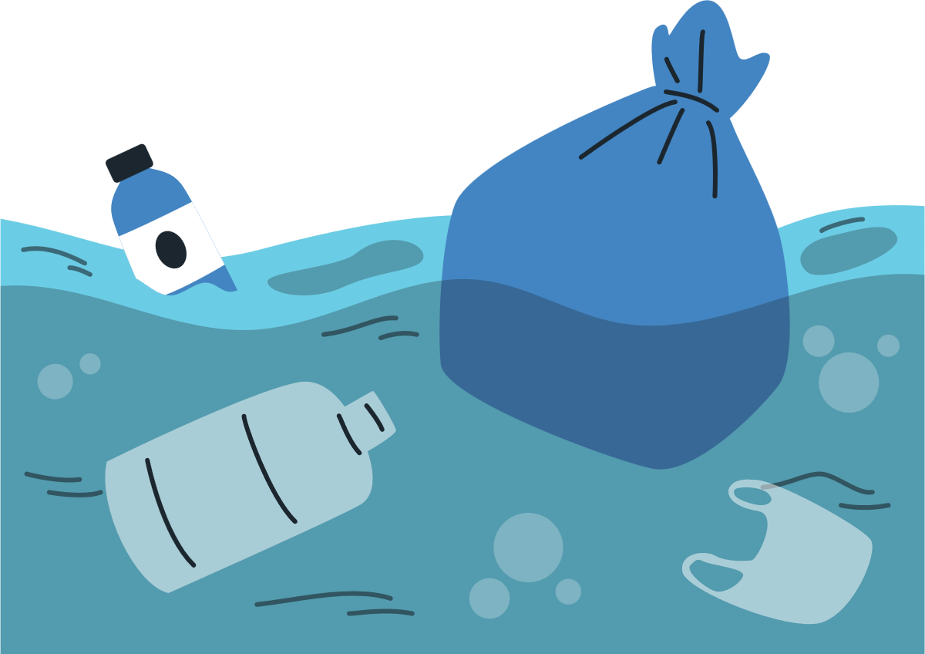


Some plastic can be recycled, but this uses lots of energy.
Some plastic ends up in the ground, where it takes hundreds of years to break down.
Some plastic ends up in the ocean, where it can harm animals.
Some plastic ends up in the rubbish, where it cannot be turned into something new.

Slide 8
It is up to you, children, to help! Let me teach you what we can do about it.

Slide 9

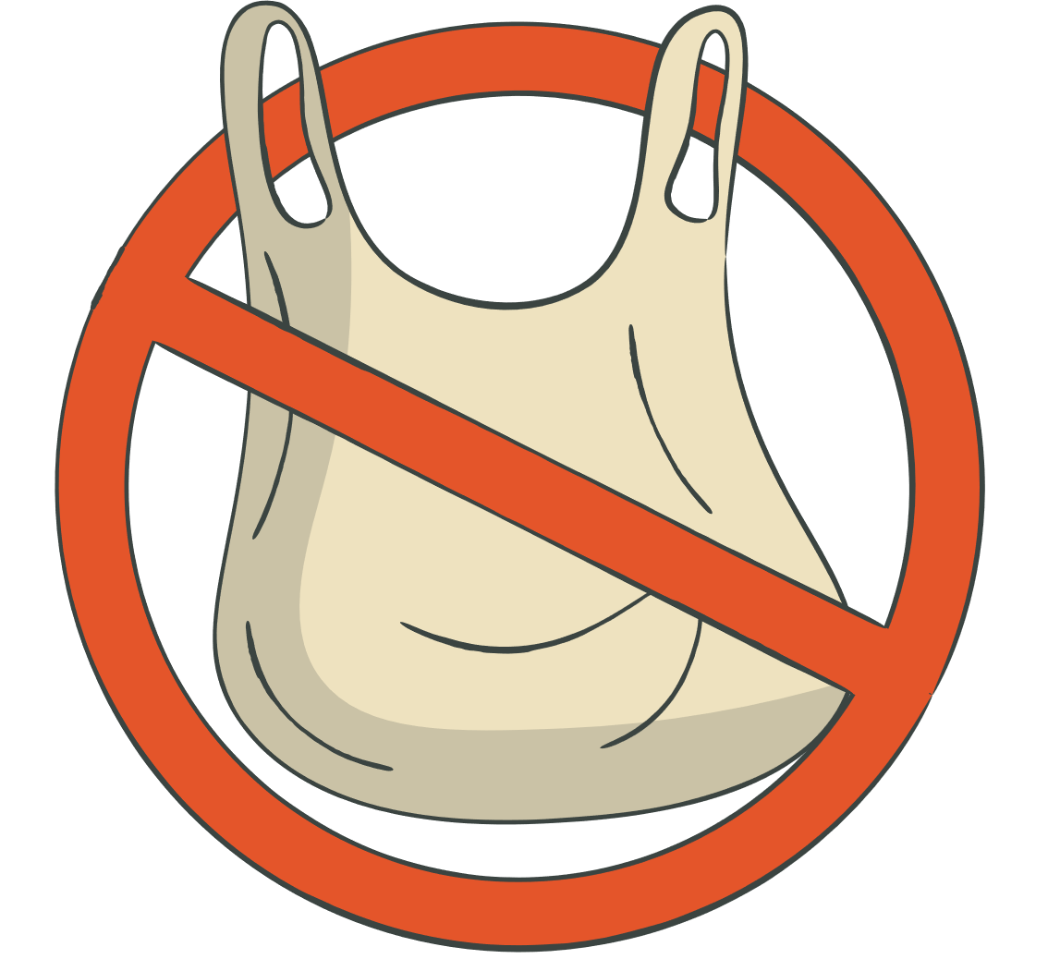

To reduce our plastic waste we can:
1) Always use a reusable bottle
2) Say no to plastic bags! Bring your own.
3) Clean and recycle your plastic

Slide 10
What can you do to reduce your plastic?
To reduce our plastic waste, we can _______, _______ and _______.

Slide 11
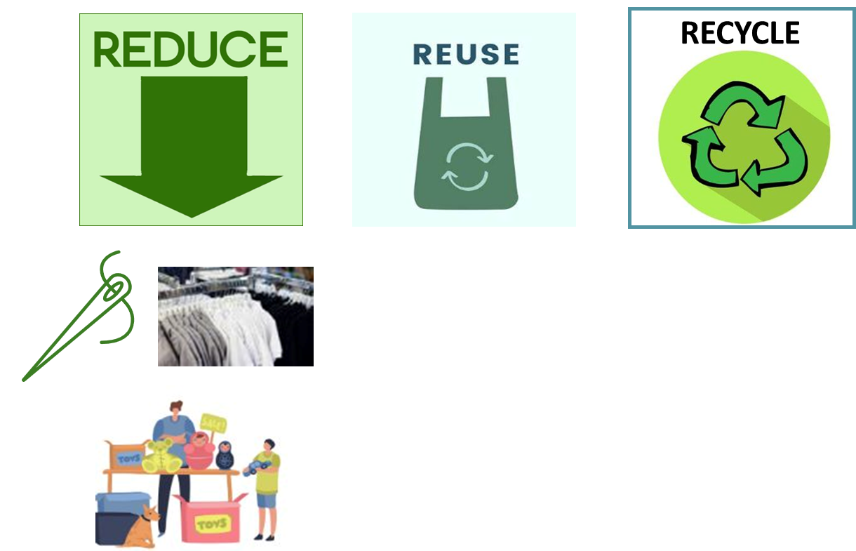
The best things we can do are to:
stop buying plastic
use it again and again
clean it and recycle it

Slide 12


Great start!
Your teacher will now use my plastic lessons to teach you all the details about plastic to become an expert!

