Slide 1
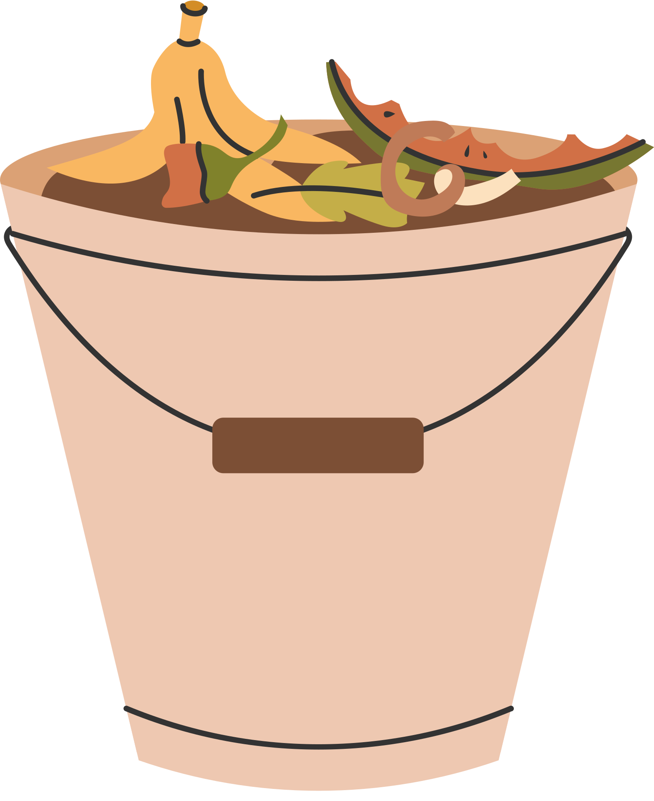
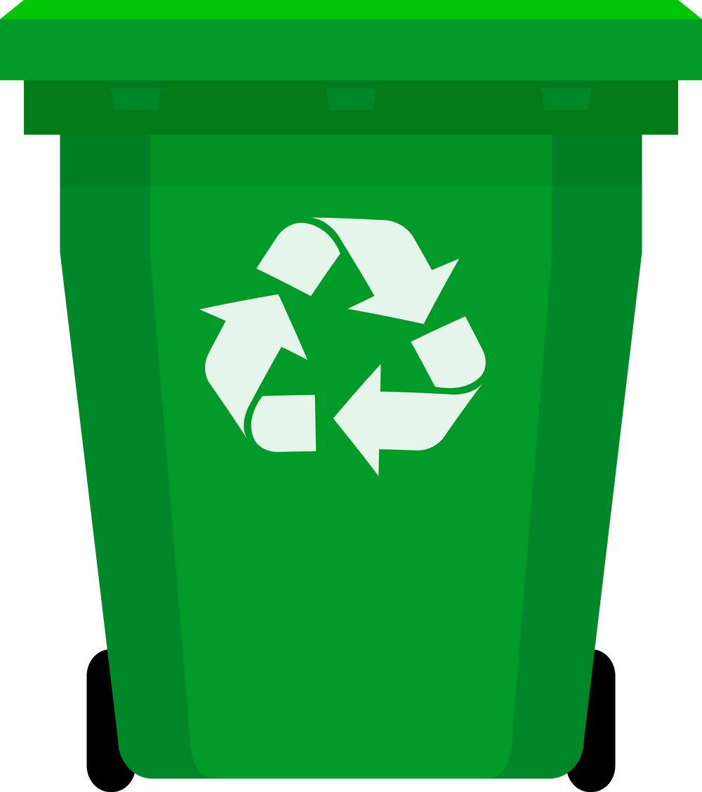


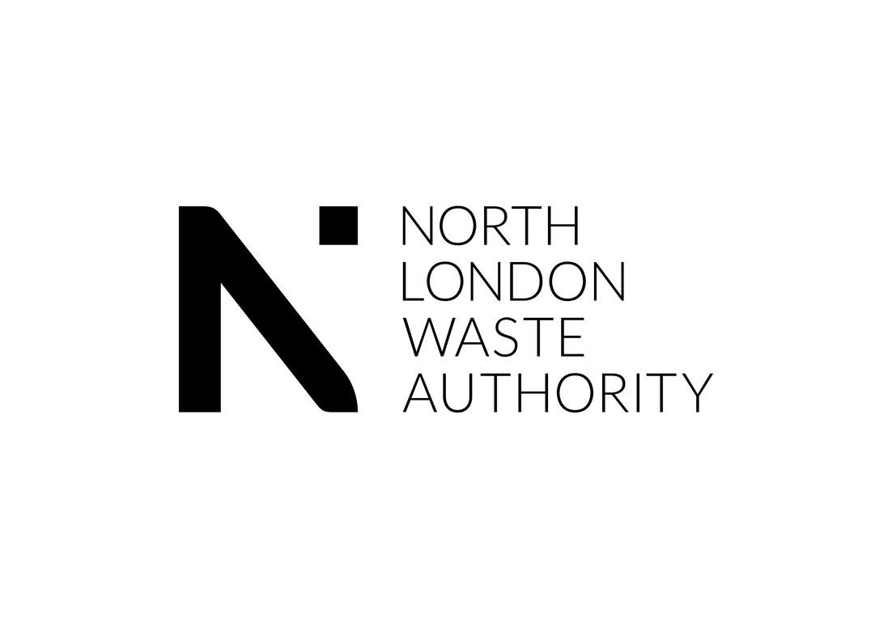

What goes in what bin?
Notes:
Display for children to think about whilst coming into assembly.

Slide 2



Know your bins

Slide 3
There are lots of types of bins in school
Food bins
Recycling bins
Rubbish
bins
Sometimes they look different!
Notes:
Teach children the types of bins.
You say the word, they repeat the word.
You could have the different bins found at your school as a concrete example.

Slide 4

Let’s find out why each bin is important!

Slide 5
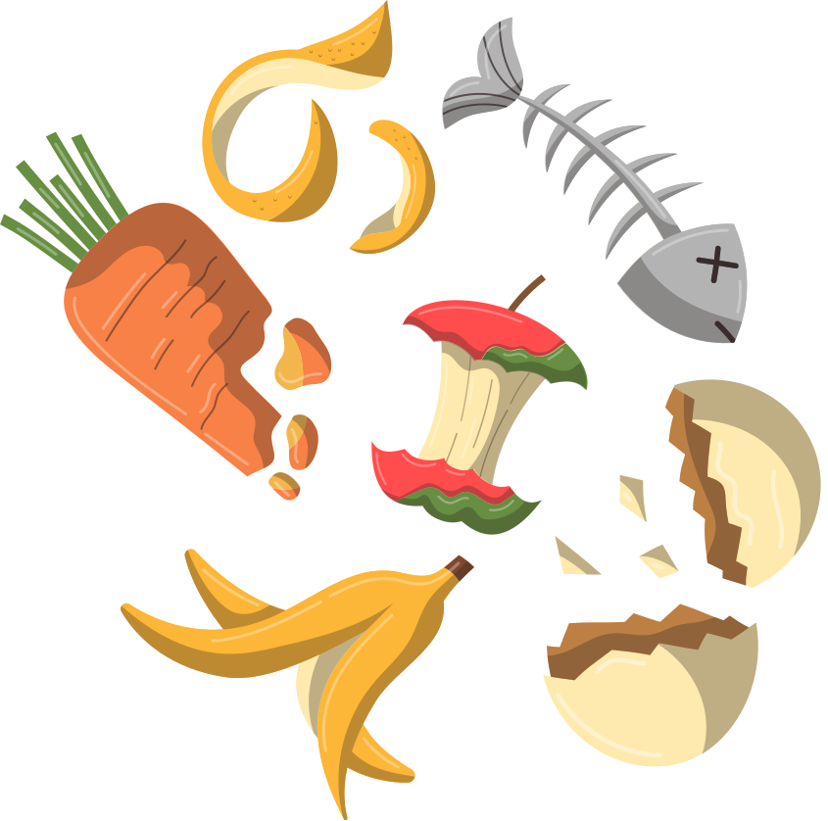
What goes in a food bin?
fruit
vegetables
leftovers
tea bags
eggshells
meat
bones
Notes:
Explicitly teach children what goes in the food waste bin - and nothing else!
You could have an actual bin with examples to bring this to life.

Slide 6
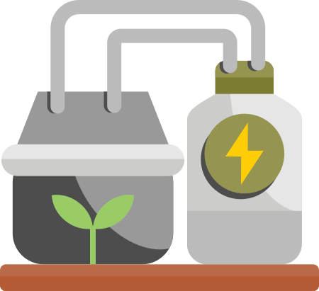

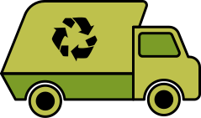
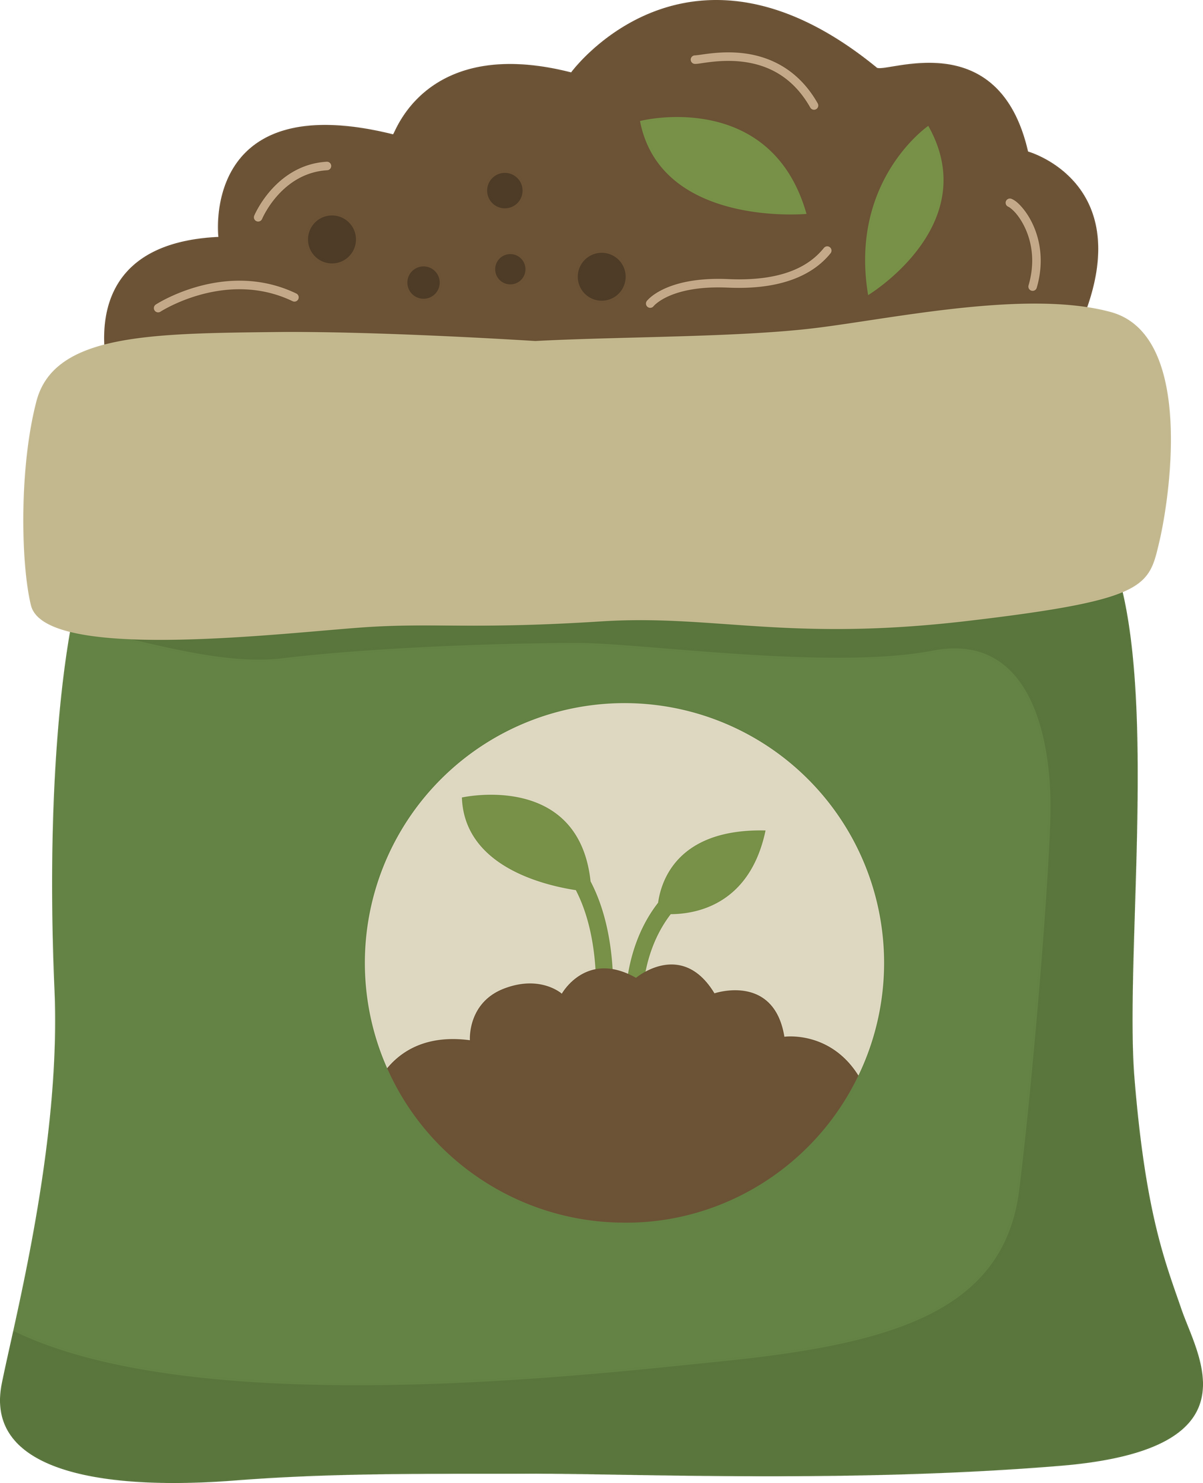
What happens to the food waste bin
Notes:
Food waste is put in the food waste bin by students.
The food waste bin is collected by a lorry.
It is taken to a big tank called an anaerobic digester –which is like a giant stomach.
Inside the tank, tiny microorganisms eat the food waste and make a gas called biogas when they break it down.
This biogas is captured and used to make electricity.
The leftover food mush becomes fertiliser to help plants grow.

Slide 7

What happens to food waste?
biogas
anaerobic digester
fertiliser
First _______.
Then _______.
Notes:
When I say go, you have 30 seconds to tell your partner what happens to our food waste - Go!

Slide 8
Wow! It is amazing that our leftovers can make electricity and fertiliser.

Slide 9
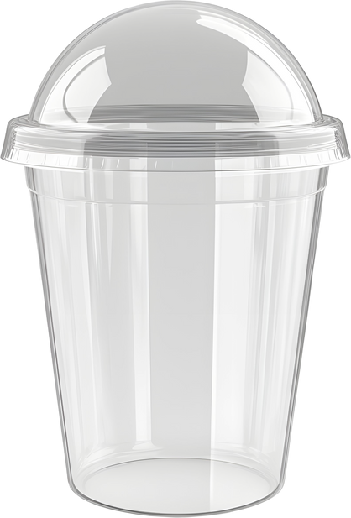
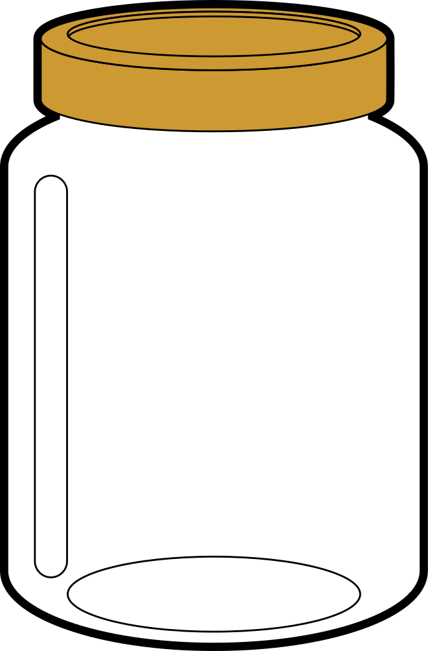

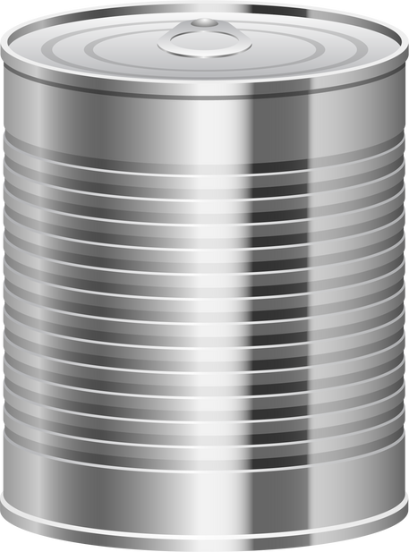

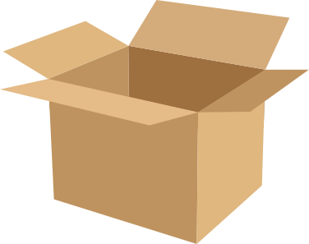
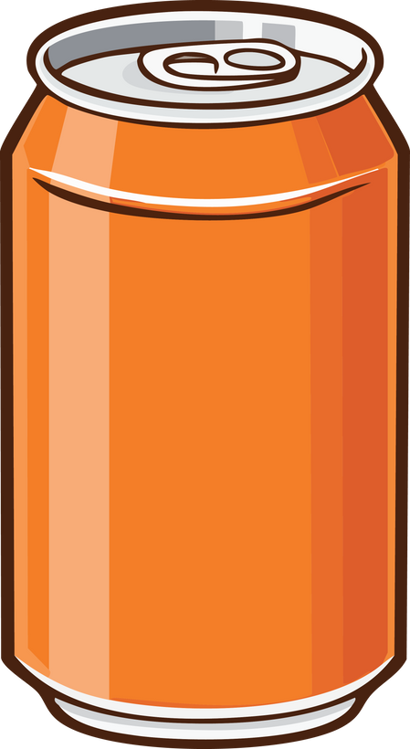

What goes in a recycling bin?
paper
cardboard
plastic bottles
plastic containers
metal tins
tin cans
glass bottles
glass jars
Notes:
Explicitly teach children what goes in the recycling bin - and nothing else!
You could have an actual bin with examples to bring this to life.

Slide 10
Top tip! If it is dirty or sticky, you must clean it before recycling 🙂

Slide 11
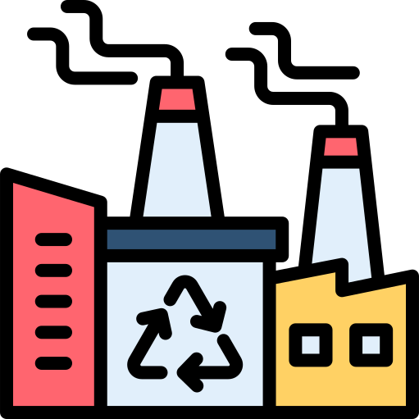
What happens to recycling?
metal
plastic
glass
paper and cardboard
Notes:
Children put paper in the recycle bin.
The recycle bin is collected by a truck.
The recycling is sent to a recycling factory called a materials recovery facility.
Machines help to sort the items into metal, plastic, paper/cardboard and metal.

Slide 12
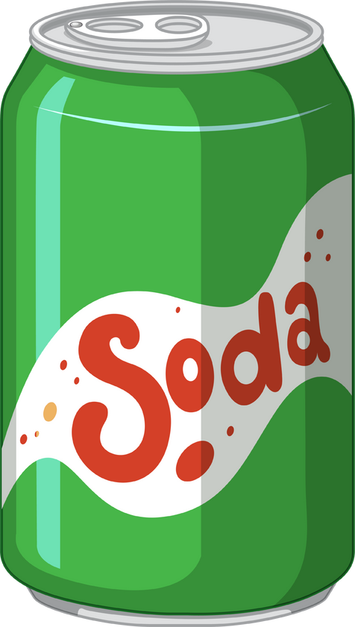
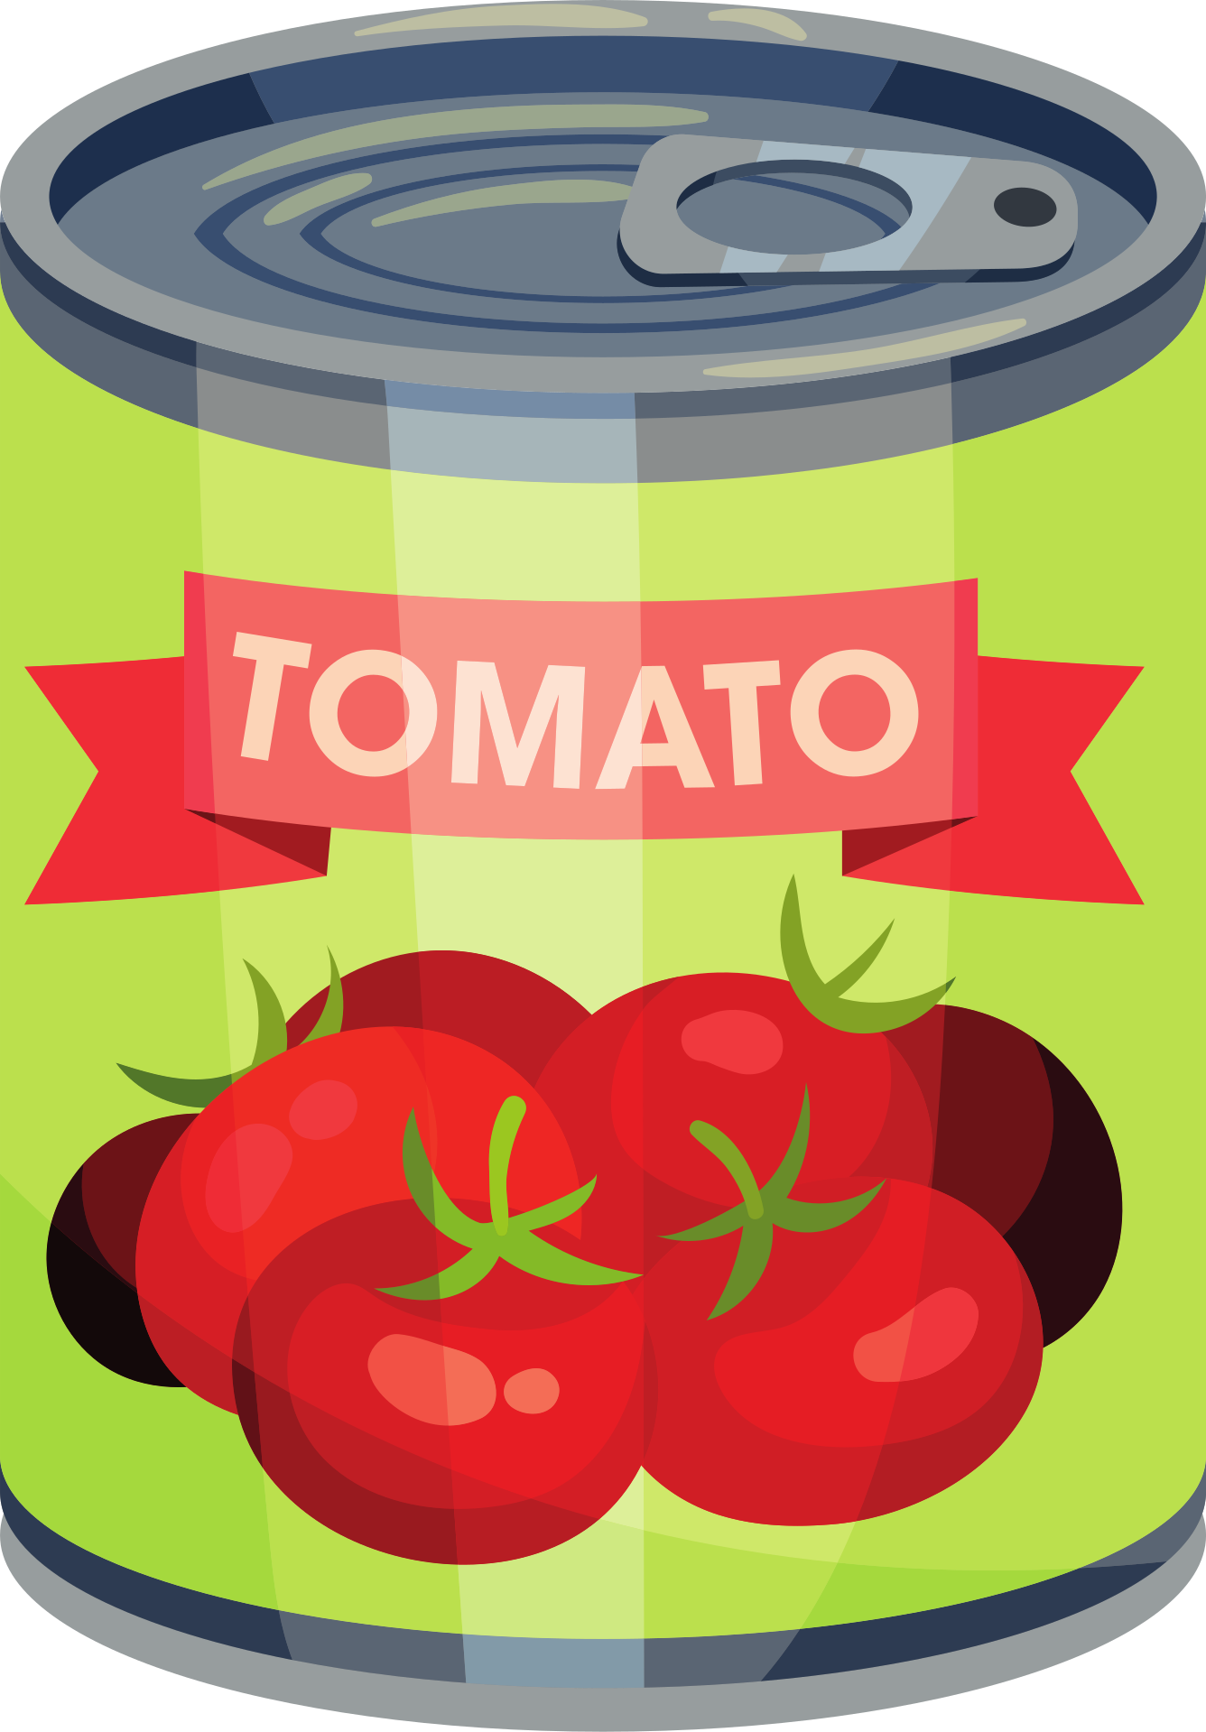
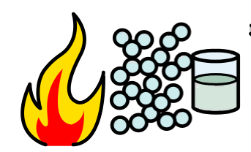


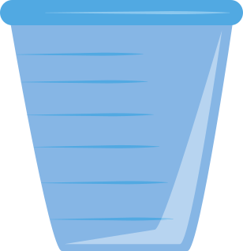
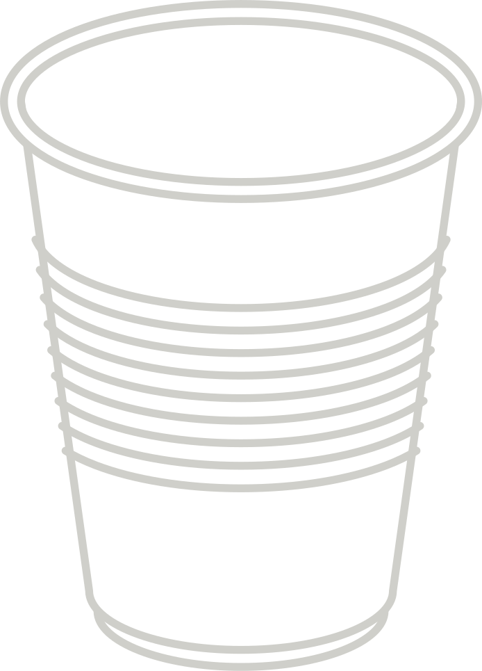
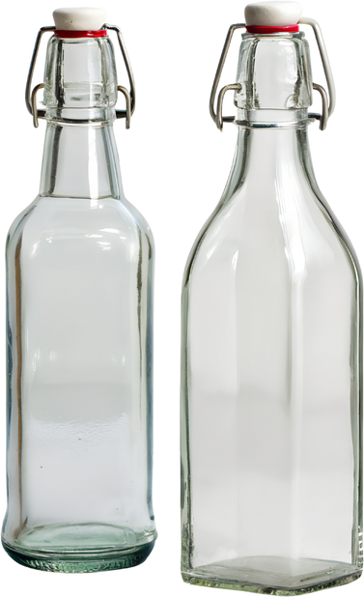
Metal, plastic and glass recycling
Notes:
Metal, plastics and glass are all heated separately, then melted, remoulded and turned into new items.

Slide 13
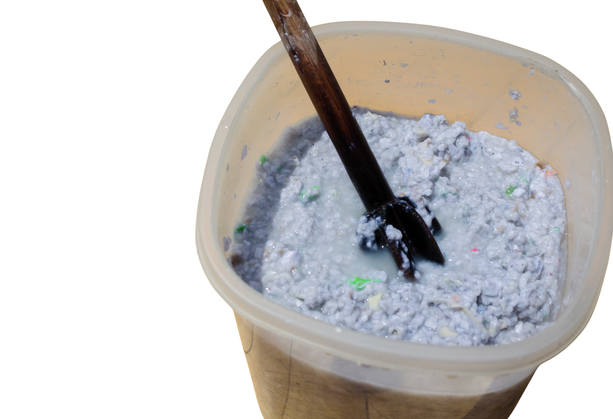
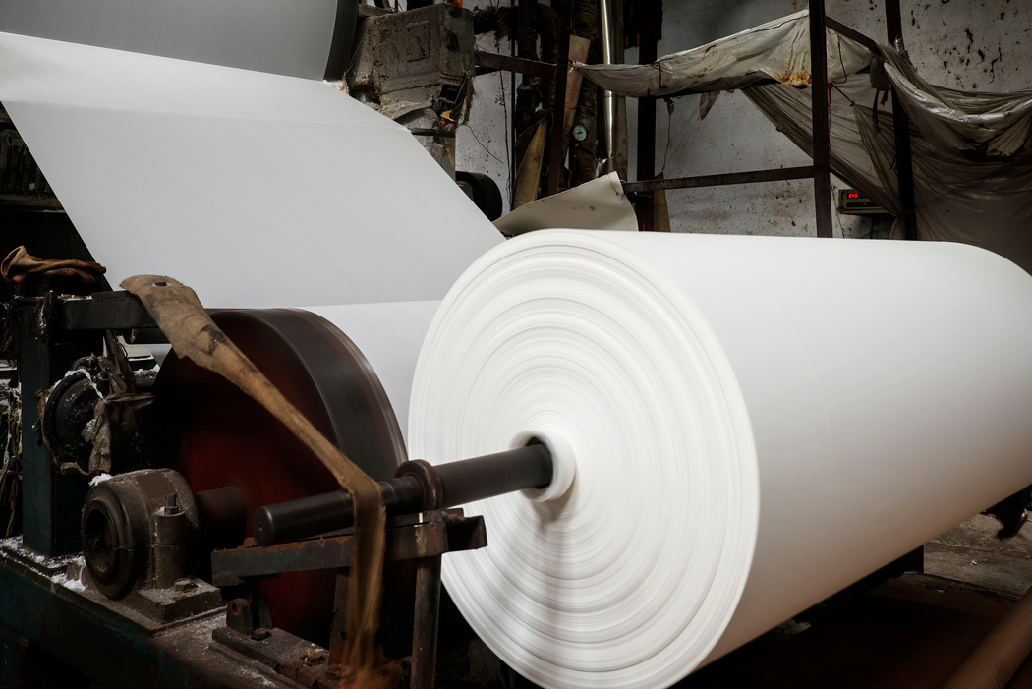
Paper recycling
Notes:
Paper is mixed with water to make a pulp.
It is then rolled out flat and dried.
It is then cut into new paper or cardboard.

Slide 14
What happens to plastic recycling?
First our plastic is ______, then ________.
Notes:
When I say go, you have 30 seconds to tell your partner what happens to our recycling - Go!

Slide 15


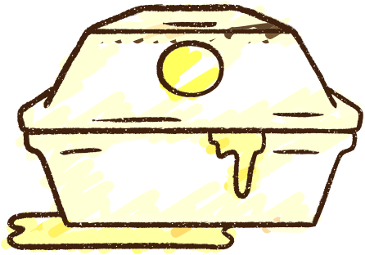


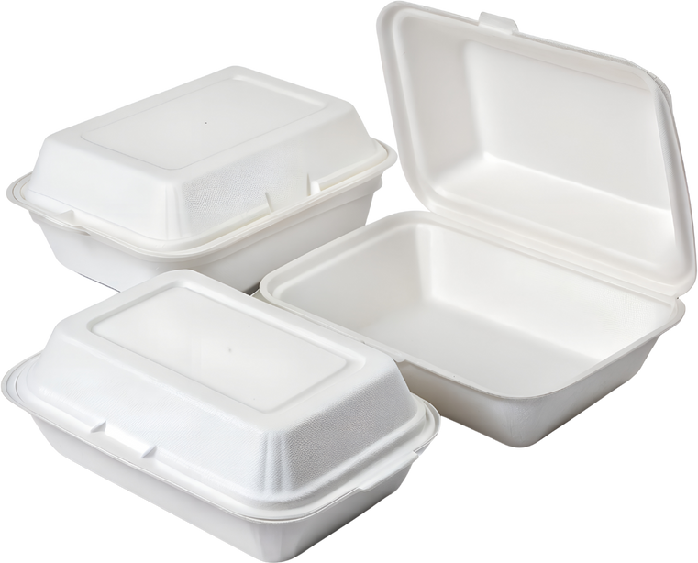
What goes in a rubbish bin?
tissues
clingfilm
crisp packets
nappies
dirty things
greasy things
polystyrene
Notes:
Explicitly teach children what goes in the rubbish bin - and nothing else!
You could have an actual bin with examples to bring this to life.

Slide 16
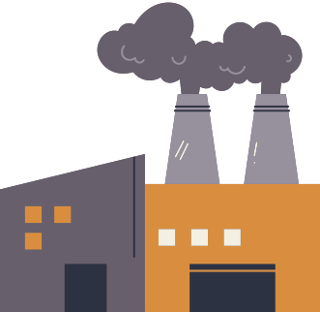



What happens to rubbish?
Notes:
Children put their tissues in the bin.
The rubbish bin is collected by a lorry.
It is sent to London Energy.
The rubbish is burnt.
Burning the rubbish makes electricity that we use for our homes.

Slide 17
What happens to rubbish?
First rubbish is _____, then ______.
Notes:
When I say go, you have 30 seconds to tell your partner what happens to our rubbish - Go!

Slide 18

CONTAMINATION!
This is my very important tip! Listen closely...

Slide 19

CONTAMINATION!
Contamination is when we put the wrong thing in the wrong bin. If this happens to the food and recycle bin it will be sent to rubbish and cannot be turned into something new.

Slide 20


Know your bins, test your friends and your families and check the internet if you do not know. Let’s all work together to help our waste.

