Slide 1





Where do man- made materials come from?
KS1 Lesson - Lesson 2 of 4

Slide 2
LO: To understand that clothes are made from different materials that come from nature or factories.
I can name a man-made material
I know the process of making polyester
I can say some positives and negatives of polyester

Slide 3






Lesson Prep
Vocabulary
Discussion
Keywords that children need to understand and use during the lesson.
An opportunity for children to practice the knowledge learnt.
Big question
Task
To assess learning and give children time to practise independently.
A central question that sparks curiosity and frames the lesson’s theme.
The knowledge
Extension
Essential facts and concepts children need to know.
Optional tasks to deepen or stretch learning beyond the core lesson.

Slide 4
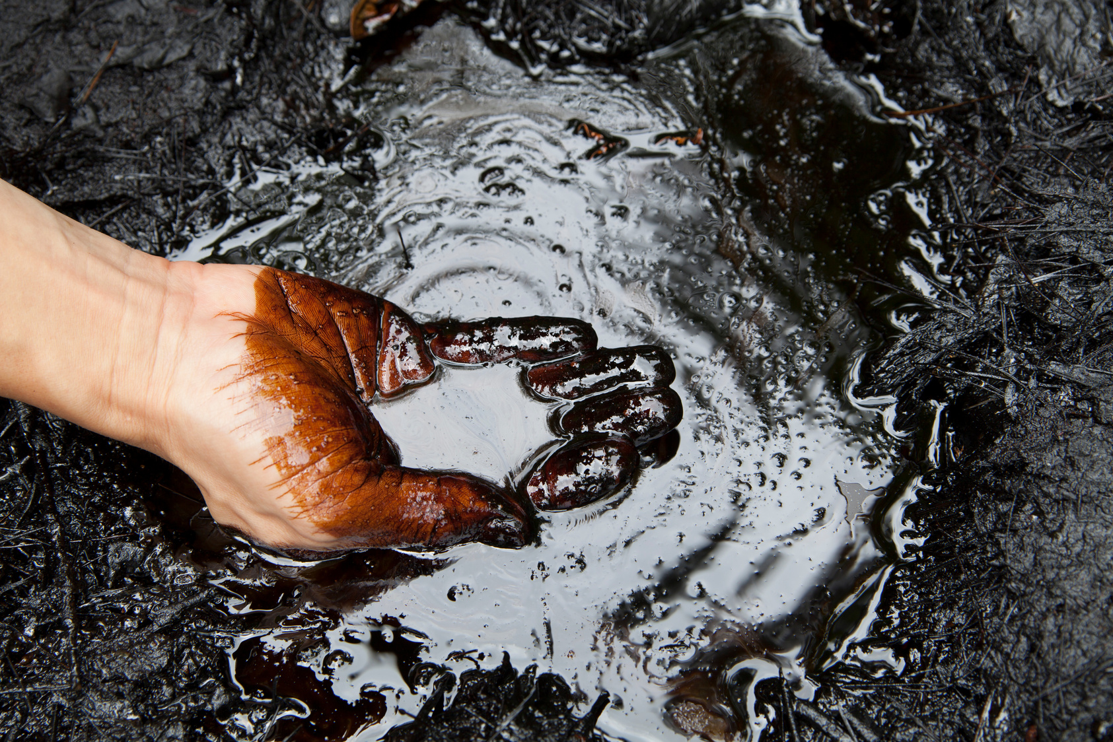

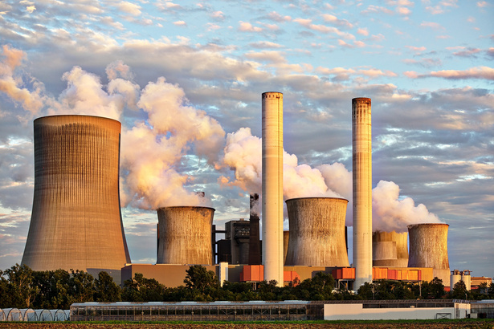
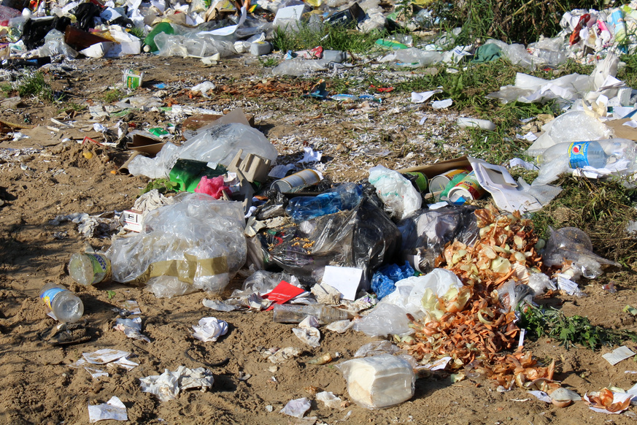

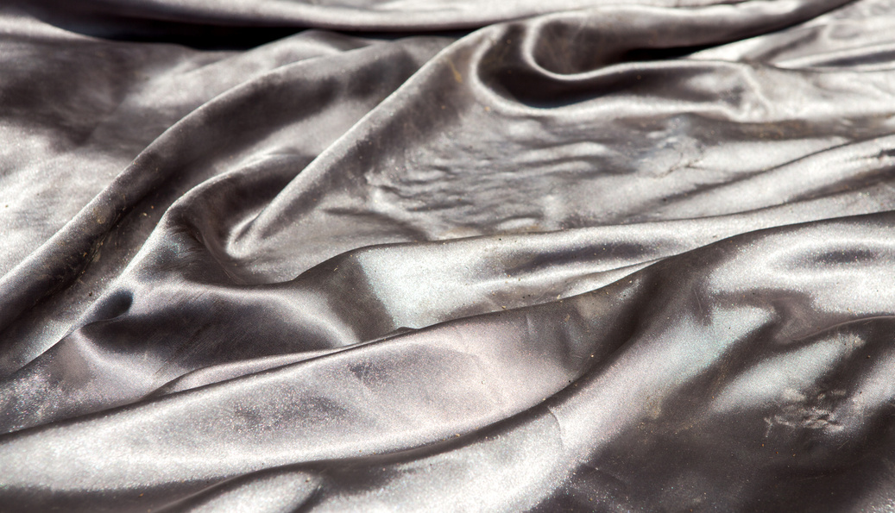
Key Words
crude oil
natural
man-made
non-biodegradable
polyester
nylon
Notes:
Crude oil: thick, black liquid found deep underground.
Natural: something that comes from nature, like plants or animals.
Man-made: something people have made, not from nature.
Non-biodegradable: something that doesn’t break down or rot, even after a long time.
Polyester: a man-made material used to make clothes.
Nylon: a strong, stretchy material made by people, often used in clothes and bags.

Slide 5
Vocabulary task
2. 3. 4. 5. 6.
natural
crude oil
polyester
man made
non-biodegradable
nylon
Challenge: Write a sentence using a new vocabulary word.
Notes:
1 = crude oil
2 = polyester
3 = nylon
4 = non-biodegradable
5 = man made
6 = natural

Slide 6








Hi Ned! I noticed that my bag was made of polyester. Where does that come from?
Great observation Nancy! Polyester is a man made material. It comes from plastic. Let’s investigate how it is made!

Slide 7
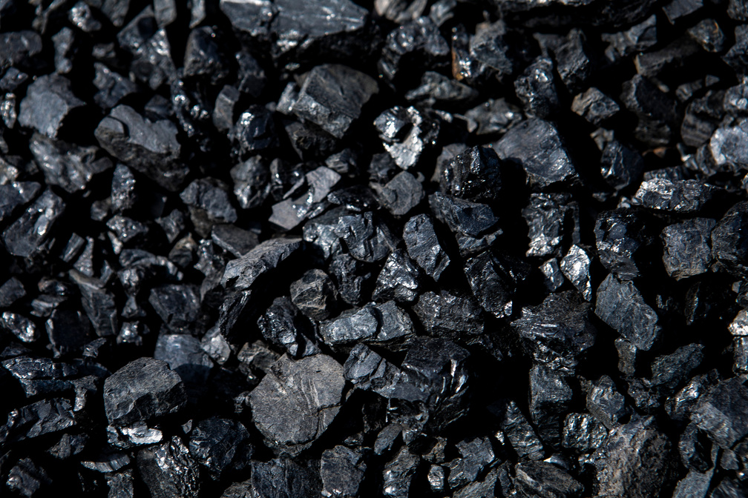
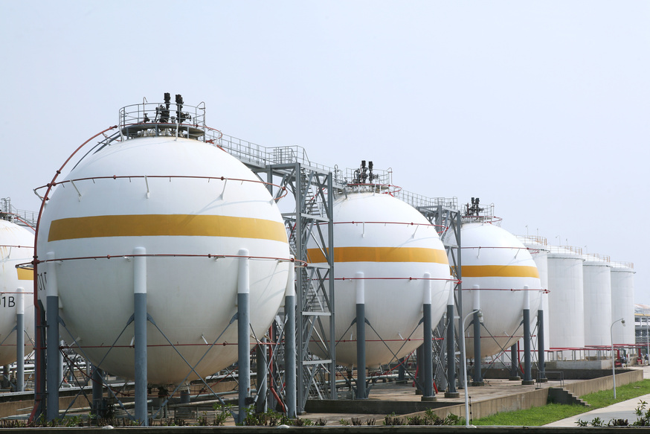

Fossil fuels
The three types of fossil fuels are:
crude oil
coal
natural gas
They are natural resources as they come from nature.

Slide 8
Fossil fuels
What are the three types of fossil fuel?

Slide 9
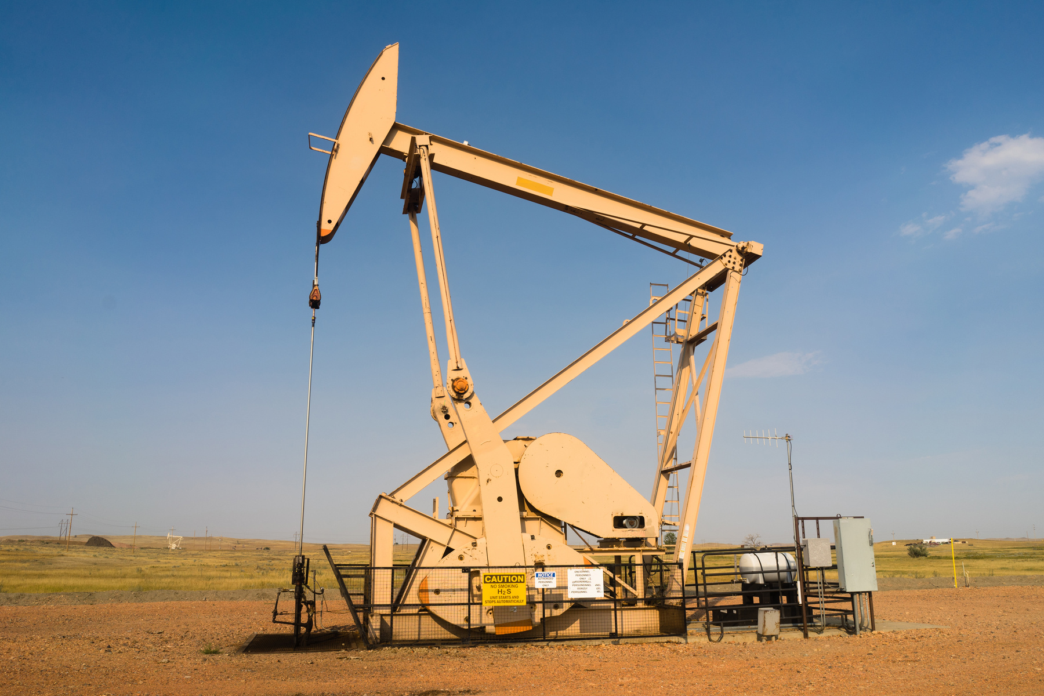
Making materials from oil
The oil is extracted from underground using a big machine.

Slide 10
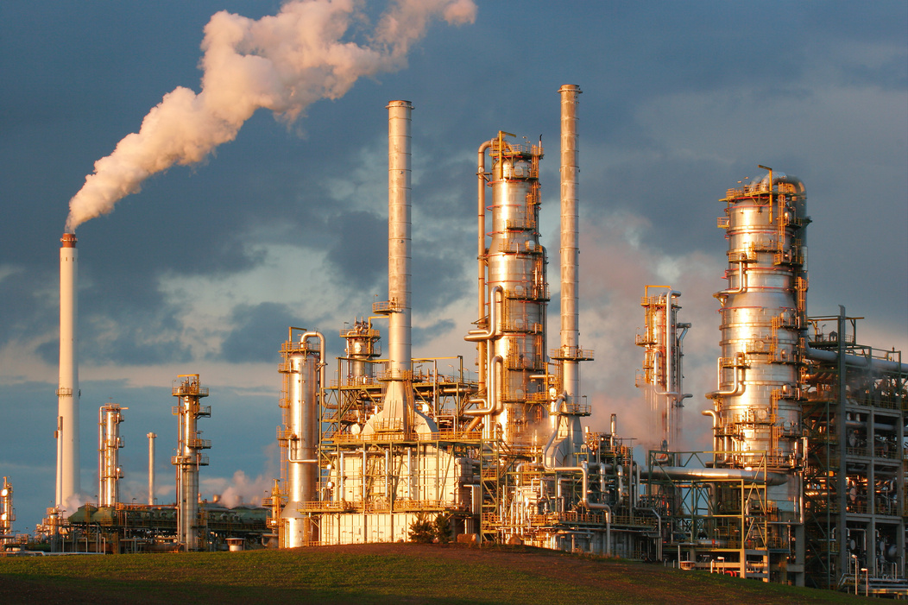



Making materials from oil
2. The oil is cleaned and separated into different chemicals.

Slide 11
Tell your partner the first 2 steps
The oil is ____ from underground using a big ______.
2. The oil is _____ and separated into different _______.
machine chemicals extracted cleaned

Slide 12

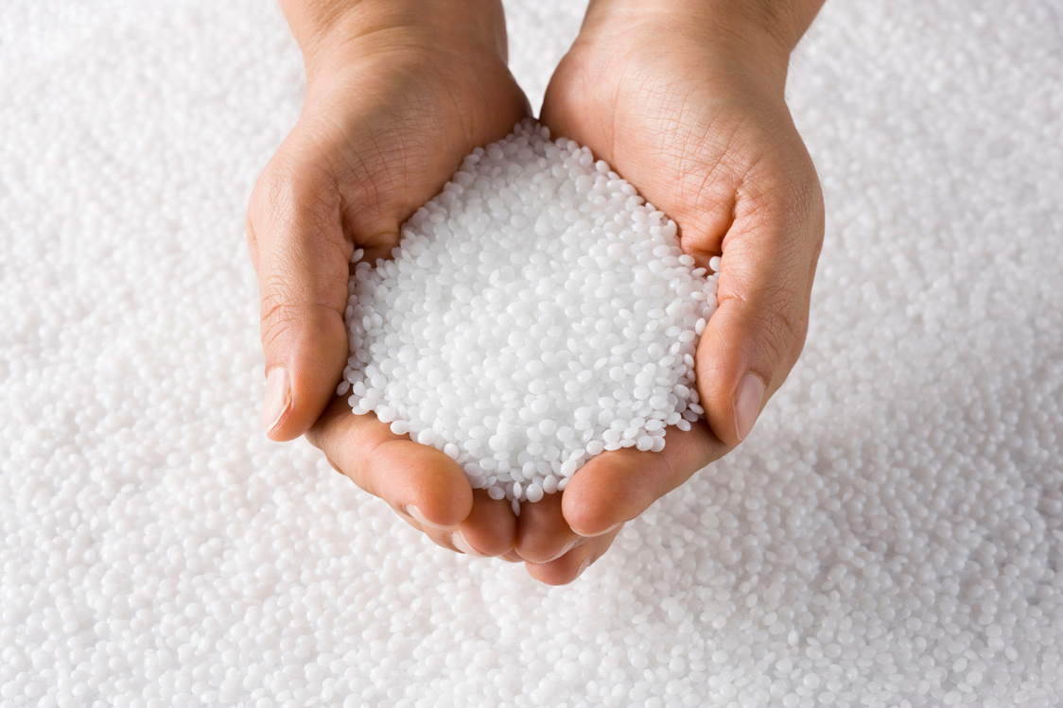

Making materials from oil
3. Chemicals are mixed together, cooled and cut into small pellets.

Slide 13
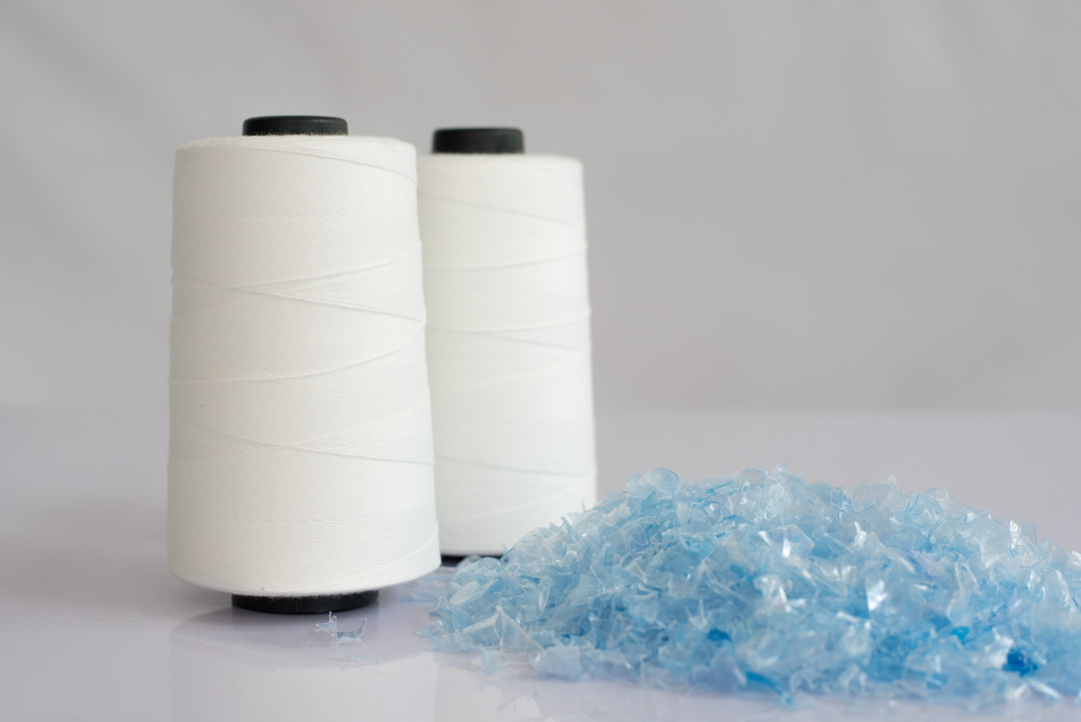

Making materials from oil
4. The pellets are melted, pushed through tiny holes and made into thread.

Slide 14
Tell your partner the second 2 steps
3. Chemicals are mixed together, ______ and cut into small _______.
4. The pellets are _____, pushed through tiny holes and made into ______.
thread cooled pellets melted

Slide 15
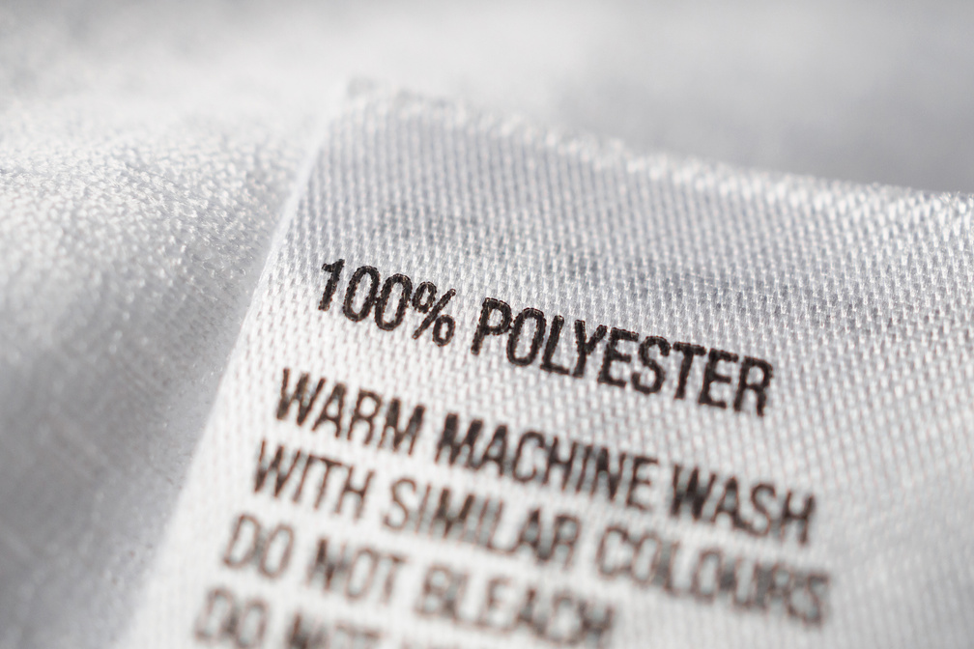

Man made materials
Using this process you can make polyester and nylon. Two man made materials.
Polyester
Nylon

Slide 16
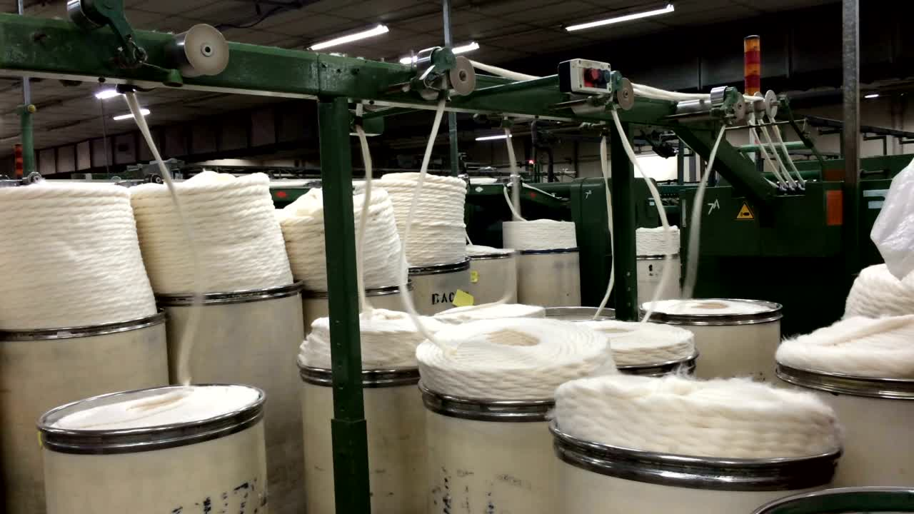
Look at some man made materials being made in action!

Slide 17
Whiteboard quiz
Name 2 man made materials
What fossil fuel do these materials come from?
Name 3 natural materials

Slide 18
Man made materials are made my man. They are not natural and cannot biodegrade.

Slide 19
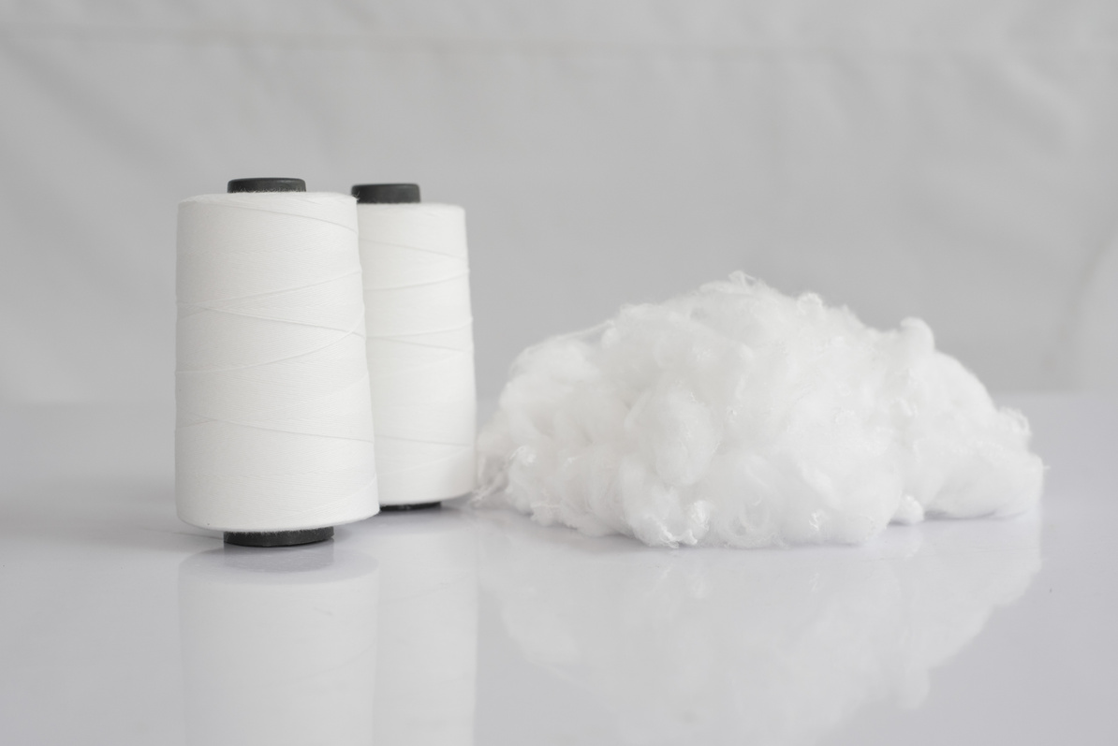


Man made materials
Polyester
Polyester is strong and useful for clothing
Polyester is a man made plastic.
It is non-biodegradable.
Microplastics can be shed into our water when we wash clothes which is bad for the environment.

Slide 20
Tell your partner one positive and negative of polyester
Polyester is __________.
Polyester is __________.
non-biodegradable microplastics strong

Slide 21
Man made materials
Nylon
Nylon is strong and water resistant.
Nylon is a man made plastic.
It is non-biodegradable.
Microplastics can be shed into our water when we wash clothes which is bad for the environment.

Slide 22
Tell your partner one positive and negative of nylon
Nylon is __________.
Nylon is __________.
non-biodegradable microplastics water resistant strong

Slide 23


Three tips about man made materials
Check the materials of clothes before you buy. Are they natural or man made?
2. Man made materials don’t biodegrade. If they break, fix them.
3. Man made materials do not biodegrade. When they are too small, recycle them or take them to the charity shop.

Slide 24
What things can we do?
Three things we can do are _______, __________ and __________.

Slide 25
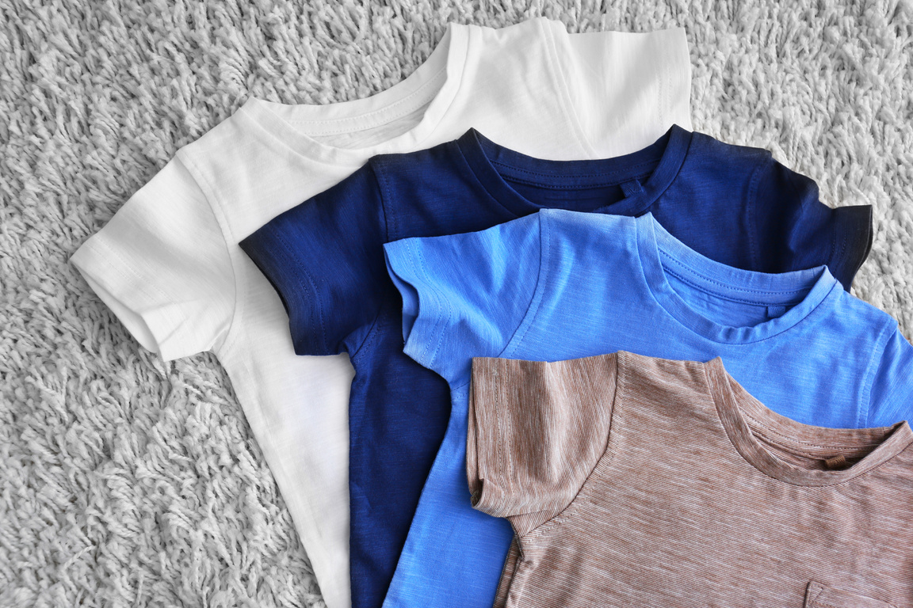
Natural vs Man-made
Why do people make fabrics instead of only using natural ones like cotton or wool?
What happens to man-made fabrics when we throw them away?
Notes:
Discussion 1
- Read question to children twice
- Give children a moment to think about the question
- In partners, get children to share their thoughts using sentence stem 'People make fabrics because...'
-Give children 2 minutes in partners to discuss their opinions
- Listen in to discussion. Spotlight two children
Repeat with question 2

Slide 26

Extension activity 1
Debate activity: Man-Made vs Natural – Which Is Better for the Planet?
Split class into two teams.
Each defends one material type based on environmental impact.
End with a vote and reflection.

Slide 27
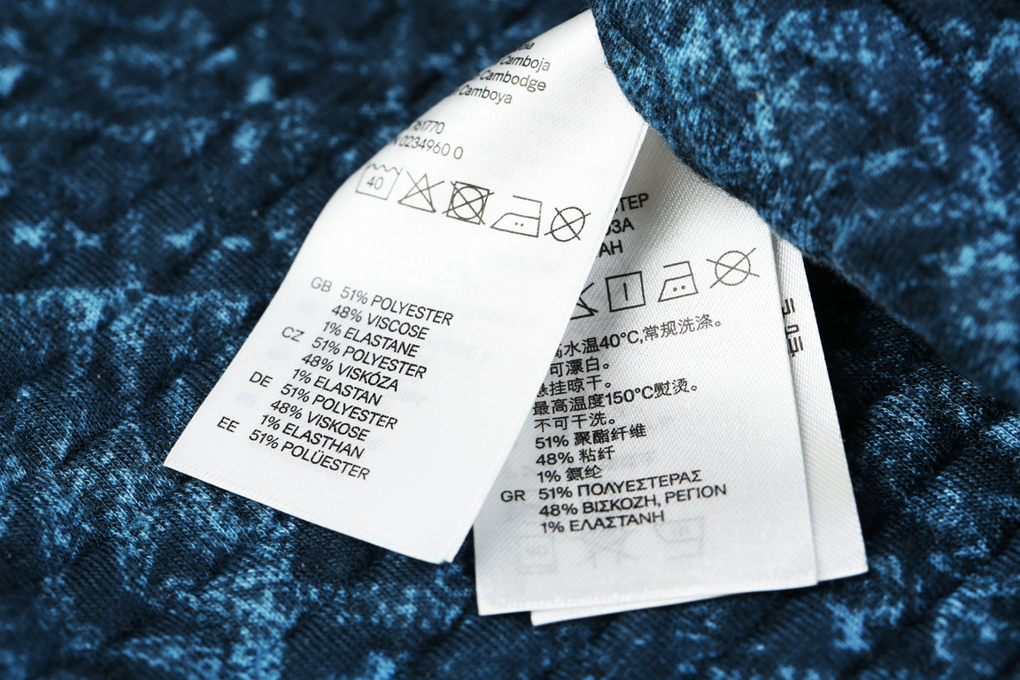
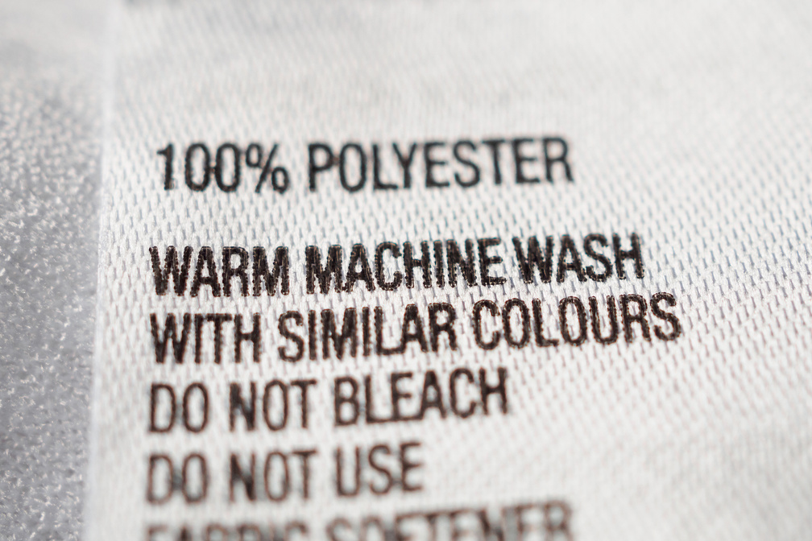
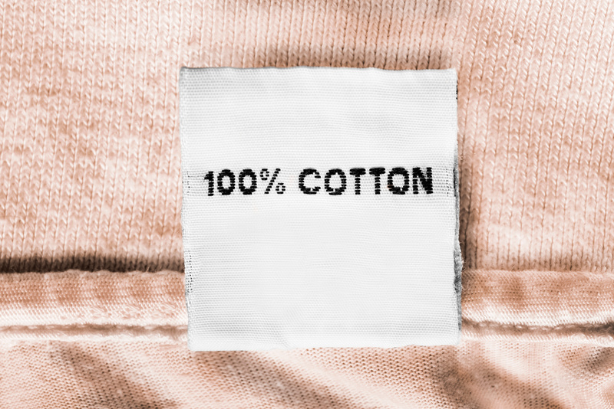
Extension activity 2
Science activity: Material detective
Put children into groups.
Get them to investigate and record the materials of their clothes by checking the labels.
Research all the un-taught materials found in the student’s clothes e.g. leather for shoes.

Slide 28

Extension activity 3
Art/writing activity: Design an outfit for a superhero. Label the materials of their clothes and explain why you have chosen these materials.

