Slide 1





What journey do clothes go on?
KS2 Lesson - Lesson 2 of 4

Slide 2
LO: To understand how cotton and polyester are made and how they travel from source to shop.
I can explain where cotton and polyester come from.
I can describe the steps in making clothes from these materials.
I can use words like natural, synthetic, factory, transportation, and dye correctly.
I can compare the journey of cotton and polyester.
I can talk about how these materials affect the environment.

Slide 3






Lesson Prep
Vocabulary
Discussion
Keywords that children need to understand and use during the lesson.
An opportunity for children to practice the knowledge learnt.
Big question
Task
To assess learning and give children time to practise independently.
A central question that sparks curiosity and frames the lesson’s theme.
The knowledge
Extension
Essential facts and concepts children need to know.
Optional tasks to deepen or stretch learning beyond the core lesson.

Slide 4


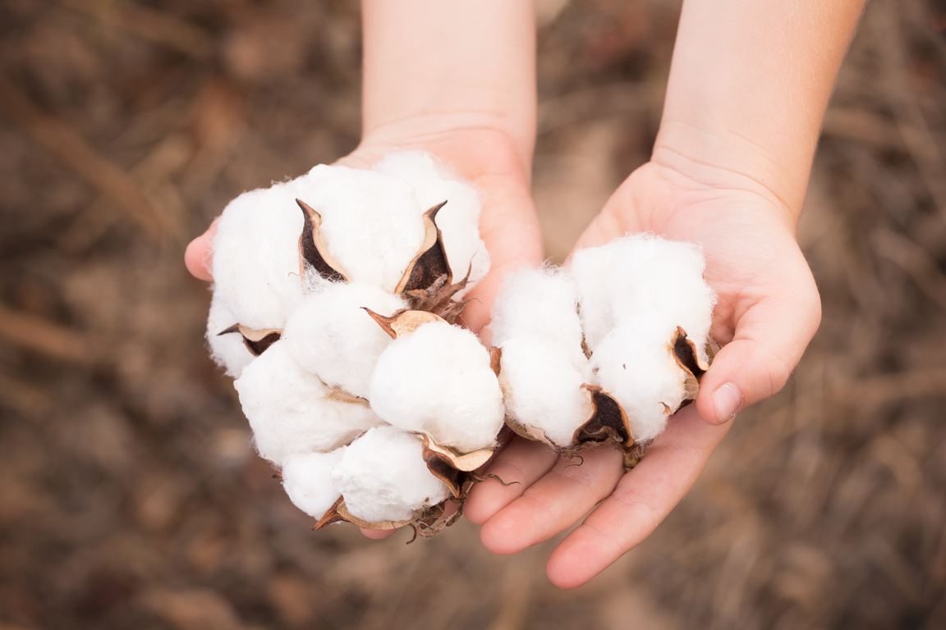
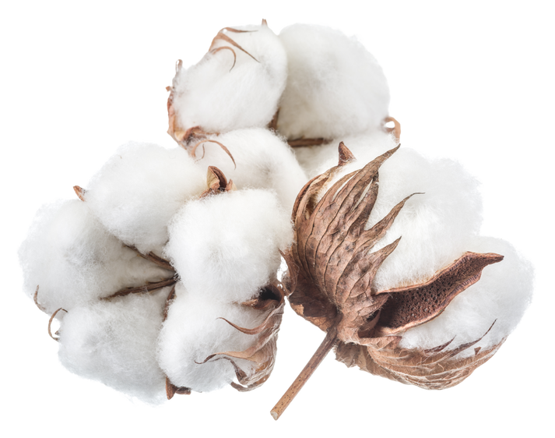
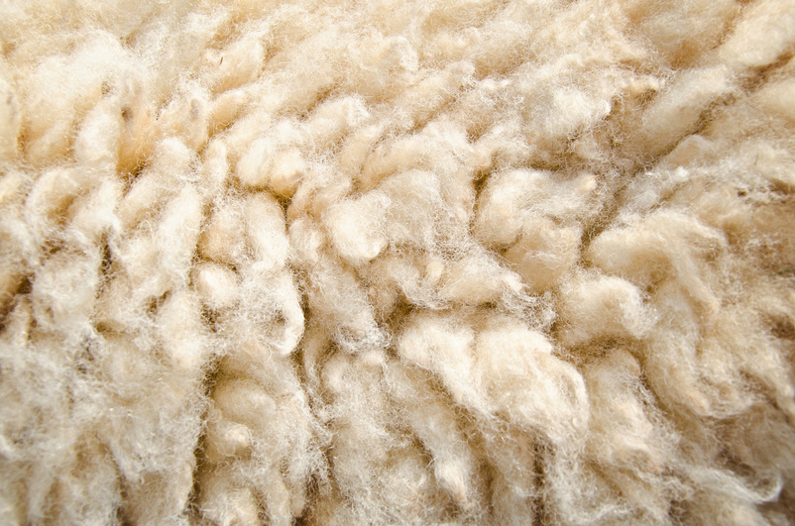
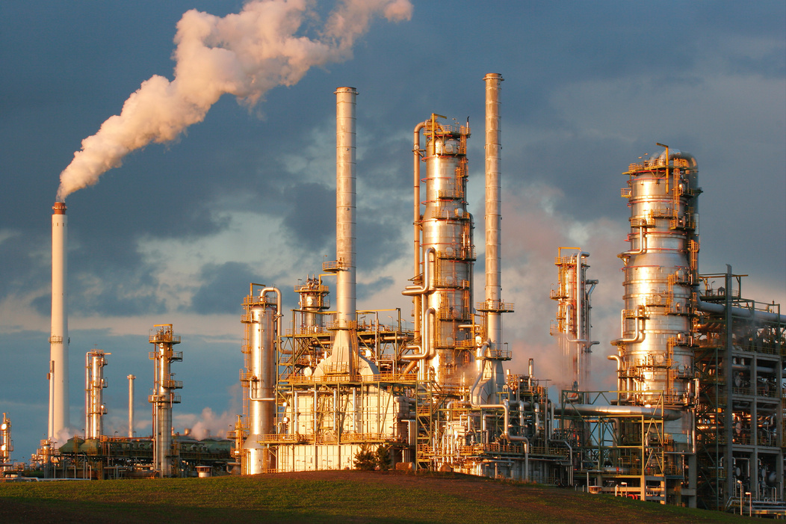
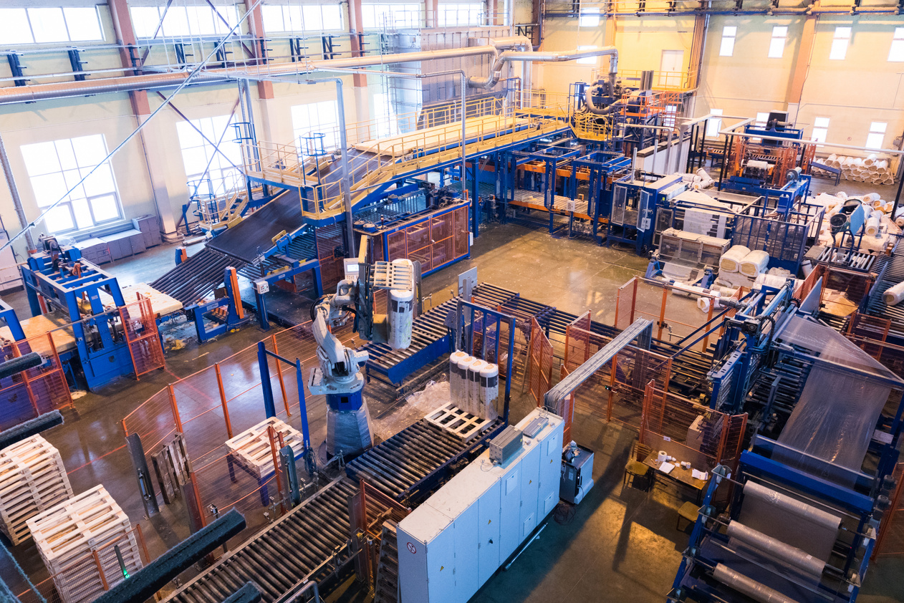
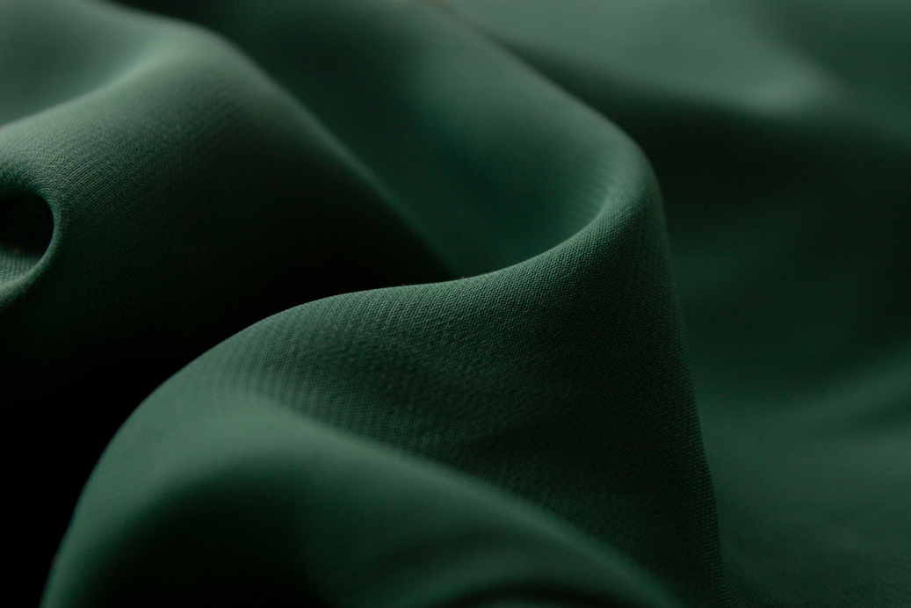

Key Words
cotton
natural
synthetic
transportation
refinary
factory
dye
chemicals
Notes:
cotton: A soft material that comes from a plant and is used to make clothes.
natural: Something that comes from nature, like plants, animals, or the earth.
synthetic: Something made by people using chemicals, not found in nature.
transportation: Moving things or people from one place to another, like by car, train, or truck.
refinery: A place where oil is cleaned and changed into useful things.
factory: A big building where things are made by machines and workers.
dye: A special liquid that changes the colour of things, like clothes.
chemicals: Special substances that can change things or help make new things.

Slide 5
Key Words
1) My backpack is made from a _______ fabric that doesn’t come from nature.
2) We use red ____ to change the colour of my clothes.
3) Some ______ are used to make synthetic materials.
4) _______ like buses and trains helps people get to school.
synthetic
transportation
dye
chemicals
Notes:
1 = synthetic
2 = dye
3 = chemicals
4 = transportation

Slide 6
Key Words
1) I wore a _____ shirt that was soft.
2) The oil was cleaned at the ___________.
3) They toy was made in a big _________.
4) Cotton is a _______ material.
cotton
natural
refinary
factory
Challenge: Put these words into your own sentence
Notes:
1 = cotton
2 = refinery
3 = factory
4 = natural

Slide 7








How does the cotton from the plants suddenly end up in a jumper in the shop? Does that happen straight away?
Oh no Nancy! That cotton jumper has been on a big journey. Let’s find out all about it!

Slide 8

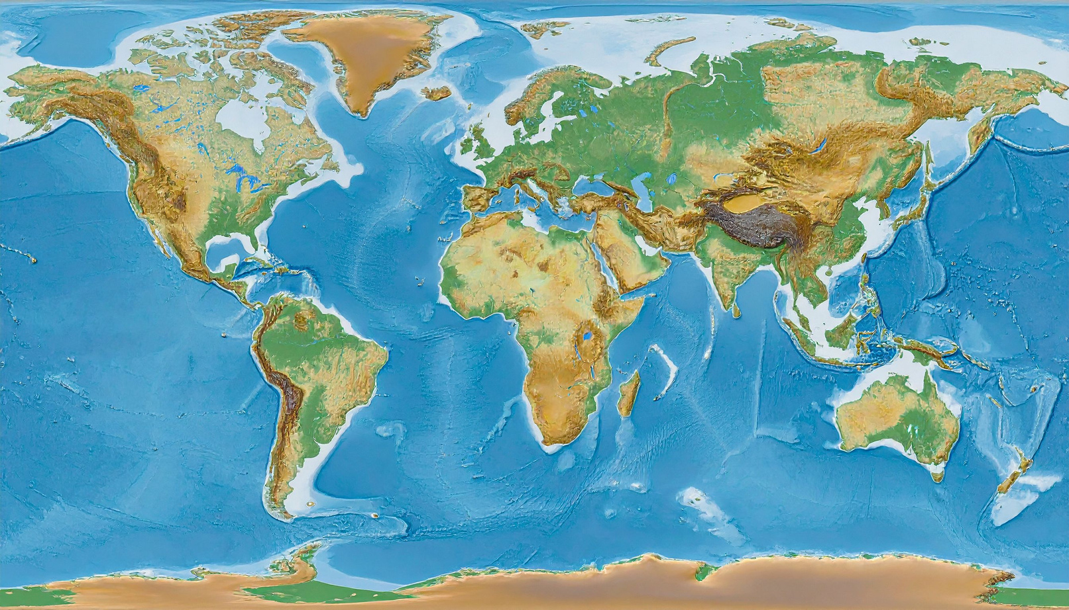
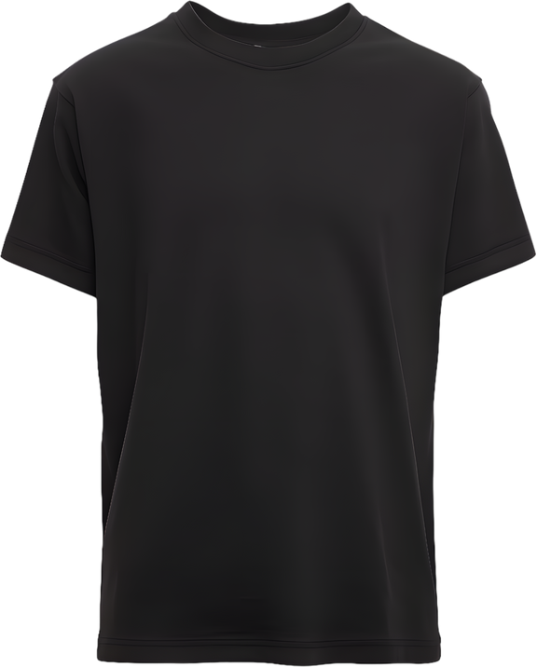
Let’s find out the journey of a cotton T-shirt
USA
3. UK
2. Vietnam
This T-shirt will travel 23,676km from source to shop

Slide 9
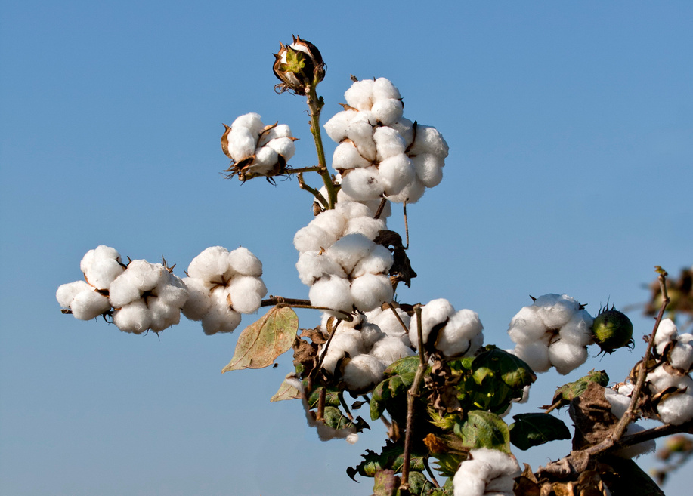
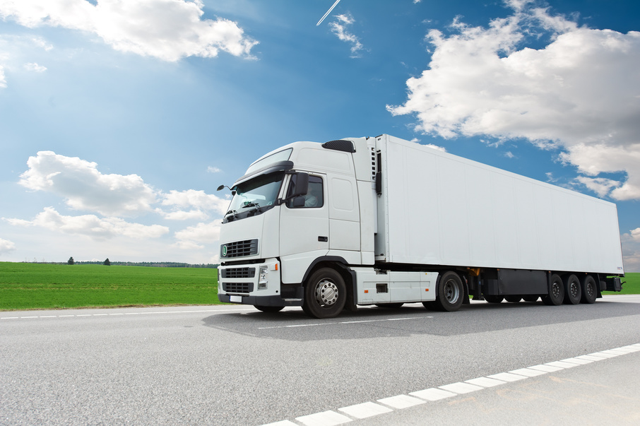
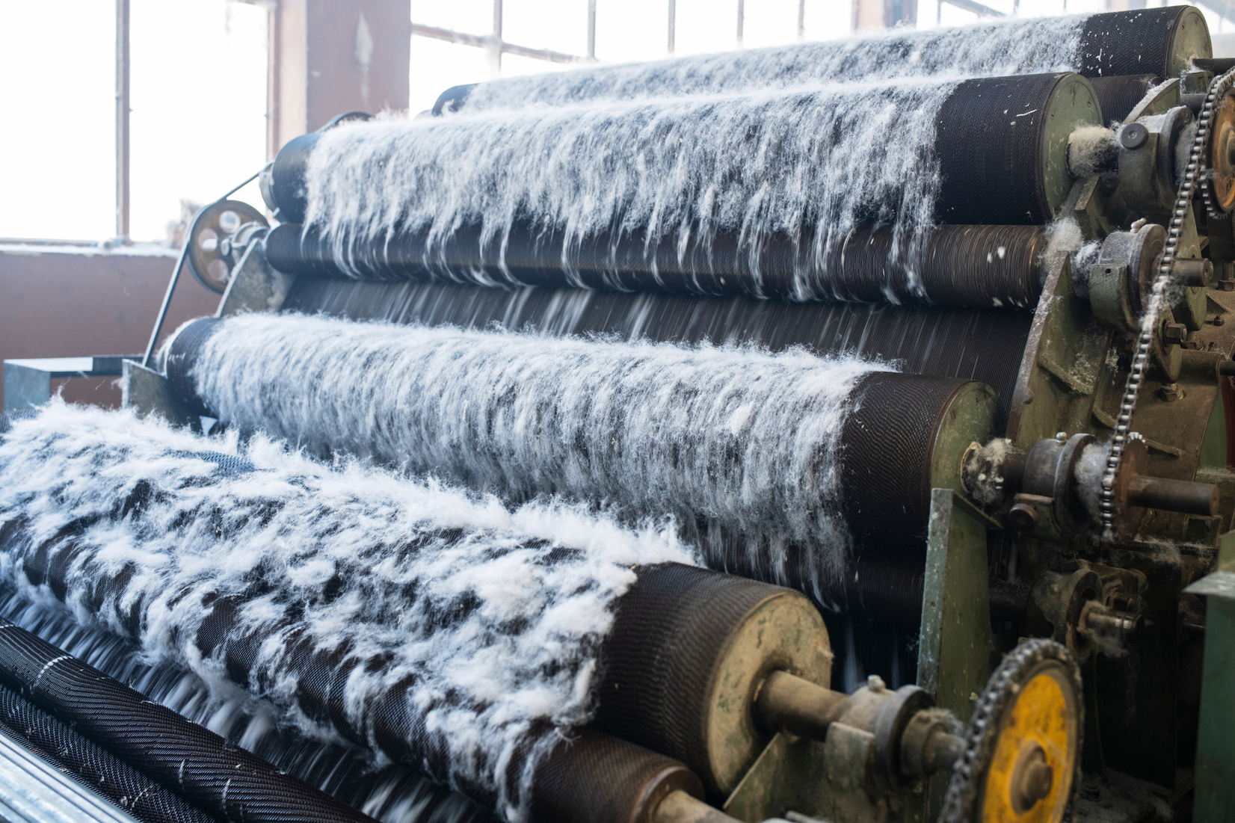
The journey of a cotton T-shirt
The cotton is picked by hand and sent to a factory
The cotton is separated into fibres and seeds
Cotton is grown in the USA.

Slide 10
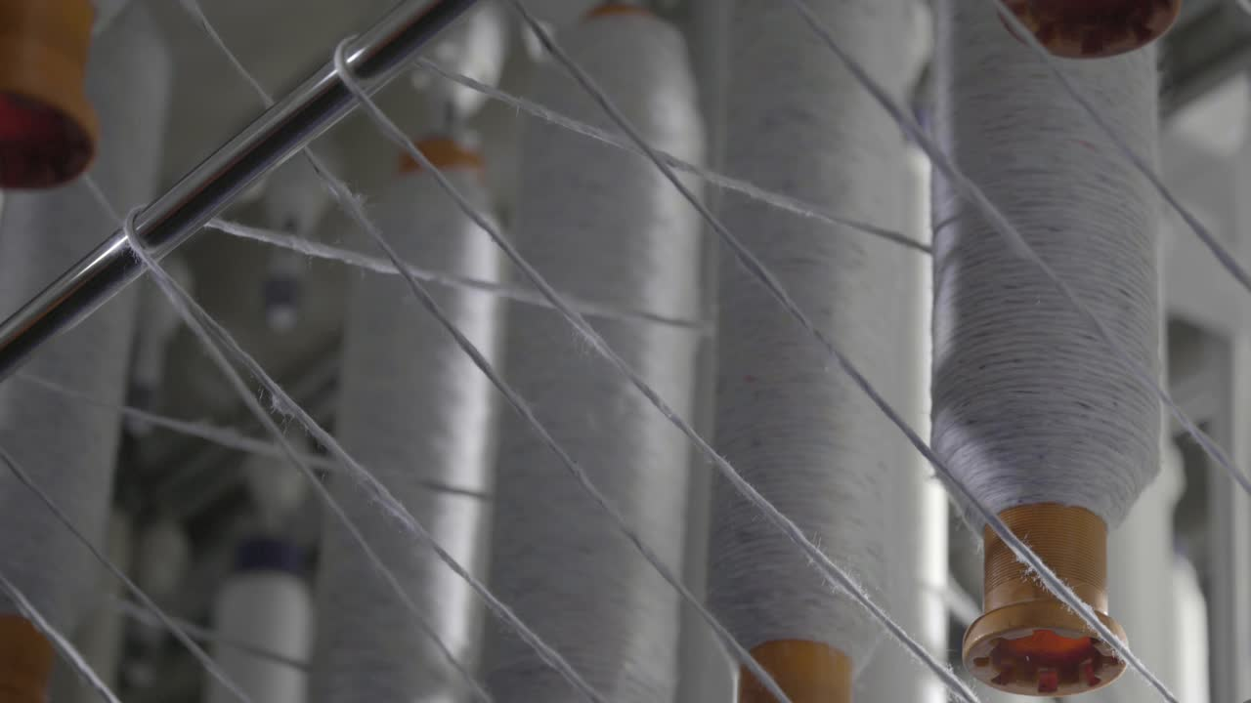
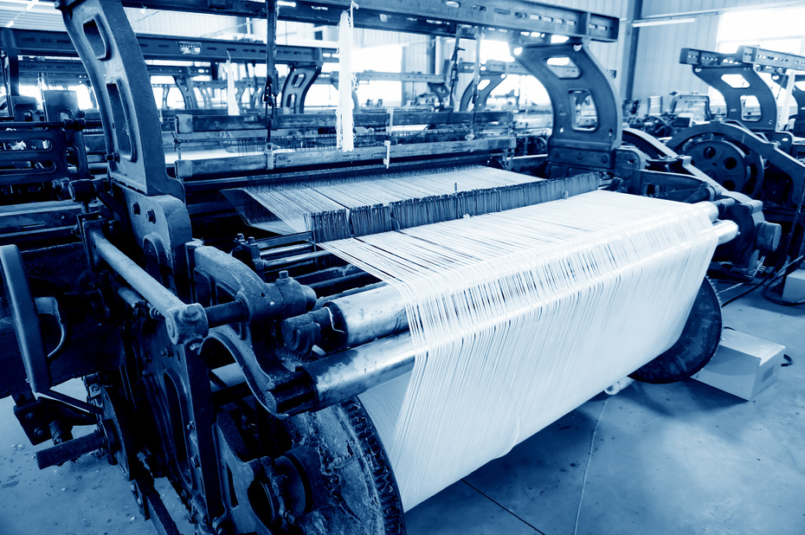
The journey of a cotton T-shirt
Cotton fibre is cleaned and spun into thread
The thread is knitted into fabric
The fabric is dyed

Slide 11
Tell your partner the journey of a cotton T-shirt so far...

Slide 12
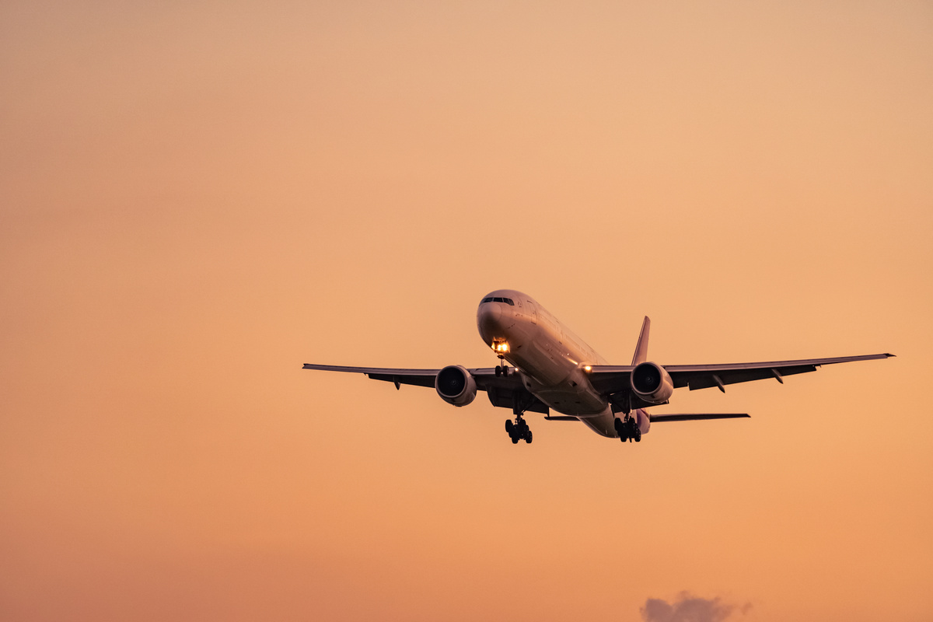
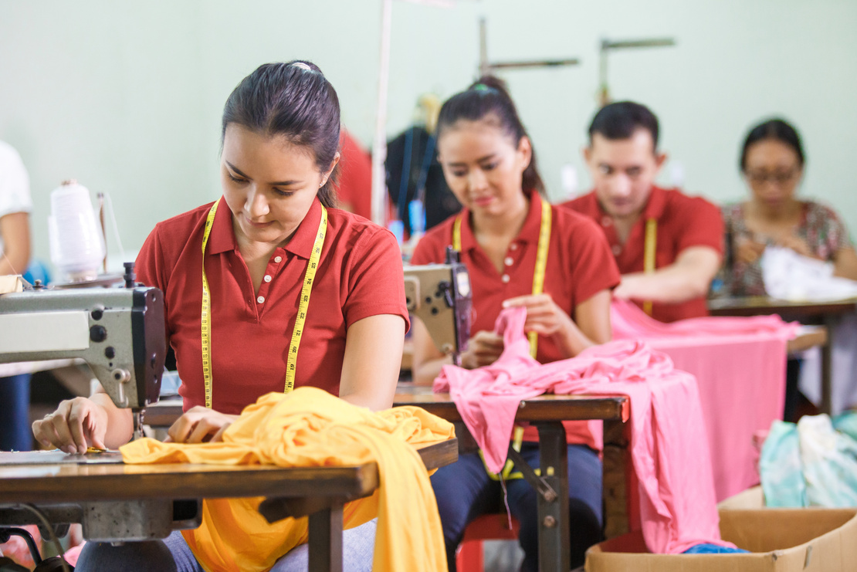
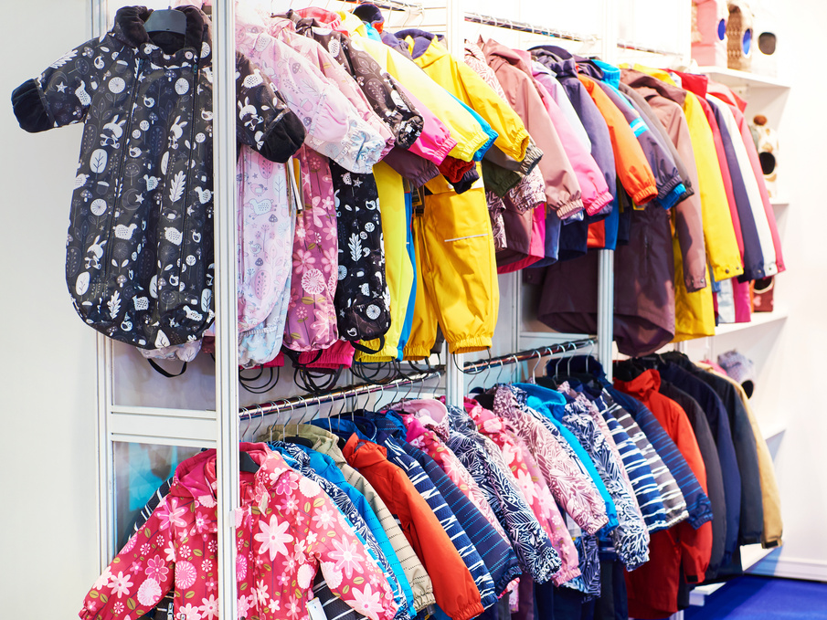
The dyed fabric is sent to factories in Vietnam
Factories make clothes with the fabric
The clothes are transported to shops in England
We buy clothes from shops

Slide 13
Tell your partner the journey of a cotton T-shirt

Slide 14
The journey of a cotton T-shirt
USA
3. UK
2. Vietnam
This T-shirt travels 23,676km from source to shop

Slide 15
Tell your partner the journey of a cotton T-shirt
USA
3. UK
2. Vietnam
This T-shirt travels 23,676km from ____ to _____.

Slide 16
Clothes travel so far from source to shop. It takes a lot of energy to make them. That is why we need to look after the clothes we buy. Let’s look at how the journey of polyester is different to cotton.

Slide 17

Let’s find out the journey of a polyester T-shirt
3. UK
Saudi Arabia
2. Columbia
This T-shirt will travel 21,320km from source to shop

Slide 18
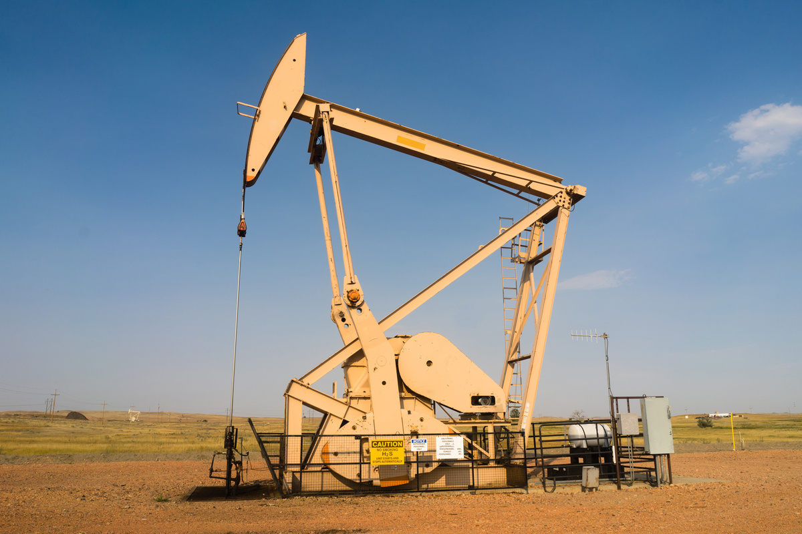
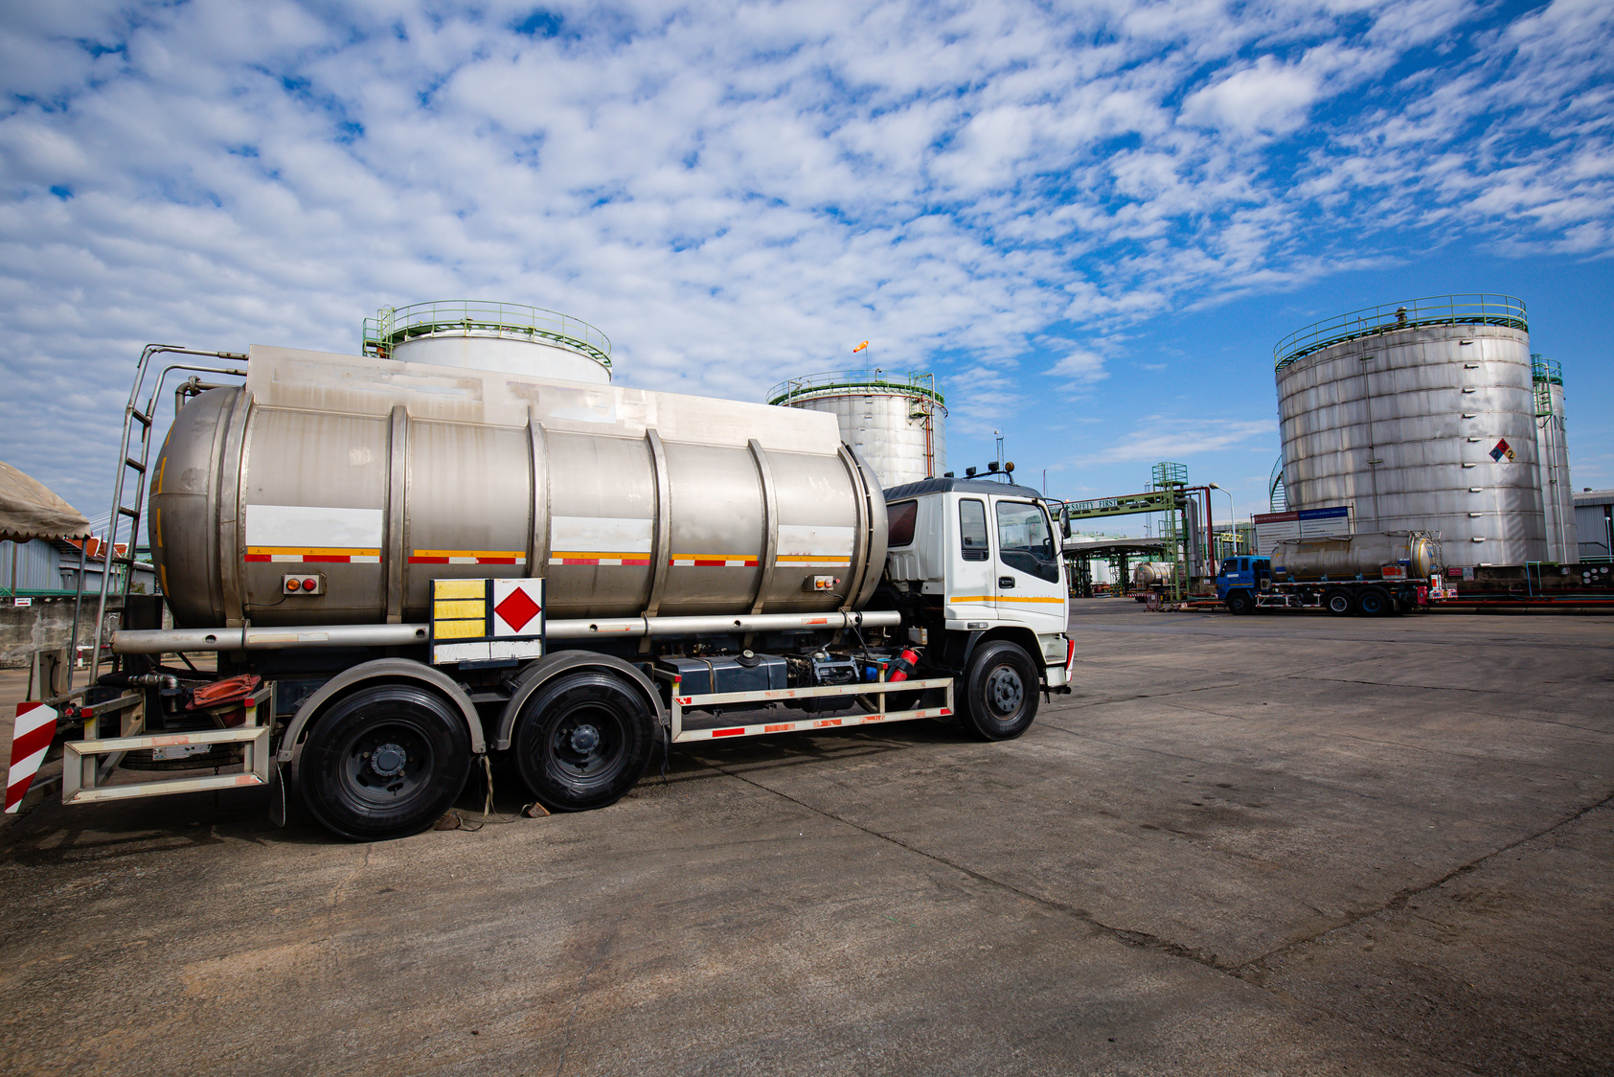
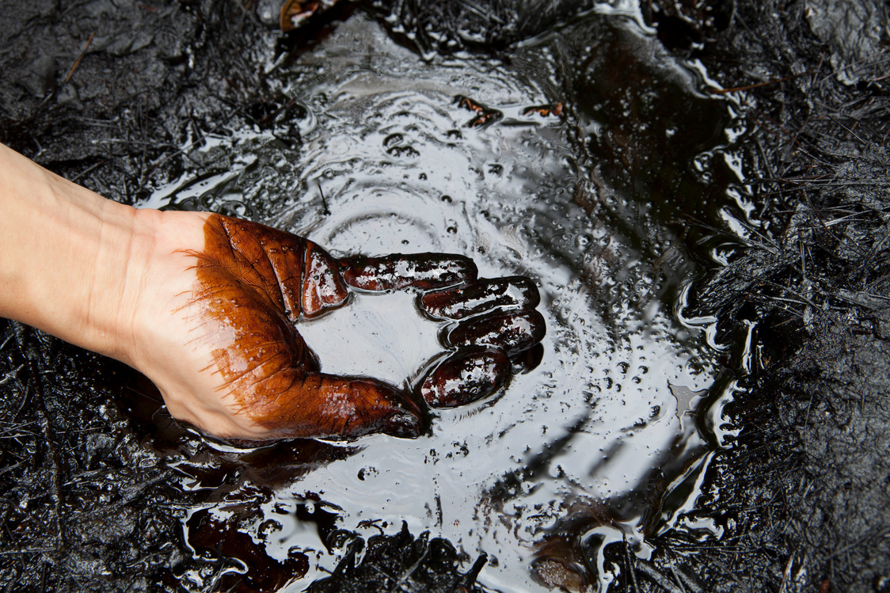
The journey of a polyester T-shirt
Crude oil is extracted in Saudi Arabia
The oil is sent to a refinery
The oil is cleaned and separated into chemicals

Slide 19
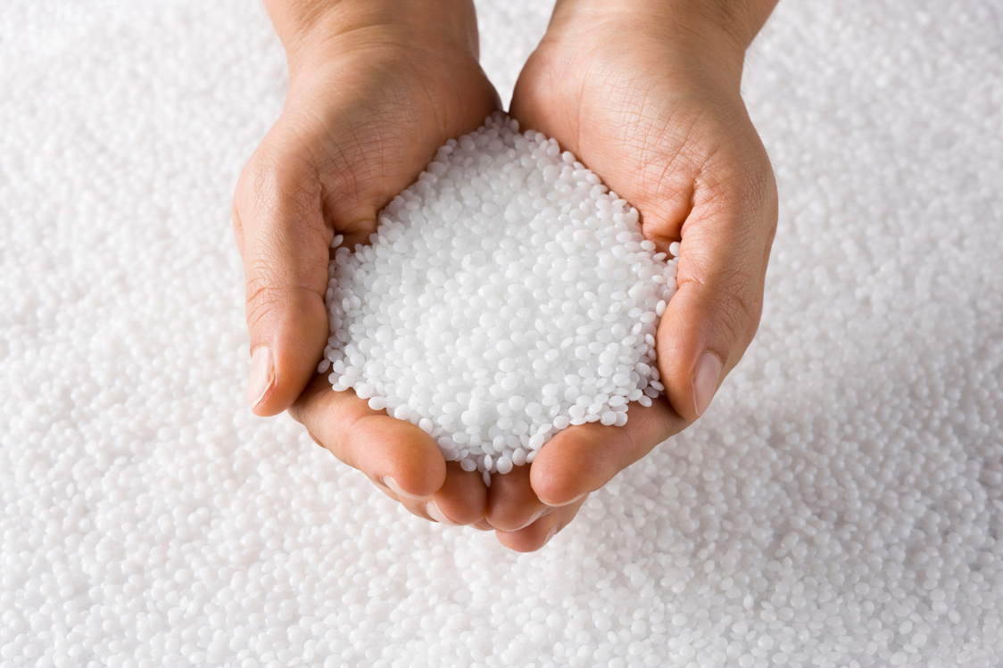
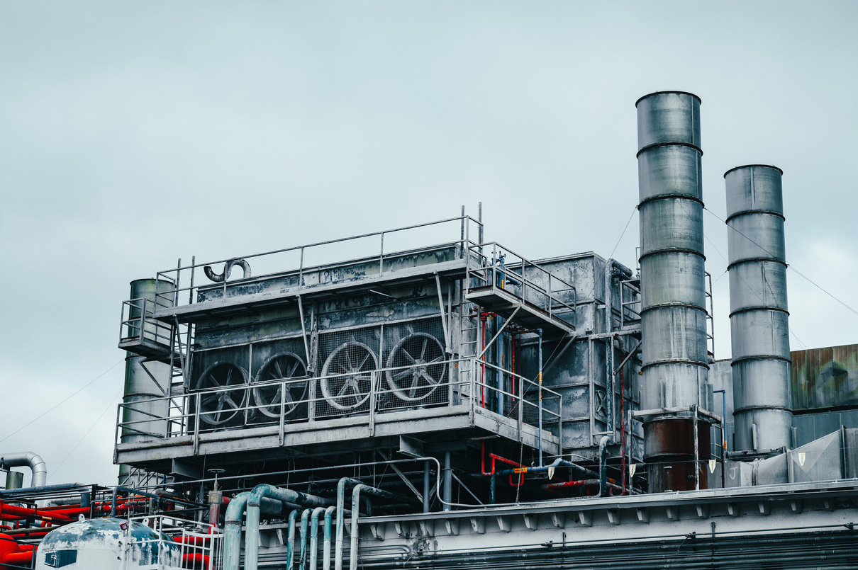
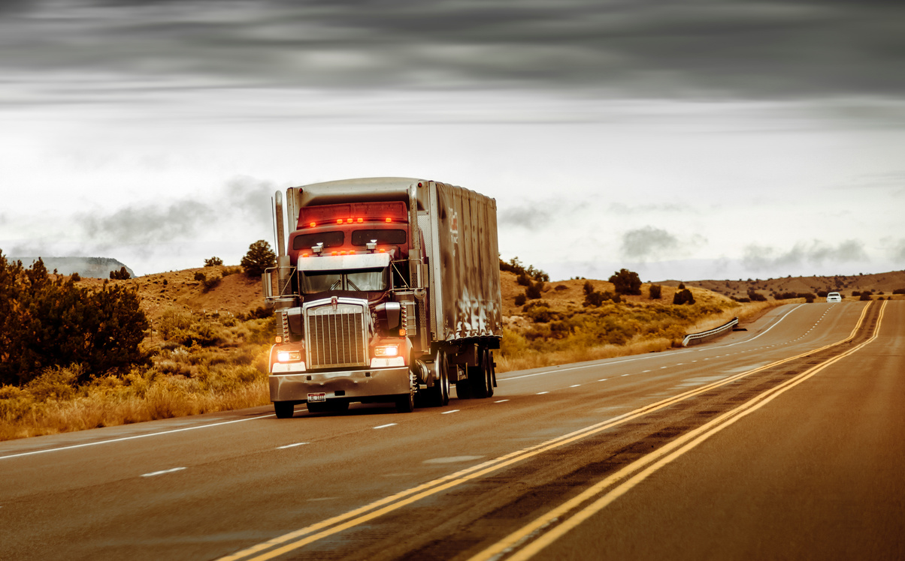
The journey of a polyester T-shirt
The chemicals go to a plastic factory
The chemicals are made into pellets in the factory
The plastic pellets are sent to a fibre factory

Slide 20
Tell your partner the journey of a polyester T-shirt so far

Slide 21
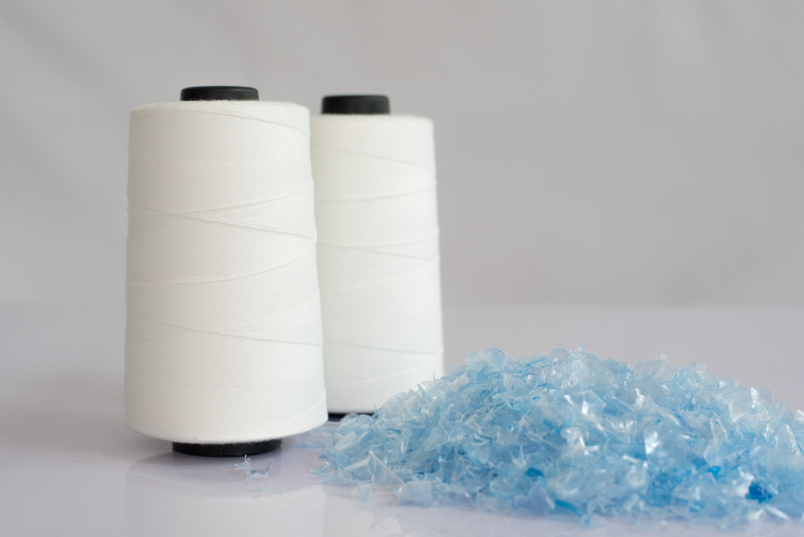
The journey of a polyester T-shirt
The pellets are melted and stretched into polyester fibre
Polyester is sent to a factory in Columbia
The factories make clothes with the fabric

Slide 22
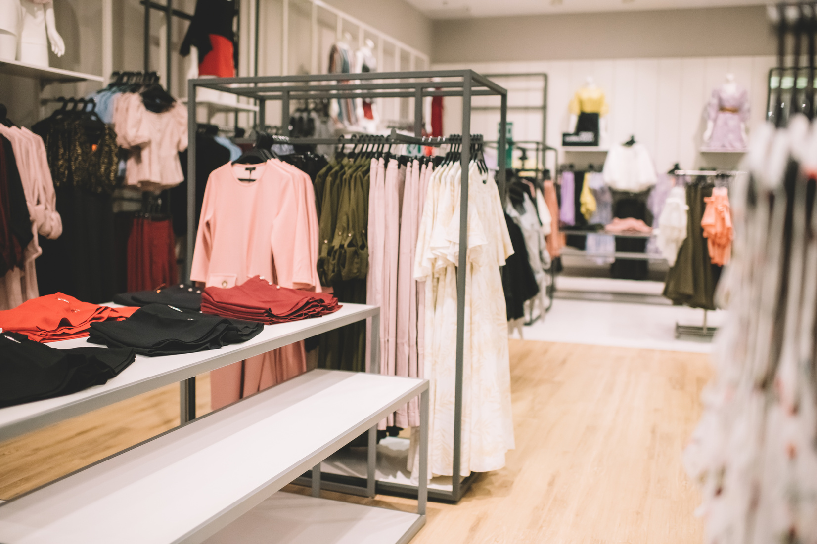
The journey of a polyester T-shirt
The clothes are sent to England
We buy the clothes from the shop

Slide 23
Tell your partner the journey of a polyester T-shirt

Slide 24
The journey of a polyester T-shirt
3. UK
Saudi Arabia
2. Columbia
This T-shirt travels 21,320km from source to shop

Slide 25
Tell your partner the journey of a polyester T-shirt
3. UK
Saudi Arabia
2. Columbia
This T-shirt travels 21,320km from source to shop

Slide 26
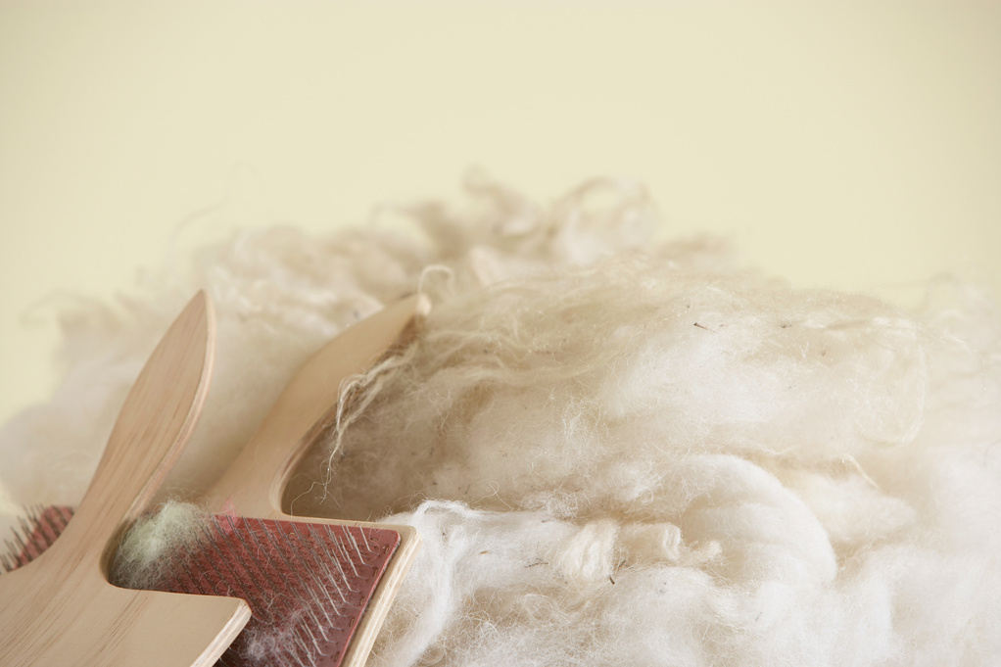
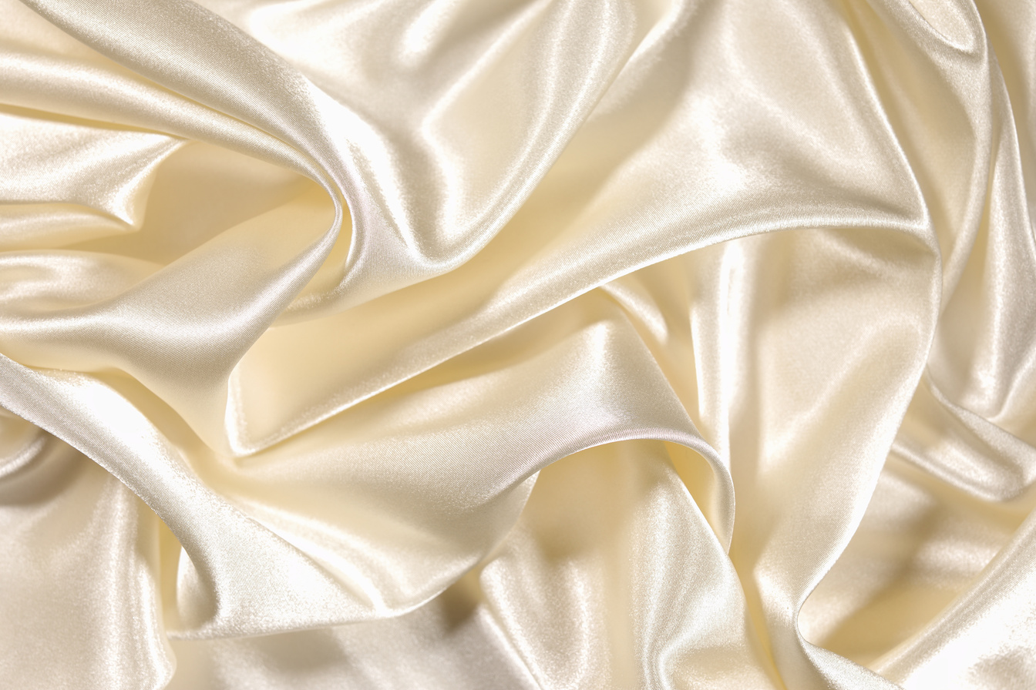
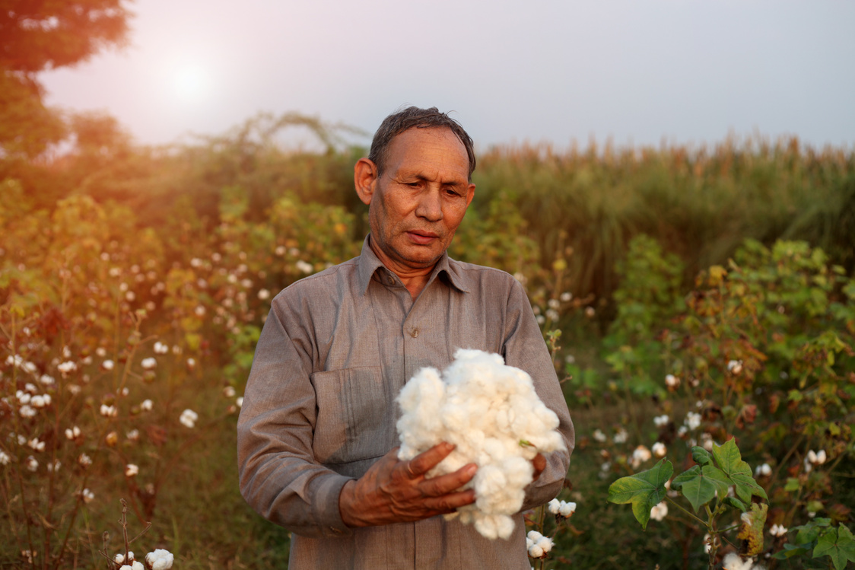
Textiles use a lot of energy to make. It is important that we use them as much as we can. I’ve got five tips for you to help our planet!
wool silk cotton

Slide 27




Five tips to look after our clothes
Wear clothes again and again and don’t buy lots of clothes.
2. Fix small holes and tears by sewing them.
3. Swap, share and donate clothes to give them another life.
4. Get your school to join the Uniform Reuse Network!
5. If you can, buy natural materials as they are kinder to our environment.

Slide 28

What 5 things can we do?
The 5 things we can do are __________________________.

Slide 29
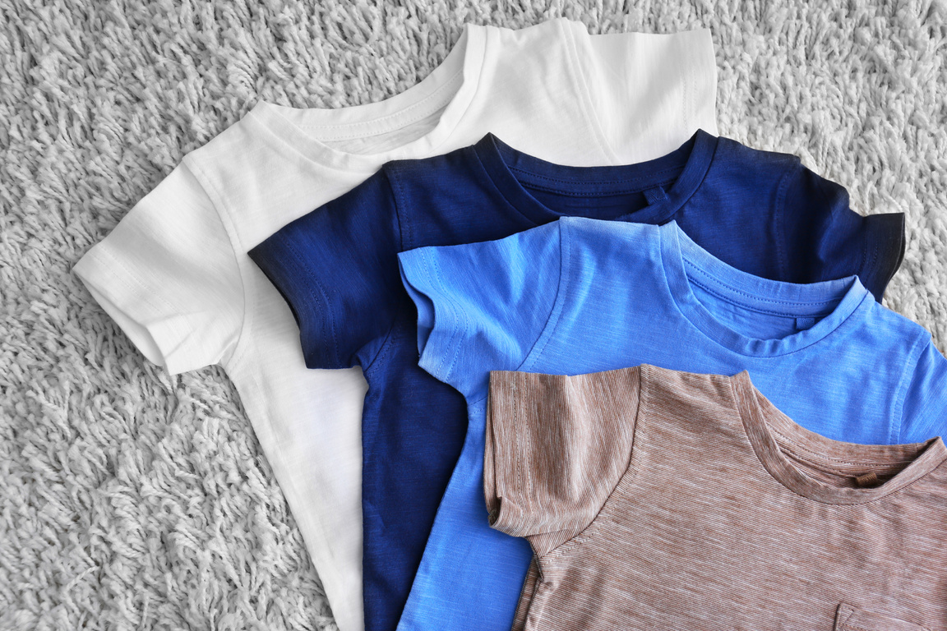
Problems...
Clothes travel far from source to shop.
How could we make the journey of clothes better for people and the planet?
Why do you think some clothes are made far away and not in the UK?
Notes:
Discussion 1
- Read question to children twice
- Give children a moment to think about the question
- In partners, get children to share their thoughts using sentence stem 'To make the journey of clothes better we can...'
-Give children 2 minutes in partners to discuss their opinions
- Listen in to discussion. Spotlight two children
Repeat with question 2

Slide 30
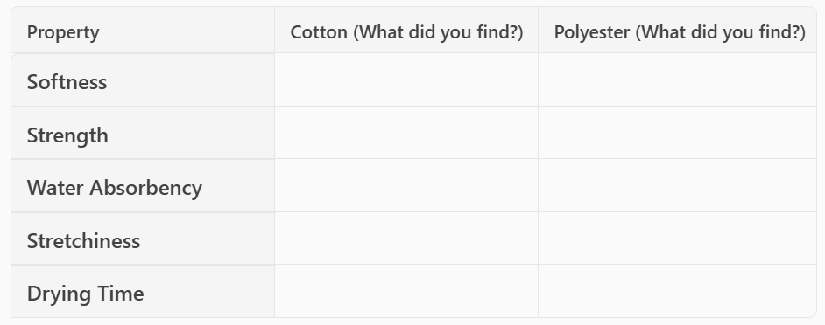
Extension activity 1
Science activity: Pupils will test and compare the properties of cotton and polyester, and suggest suitable uses for each material based on their results.

Slide 31

Extension activity 2
Persuasive writing activity: Pupils write a letter to a clothing company asking them to use more eco-friendly materials.

Slide 32
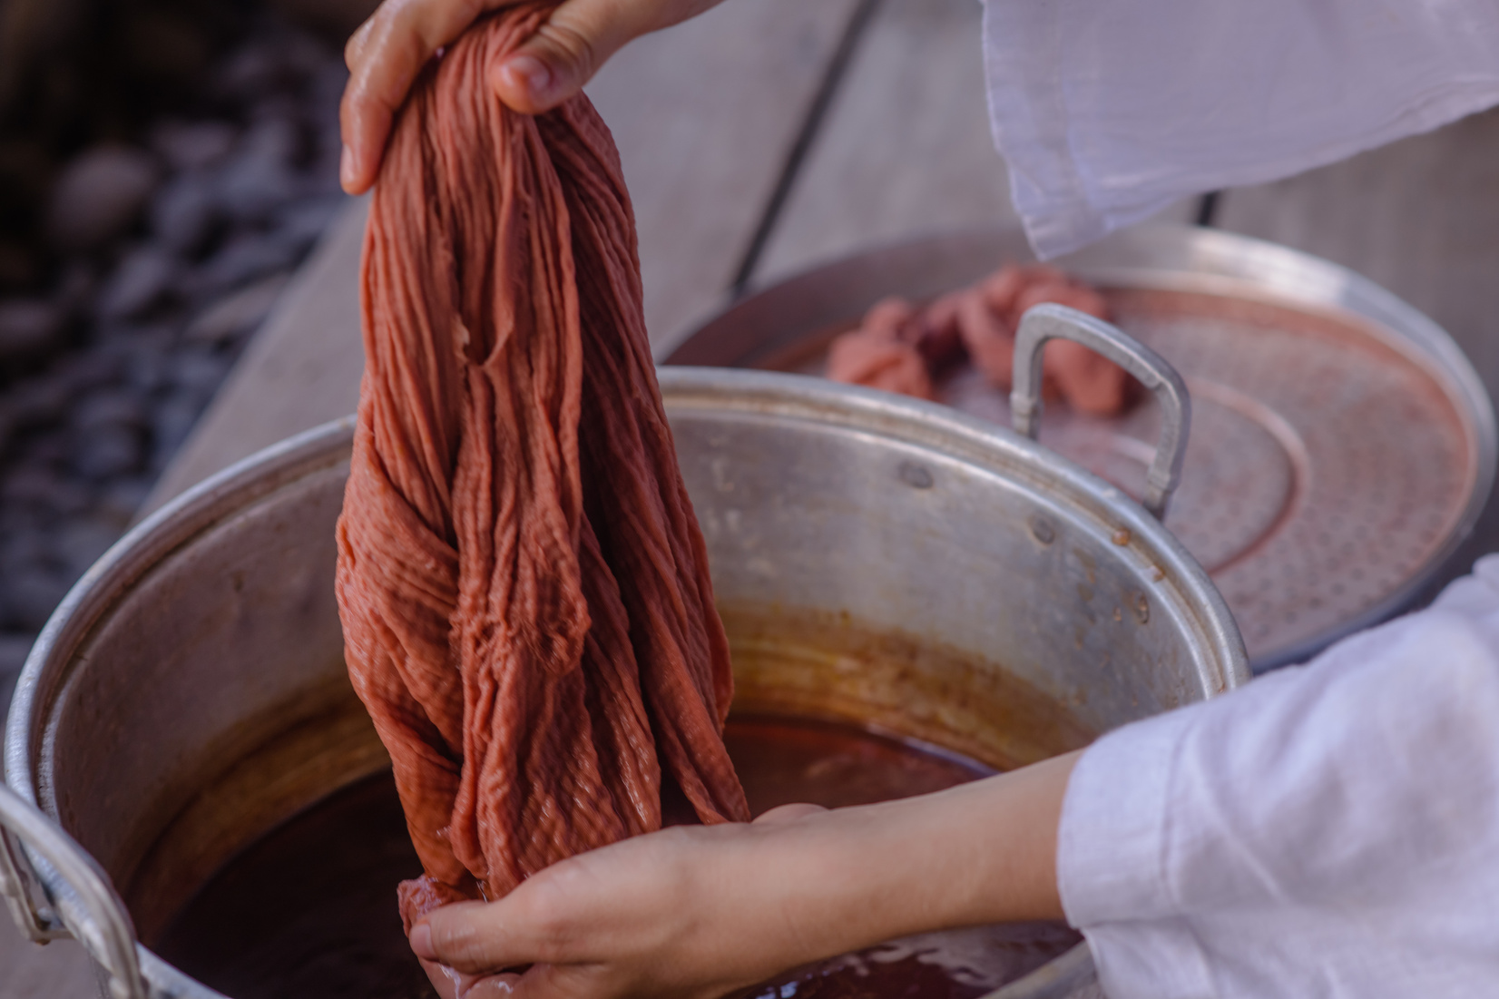
Extension activity 3
Art activity: Try natural dyeing with things like beetroot or turmeric and compare with synthetic dyes. What is better for the environment and why?

