Slide 1





How can we repair our clothes?
KS1 Lesson - Lesson 4 of 4

Slide 2
LO: To understand what we can do with clothes that are broken, don’t fit, or can’t be reused.
I can explain what to do if clothes are broken
I can say what to do if clothes don’t fit anymore
I can describe what to do if clothes can’t be reused
I can talk about why it’s good to reuse and recycle clothes.

Slide 3






Lesson Prep
Vocabulary
Discussion
Keywords that children need to understand and use during the lesson.
An opportunity for children to practice the knowledge learnt.
Big question
Task
To assess learning and give children time to practise independently.
A central question that sparks curiosity and frames the lesson’s theme.
The knowledge
Extension
Essential facts and concepts children need to know.
Optional tasks to deepen or stretch learning beyond the core lesson.

Slide 4
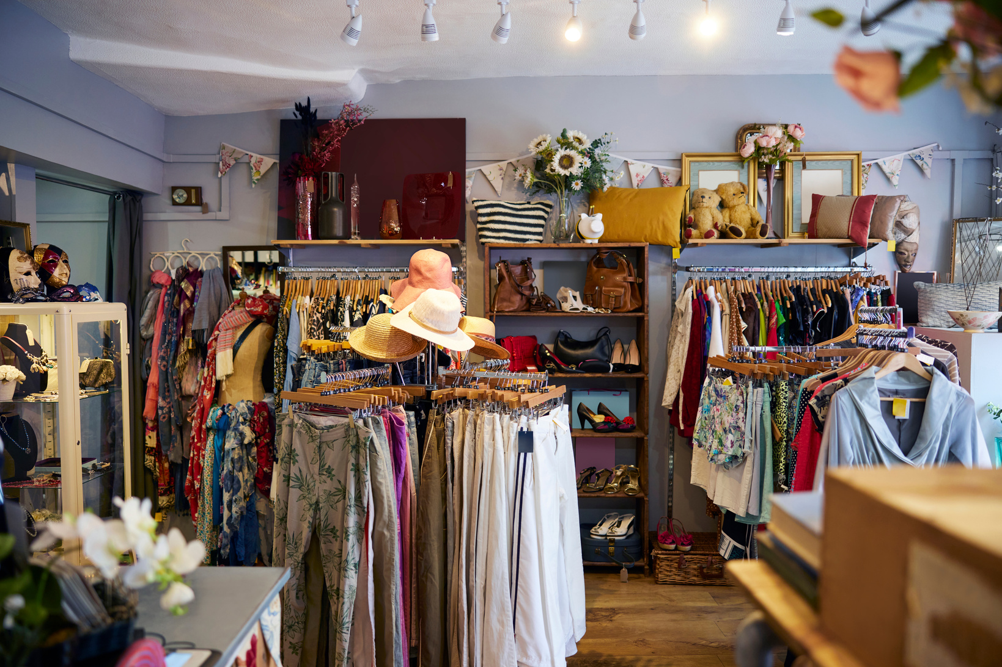


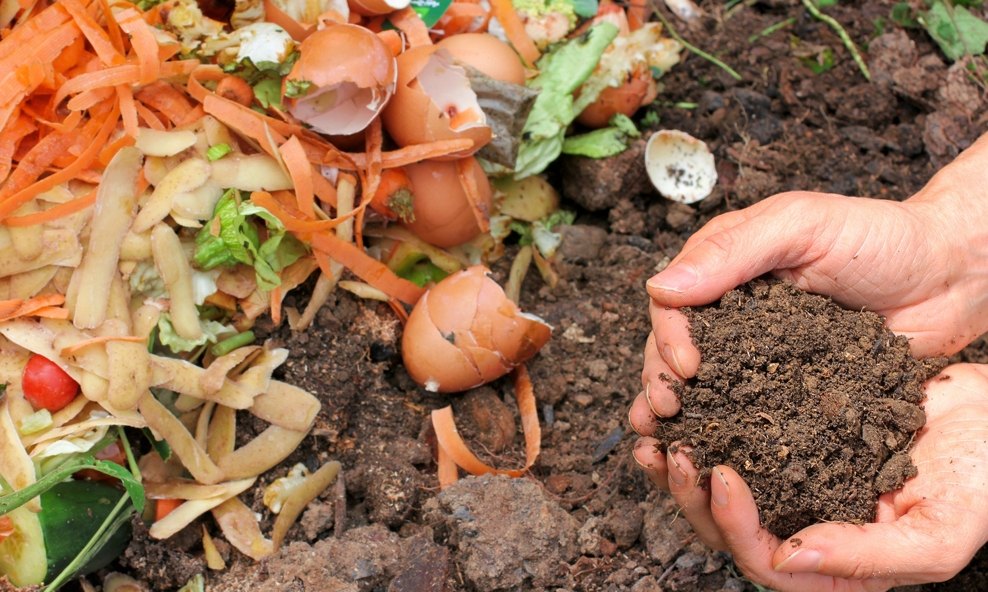


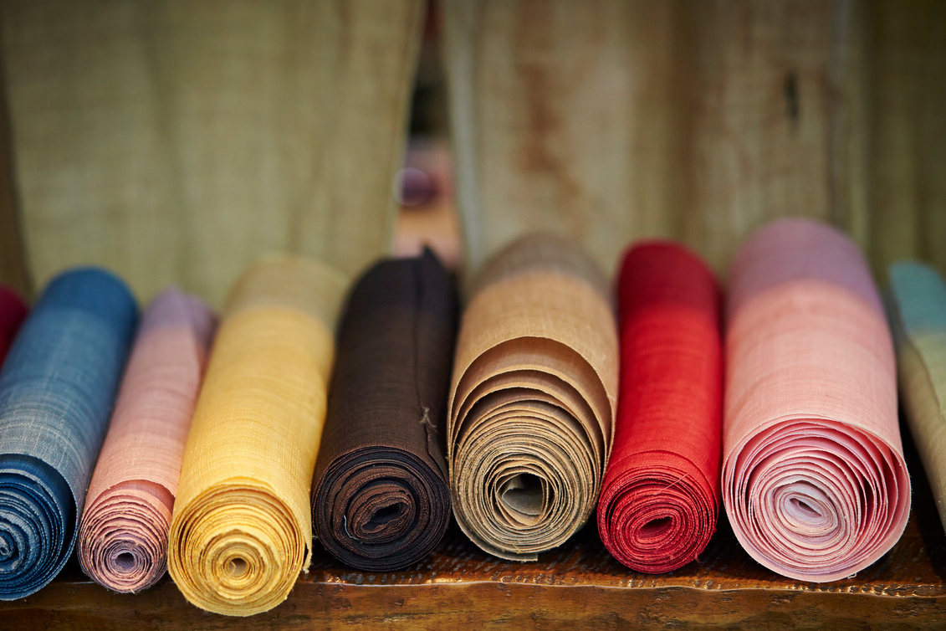
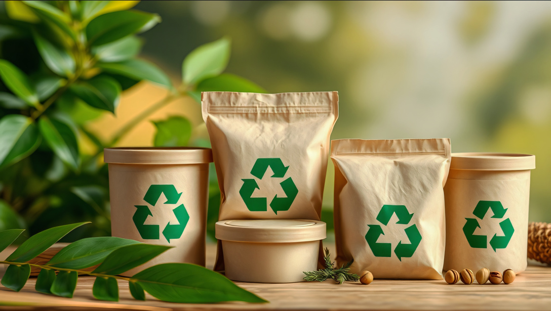
Key Words
charity shop
resell
upcycle
compost
biodegrade
patch
textile
donate
Notes:
Charity shop: A place where people give things they don’t need, and others can buy them.
Resell: To sell something again after you’ve used it, so someone else can enjoy it.
Upcycle: To turn old things into something new and useful — like making a bag from an old T-shirt.
Compost: To let natural things like food or fabric break down in the soil and help plants grow.
Biodegrade: When something breaks down naturally over time and goes back into the earth.
Patch: A small piece of fabric used to cover a hole or tear in clothes to fix them.
Donate: To give something away to help someone else, like giving clothes to people who need them.
Textile: Any kind of fabric or cloth used to make clothes, blankets, and more.

Slide 5
Vocabulary task
2. 3. 4.
resell
compost
charity shop
upcycle
Challenge: Write a sentence using a new vocabulary word.
Notes:
1 = charity shop
2 = resell
3 = upcycle
4 = compost

Slide 6
Vocabulary task
2. 3. 4.
patch
biodegradable
textile
donate
Challenge: Write a sentence using a new vocabulary word.
Notes:
1 = biodegradable
2 = patch
3 = donate
4 = textile

Slide 7








Hi Ned! I was sad yesterday as my favourite top got a hole in. I had to throw it away!
Oh Nancy! You could have saved that top. I’ve got some great tips on fixing clothes. That way you never have to throw away your favourite top again! Let me show you...

Slide 8

Today we are going to learn what to do with clothes if they are damaged, if they don’t fit and if they can’t be reused!

Slide 9
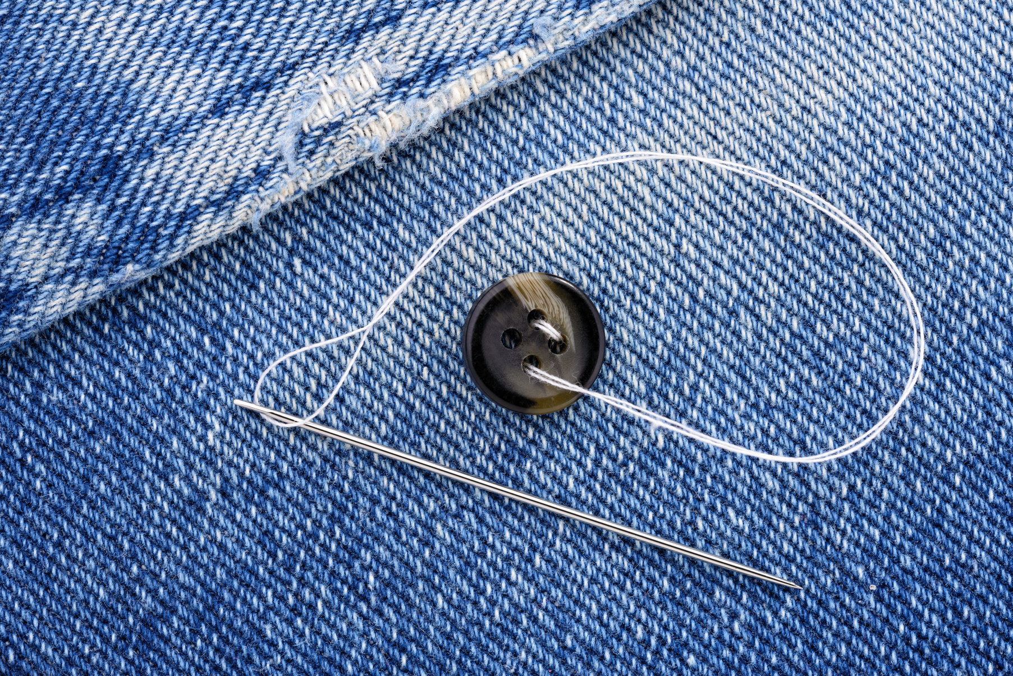
If clothes break or get damaged
You can repair clothes by sewing on a missing button.

Slide 10
If clothes break or get damaged
You can patch holes or tears in clothes by sewing on a patch.

Slide 11
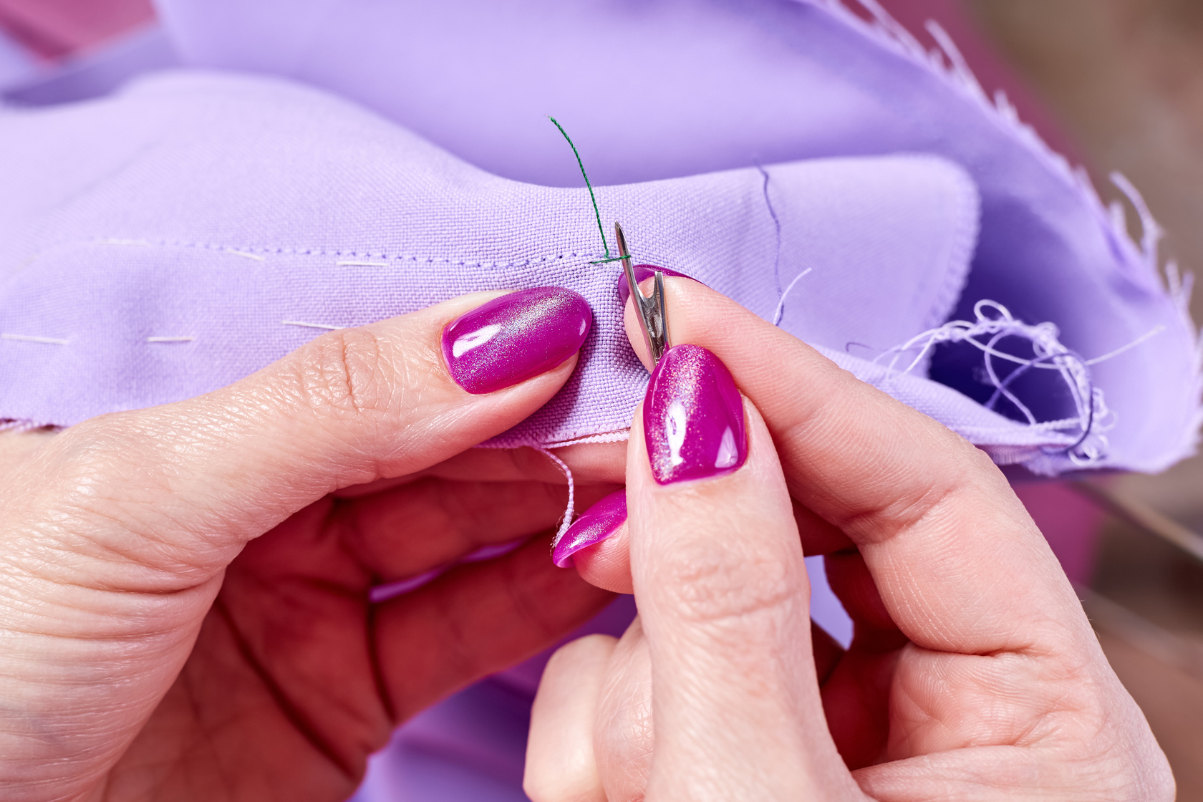
If clothes break or get damaged
You can fix broken seams (the edges of clothing) by sewing them back up!

Slide 12
What can you do if your clothes break or get damaged?
button patch seam
If clothes are damaged you can __________________.

Slide 13
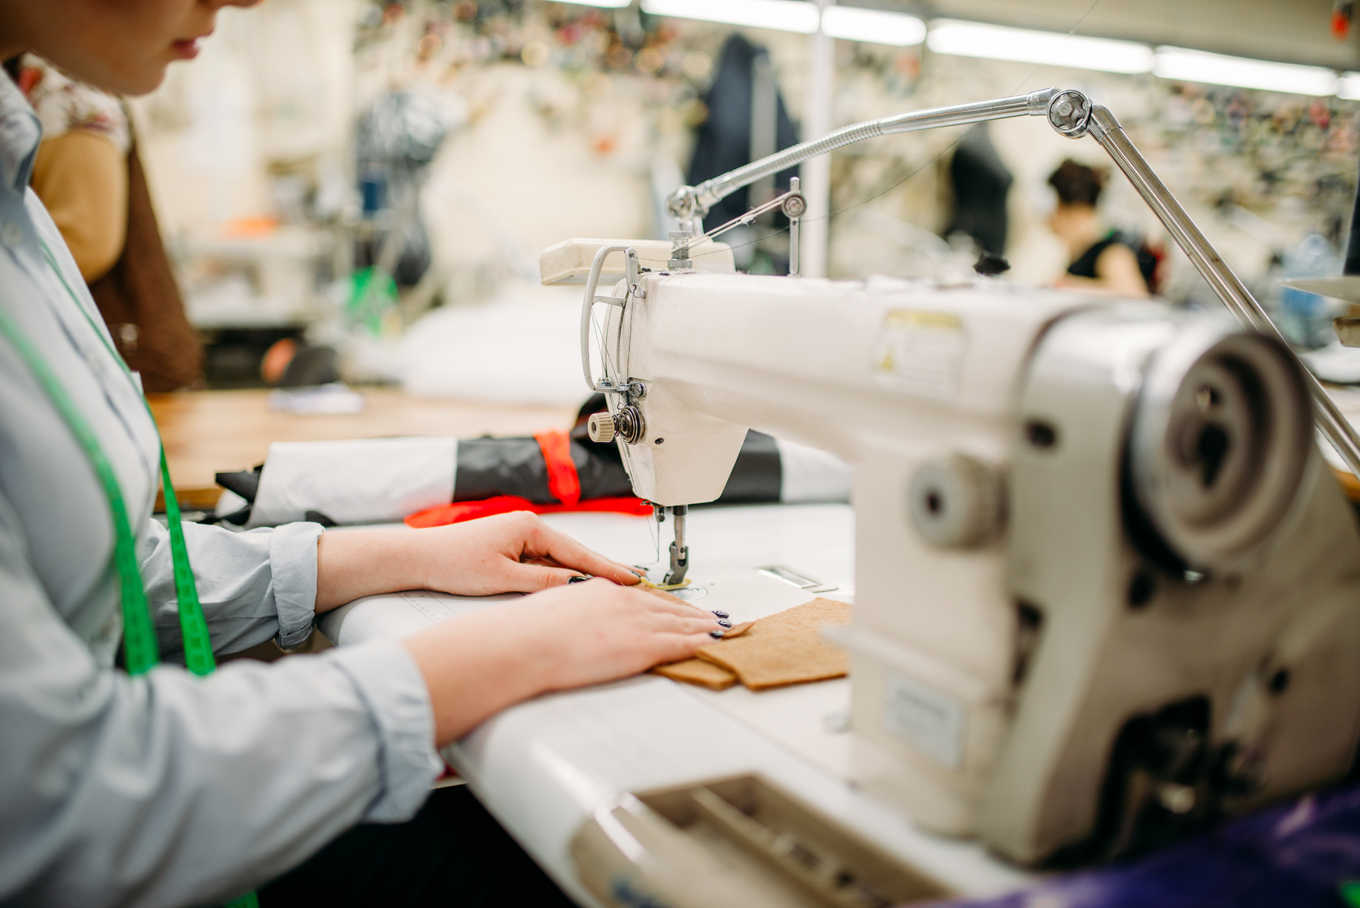
If clothes don’t fit
You can repair or alter them. You can make them bigger or smaller.

Slide 14

If clothes don’t fit
You can swap clothes with friends.

Slide 15
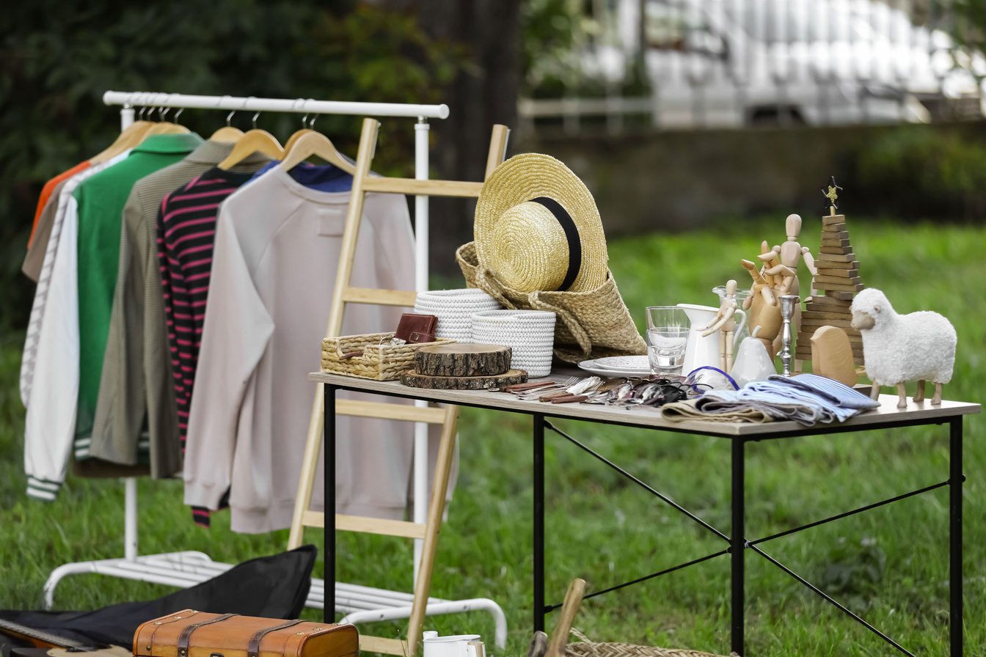
If clothes don’t fit
You can sell them on apps or local markets.

Slide 16
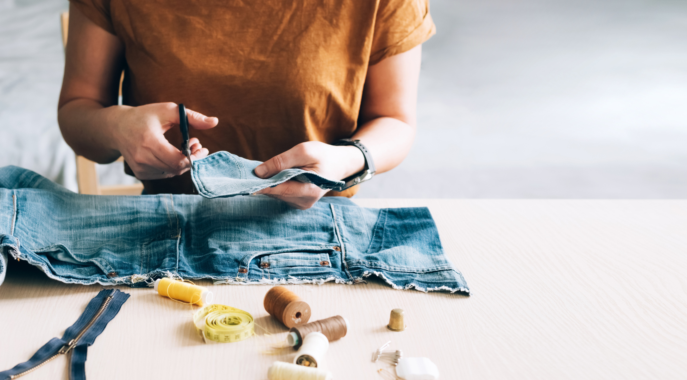
If clothes don’t fit
You can cut them up and make new things from them!

Slide 17
If clothes don’t fit
You can donate them to a charity shop.

Slide 18
What can you do if clothes don’t fit?
If clothes don’t fit you can _____________________.

Slide 19
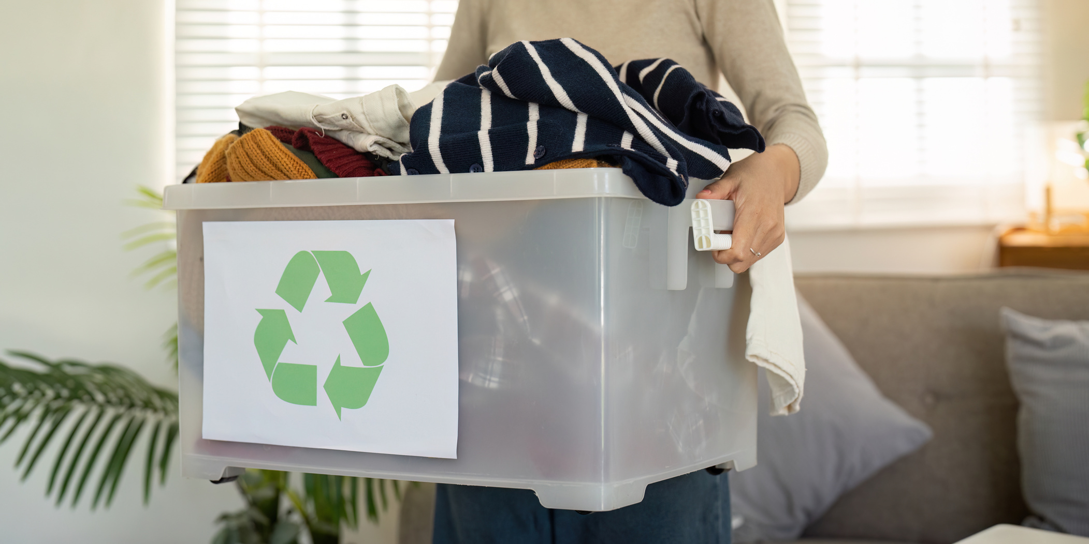
If clothes can’t be reused...
Take them to a textile recycling bin. They can be changed into stuffing or insulation!

Slide 20
If clothes can’t be reused...
If clothes are made of cotton, wool or silk you can compost them. They are biodegradable.

Slide 21
If clothes don’t fit
You can cut them up and make new things from them!

Slide 22
What can you do with clothes that can’t be reused?
If clothes can’t be reused you can _____________________.

Slide 23
Wow, that’s interesting! Remember, clothes take a lot of time, money and energy to make. If we reuse them and give them a second life, we look after our world!

Slide 24

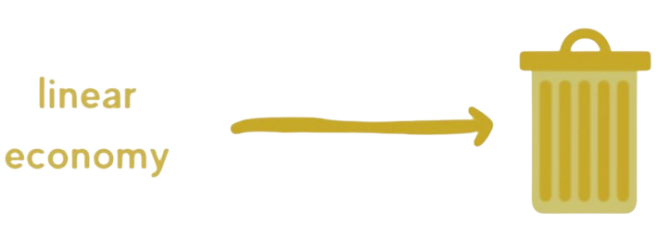
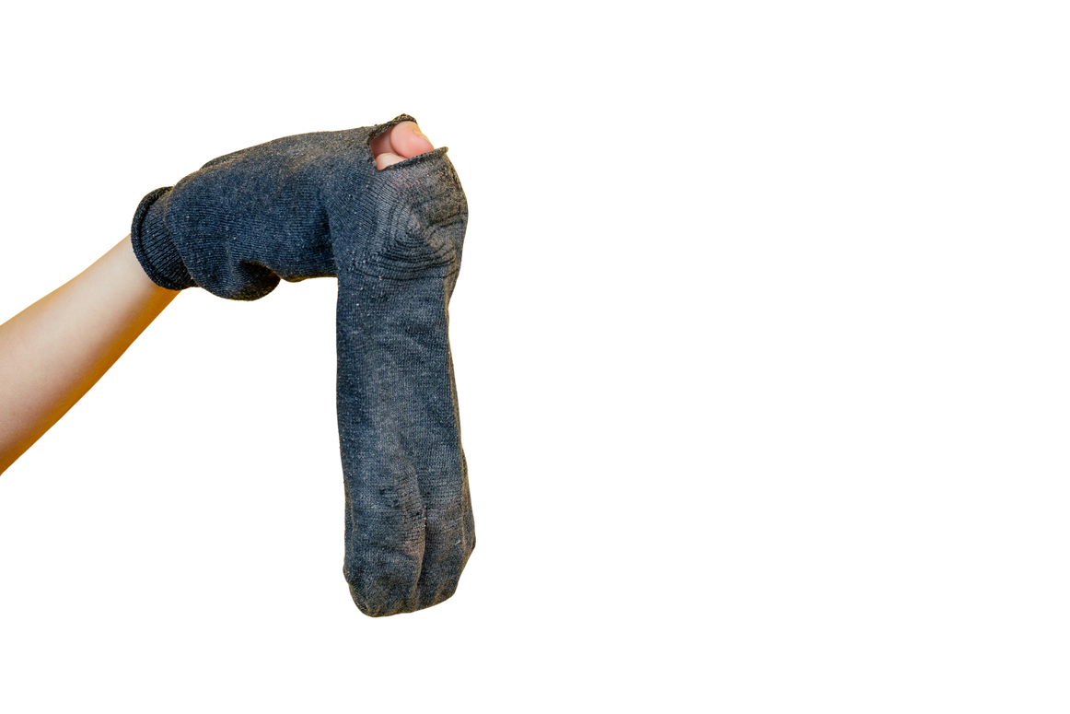


Linear economy vs circular economy
Linear economy
Circular economy
Notes:
Linear Economy
A linear economy means we:
Take materials from nature (like cotton or oil),
Make things (like clothes),
Use them,
Then throw them away when we don’t want them anymore.
It’s like a straight line — from making to wasting.
Circular Economy
A circular economy means we:
Make things,
Use them,
Then fix, reuse, or recycle them so they don’t go to waste.

Slide 25


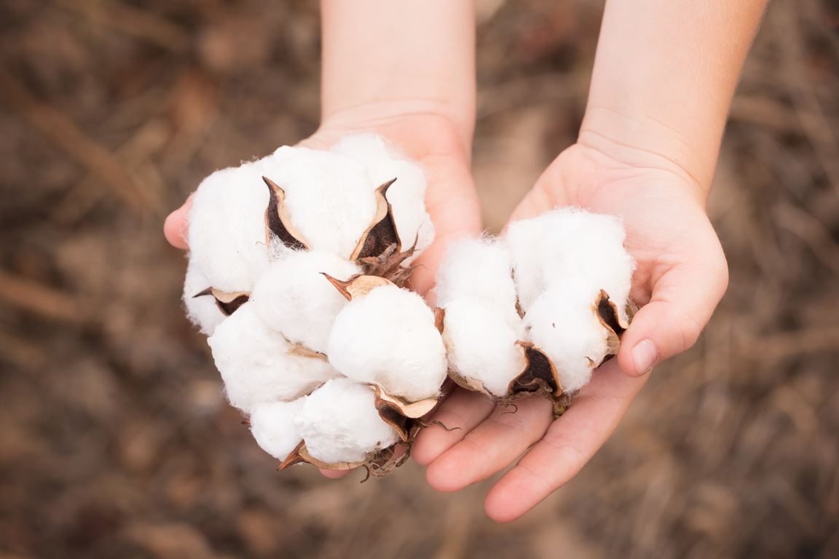
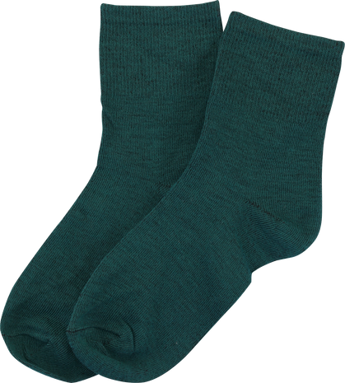
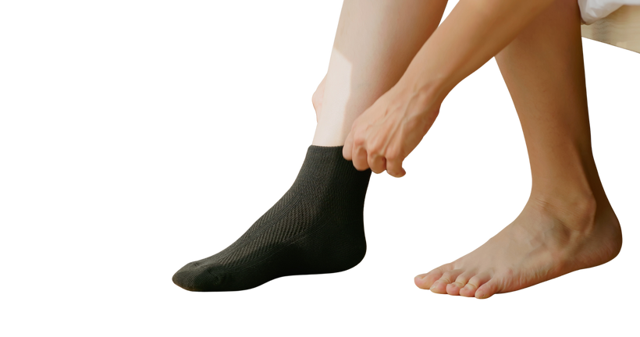

Circular economy
A circular economy is when we:
Take materials, make things, use them, fix them and reuse them.

Slide 26
What is a circular economy
A circular economy is when we:
_____ materials, _____things, _____ them, _____them and _____ them.

Slide 27

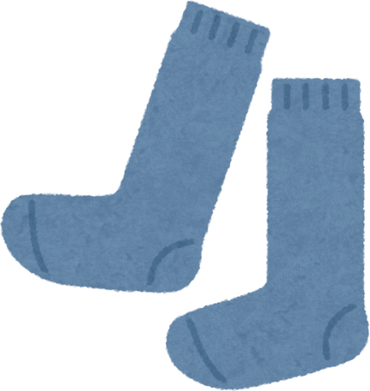
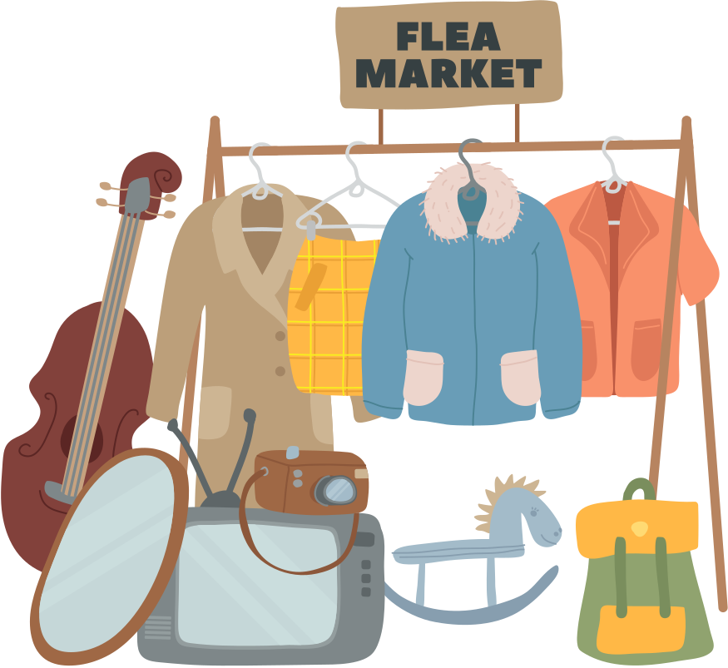



Ned’s circular economy
When my socks break I fix them again and again. I do this as it is much better for our environment.

Slide 28
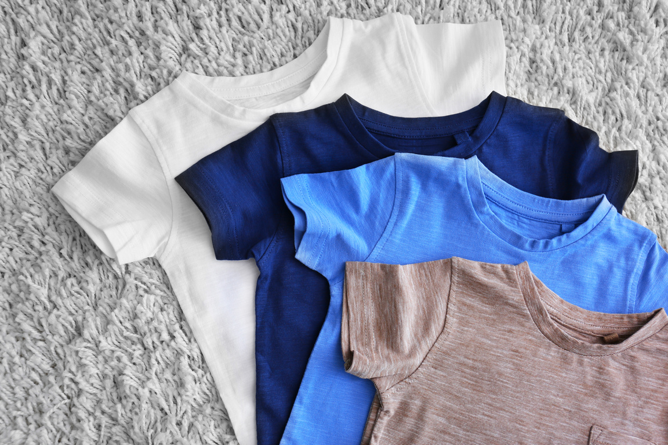
Linear vs Circular economy
If everyone threw away clothes with small holes, what do you think would happen to the planet?
Do you think fixing clothes is a kind thing to do? Why?
Notes:
Discussion 1
- Read question to children twice
- Give children a moment to think about the question
- In partners, get children to share their thoughts using sentence stem 'If everyone threw away clothes I think the planet would...'
-Give children 2 minutes in partners to discuss their opinions
- Listen in to discussion. Spotlight two children
Repeat with question 2

Slide 29
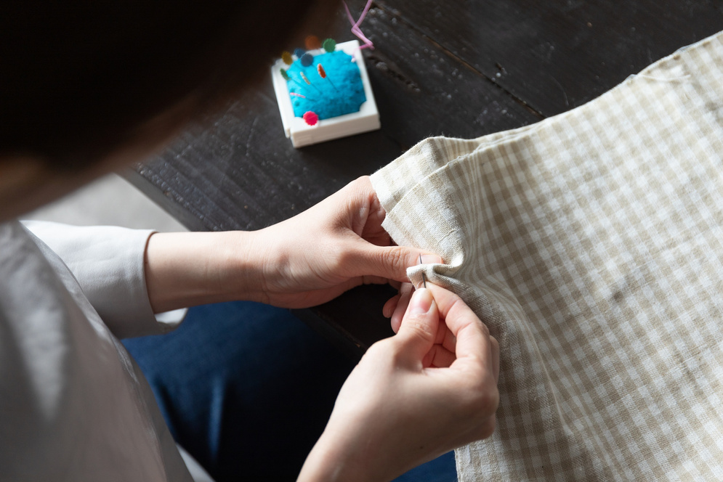
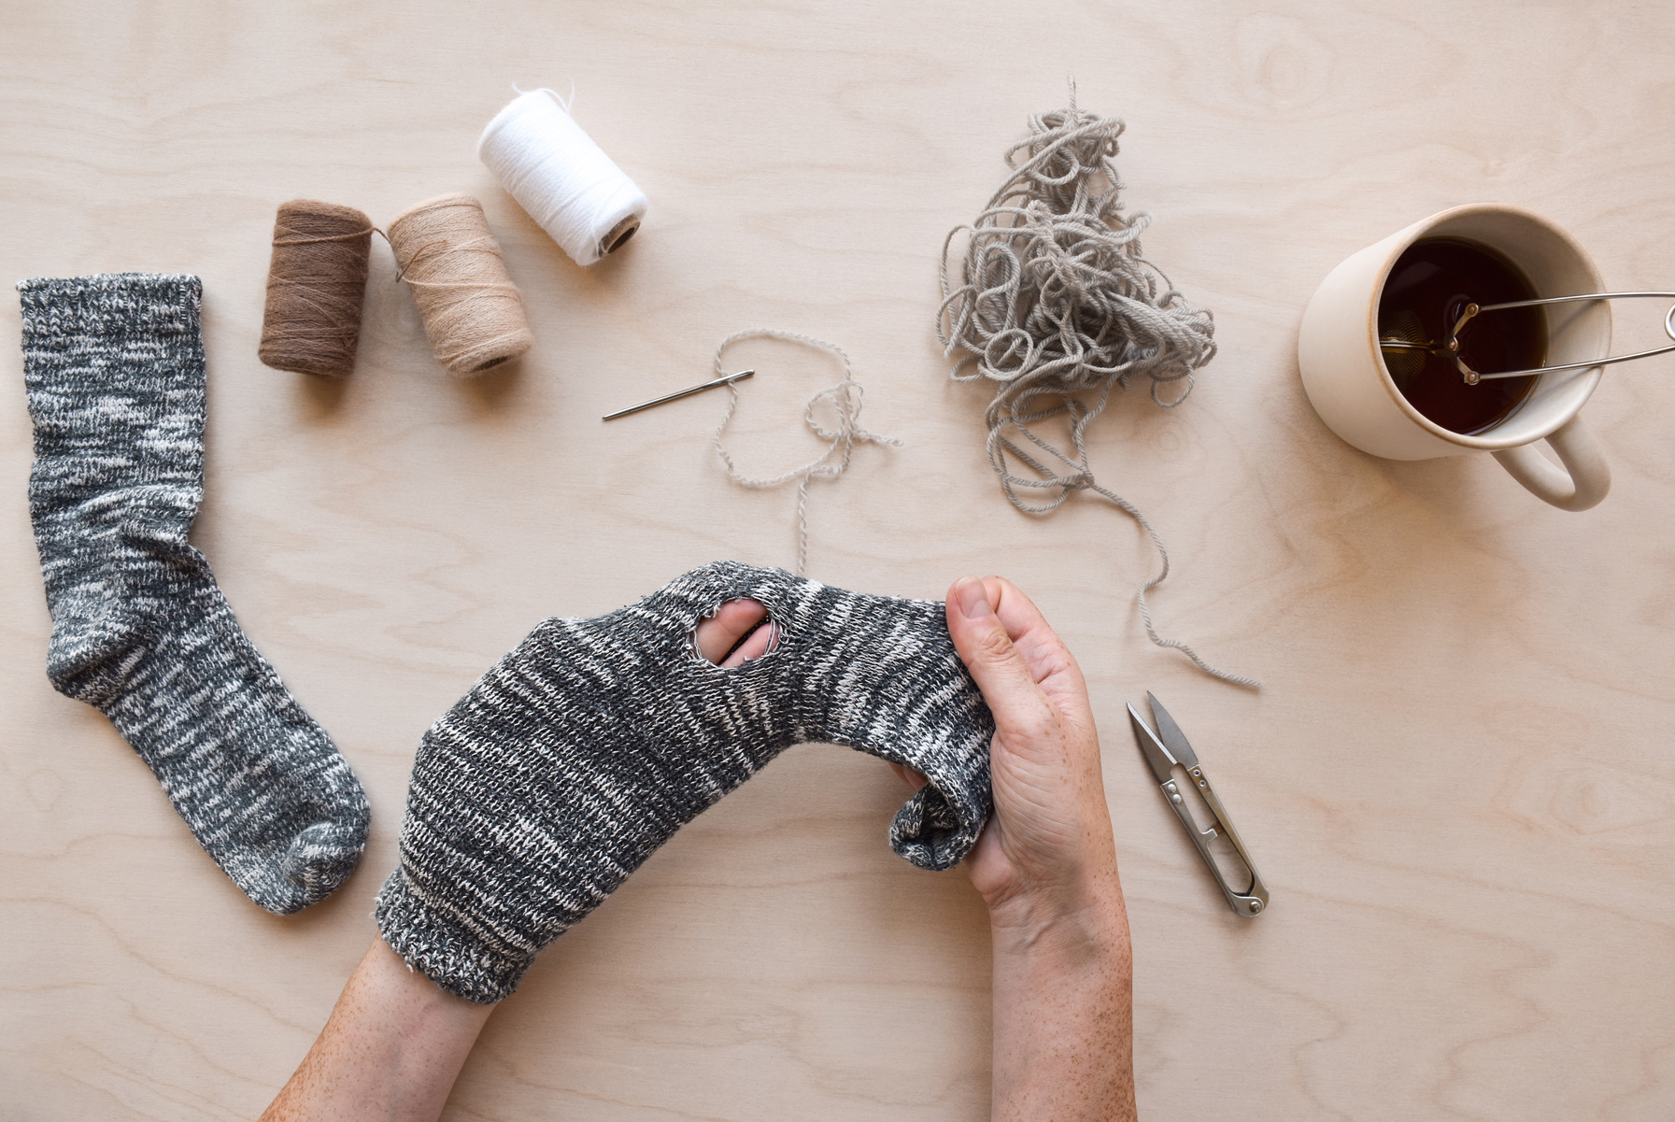
Extension activity 1
DT activity: Clothes repair
Teach children how to sew on a button or fix a hole in a sock.

Slide 30

Extension activity 2
Art activity: What can you create from a school shirt?
Use unclaimed lost property or second-hand uniform items.
Children can either:
Design something new from an old shirt (e.g. a bag, puppet, or costume), or
Learn how to make bunting using fabric scraps.
This activity helps children understand that old clothes can be turned into something new and useful, instead of being thrown away.

Slide 31
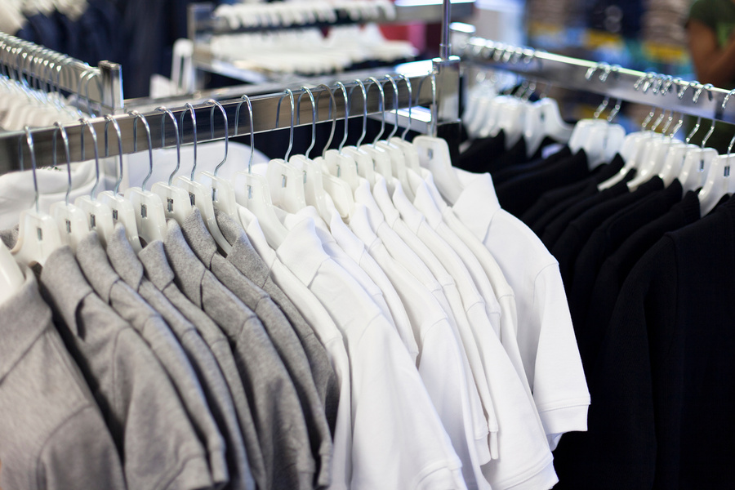
Extension activity 3
Writing/art activity: Children will design and write a poster to advertise a new School Uniform Reuse Shop.
Details to include:
A catchy name for the shop
What the shop does (e.g. sells second-hand uniforms, helps reduce waste)
When and where it will open
How and when families can donate clothes
*Must be SLT/PTA approved

