Slide 1





How can we fix our clothes?
KS2 Lesson - Lesson 4 of 4

Slide 2
LO: To learn how to repair clothes and understand how this helps the environment through the idea of a circular economy.
I can explain what a circular economy is.
I can state why repairing clothes is better than throwing them away.
I can use basic textile repair techniques such as stitching or patching.

Slide 3






Lesson Prep
Vocabulary
Discussion
Keywords that children need to understand and use during the lesson.
An opportunity for children to practice the knowledge learnt.
Big question
Task
To assess learning and give children time to practise independently.
A central question that sparks curiosity and frames the lesson’s theme.
The knowledge
Extension
Essential facts and concepts children need to know.
Optional tasks to deepen or stretch learning beyond the core lesson.

Slide 4
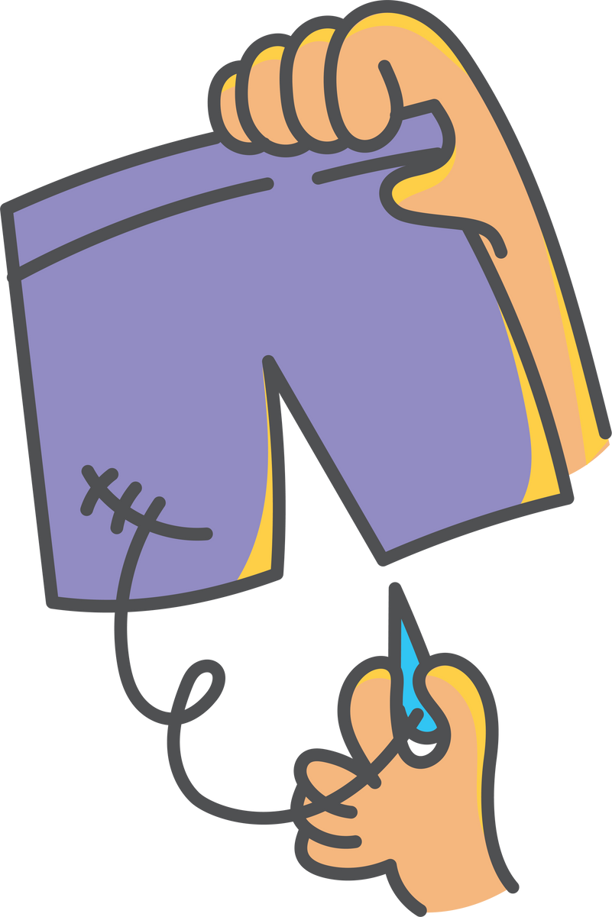
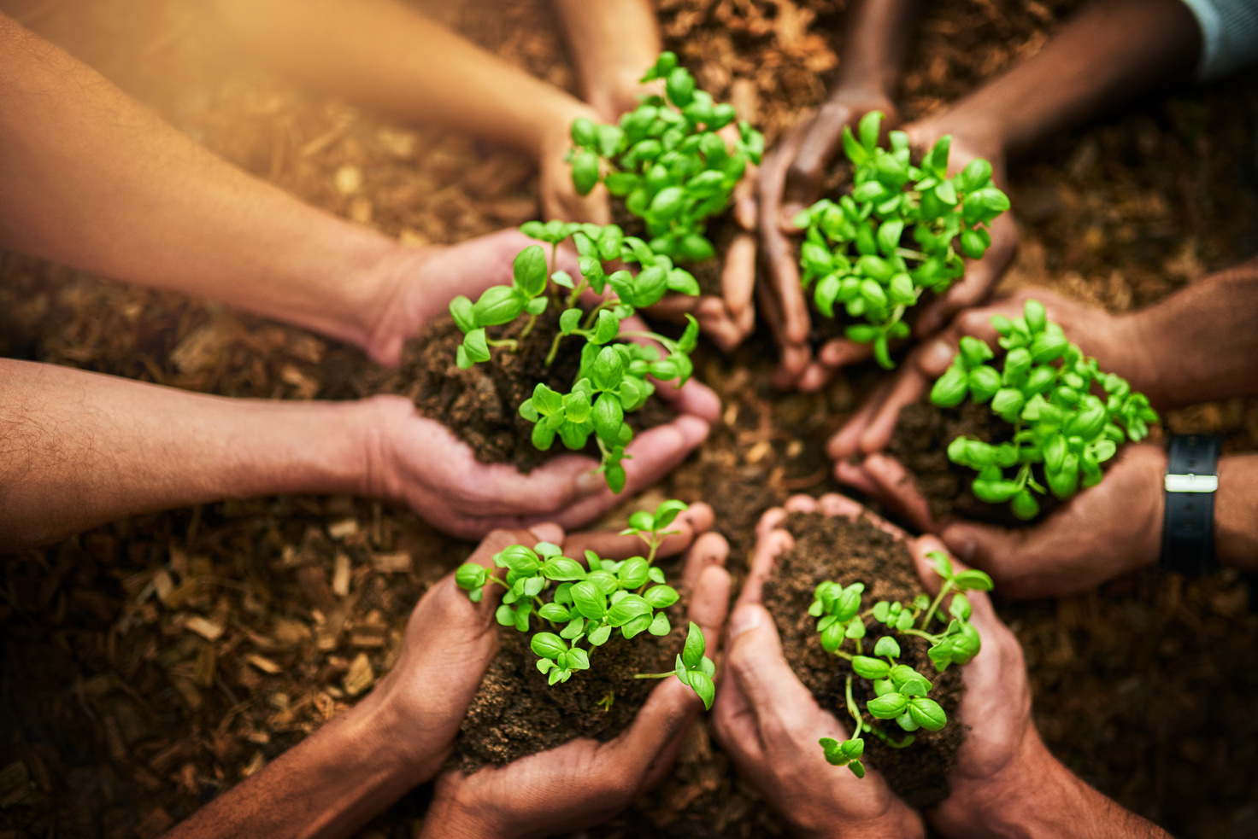


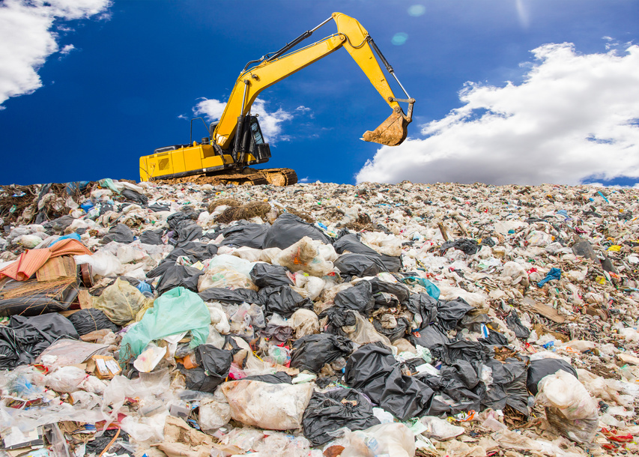

Key Words
natural resource
carbon footprint
repair
sustainable
landfill
reuse
Notes:
Repair: Fixing something that is broken or damaged so it can be used again.
Natural resources: Materials found in nature that people use, such as water, trees, oil, and minerals.
Carbon footprint: The total amount of carbon dioxide (CO₂) released into the air because of a person’s or product’s actions.
Sustainable: Something that can be done in a way that doesn’t harm the environment or use up resources for the future.
Landfill: A place where rubbish is buried under the ground.
Reuse: Using something again instead of throwing it away.

Slide 5


Vocabulary task
Making and moving new clothes uses pollution and adds to our ________ _______________.
When clothes are thrown away, they often end up in a ________ where they stay for many years.
Fixing and using clothes again is a ________ way to help the planet.
I learned how to ________ a hole in my jumper.
Instead of throwing away my old T-shirt, I decided to ________ it as a cloth.
Cotton comes from a plant, which is a type of ________ .
Challenge: Write a sentence using a new vocabulary word.
Notes:
1 = carbon footprint
2 = landfill
3 = sustainable
4 = repair
5 = reuse
6 = natural resource

Slide 6








I got a hole in my jumper and I had to throw it away. I’ve got a new one now so it is ok!
Oh no Nancy! That jumper took a lot of energy to make. There are lots of options to fix it, reuse it or recycle it. Let’s learn all about it!

Slide 7

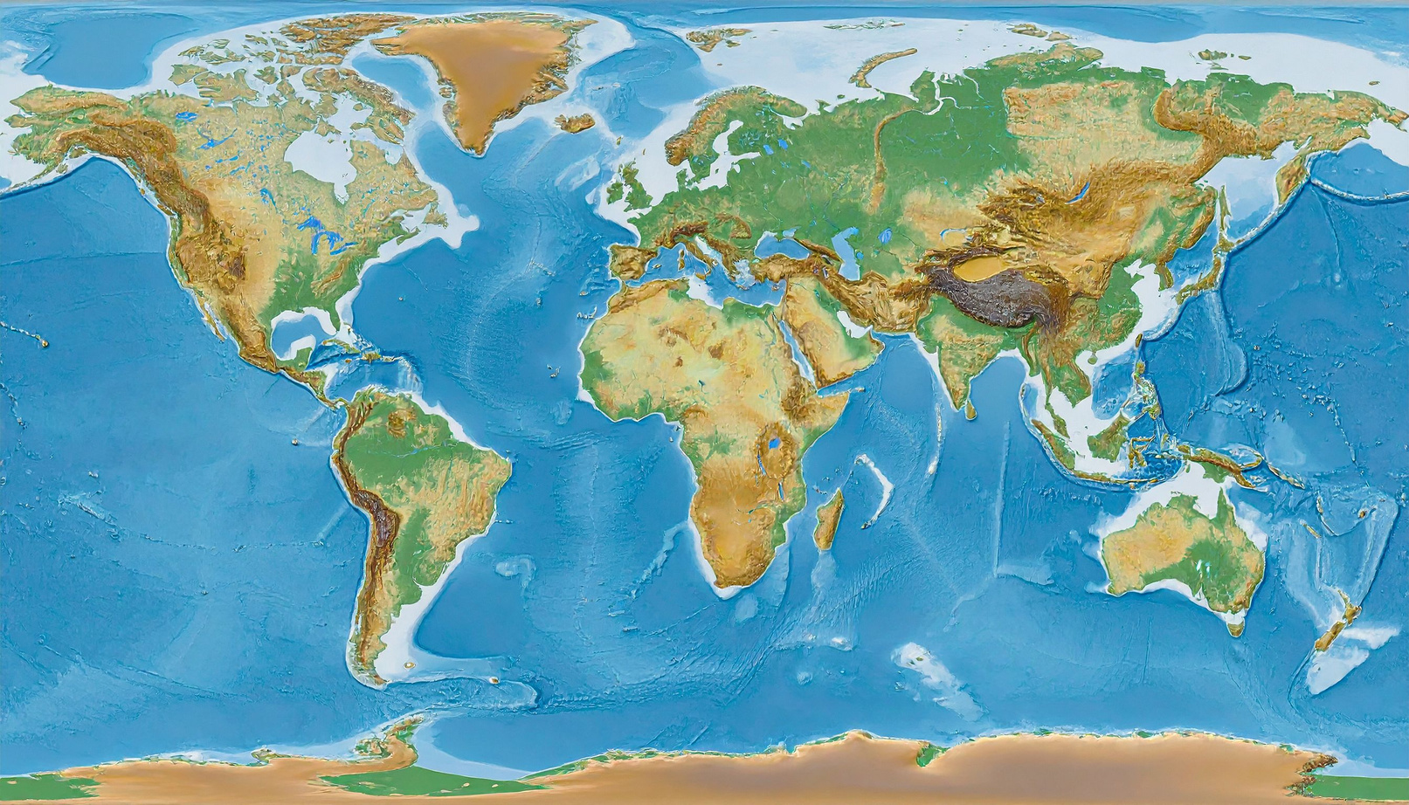
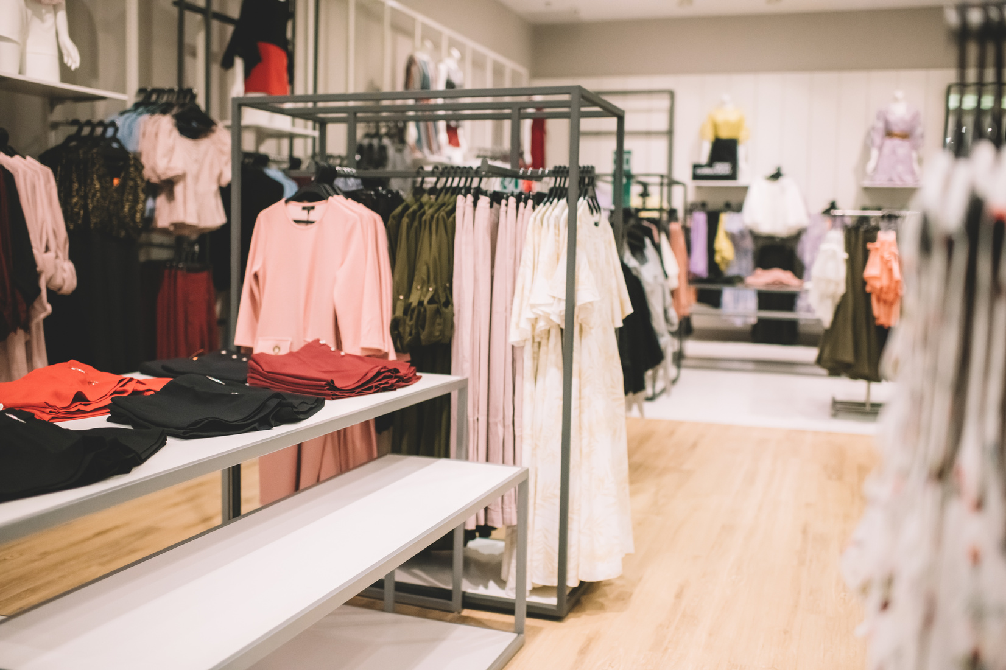
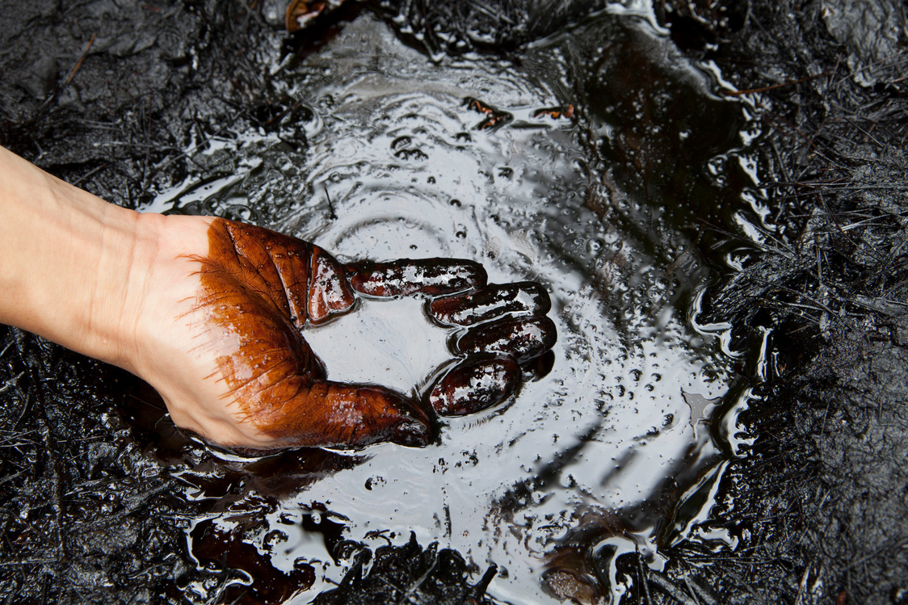
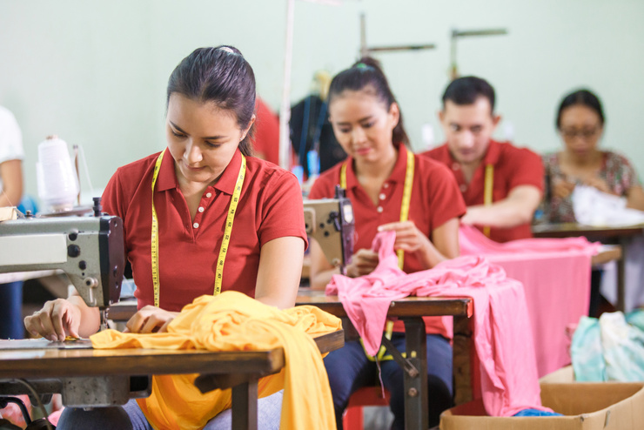
Recap: What was the journey of a polyester T-Shirt?
3. UK
Saudi Arabia
2. Columbia

Slide 8
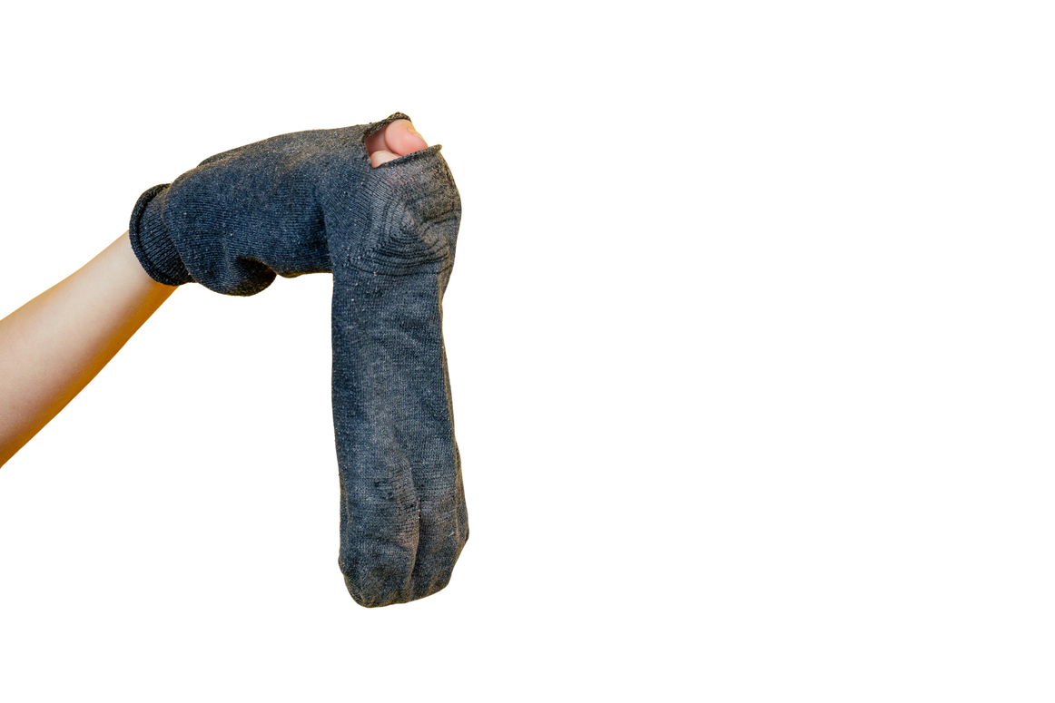
What do you think would happen to the world if everyone threw away their socks just because they had a hole?
Notes:
Give 30 seconds in silence to think about this.
Children can then share with their partners.

Slide 9

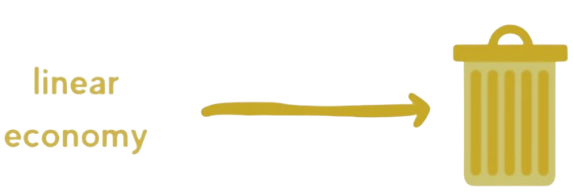

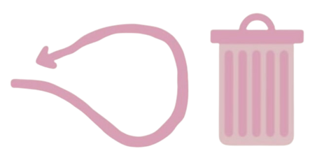
Linear economy vs circular economy
Linear economy
Circular economy

Slide 10
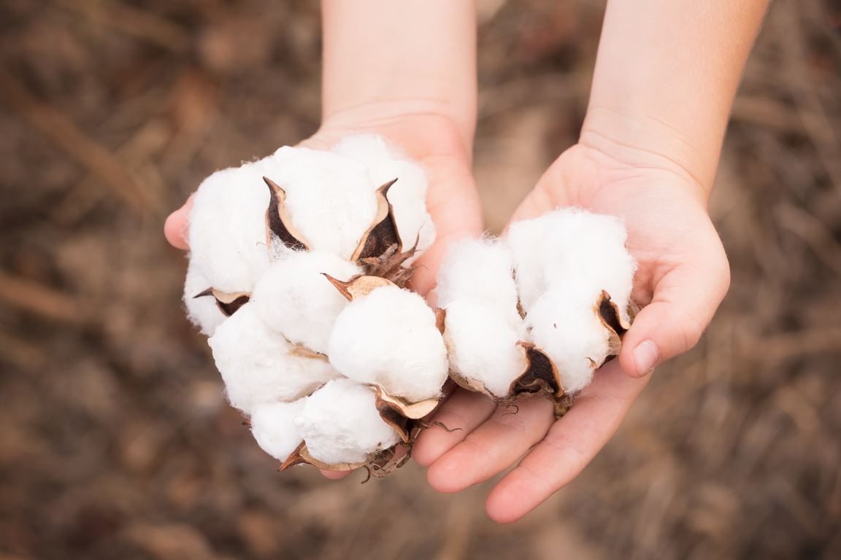
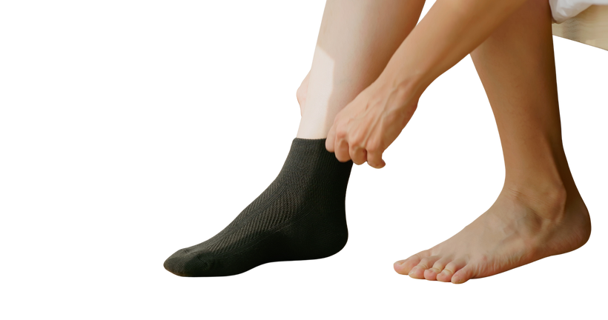
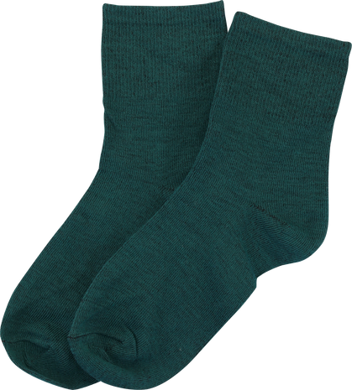

Linear economy
A linear economy is when we:
Take materials, make things, use them and then throw them away.

Slide 11
What is a linear economy
A linear economy is when we:
_____ materials, _____ things, _____ them and then _____ them away.

Slide 12


Circular economy
A circular economy is when we:
Take materials, make things, use them, fix them and reuse them.

Slide 13
What is a circular economy
A circular economy is when we:
_____ materials, _____things, _____ them, _____them and _____ them.

Slide 14



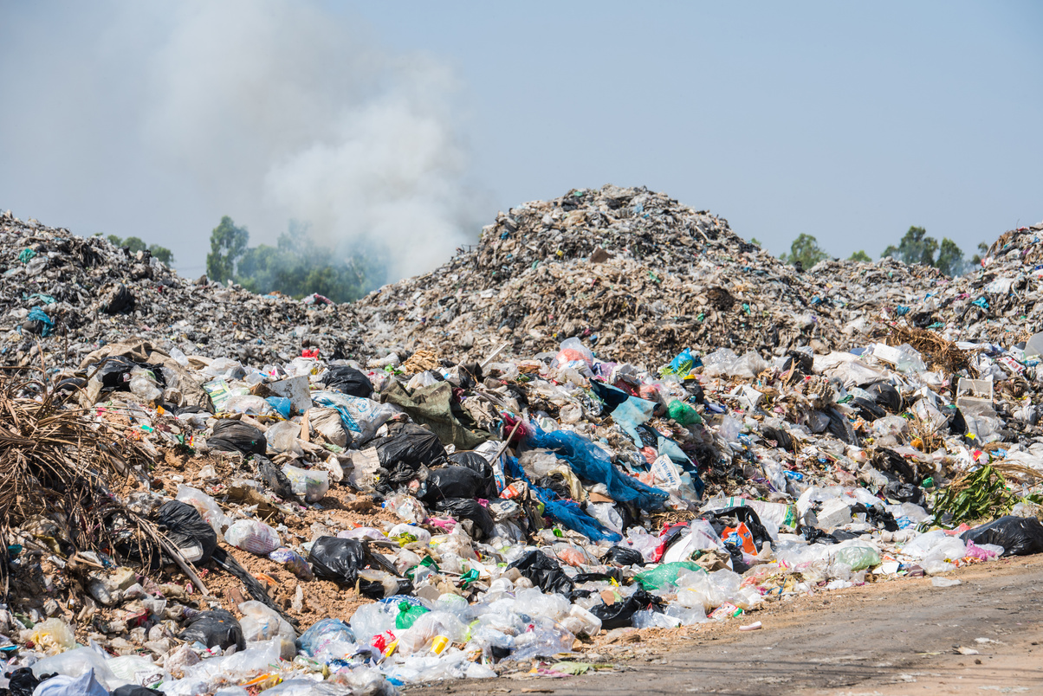
What are the impacts of a linear economy?
Waste of resources - we need more cotton
Increased carbon footprint - new socks need to be transported
More waste in landfill

Slide 15
What are the impacts of a linear economy?
1.
2.
3.

Slide 16

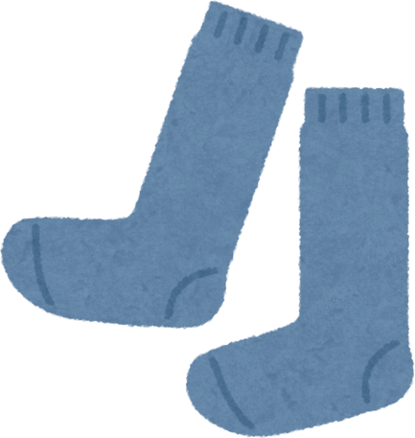
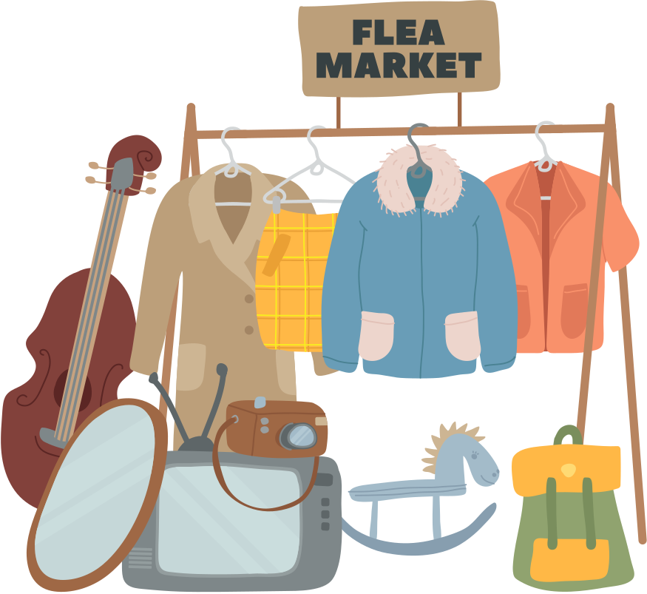



The circular economy
Notes:
Ned loves clothes, but not the kind you throw away after one wear. He always checked labels to find clothes made from cotton, wool, or recycled fabric. Most of his favourite outfits came from second-hand shops, where he found cool, unique pieces. When his jumper got a hole, he didn’t toss it — he stitched it up with a patch shaped like a star!
Ned even swaps clothes with his cousin and helped his mum organise a clothes swap at school. He wore his clothes again and again, proud to know he was helping the planet one outfit at a time.

Slide 17


What are the benefits of a circular economy?
Saves resources- less water and energy needed
Reduces carbon footprint
Stops waste going to landfill

Slide 18
What are the benefits of a circular economy?

Slide 19
Let’s learn how to fix our clothes!

Slide 20
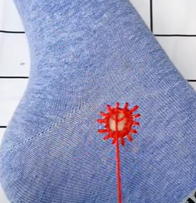
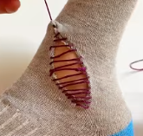
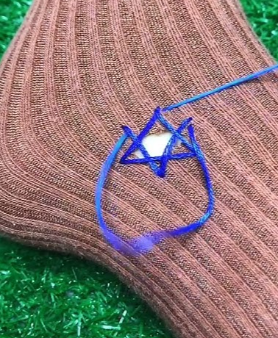
3 ways to repair your socks
Use a patch
3. Sew it back!
2. Use visible mending
Notes:
https://www.youtube.com/watch?v=FCQlAoRq-Ag
https://www.youtube.com/shorts/VSI-HSQ_FZ0

Slide 21
What are 3 ways to repair your socks?
Notes:
https://www.youtube.com/watch?v=FCQlAoRq-Ag
https://www.youtube.com/shorts/8r5ZFIbYgBk
https://www.youtube.com/shorts/VSI-HSQ_FZ0

Slide 22
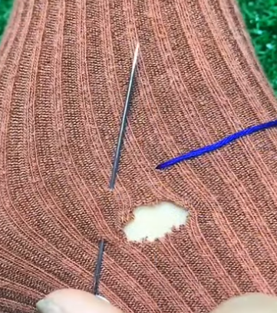
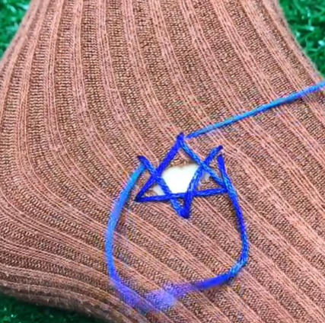
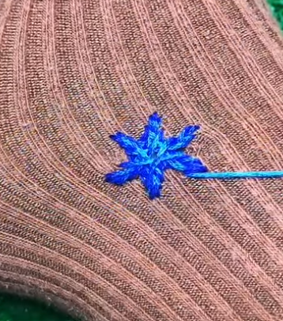
Visible mending
Practice this technique to fix your socks!
*There are many videos online!
Notes:
https://www.youtube.com/watch?v=FCQlAoRq-Ag
https://www.youtube.com/shorts/8r5ZFIbYgBk
https://www.youtube.com/shorts/VSI-HSQ_FZ0

Slide 23




Five tips to look after our clothes
Wear clothes again and again and don’t buy lots of clothes.
2. Fix small holes and tears by sewing them.
3. Swap, share and donate clothes to give them another life.
4. Get your school to join the Uniform Reuse Network!
5. Try to buy natural materials as they are kinder to our environment.

Slide 24

What 5 things can we do?
The 5 things we can do are __________________________.

Slide 25
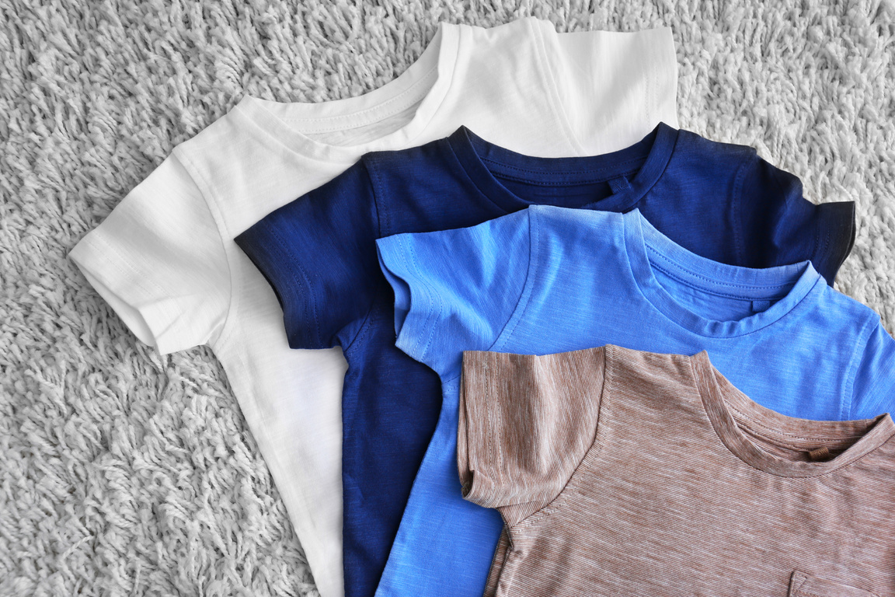
Problems...
Clothes take a long time and a lot of energy to make.
Why do you think people often buy new clothes instead of repairing old ones?
How would the world be different if everyone repaired their clothes instead of throwing them away?
Notes:
Discussion 1
- Read question to children twice
- Give children a moment to think about the question
- In partners, get children to share their thoughts using sentence stem 'People often buy new clothes because...'
-Give children 2 minutes in partners to discuss their opinions
- Listen in to discussion. Spotlight two children
Repeat with question 2

Slide 26
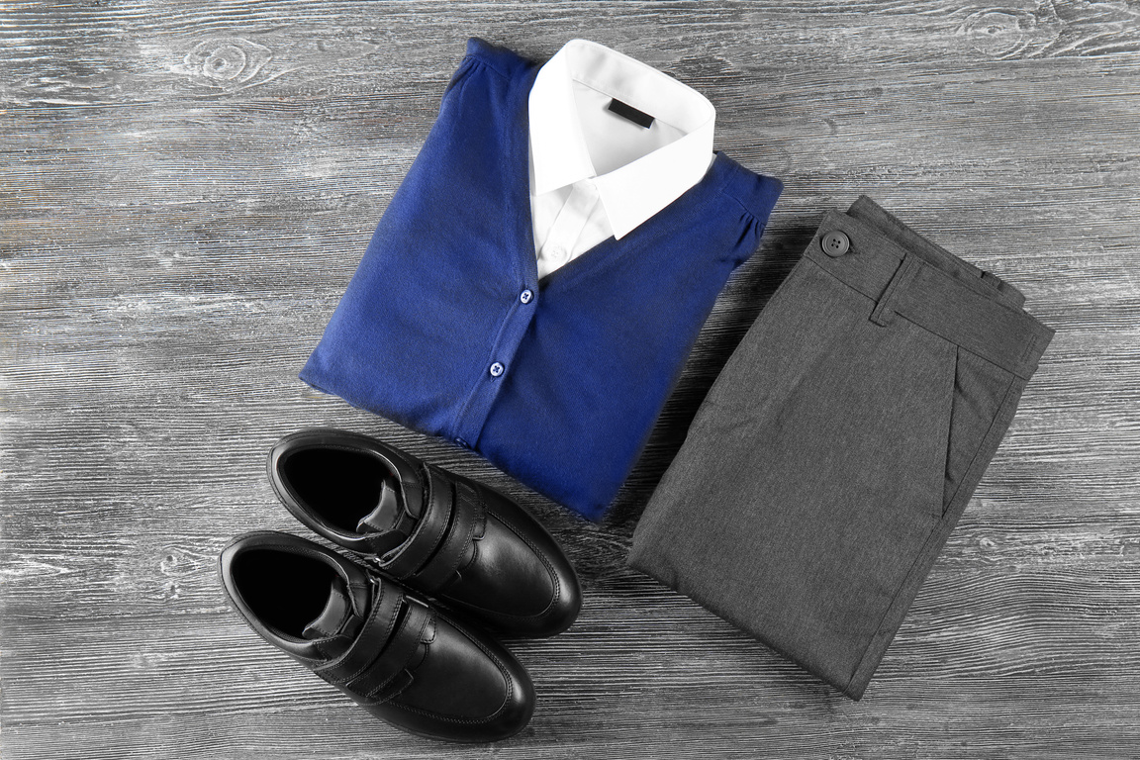
Extension activity 1
Art/design activity:
Pupils will choose an item of old school uniform or unclaimed lost property (e.g. a shirt, jumper, or trousers) and transform it into something new and useful, such as a pencil case, tote bag, soft toy, or patchwork cushion.

Slide 27
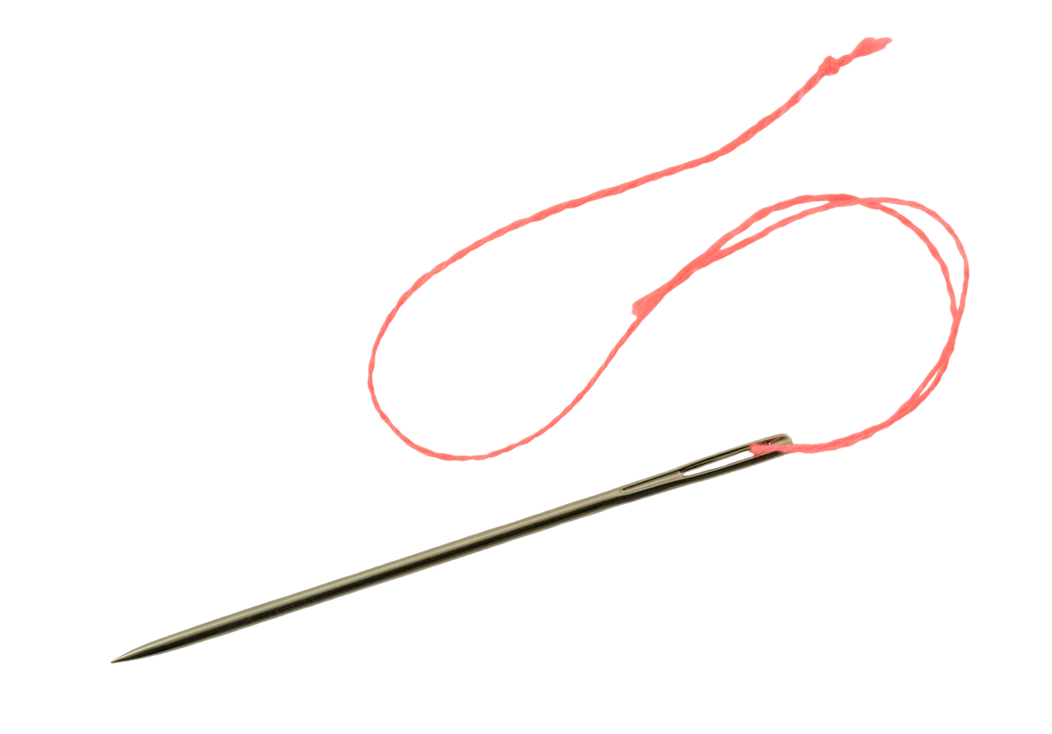
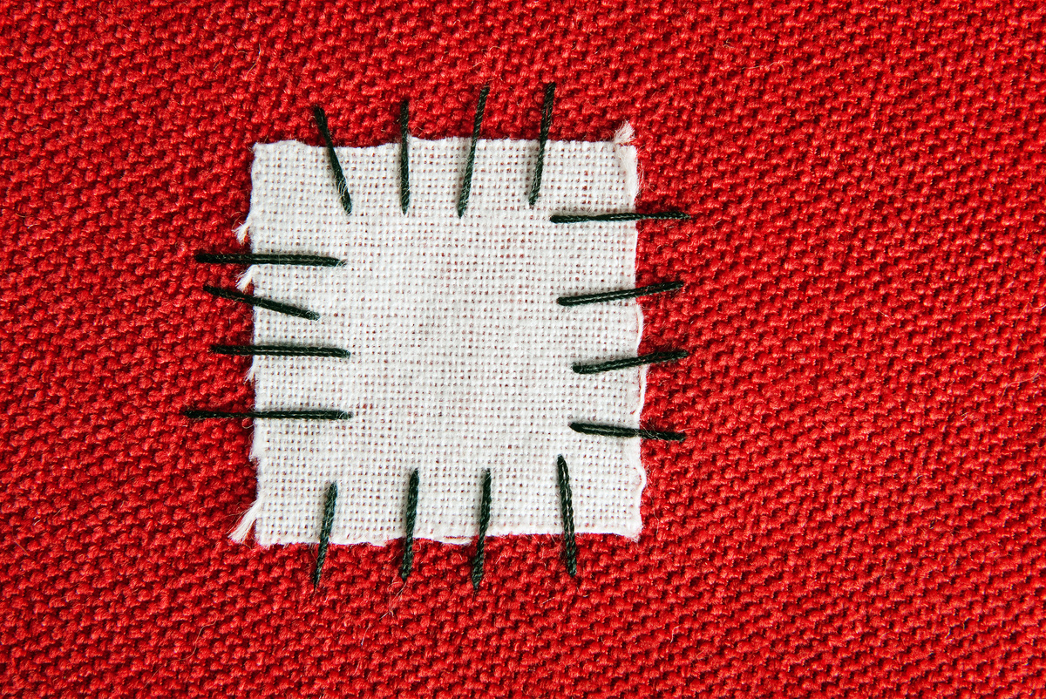
Extension activity 2
Art/design activity: Children practice repair techniques such as sewing on a button or sewing on a patch.

Slide 28
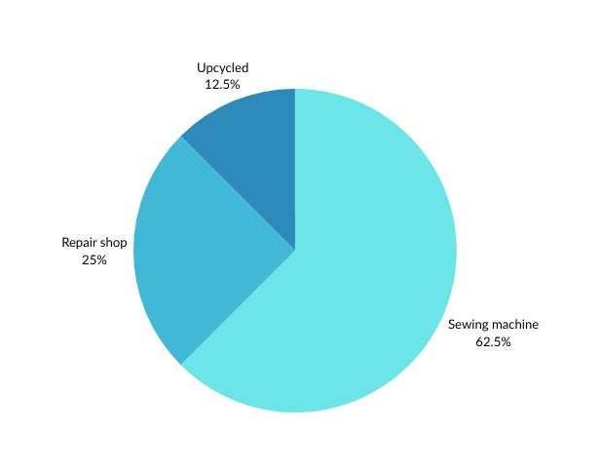
Extension activity 3
Maths activity: Interview a Grown-Up
Pupils interview a parent, grandparent, or carer about how they used to repair or reuse clothes, and share their findings with the class using a data method collection of choice.

