Slide 1





What happens to my rubbish?
KS2 Lesson - Lesson 1 of 3

Slide 2
LO: To understand what happens to our rubbish in north London
I can list items that go in a black rubbish bags
I can state the process of getting energy from waste
I can state the by-products of the process

Slide 3






Lesson Prep
Vocabulary
Discussion
Keywords that children need to understand and use during the lesson.
An opportunity for children to practice the knowledge learnt.
Big question
Task
To assess learning and give children time to practise independently.
A central question that sparks curiosity and frames the lesson’s theme.
The knowledge
Extension
Essential facts and concepts children need to know.
Optional tasks to deepen or stretch learning beyond the core lesson.

Slide 4
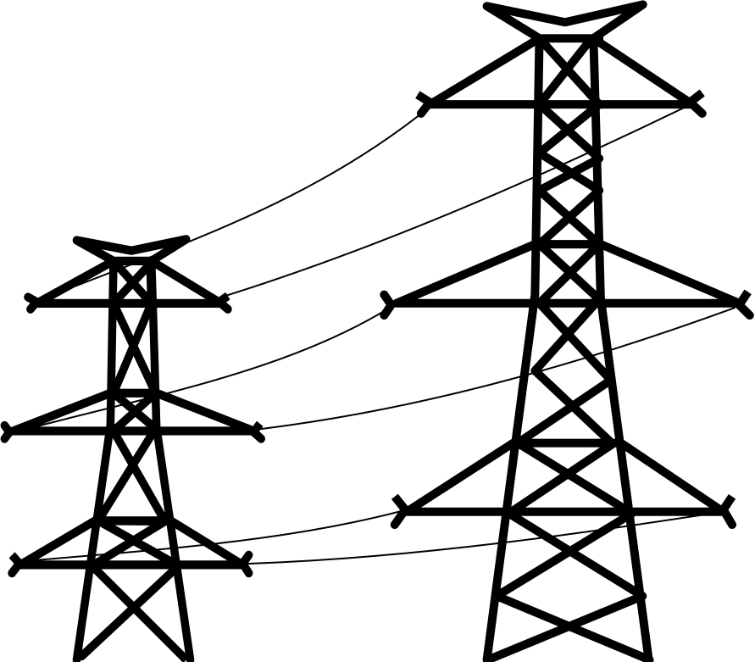
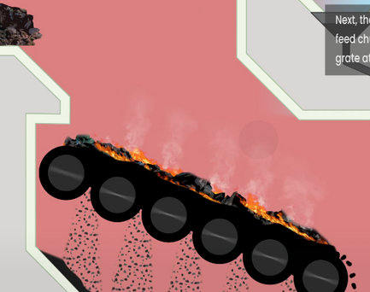






Key Words
electricity
national grid
boiler grate
turbine
energy from waste
boiler
steam
bunker
Notes:
Electricity: Energy that powers things like lights, machines, and devices.
National grid: A network that carries electricity from power stations to homes and businesses.
Boiler grate: A metal surface where waste burns.
Turbine: A machine with blades that spin to make electricity when pushed by steam or gas.
Energy from waste: Making electricity or heat by burning rubbish instead of sending it to landfill.
Boiler: A large container that heats water or makes steam using heat from burning waste.
Steam: Hot water turned into gas when heated.
Bunker: A big storage area where waste is kept before burning.

Slide 5
Vocabulary task
Match the picture numbers with the correct word
2. 3. 4.
national grid
turbine
boiler grate
electricity
Challenge: Write a sentence using a new vocabulary word.
Notes:
1 = electricity
2 = national grid
3 = boiler grate
4 = turbine

Slide 6
Vocabulary task
Match the picture numbers with the correct word
2. 3. 4.
steam
bunker
energy from waste
boiler
Challenge: Write a sentence using a new vocabulary word.
Notes:
1 =energy from waste
2 = boiler
3 = steam
4 = bunker

Slide 7








Good question Nancy. Let’s learn about how we get energy from waste in north London.
In London, rubbish is not sent to a landfill. What happens to it?

Slide 8



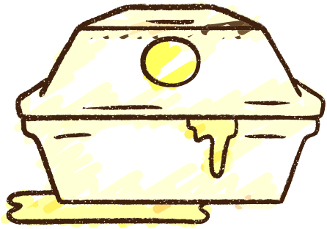


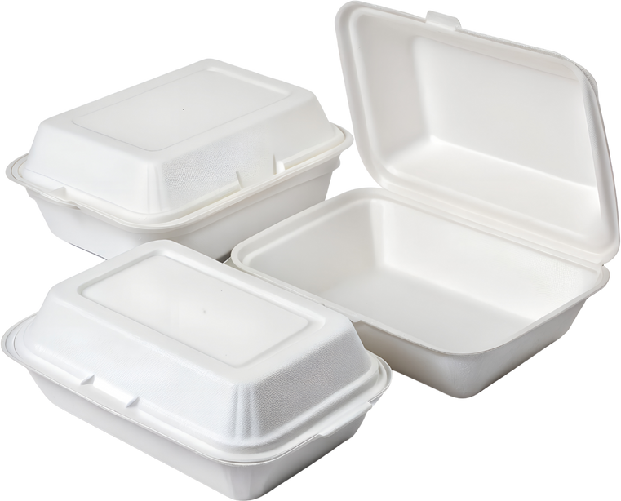
What goes in a rubbish bin?
tissues
clingfilm
crisp packets
nappies
dirty things
greasy things
polystyrene
Notes:
Explicitly teach children what goes in the rubbish bin.
You could have an actual bin with examples to bring this to life.

Slide 9
Tell your partner, what goes in the rubbish bin?
In the rubbish bin, you can put _________.
Notes:
Parnter task

Slide 10
Rubbish
These things go in the rubbish bin as they can not be recycled.
They can not be turned into new things.
Notes:
Teach children why these items go in the rubbish.

Slide 11
Rubbish
These things go in the rubbish bin as they _____________ be __________.
They cannot be turned into __________.
Notes:
Assessment for learning - partner task

Slide 12








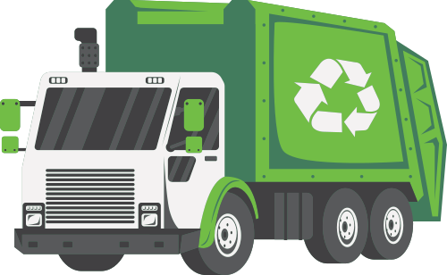
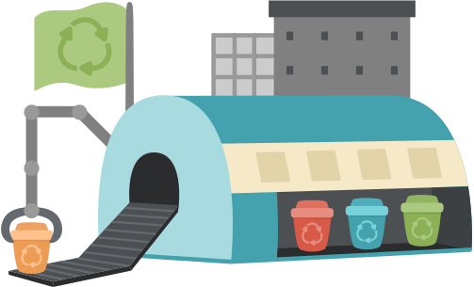

The journey of waste in north London
Recycling goes to a material recovery facility.
Rubbish goes to London Energy.

Slide 13
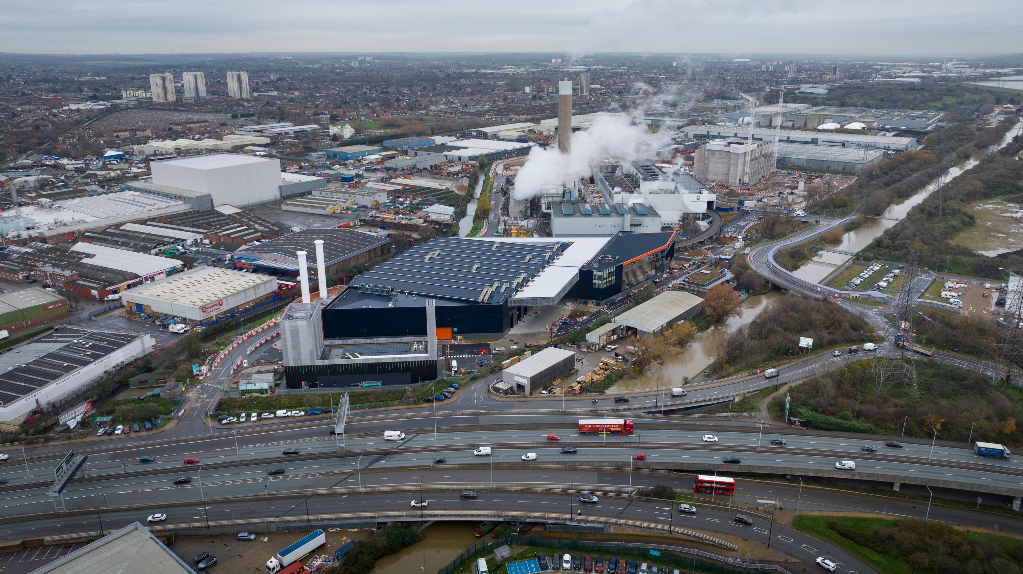




The journey of rubbish
Rubbish is collected from the streets and taken to London Energy
Notes:
Black bin bags are put outside homes and buisnesses.
They are collected by a lorry.
They are taken to London Energy.

Slide 14
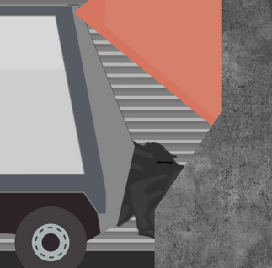
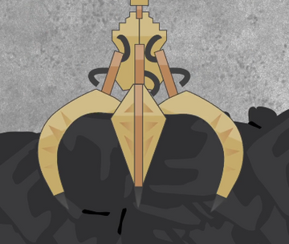
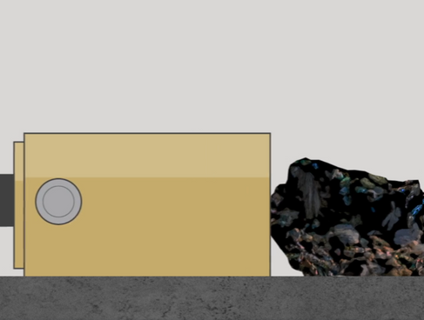
The first 4 steps of rubbish disposal
The rubbish is emptied into a large bunker.
The rubbish is lifted from the bunker and placed into a feed chute.
The rubbish is pushed along, with a hydraulic ram, so the rubbish isn’t pushed through too quick.
The rubbish is burnt on the boiler grate at temperatures above 1000°C.

Slide 15
Tell your partner the first four steps
First the rubbish is ______, then ____________, after that _______, then __________.
bunker stored feed chute hydraulic ram boiler grate temperature 1000°C

Slide 16
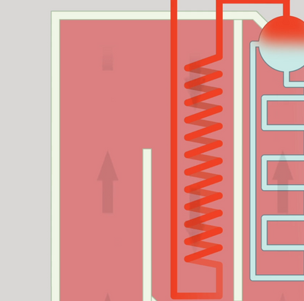
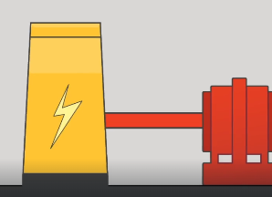
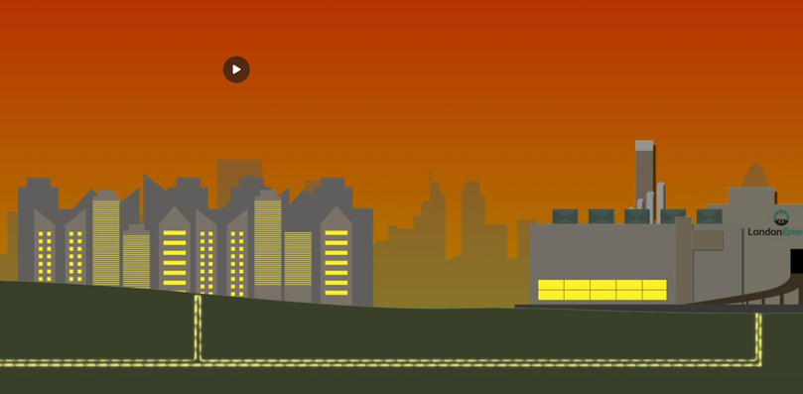

The next 4 steps of rubbish disposal
Hot gases from the boiler rise and heat water in tubes. This makes superheated steam.
The superheated steam turns a turbine.
The turbine turns and makes electricity.
The electricity is sent to the national grid. It is enough to power 80,000 homes and businesses every year as well as London Energy’s building.

Slide 17
Tell your partner the next four steps
Then the rubbish is ______, next ____________, after that _______, then __________.
hot gases boiler superheated steam turbine electricity national grid

Slide 18
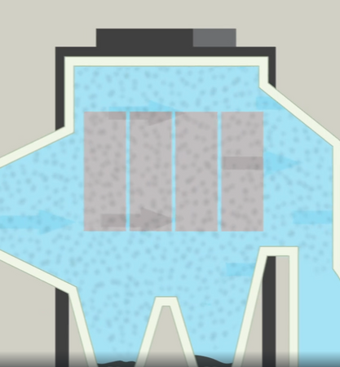
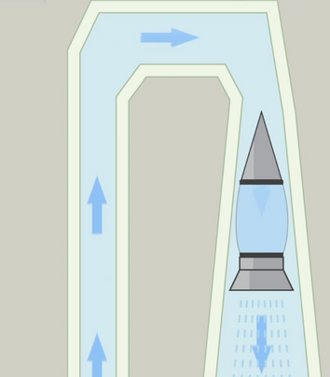
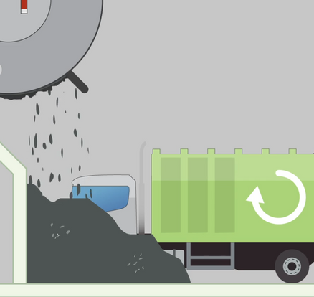
Flue gas cleaning
Rubbish being burnt creates flue gas that needs to be cleaned.
An electrostatic precipitator uses electric charges to pull tiny metal particles out of the flue gas.
Special equipment cleans the flue gas before sending it out to the atmosphere as steam.
When we burn waste, ash is made. This is collected and reused for making roads.

Slide 19
How is the flue gas cleaned?
flue gas electrostatic precipitator electric charges metal steam ash

Slide 20

Recap - Energy from waste video
Notes:
This video may be too advance for young learners so pauses may be necessary if watching.

Slide 21
I did not know that we got electricity from rubbish. That’s good!
It is better than it going to landfill Nancy, but there are much better things we can do. Let’s take a look.

Slide 22
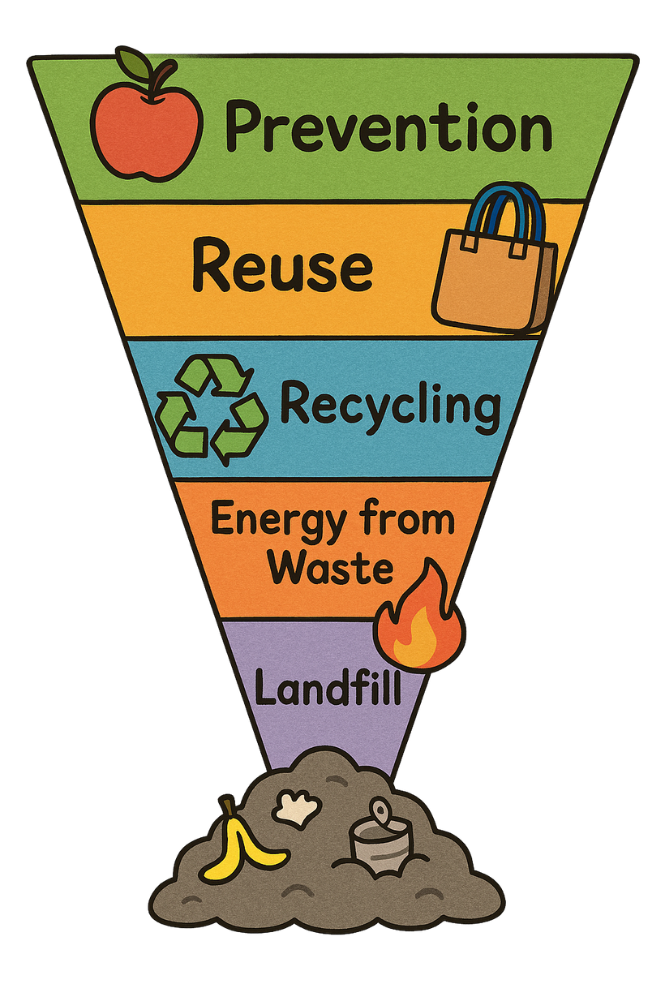
The best for our environment
The worst for our environment
Look at the diagram. What is better than getting energy from waste?
Notes:
Landfill: Putting waste into the ground where it stays for a long time and can harm the environment.
Energy from Waste: Burning waste to make electricity or heat. It reduces waste but can cause pollution.
Recycling: Turning old materials into new things so they can be used again instead of thrown away.
Reuse: Using items again without changing them, like refilling a water bottle or donating clothes.
Prevention: Stopping waste before it happens by using less and choosing things that last longer.

Slide 23
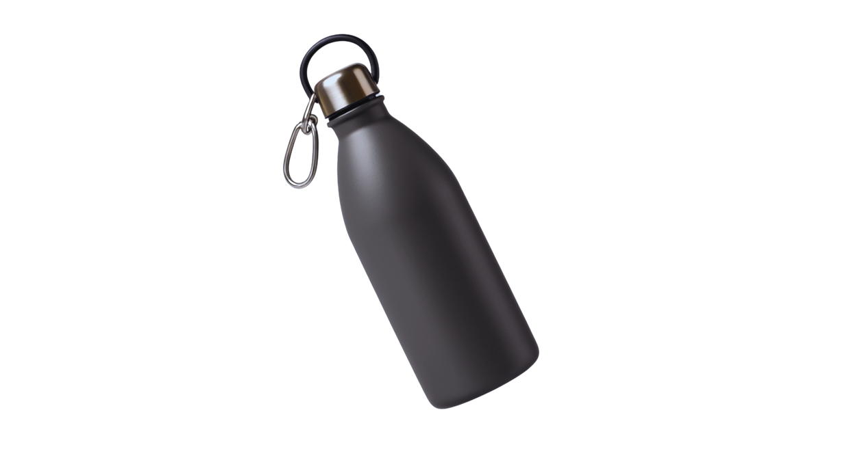

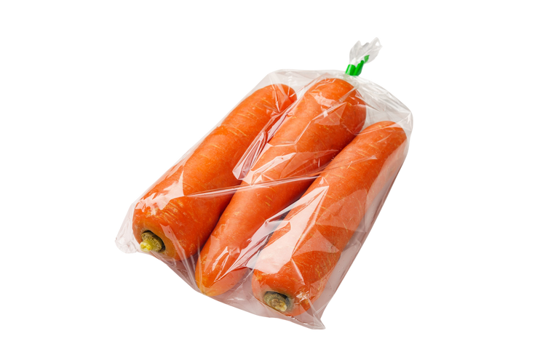

Top rubbish tips!
Use it again! – Try reusing things like bags, bottles, and containers.
2. Think before you throw! – Can it be recycled or donated instead?
3. Choose less packaging! – Pick snacks and toys with less plastic or wrapping.

Slide 24
What 3 things can we do?
Three things we can do are _______, __________ and __________.

Slide 25
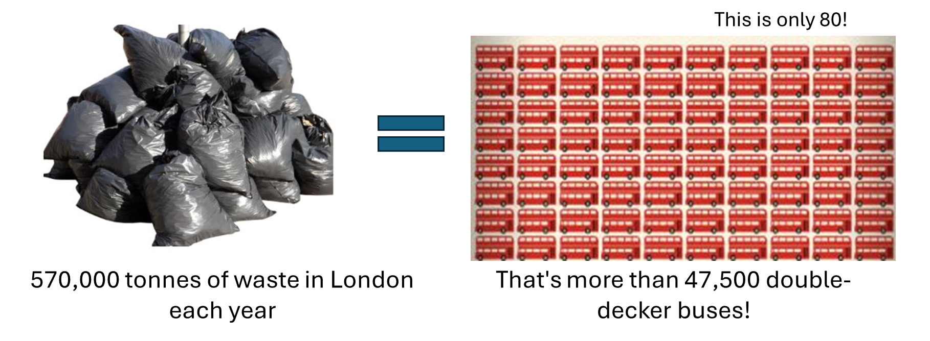
The problem in London!
What could we do to reduce how much rubbish we have?
Notes:
Discussion 1
- Read question to children twice
- Give children a moment to think about the question
- In partners, get children to share their thoughts using sentence stem 'To reduce this we can...'
-Give children 2 minutes in partners to discuss their opinions
- Listen in to discussion. Spotlight two children
Repeat with question 2

Slide 26
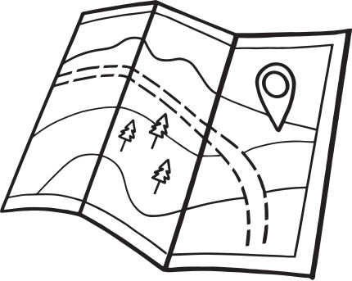
Extension activity 1
Art/geography activity: Draw a map of the journey of waste in north London with annotations.

Slide 27
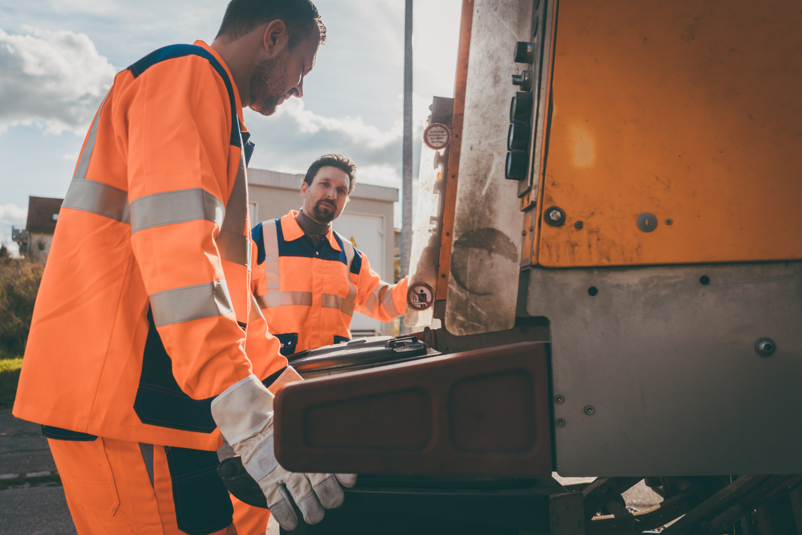
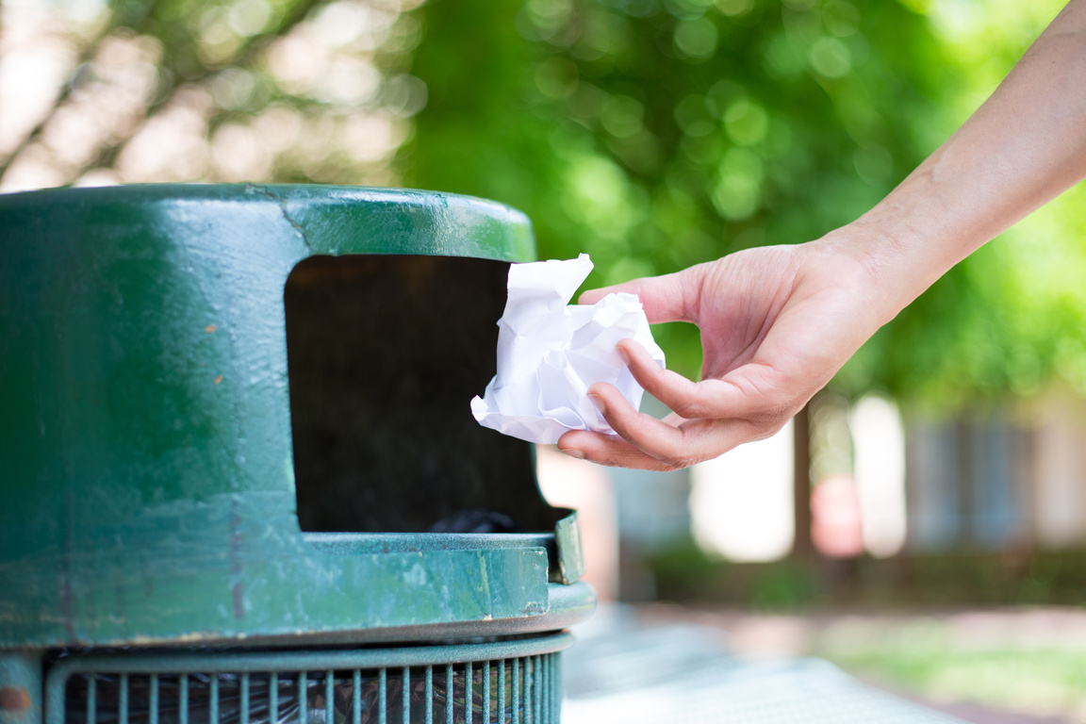


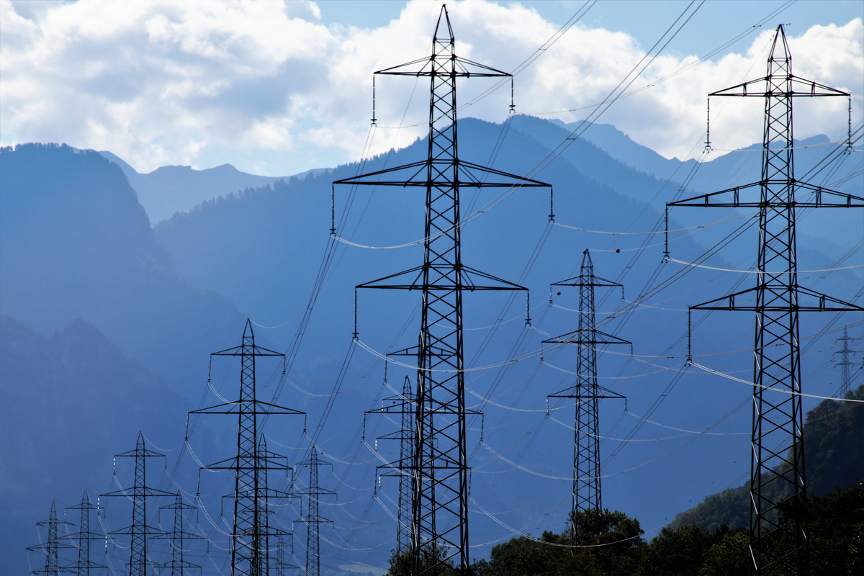
Extension activity 2
Science activity: Reorder the steps to rubbish waste in North London. Write a caption for each. Can you include the key words?
Key words
bunker
feed chute
boiler grate
superheated steam
turbine
national grid
flue gas

Slide 28

Extension activity 3
Science/STEM activity: Go around the school to look in the rubbish bins. Is your school putting the correct things in the rubbish bin?

