Slide 1





What happens to my rubbish?
KS1 Lesson - Lesson 1 of 3

Slide 2
LO: To understand what happens to our rubbish in North London
I can list what items go in the black rubbish bags
I know where our black rubbish bags go
I can say what happens to our rubbish bags

Slide 3






Lesson Prep
Vocabulary
Discussion
Keywords that children need to understand and use during the lesson.
An opportunity for children to practice the knowledge learnt.
Big question
Task
To assess learning and give children time to practise independently.
A central question that sparks curiosity and frames the lesson’s theme.
The knowledge
Extension
Essential facts and concepts children need to know.
Optional tasks to deepen or stretch learning beyond the core lesson.

Slide 4
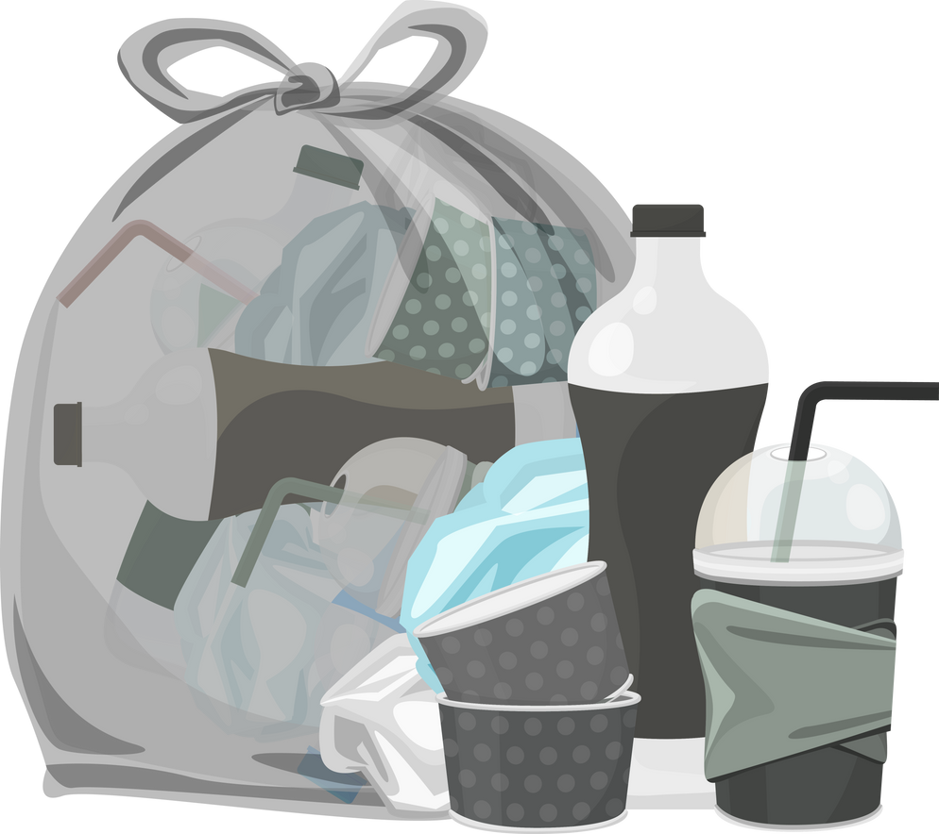


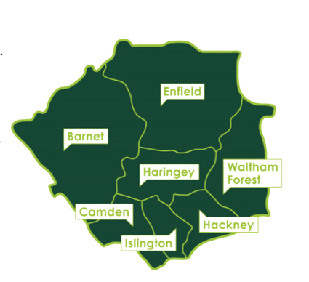

Key Words
rubbish
recycling
electricty
energy from waste
North London
Notes:
Rubbish: Waste material or things that are no longer wanted or needed and are thrown away.
Recycling: The process of converting waste materials into new materials and objects to prevent waste and reduce environmental impact.
Electricity: A form of energy resulting from the movement of charged particles, used to power devices, lights, and machines.
Energy from waste: A process of generating energy, usually electricity or heat, by burning or processing waste materials.
North London: A region of London. North London Waste Authority take the waste from 7 London boroughs.

Slide 5
Vocabulary task
2. 3. 4. 5.
energy from waste
rubbish
North
London
recycling
electricity
Challenge: Write a sentence using a new vocabulary word.
Notes:
1 = rubbish
2 = energy from waste
3 = recycling
4 = North London
5 = electricity

Slide 6








Oh Nancy! It is very important to know what goes in the black bin bag and what happens to it! Let’s find out!
Do you just guess what you put in your black bin bag Ned?

Slide 7






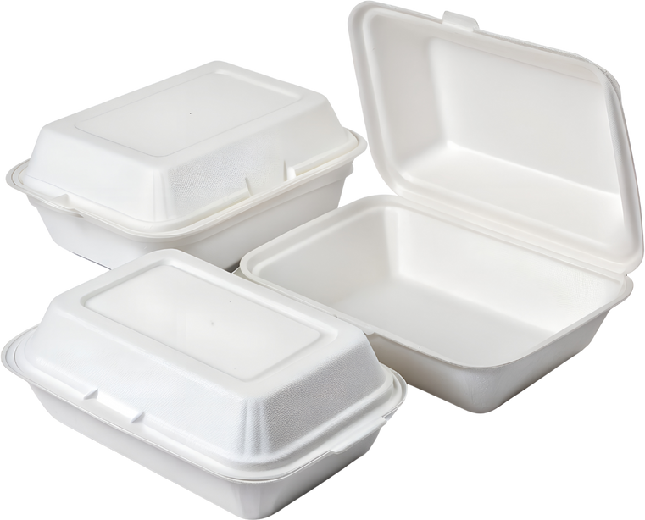
What goes in a rubbish bin?
tissues
clingfilm
crisp packets
nappies
dirty things
greasy things
polystyrene
Notes:
Explicitly teach children what goes in the rubbish bin.
You could have an actual bin with examples to bring this to life.

Slide 8
Tell your partner, what goes in the rubbish bin?
In the rubbish bin, you can put _________.
Notes:
Parnter task

Slide 9
Rubbish
These things go in the rubbish bin as they can not be recycled.
They can not be turned into new things.
Notes:
Teach children why these items go in the rubbish.

Slide 10
Rubbish
These things go in the rubbish bin as they _____________ be __________.
They can not be turned into __________.
Notes:
Assessment for learning - partner task

Slide 11








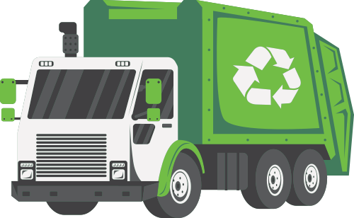
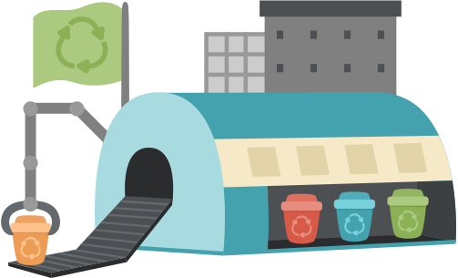

The journey of waste in North London
Recycling goes to a recycle centre.
Rubbish goes to London Energy.

Slide 12
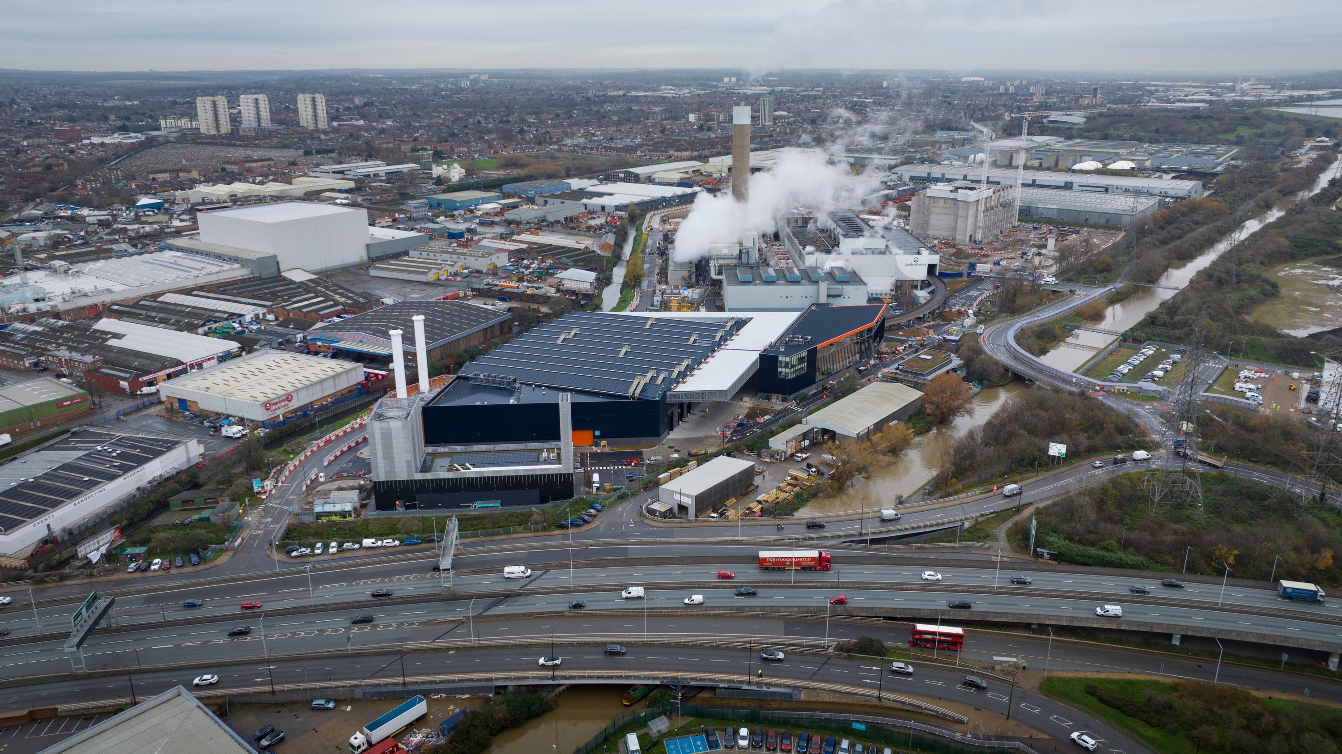




The journey of rubbish
Rubbish is sent to London Energy
Notes:
Black bin bags are put outside.
They are collected by a lorry.
They are taken to London Energy.

Slide 13
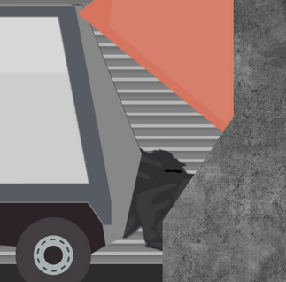
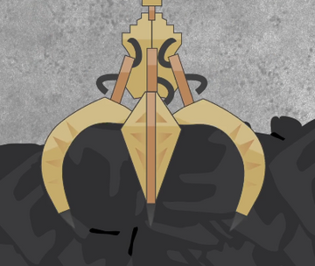
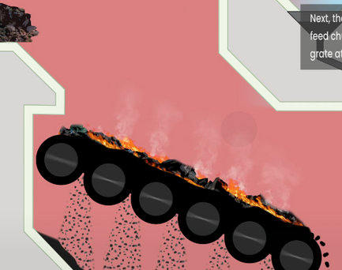
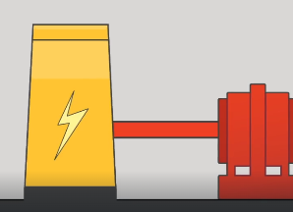
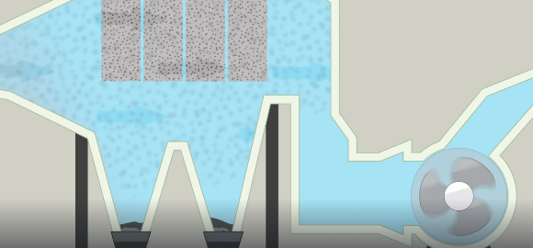
Inside London Energy (where the rubbish goes in North London)
The rubbish is emptied.
The rubbish is picked up by a claw.
The rubbish is burnt.
The heat makes electricity for homes in London.
The air is cleaned.

Slide 14
Tell your partner what happens to our rubbish
emptied claw burnt electricity air

Slide 15

Optional video
Notes:
This video may be too advance for young learners so pauses may be necessary if watching.

Slide 16
I did not know that we got electricity from rubbish. That is good.
It is better than it going to landfill Nancy, but there are much better things we can do. Let’s take a look.

Slide 17
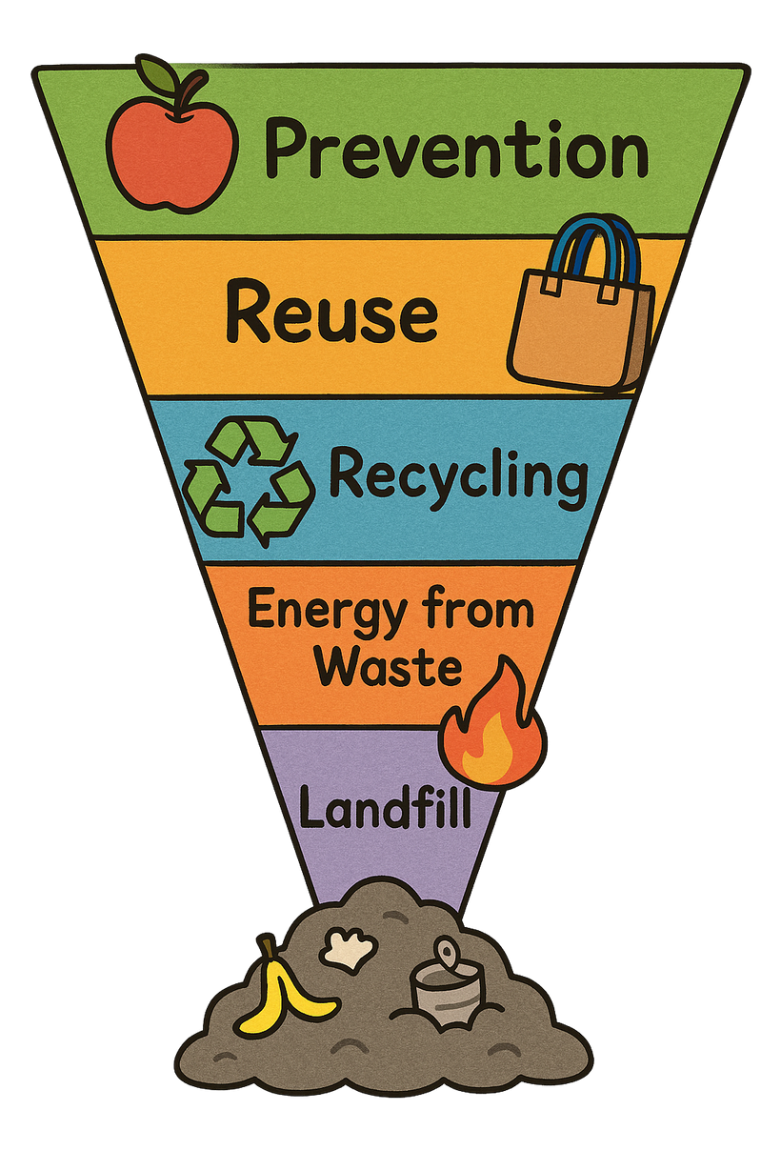
The best for our environment
The worst for our environment
Look at the diagram. What is better than getting energy from waste?
Notes:
Landfill: Putting waste into the ground where it stays for a long time and can harm the environment.
Energy from Waste: Burning waste to make electricity or heat. It reduces waste but can cause pollution.
Recycling: Turning old materials into new things so they can be used again instead of thrown away.
Reuse: Using items again without changing them, like refilling a water bottle or donating clothes.
Prevention: Stopping waste before it happens by using less and choosing things that last longer.

Slide 18
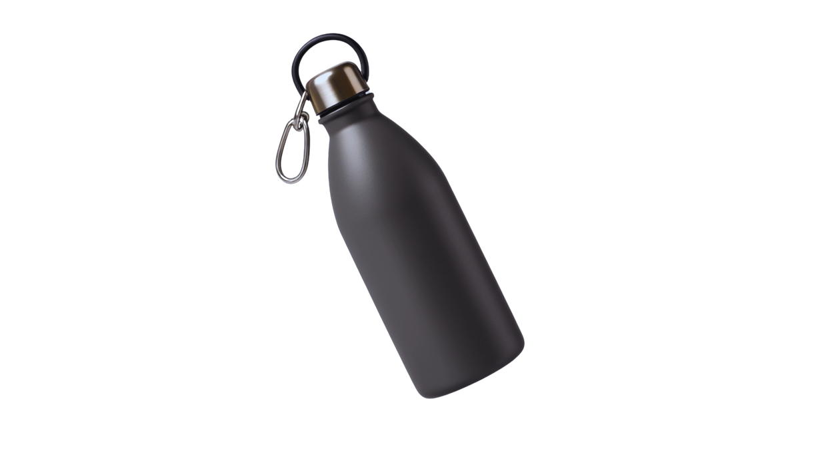

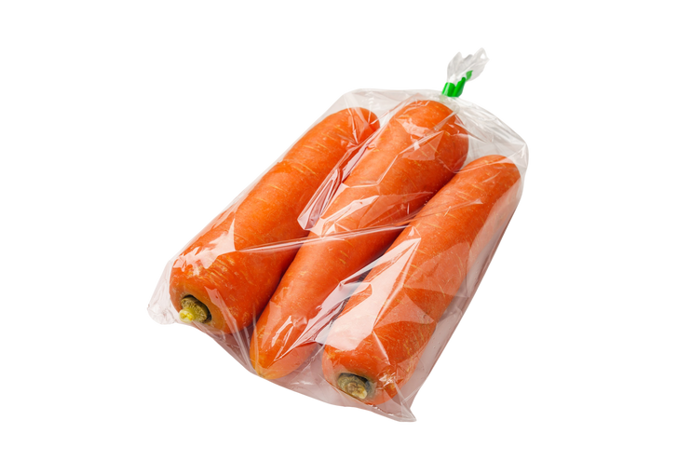

Top rubbish tips!
Use it again! – Try reusing things like bags, bottles, and containers.
2. Think before you throw! – Can it be recycled or donated instead?
3. Choose less packaging! – Pick snacks and toys with less plastic or wrapping.

Slide 19
What 3 things can we do?
Three things we can do are _______, __________ and __________.

Slide 20
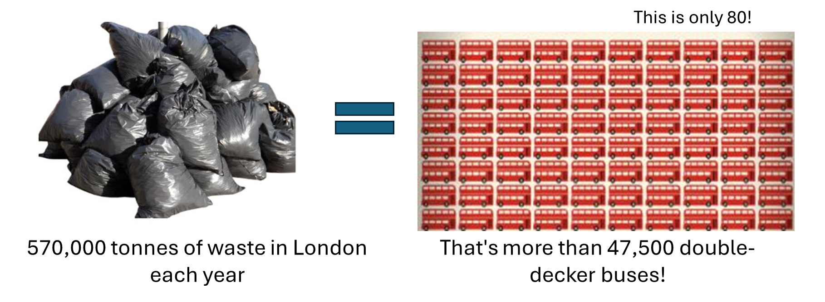
The problem in London!
What could we do to reduce how much rubbish we have?
Notes:
Discussion 1
- Read question to children twice
- Give children a moment to think about the question
- In partners, get children to share their thoughts using sentence stem 'To reduce this we can...'
-Give children 2 minutes in partners to discuss their opinions
- Listen in to discussion. Spotlight two children
Repeat with question 2

Slide 21
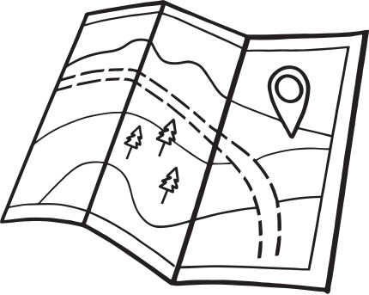
Extension activity 1
Art/geography activity: Draw a map of the journey of waste in north London

Slide 22
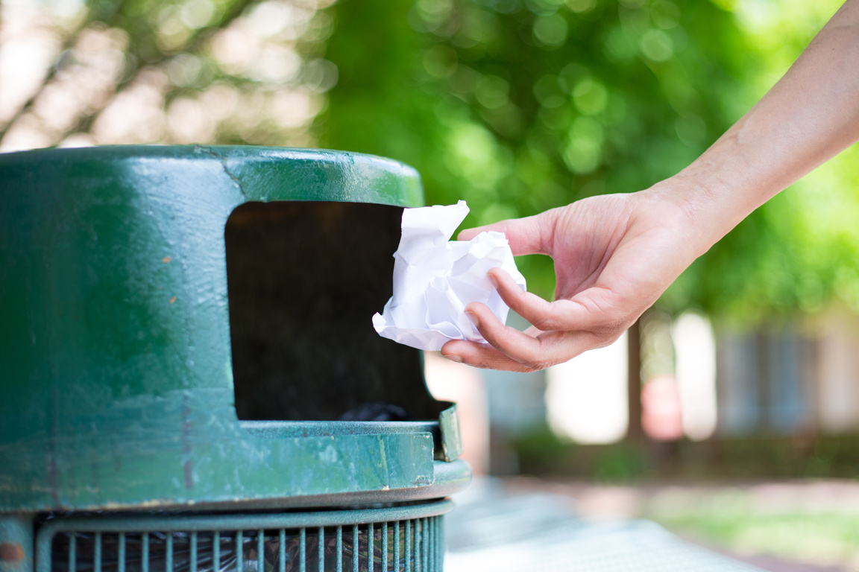
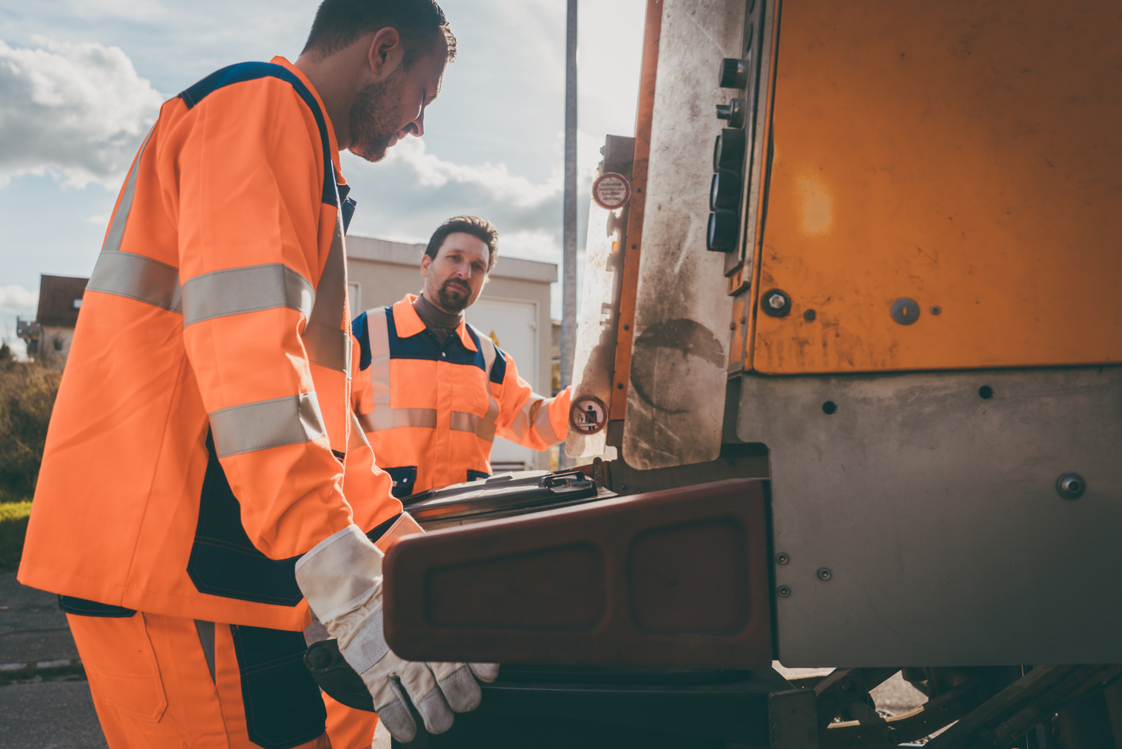

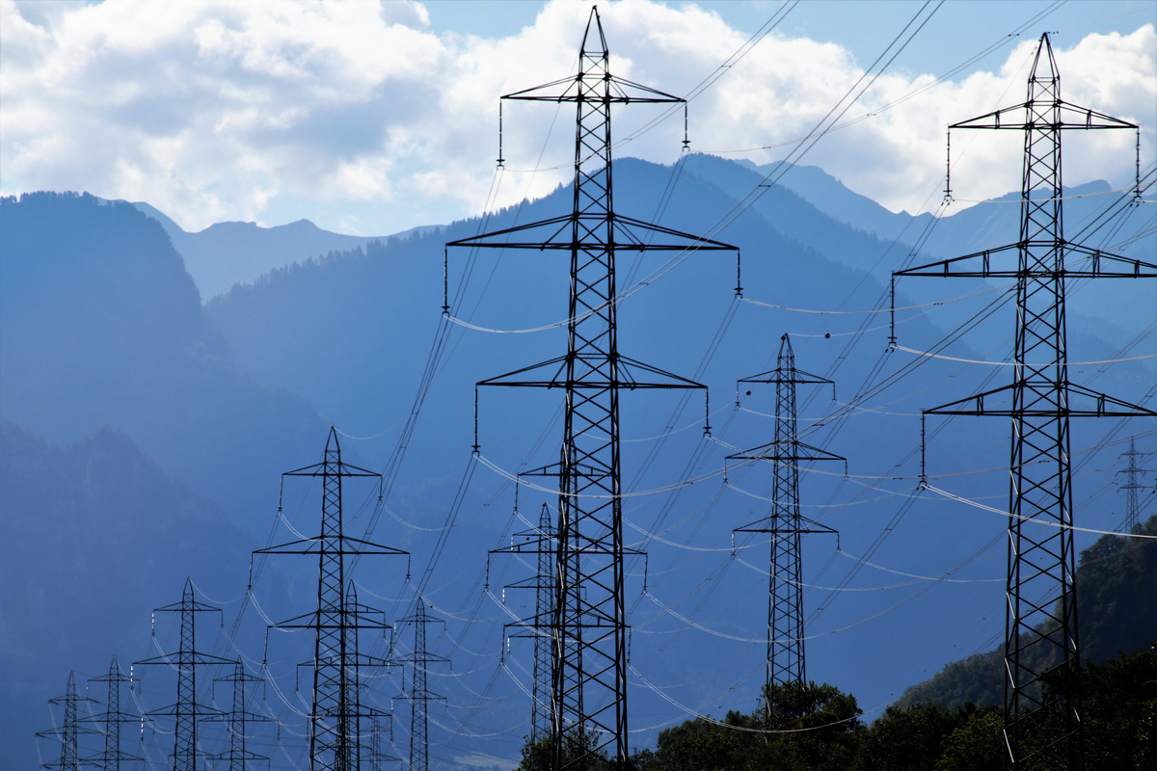
Extension activity 2
Science activity: Reorder the steps to rubbish waste in North London. Write a caption for each.

Slide 23

Extension activity 3
Science/STEM activity: Go around the school to look in the rubbish bins. Is your school putting the correct things in the rubbish bin?

