Slide 1





What happens to my recycling?
KS2 Lesson - Lesson 2 of 3

Slide 2
LO: To understand and explain how some materials are recycled
  I can explain why recycling is important.
  I know how materials are sorted at the material recovery facility.
  I can explain how plastic, paper and metal are recycled.

Slide 3






Lesson Prep
Vocabulary
Discussion
Keywords that children need to understand and use during the lesson.
An opportunity for children to practice the knowledge learnt.
Big question
Task
To assess learning and give children time to practise independently.
A central question that sparks curiosity and frames the lesson’s theme.
The knowledge
Extension
Essential facts and concepts children need to know.
Optional tasks to deepen or stretch learning beyond the core lesson.

Slide 4




There is a lot to learn about recycling. This is part 1 of the lesson.

Slide 5

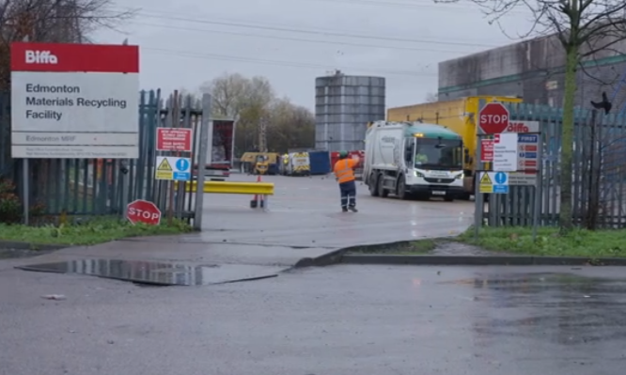
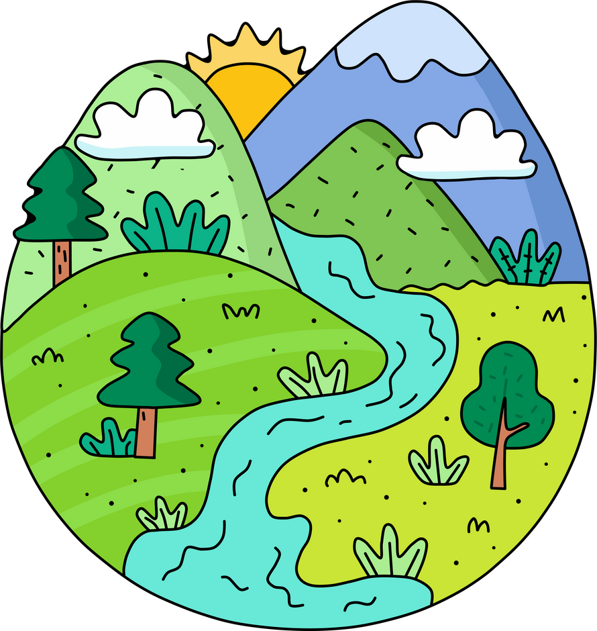

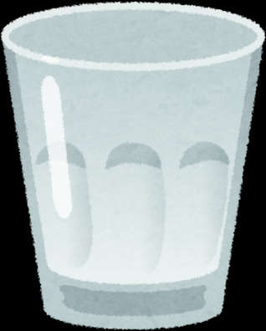
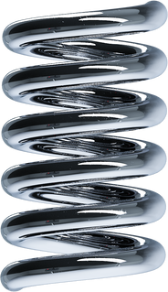
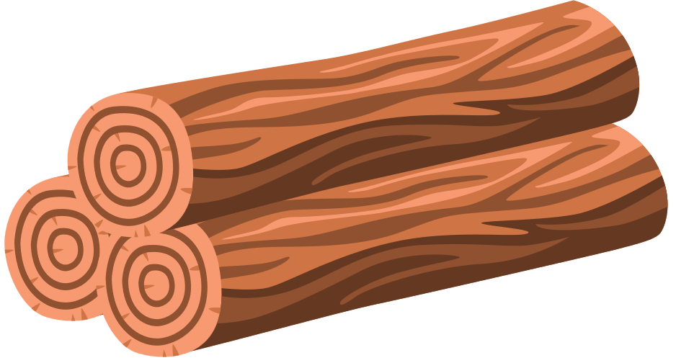


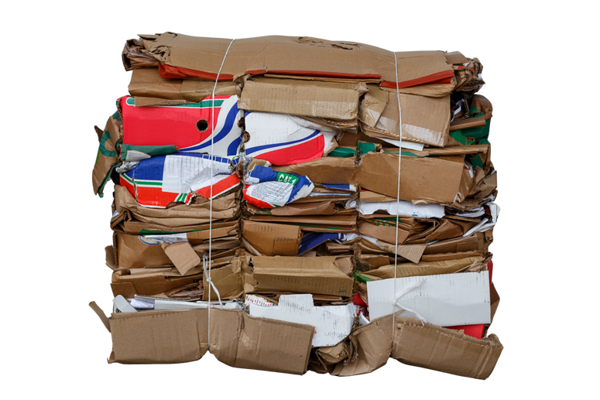
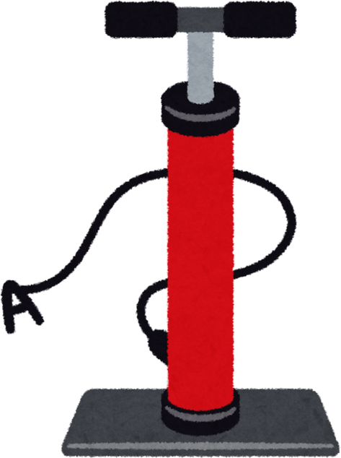
Key Words
recycle
Materials recovery facility (MRF)
natural resources
material
magnets
air jets
infrared
compressed
Notes:
Recycle: To turn old or used things into new products instead of throwing them away.
Materials recovery facility: A place where rubbish is sorted so things like paper, plastic, and metal can be recycled.
Natural resources: Things we get from nature, like water, trees, and minerals, that we use to make products.
Material: What something is made of, like wood, metal, plastic, or fabric.
Magnets: Objects that attract metals like iron and help separate them from other materials.
Air jets: Strong blasts of air used to push or move items, often for sorting.
Infrared: A type of light we can’t see, used by machines to identify different materials.
Compressed: Pressed or squeezed into a smaller space or shape.

Slide 6
Vocabulary task
Match the picture numbers with the correct word
  2. 3. 4.
recycle
materials
natural resources
Materials recovery facility (MRF)
Challenge: Write a sentence using a new vocabulary word.
Notes:
1 = recycle
2 = MRF
3 = natural resources
4 = materials

Slide 7
Vocabulary task
Match the picture numbers with the correct word
  2. 3. 4.
air jet
magnets
compressed
infrared
Challenge: Write a sentence using a new vocabulary word.
Notes:
1 = magnet
2 = air jet
3 = infrared
4 = compressed

Slide 8



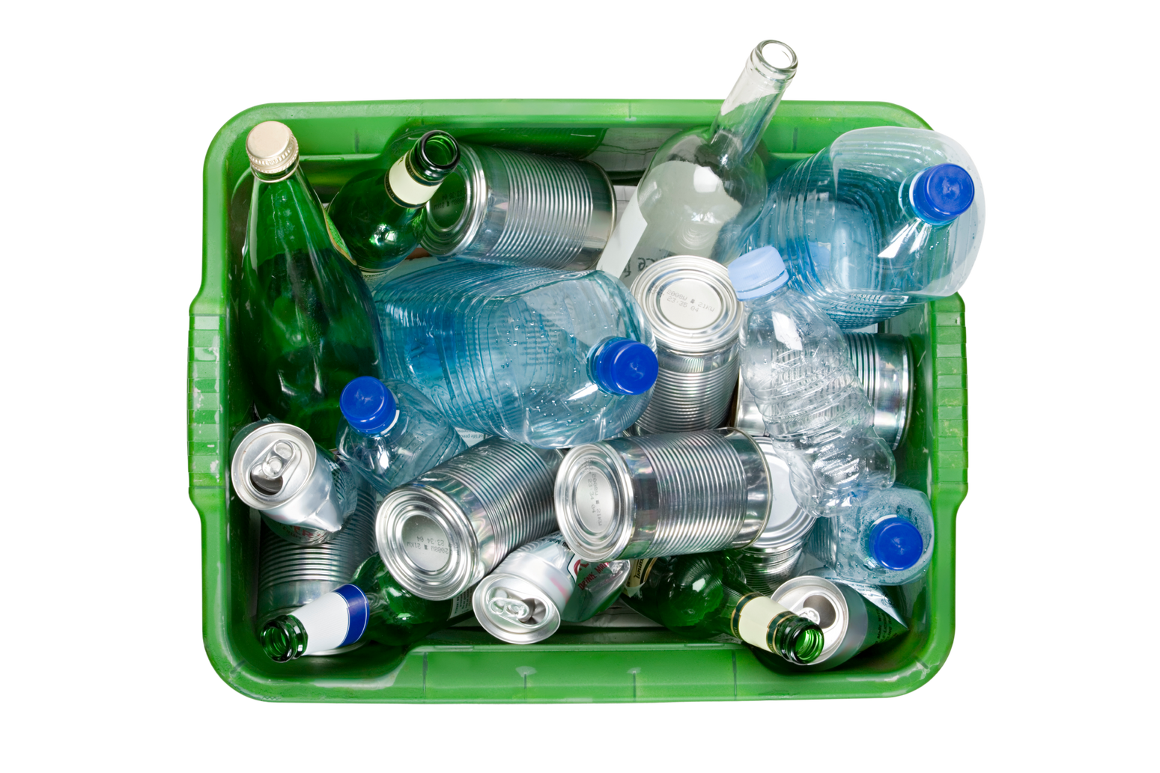
I love to recycle but what actually happens to it?
The process of sorting recycling is fascinating. Let’s learn all about it!

Slide 9
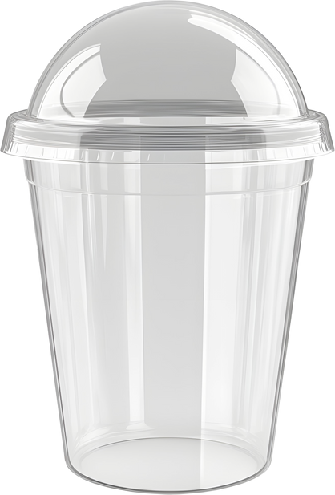
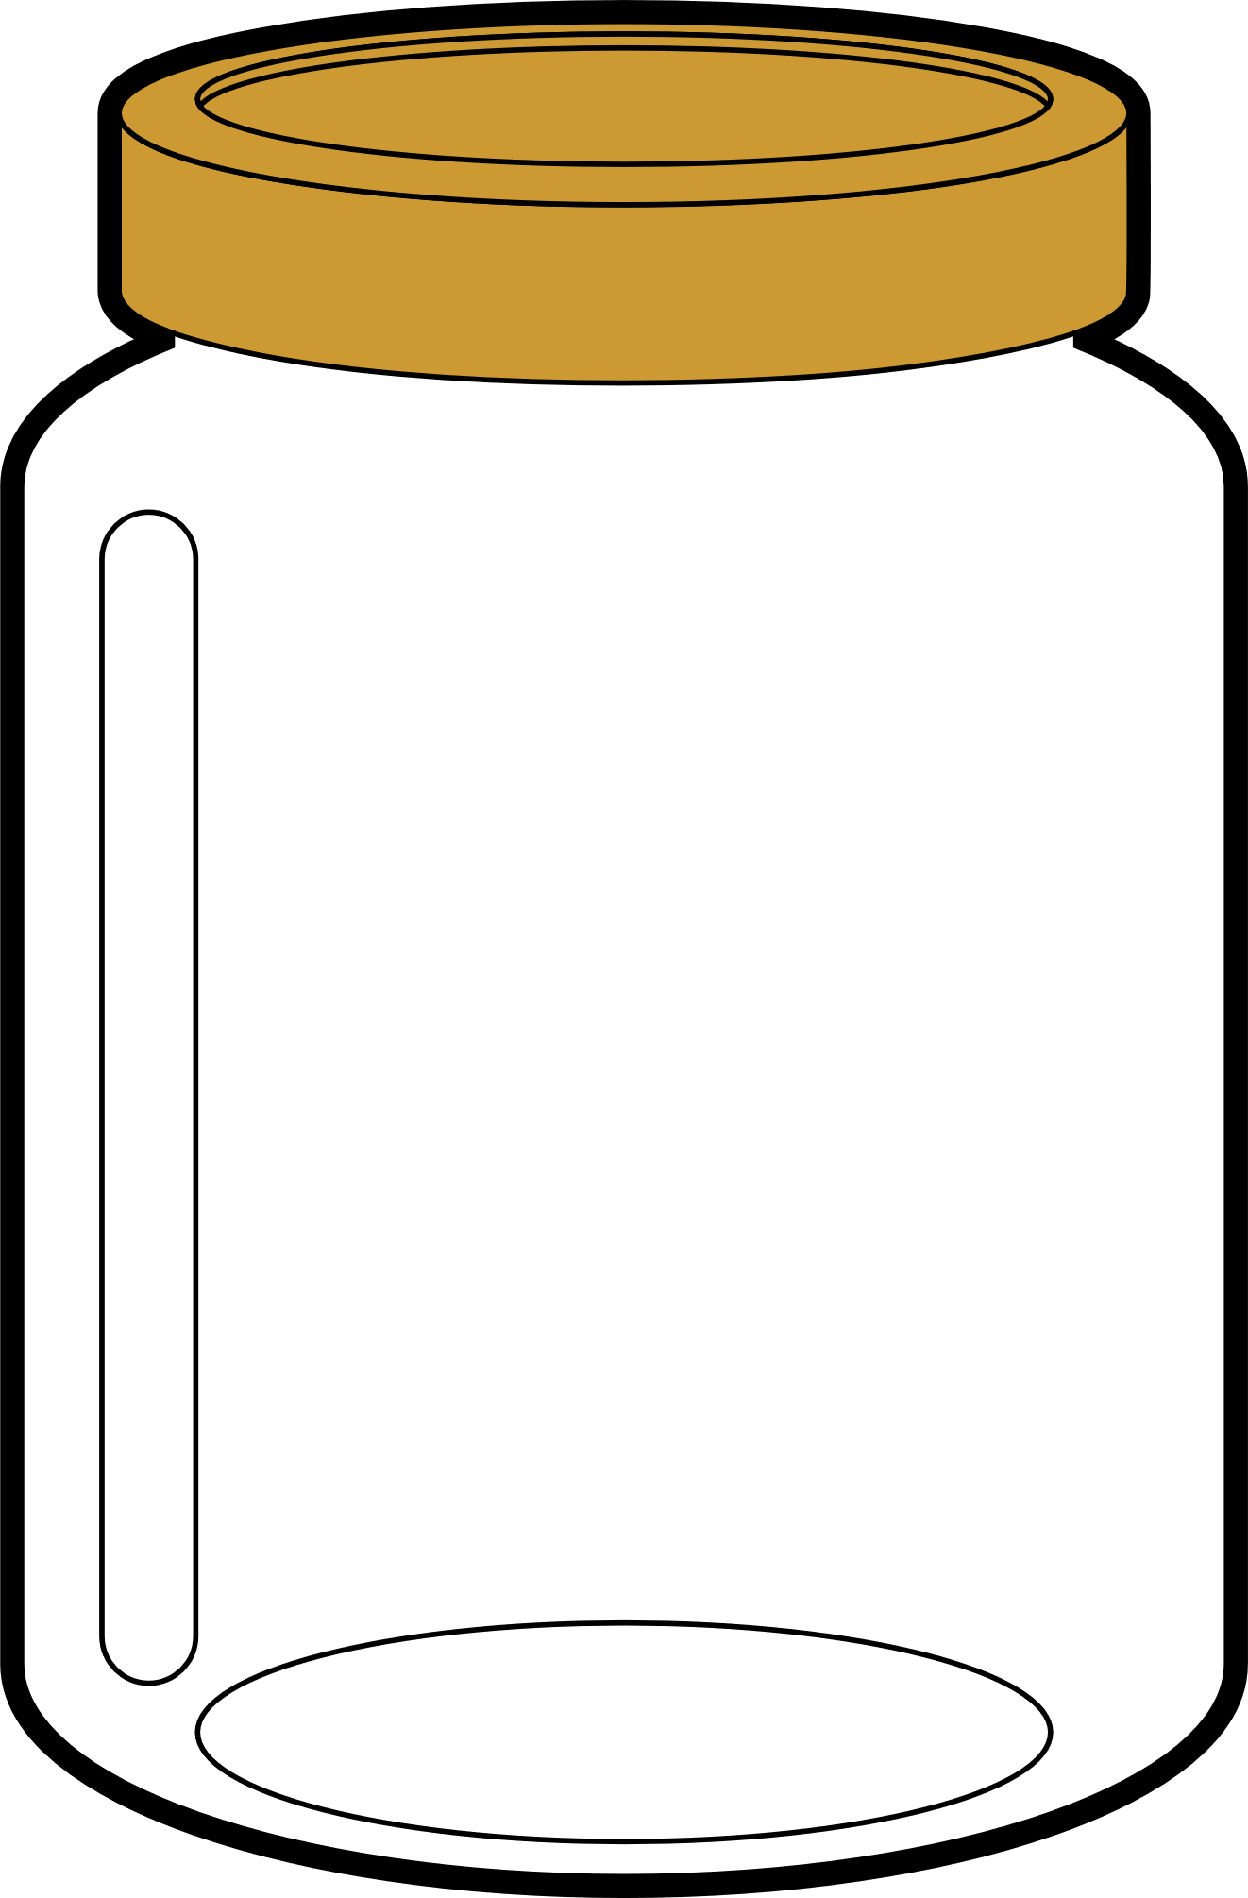
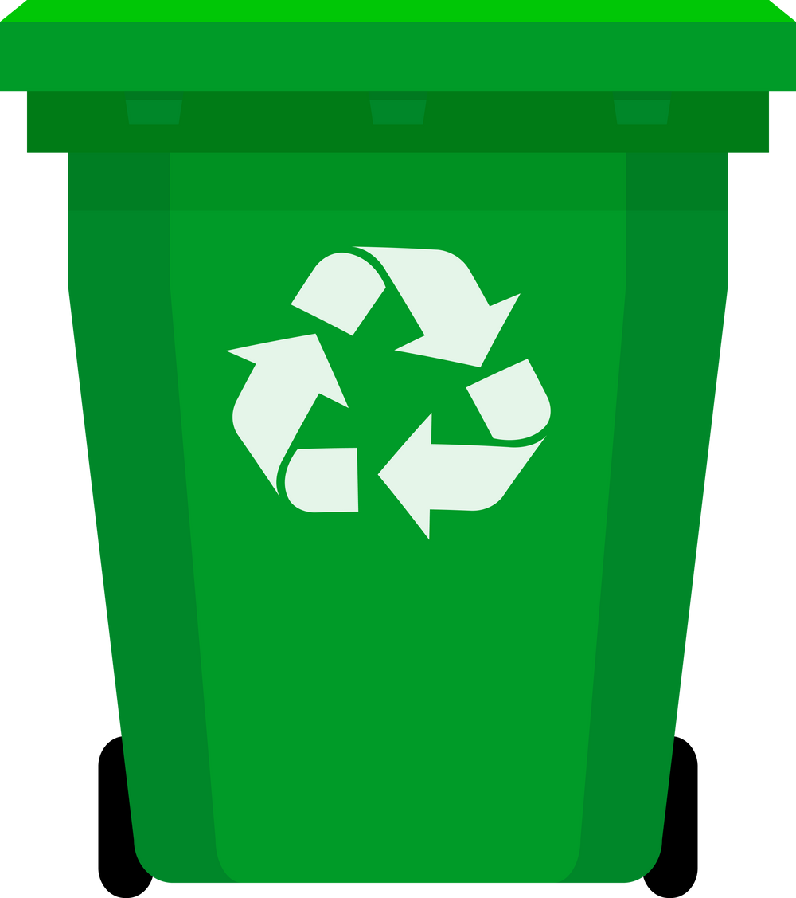
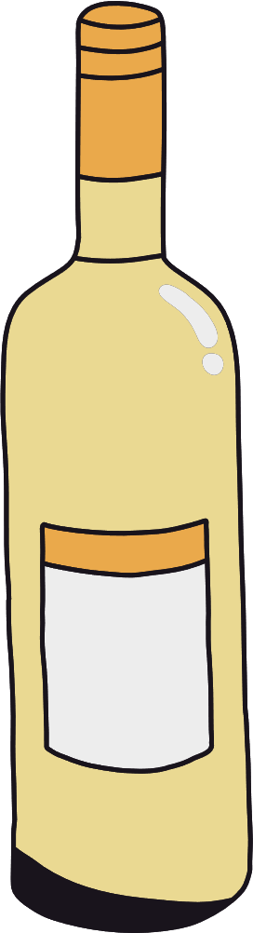
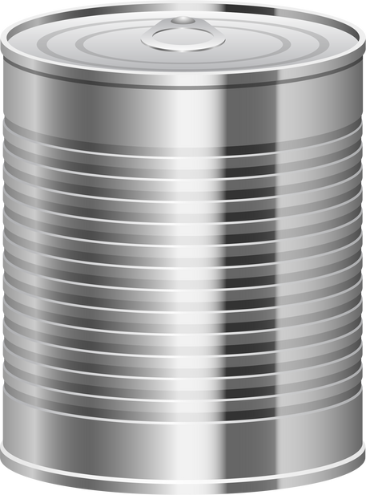

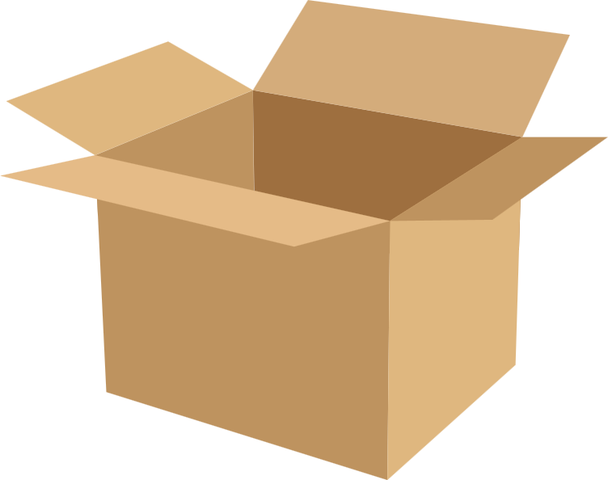
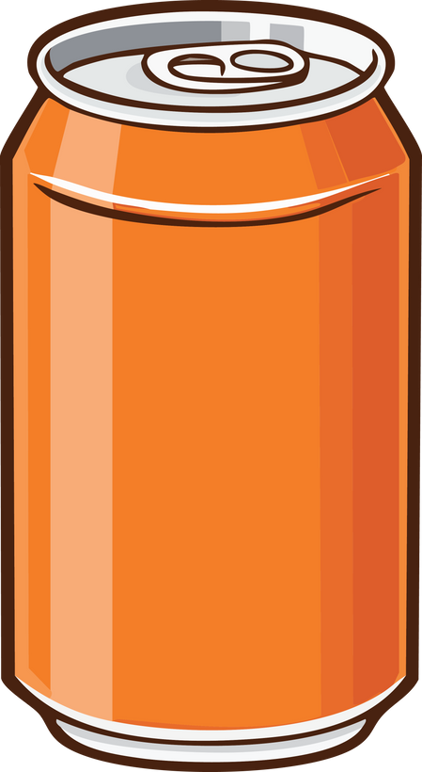

What goes in a recycling bin?
paper
cardboard
plastic bottles
plastic containers
metal tins
tin cans
glass bottles
glass jars
Notes:
Explicitly teach children what goes in the recycling bin - and nothing else!
You could have an actual bin with examples to bring this to life.

Slide 10
Tell your partner, what goes in the recycling bin?
In the recycling bin, you can put _________.
Notes:
Parnter task

Slide 11
Recycling
These things go in the recycling bin as they can be recycled.
They can be turned into new things.
Notes:
Teach children why these items go in the recycling.

Slide 12
Recycling
These things go in the recycling bin as they _____________ be __________.
They can be turned into __________.
Notes:
Assessment for learning - partner task

Slide 13



Rubbish or recycling?
plastic wrappers glass tissue metal cardboard
Notes:
Assessment for learning - partner task

Slide 14



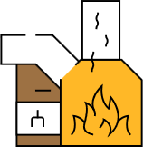



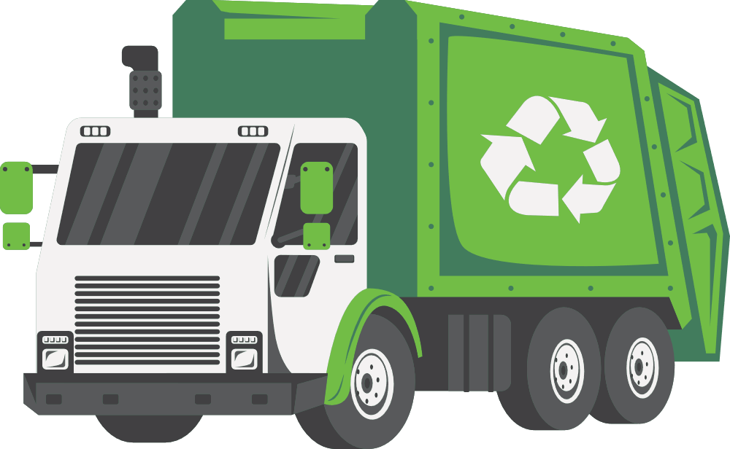
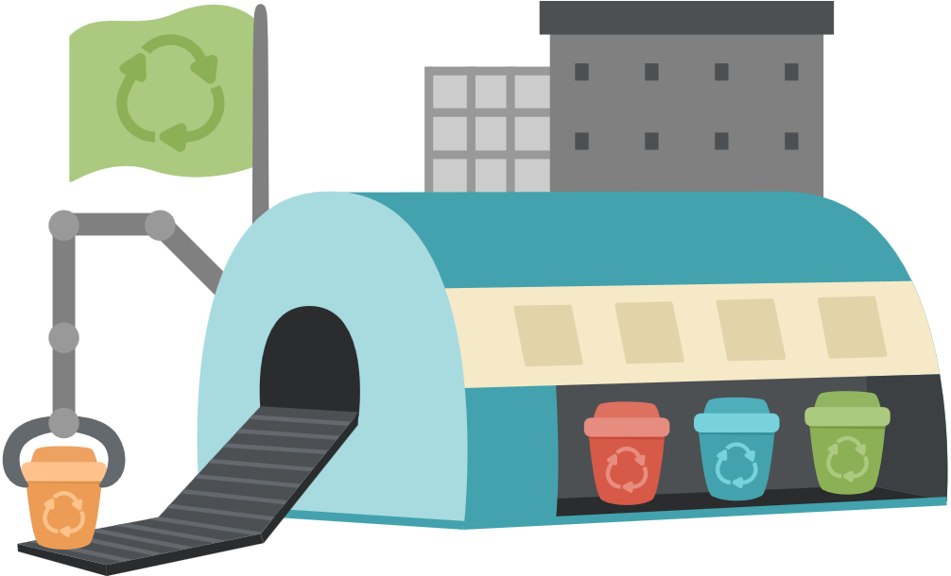

The journey of waste in North London
Recycling goes to a the material recovery facility.
Rubbish goes to London Energy.

Slide 15
Welcome to the Material Recovery Facility (MRF). This is where recycle bins get sorted into materials.
Notes:
In North London, recycling goes to the Material Recovery Facility to get sorted into materials.

Slide 16
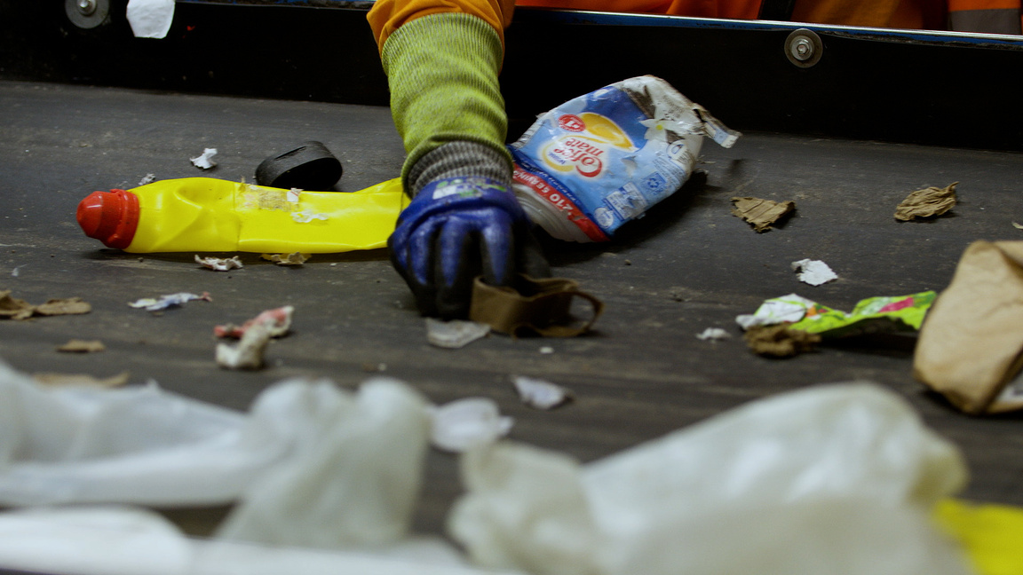
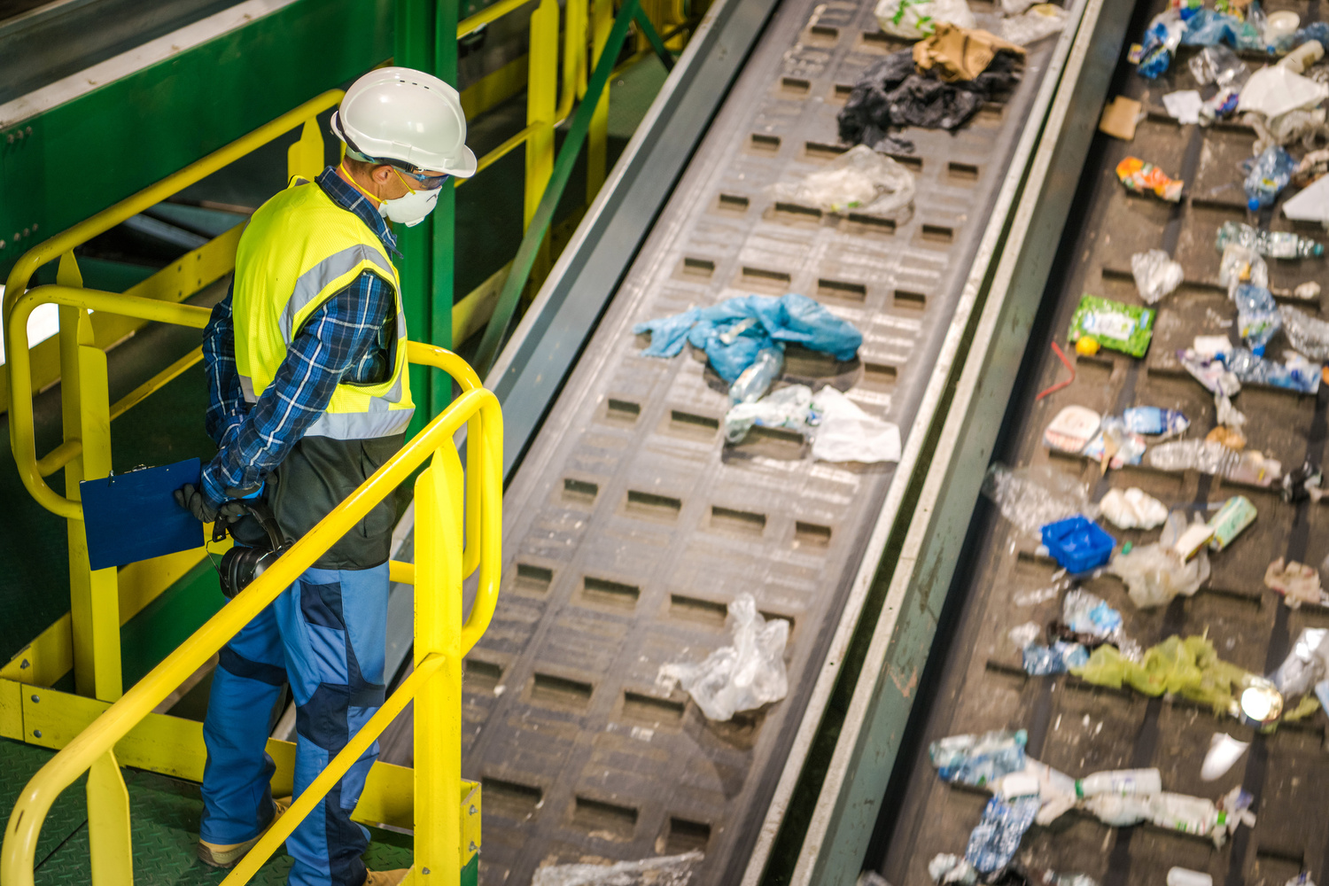
Step 1
Recycling bags are tipped onto a conveyor belt.
Anything that is dirty or cannot be recycled is removed.
This is done by people called ‘Recycling Operatives’

Slide 17
Step 1
Recycling bags are tipped onto a ___________.
Anything that is ___________ or cannot be ___________ is removed.
This is done by people called ‘___________ ___________’

Slide 18
Next, different types of machines use some amazing science to help sort the materials! Let’s take a look!

Slide 19
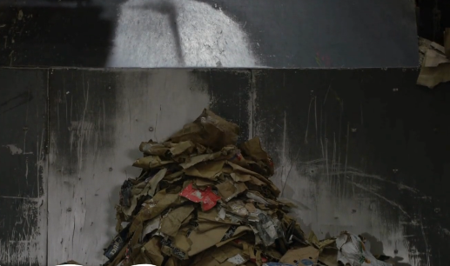
Step 2
Cardboard and paper
Cardboard is large and light. Smaller items like tins and glass fall through gaps but cardboard stays on top.

Slide 20
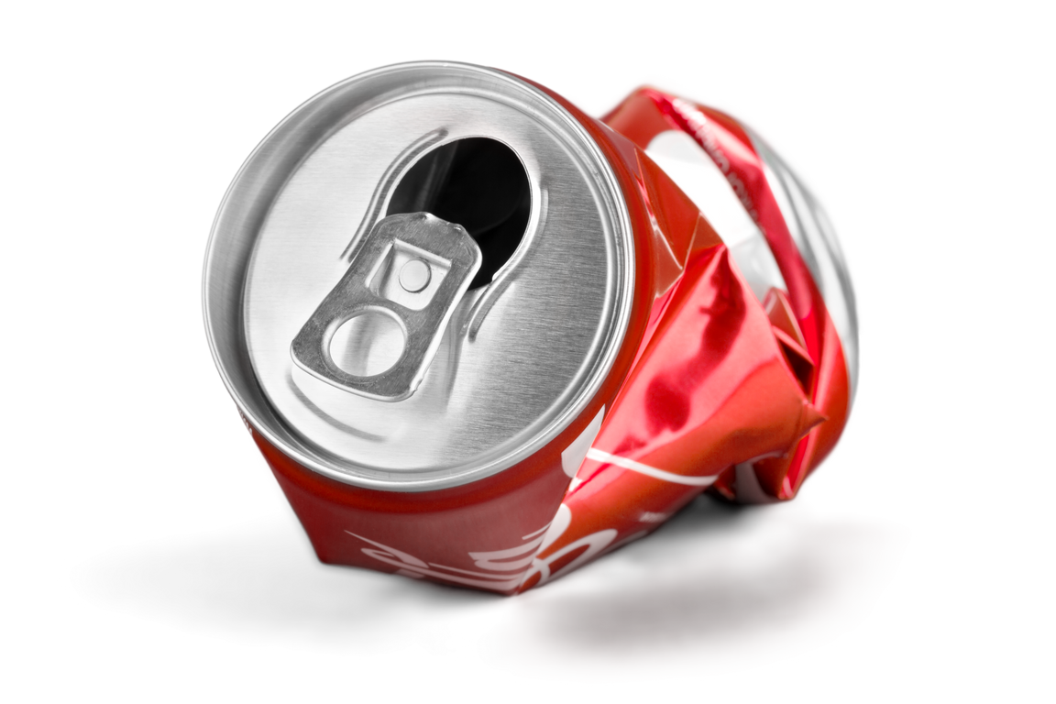
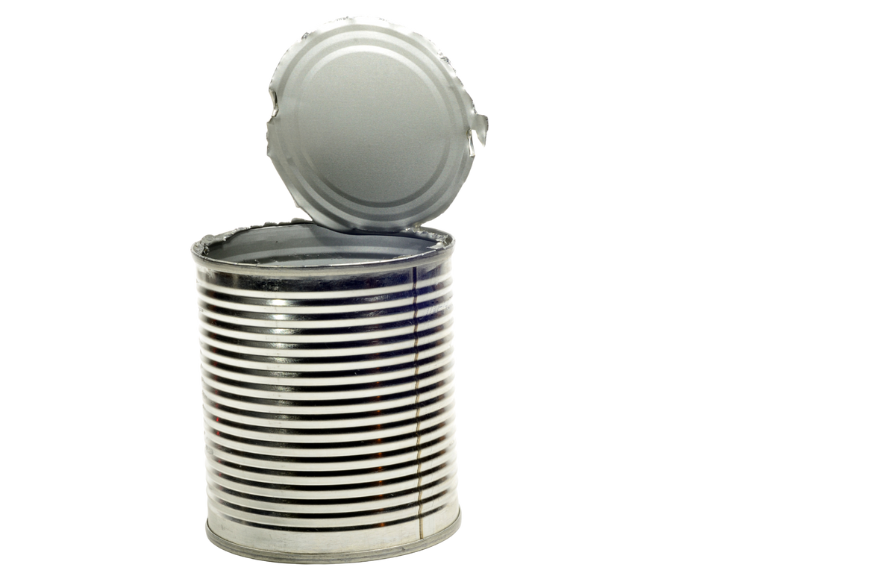
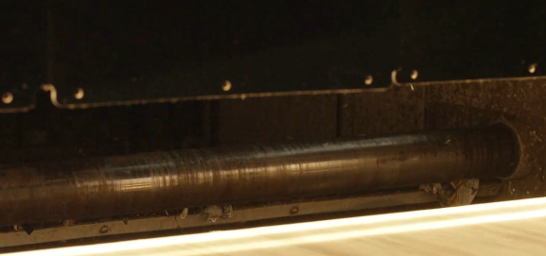
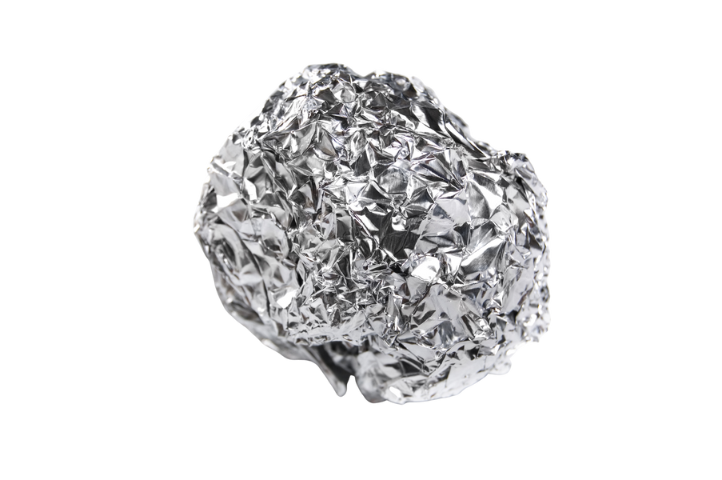
Step 2
Metal
A magnet pulls out metals as recyclables move along the conveyor. Anything metal sticks to the magnet and is removed.

Slide 21
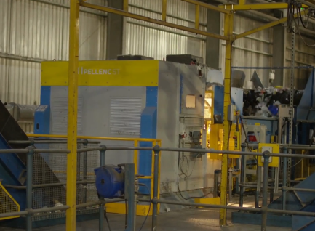
Step 2
Plastic
Machines use infrared light to spot different types of plastic. Once they know the type, powerful air jets blow each piece into the right place.

Slide 22
Complete the sentences
________ is large so it does not fit through the sorting gaps.
Machines use infrared light to spot different types of _______.
Magnets are used to remove _________.
plastic metal cardboard

Slide 23
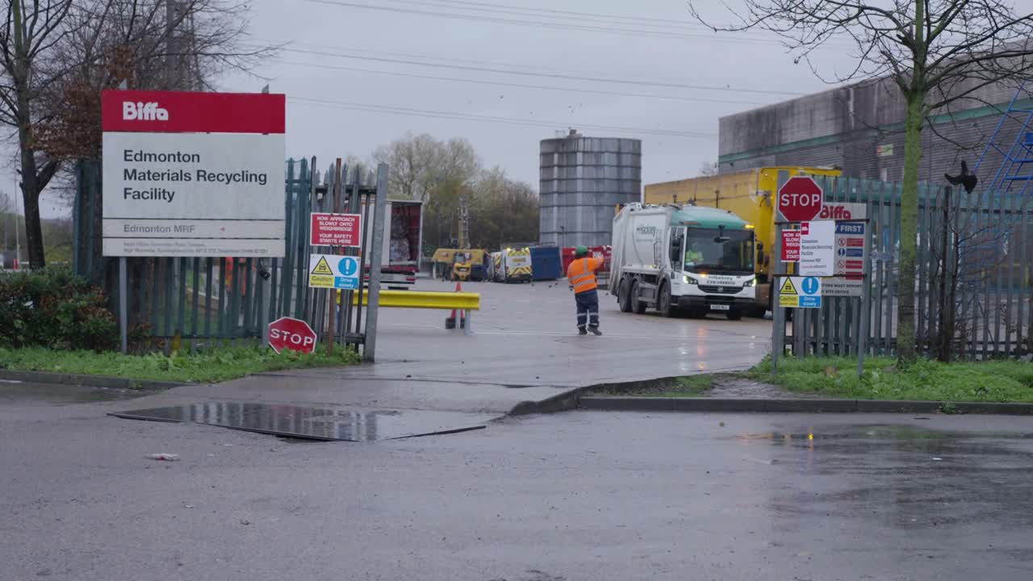
Watch sorting the materials in action

Slide 24
There is a lot to learn about recycling. This is part 2 of the lesson.

Slide 25
Recap
  How is metal sorted?
  How is plastic sorted?
magnet
infrared

Slide 26

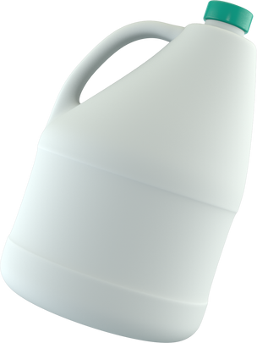




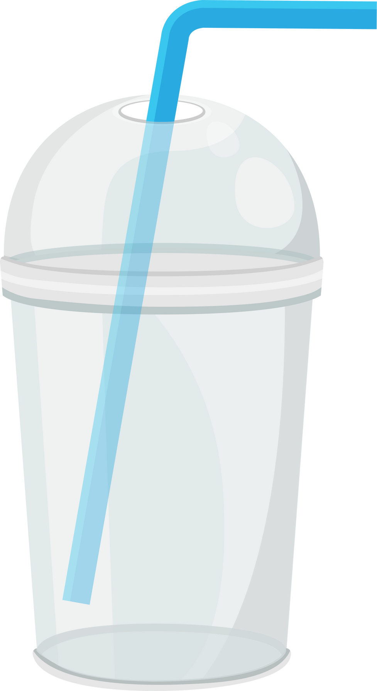

Sort these items into groups of materials.
metal
cardboard
plastic
Notes:
Allow students time to sort the materials into different categories.
Feedback and ask students to justify their choices and address any misconceptions.

Slide 27
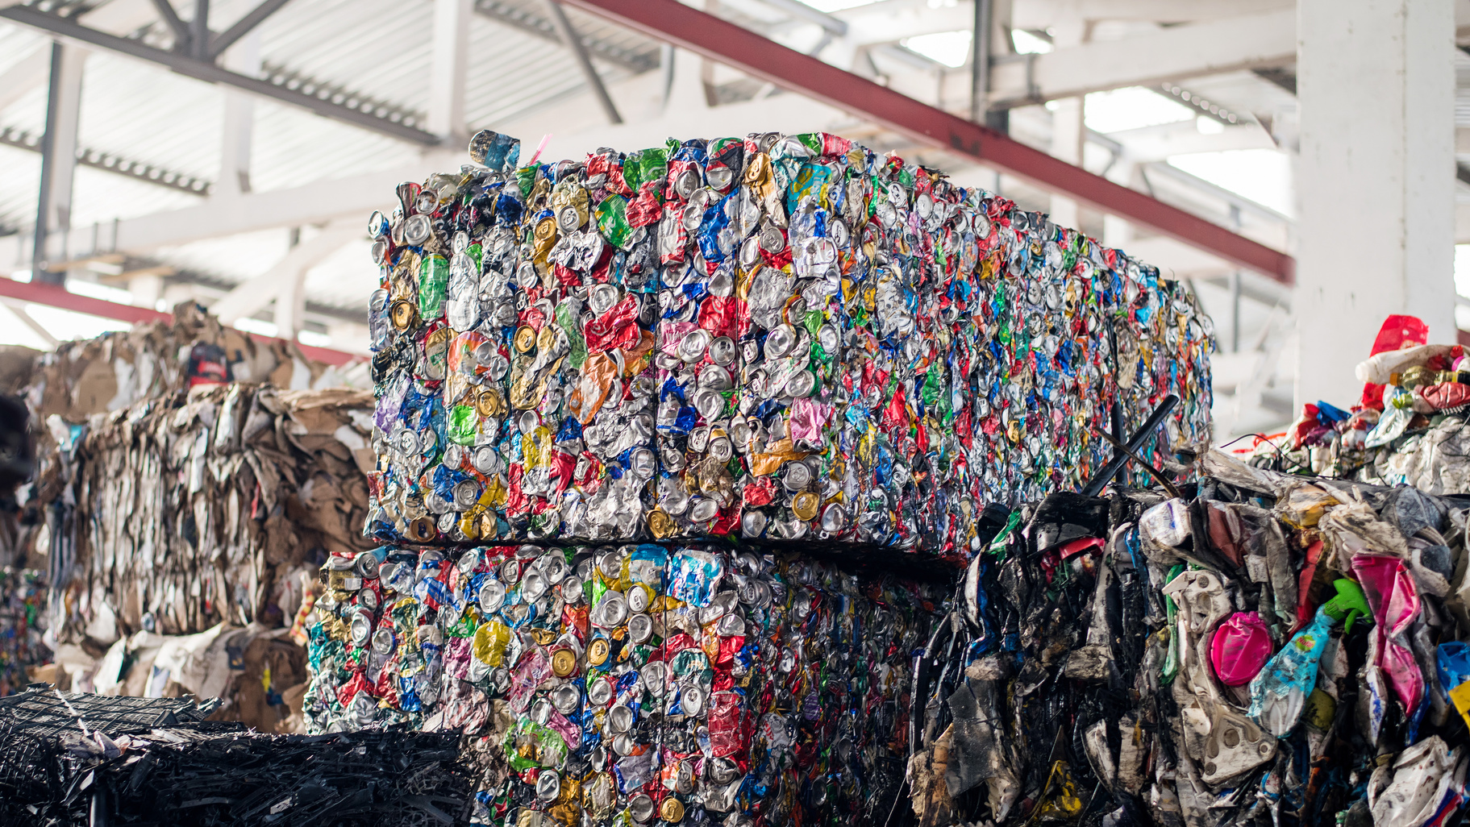
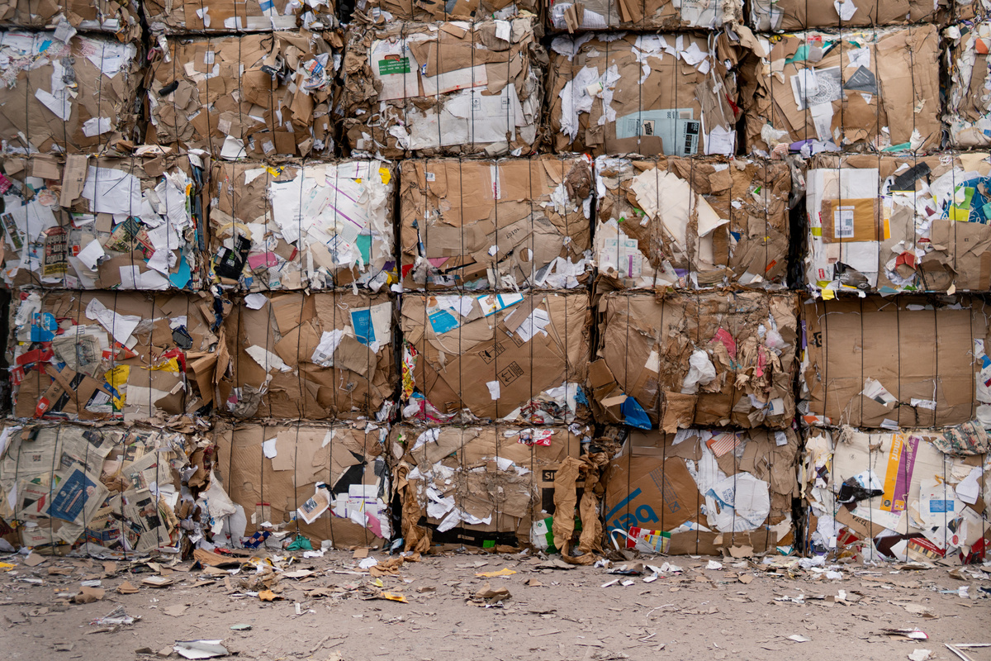
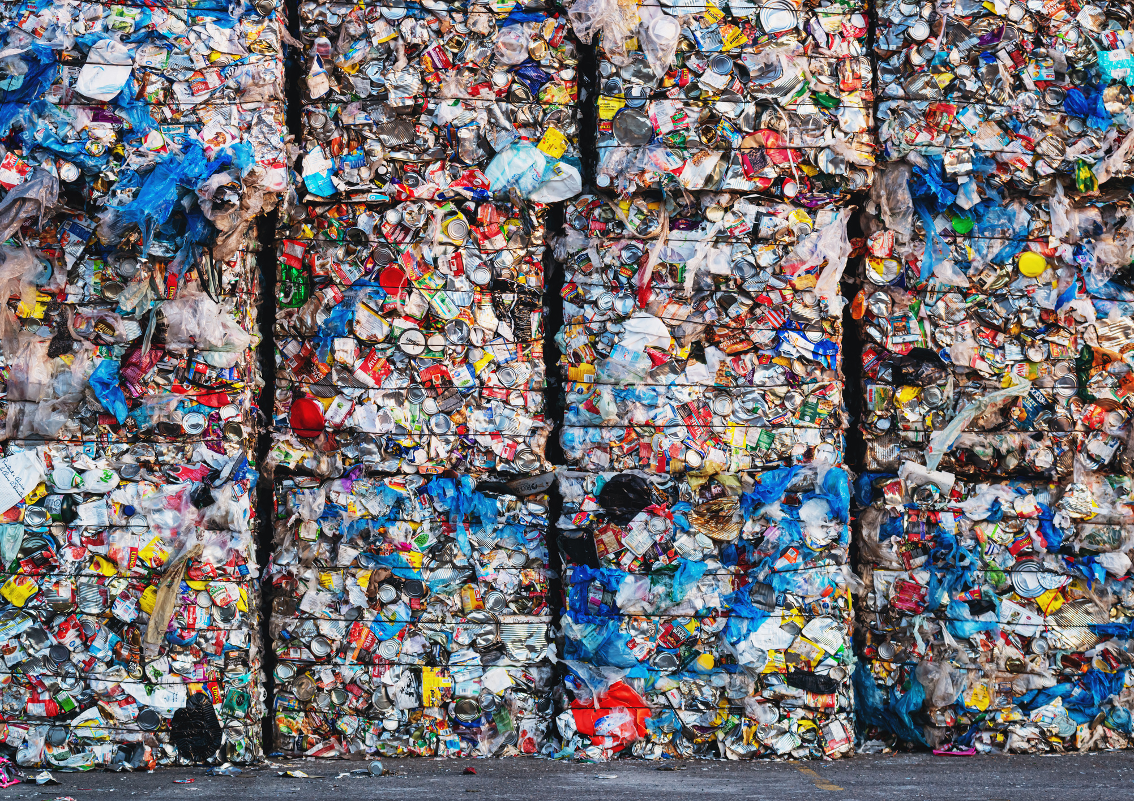
Each type of material is then sent to another factory where they are turned into something new.
metal
cardboard
plastic

Slide 28

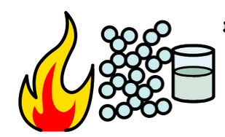


Metal recycling
Metals are melted at high temperatures to make it into a liquid.
The melted metal is then put in a mould.
This makes a new item.

Slide 29
Tell your partner the steps to recycle metal
metals melted high temperatures liquid mould
Notes:
When I say go, you have 30 seconds to tell your partner how you recycle metal. Go!

Slide 30
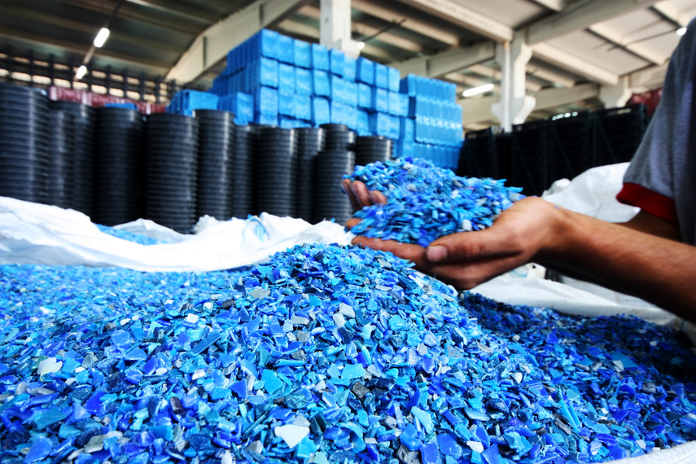
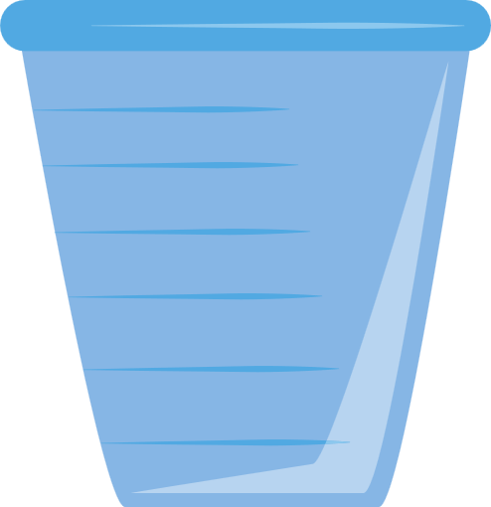
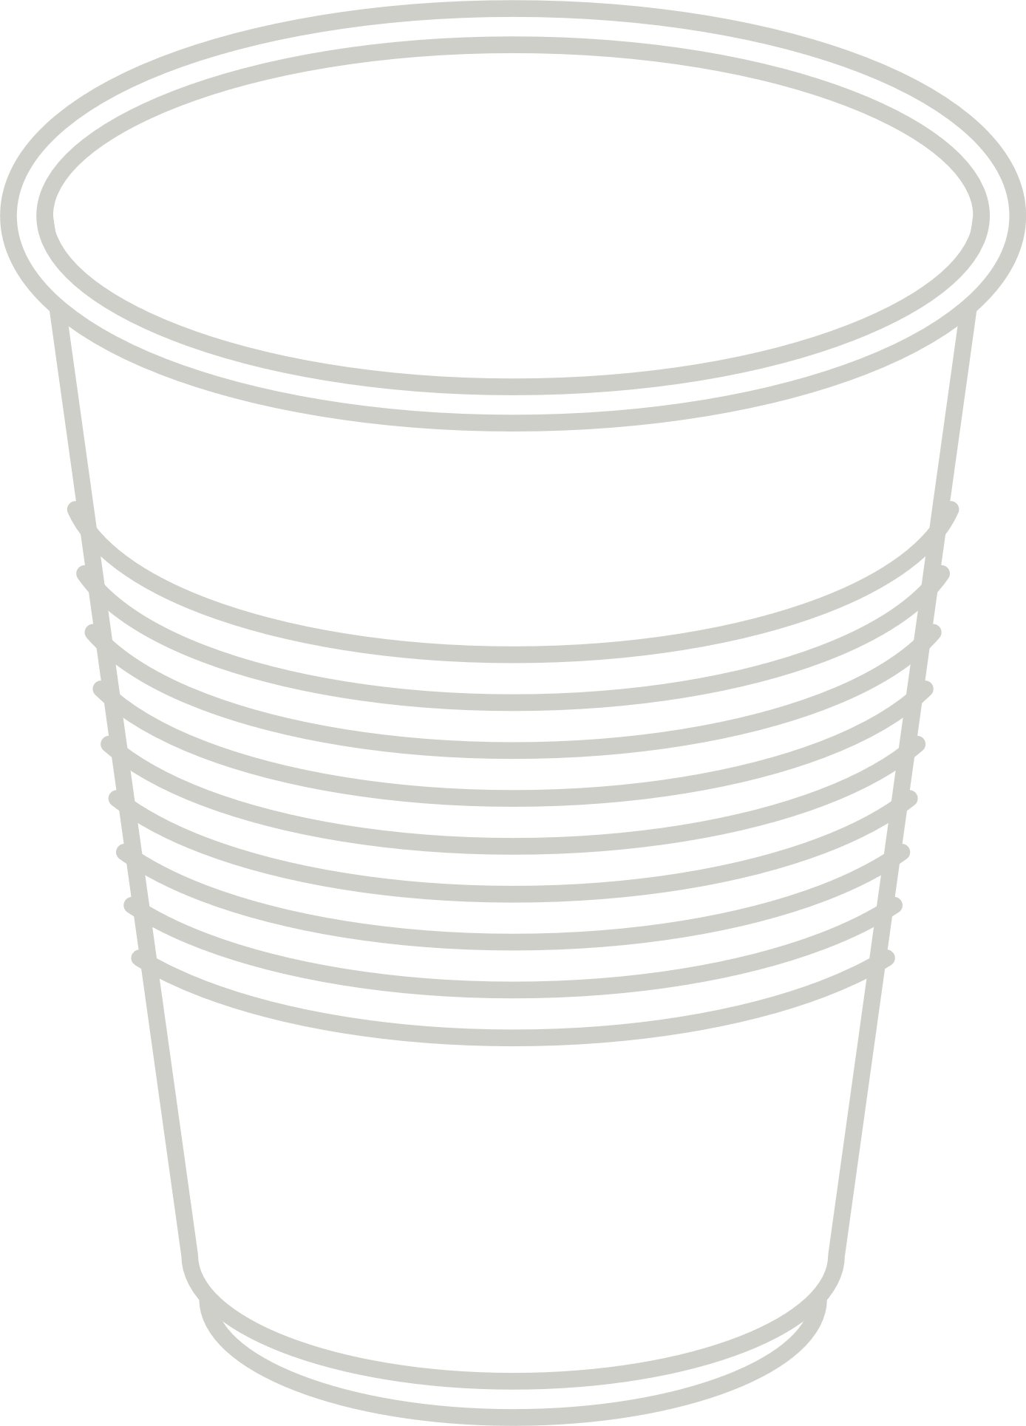
Plastic recycling
Plastics are sorted by type.
They are then cleaned and shredded into tiny pellets.
The pellets are melted a little bit to reshape them into a new product.

Slide 31
Tell your partner the steps to recycle plastic
cleaned shredded pellets melted reshaped
Notes:
When I say go, you have 30 seconds to tell your partner how you recycle plastic. Go!

Slide 32
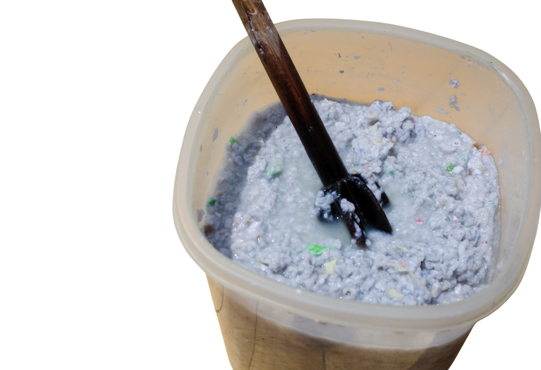
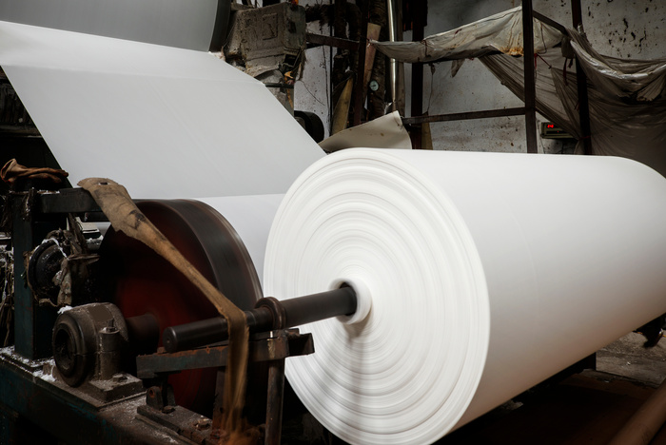
Cardboard recycling
Cardboard is cleaned then mixed with water to make a pulp. The pulp is rolled out, dried and turned into new cardboard sheets.

Slide 33
Tell your partner the steps to recycle cardboard
cleaned water pulp rolled out dried cut
Notes:
When I say go, you have 30 seconds to tell your partner how you recycle cardboard. Go!

Slide 34

CONTAMINATION!
This is my very important tip! Listen closely...

Slide 35

CONTAMINATION!
Contamination is when we put the wrong thing in the wrong bin. If this happens to the recycle bin it can be sent to rubbish and cannot be turned into something new.

Slide 36

Wow. It is really important we put the right things in the recycle bin!
Yes Nancy, when we recycle materials, it means we can reuse them which is better than taking new materials.

Slide 37
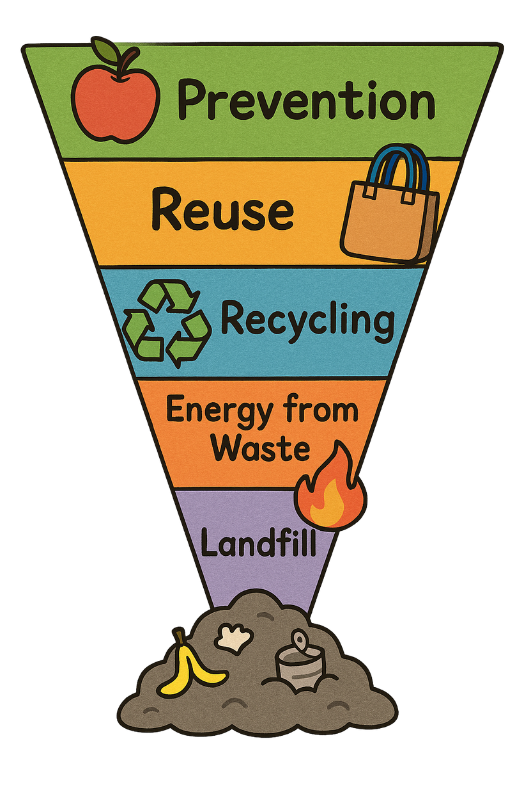

The best for our environment
Recycling is good but there are better options
The worst for our environment
What is better than recycling?
Notes:
Landfill: Putting waste into the ground where it stays for a long time and can harm the environment.
Energy from Waste: Burning waste to make electricity or heat. It reduces waste but can cause pollution.
Recycling: Turning old materials into new things so they can be used again instead of thrown away.
Reuse: Using items again without changing them, like refilling a water bottle or donating clothes.
Prevention: Stopping waste before it happens by using less and choosing things that last longer.

Slide 38

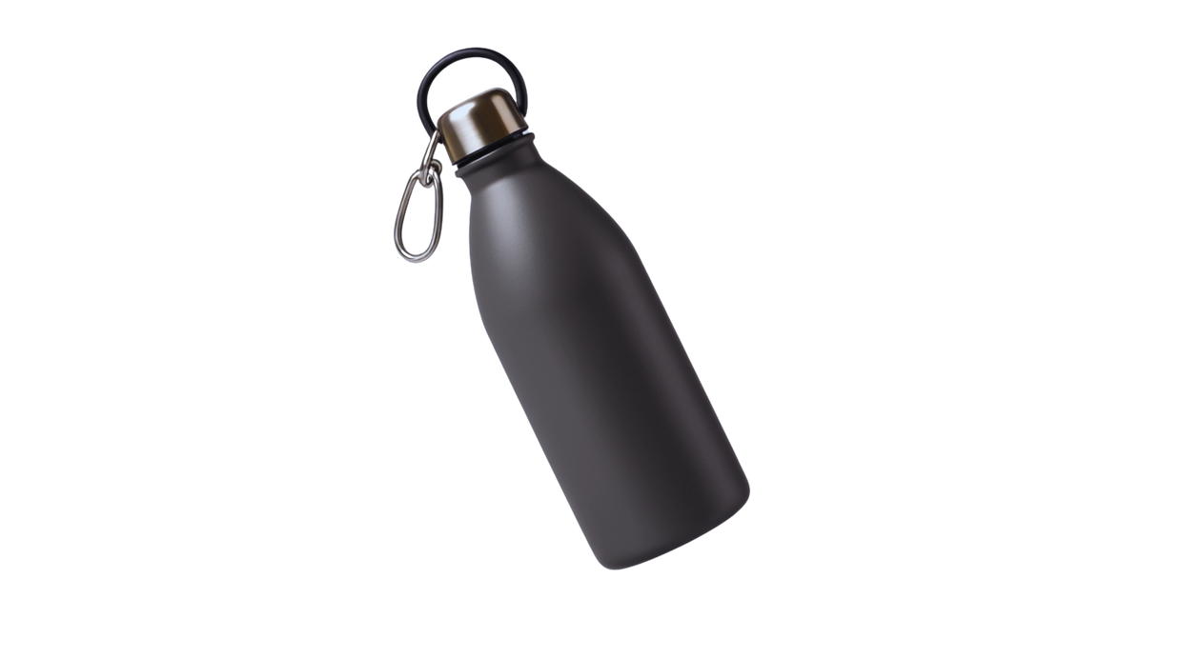


Top recycling tips!
  Use it again! – Try reusing things like bags, bottles, and containers.
2. Think before you throw! – Can it be recycled or donated instead?
3. Wash the materials before you recycle!

Slide 39
What 3 things can we do?
Three things we can do are _______, __________ and __________.

Slide 40
Extension activity 1
Art/writing activity: Draw and write about how cardboard, plastics and metals are sorted by material.
metal
cardboard
plastic

Slide 41
Extension activity 2
Science activity: State the process of how metal, plastic or cardboard is recycled into a new product.

Slide 42

Extension activity 3
Science/STEM activity: Go around the school to look in the recycling bins. Is your school putting the correct things in the recycling bin?
Complete a waste audit. Count and record which items you find in the recycle bins.

