Slide 1





What happens with my food waste?
KS2 Lesson - Lesson 3 of 3

Slide 2
LO: To understand what happens to food waste
  Understand what can be put into the food waste bin.
  Explore where food waste goes after we throw it away.
  Learn how food waste can be used to make electricity and fertiliser.

Slide 3






Lesson Prep
Vocabulary
Discussion
Keywords that children need to understand and use during the lesson.
An opportunity for children to practice the knowledge learnt.
Big question
Task
To assess learning and give children time to practise independently.
A central question that sparks curiosity and frames the lesson’s theme.
The knowledge
Extension
Essential facts and concepts children need to know.
Optional tasks to deepen or stretch learning beyond the core lesson.

Slide 4
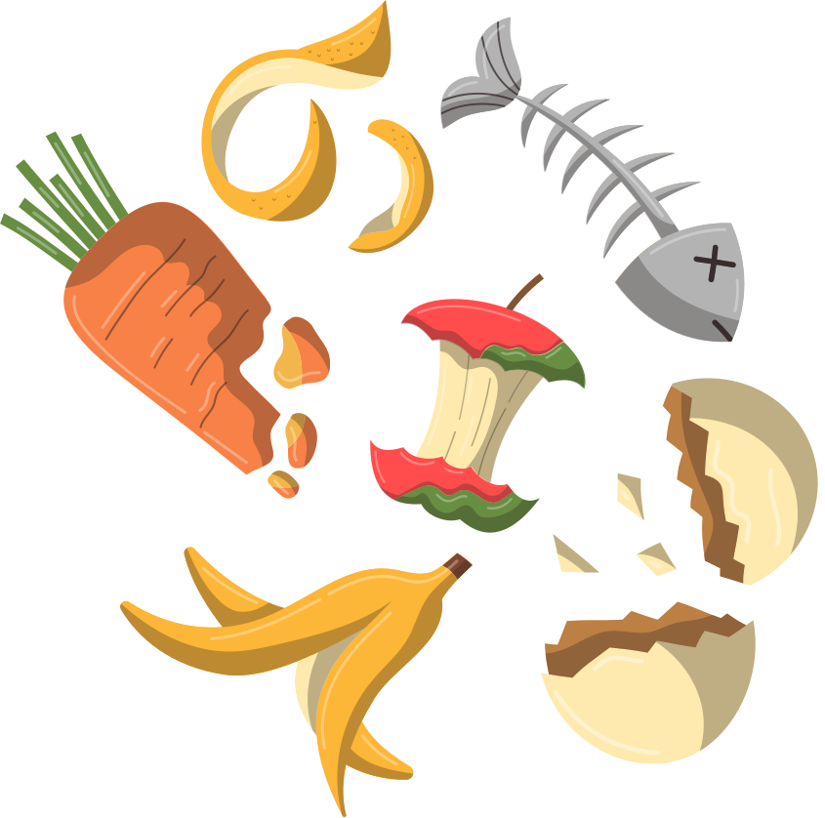



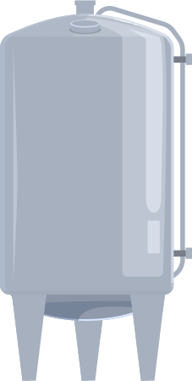

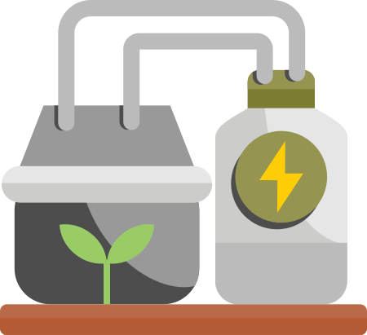

Key Words
food waste
fertiliser
methane
electricity
anaerobic digestor
thermometer
biogas
microbes
Notes:
Food waste: Leftover or spoiled food that is thrown away instead of eaten.
Fertiliser: A substance added to soil to help plants grow by giving them nutrients.
Methane: A gas made from rotting food and plants.
Electricity: Energy that powers things like lights, machines, and devices.
Anaerobic digestor: A big tank where food waste is broken down without air to make gas and fertiliser.
Biogas: A gas made from rotting food or plants that can be burned to make energy.
Microbes: Tiny living things, like bacteria, that break down food waste.

Slide 5
Vocabulary task
Match the picture numbers with the correct word
  2. 3. 4.
fertiliser
methane
electricity
food waste
Challenge: Write a sentence using a new vocabulary word.
Notes:
1 = food waste
2 = fertiliser
3 = methane
4 = electricity

Slide 6
Vocabulary task
Match the picture numbers with the correct word
  2. 3. 4.
microbes
anaerobic digestor
biogas
thermometer
Challenge: Write a sentence using a new vocabulary word.
Notes:
1 = anaerobic digestor
2 = thermometer
3 = biogas
4 = microbes

Slide 7






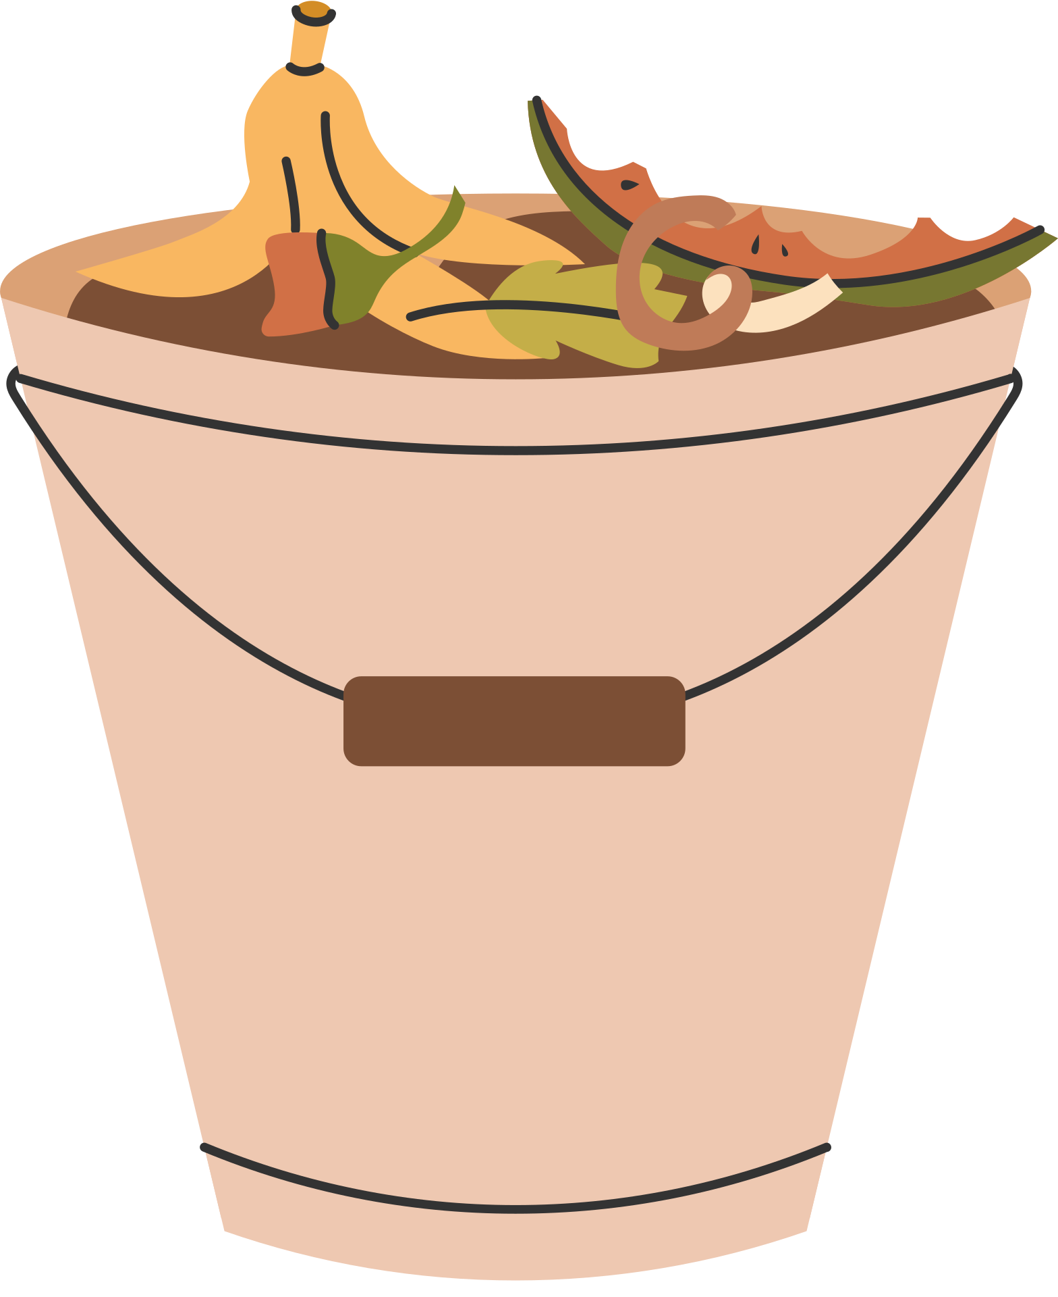

I’ve always wondered where food waste goes, does it get reused?
Yes, it does get reused Nancy. It is a fascinating process. Let’s learn all about it!

Slide 8
What goes in a food bin?
fruit
vegetables
leftovers
tea bags
eggshells
meat
bones
Notes:
Explicitly teach children what goes in the food waste bin - and nothing else!
You could have an actual bin with examples to bring this to life.

Slide 9
What goes in the food bin?
You can put _______ in the food bin.
Notes:
Explicitly teach children what goes in the food waste bin - and nothing else!
You could have an actual bin with examples to bring this to life.

Slide 10

The journey of food waste
Step 1
Schools, buisness and families collect food waste and put it out to be collected by food waste trucks.

Slide 11


The journey of food waste
Step 2
The food waste trucks arrive at the food waste facility. Food waste is emptied into a large container.

Slide 12

The journey of food waste
Step 3
The container of food waste vibrates. This removes any food waste bags and mushes the food into a soup.

Slide 13
Tell your partner the first 3 steps
food waste collected container vibrate mush

Slide 14
The journey of food waste
Step 4
The food soup is sent through pipes to an anaerobic digestor. The food is heated to body temperature.

Slide 15
The journey of food waste
Step 5
The food starts to break down. It releases methane which is a gas. This gas is used to make electricity for our homes. This is called biogas.

Slide 16
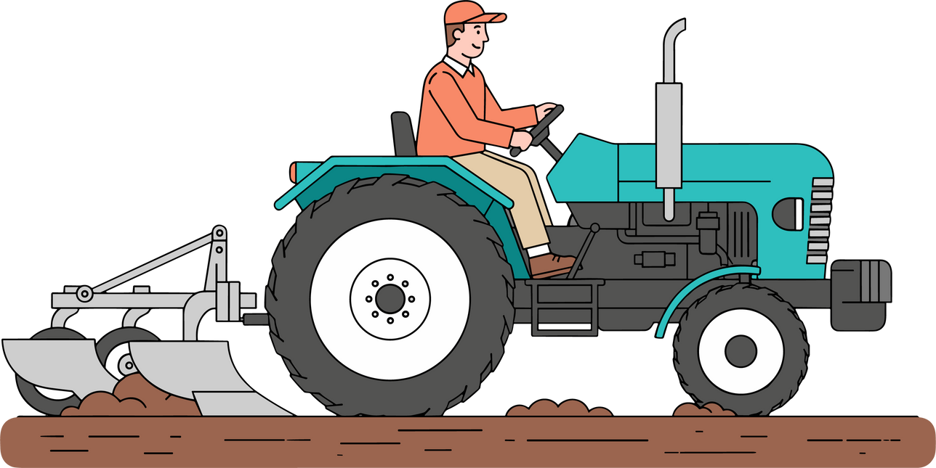
The journey of food waste
Step 6
The food is broken down by microbes. It is then dried and spread onto fields as fertiliser. It is rich in nutrients.

Slide 17
Tell your partner the next 3 steps
anaerobic digester heated methane electricity fertiliser

Slide 18



What does food waste make?
biogas
Makes energy for our homes
fertiliser
Makes good food for plants

Slide 19


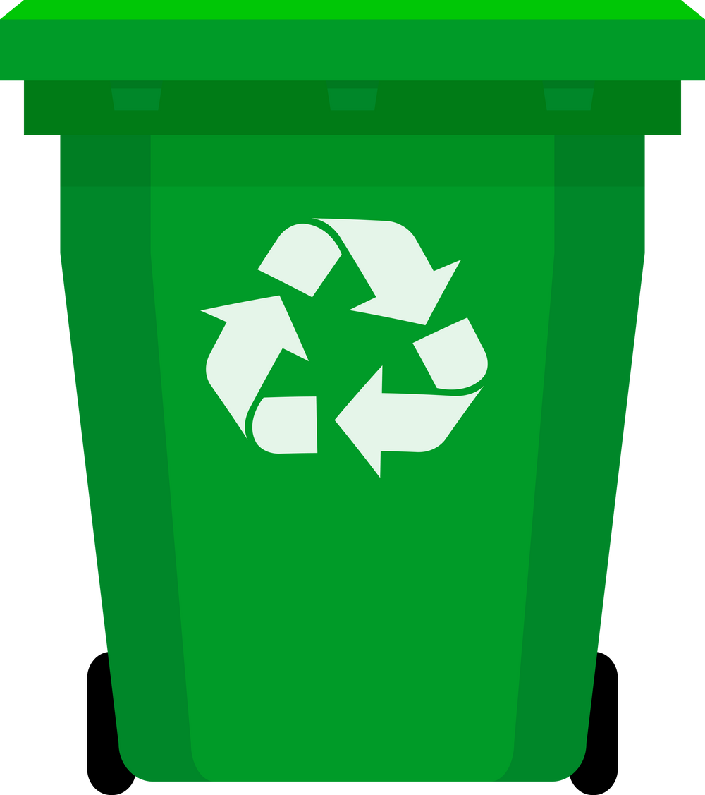





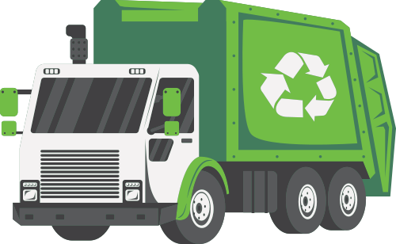
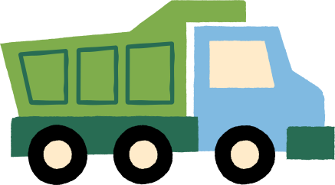
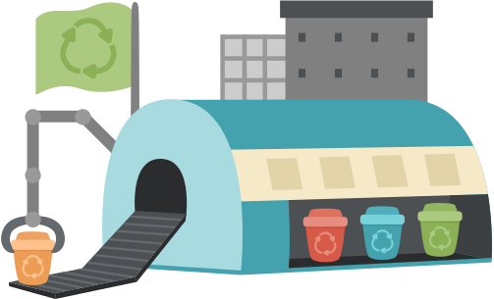

The journey of waste in North London
Recycling goes to a reuse and recycling centre.
Rubbish goes to London Energy.
Food waste goes to an anaerobic digestor.

Slide 20
Where does the waste go?
Recycling goes to a _____ _________________.
Rubbish goes to _______ _________.
Food waste goes to an _________ __________.
reuse and recycling centre
London Energy
anaerobic digestor

Slide 21
Watch this video to see it in action!

Slide 22
I did not know that we got energy from food waste. I am going to get a food waste bin and start straight away!
Brilliant Nancy, that is going to make a great difference!

Slide 23



Top food waste tips!
  Only put food on your plate that you know you can finish.
2. Keep extra food in the fridge to eat later instead of throwing it.
3. Eat the oldest food first to stop it going to waste.

Slide 24
What 3 things can we do?
Three things we can do are _______, __________ and __________.

Slide 25

Extension activity 1
Science activity: Reorder the steps to food waste recycling in North London. Write a caption for each. Challenge: Include the key words
Key words
food waste
anaerobic digestor
mush
methane
electricity
fertiliser

Slide 26
Extension activity 2
Drama writing: In partners act out the stages to food waste being turned into electricity and fertiliser. Include the below steps
  Food waste collected by truck
  Food waste put into a large container
  Food waste is vibrated to remove plastic bags and turn it into a soup
  Food waste is put into an anaerobic digestor and heated to body temperature
  Methane is released and used to make electricity
  The remains are dried and used as fertiliser

Slide 27
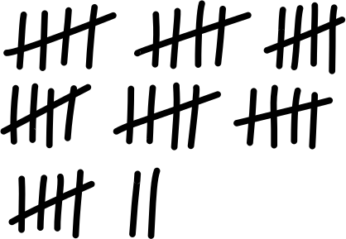
Extension activity 3
Science/STEM activity: At lunch time, record data on how many children eat all their school lunch, some of their school lunch and none of their school lunch.

