Slide 1


KS2 Lesson
How can we grow plants from our scraps?

Slide 2
LO: To investigate how to propagate a basil plant.
  I can explain how different plants reproduce.
  I can explain how to propagate a basil plant.
  I can explain how growing our own food can help reduce food waste.

Slide 3

Convince me
All food waste is avoidable.
Notes:
In pairs, students take turns to convince each other of the why the statement is correct. Allow for 2 minutes.
Answers may include: food can be stored correctly; creating a shopping list; and creating zero-waste recipes.
Ask student to share ideas as a class.

Slide 4






Key Words
fertilisation
pollenisation
scraps
observe
cutting
propagation

Slide 5
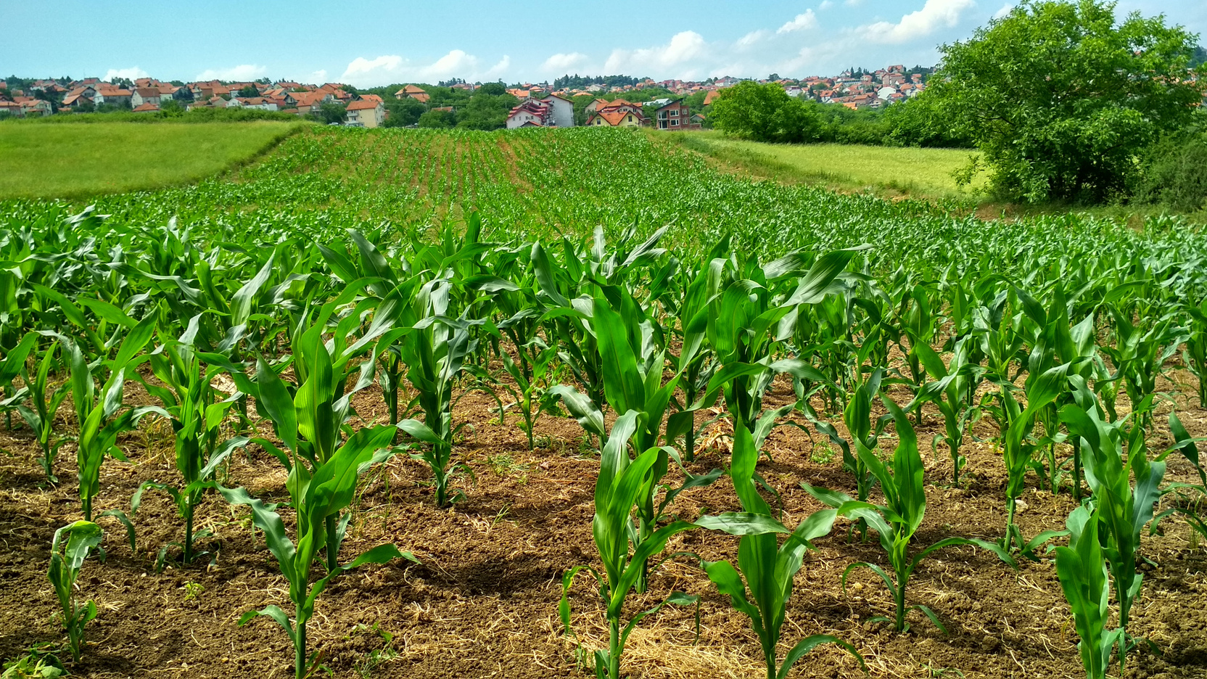

Agriculture relies on reproducing plants on a large scale.
How do plants reproduce?
Notes:
Begin to discuss that agriculture relies on the reproduction of plants on a large scale. In the UK, 3.3 million tonnes of food are wasted before it even leaves the farm (WWF, 2022). This could be from changes in climate such as a very cold winter or problems with storing or moving the crops. Ask students to explain how plants reproduce

Slide 6
Sexual reproduction of plants
Notes:
Sexual reproduction requires a male and female part of the flower.
The male part is the stamen which holds the pollen. The female part is the stigma and ovule.
Either in pairs or as a class, label the female and male parts of a flower.
Cross-pollination occurs when pollen from one flower is transferred to another. Self-pollination occurs when the pollen from the stamen is transferred to the stamen on the same flower.

Slide 7

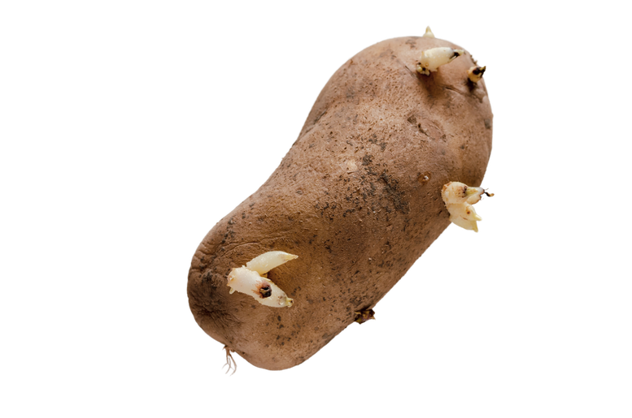
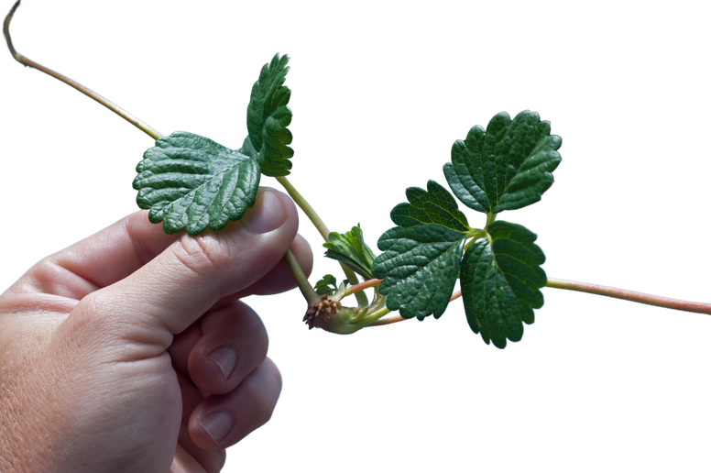
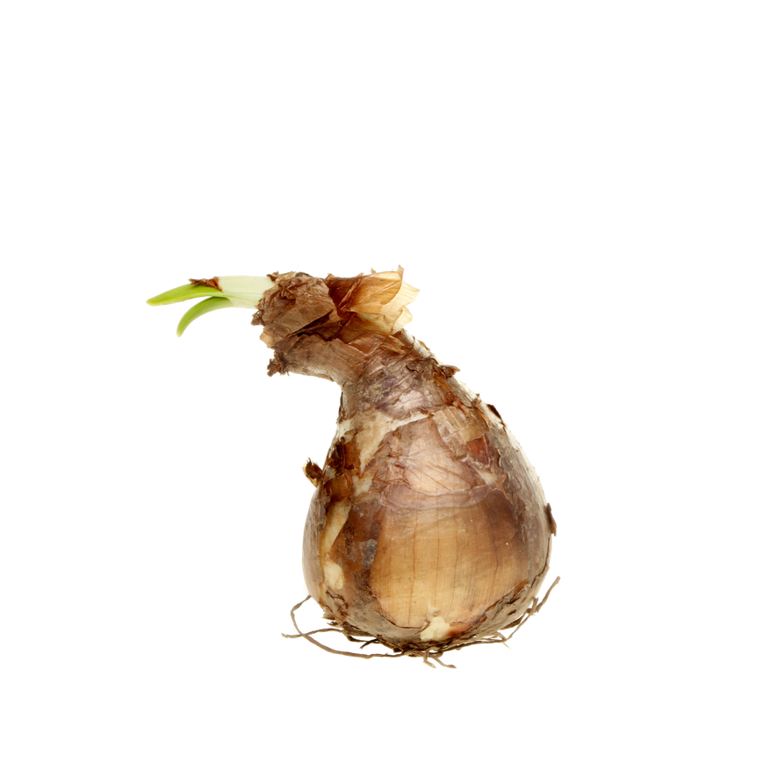
Three ways plants reproduce asexually
Some plants produce asexually. This means they do not need fertilisation to occur.
They reproduce through creating clones of themselves.
tubers
runners
bulbs
Notes:
Asexual reproduction does not require a male and female part of a plant. Therefore, it does not require fertilisation to happen.
Ask students if they have ever noticed what happens to potatoes after a while? Potatoes will grow tubers if left in a dark place. Other examples on the slide, include strawberry runners and daffodil bulbs.

Slide 8
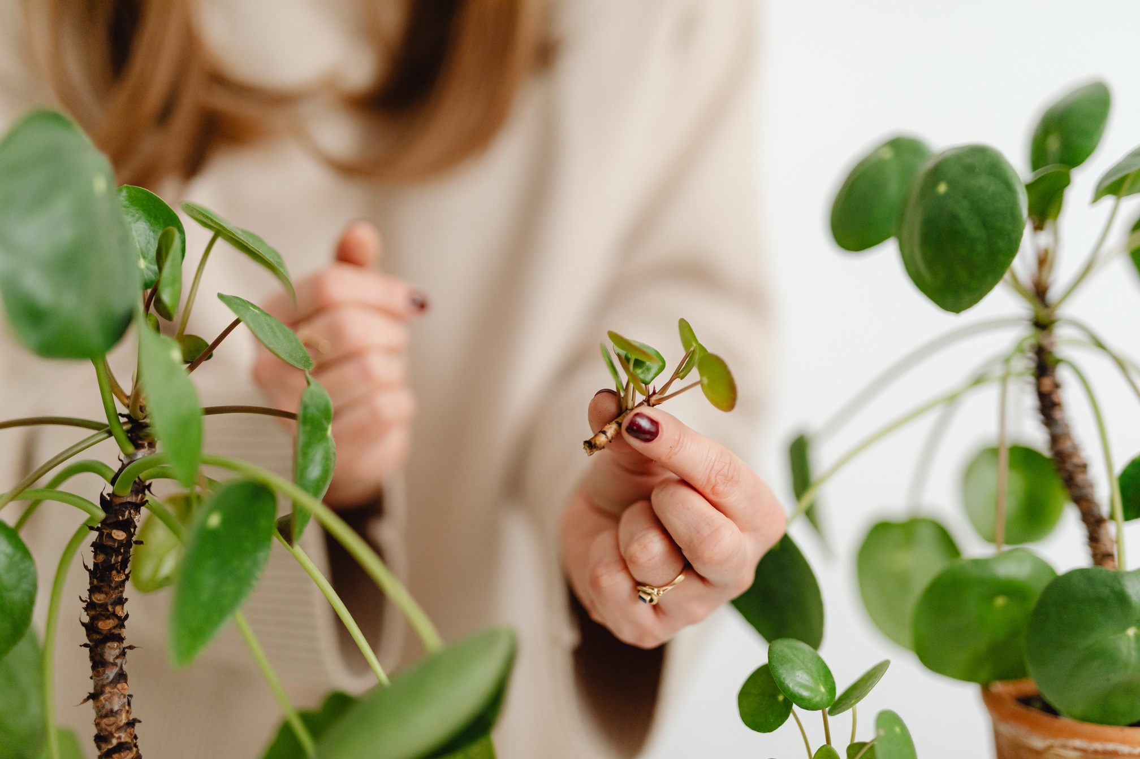
Humans can encourage the asexual reproduction of plants through a process called propagation.
This is where we take cutting from a plant to grow new ones.
Notes:
It is important that you do not inform students what happens in propagation as the students will generate a hypothesis on the next slide.

Slide 9


What will happen to a basil cutting if it is placed and left in water?
Notes:
Ask students to create a hypothesis about what may happen if a basil cutting is placed in water.
Extension question:
What the cutting will look like in 2 days, 5 days, 10 days?
Either note down in the investigation planner or create a mind map on the board.
Optional: Use the resource 'Investigation Template' to structure your write-up.

Slide 10
Method:
  Take a cutting from the top of the plant.
  Remove leaves at the bottom of the stem.
  Fill the jar with clean water.
  Place the cutting in the water.
  Place in a sunny place.
  Observe a record changes daily. Ensure water is changed on a regular basis.
Notes:
Model propagating a basil plant and allow time for students to complete their own propagation. Ensure plants are labelled. Student need to record their observation on day 1 and then at regular intervals.

Slide 11

How do you propagate a plant?
Notes:
Exit ticket: Ask students to explain how humans can encourage asexual reproduction of plants.

