Slide 1


KS2 Lesson
How can we reduce our food waste?

Slide 2
LO: To explain how food waste can be reduced.
I can explain what food waste is.
I can explain the impact food waste has on the environment.
I can explain how food waste can be reduced.

Slide 3
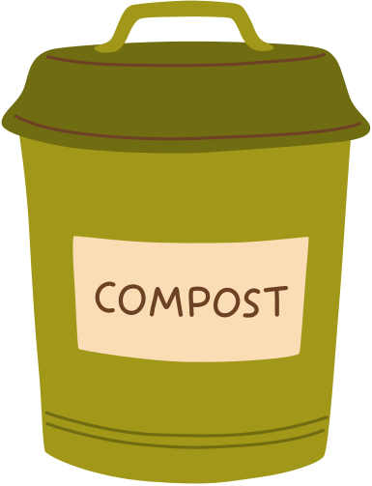
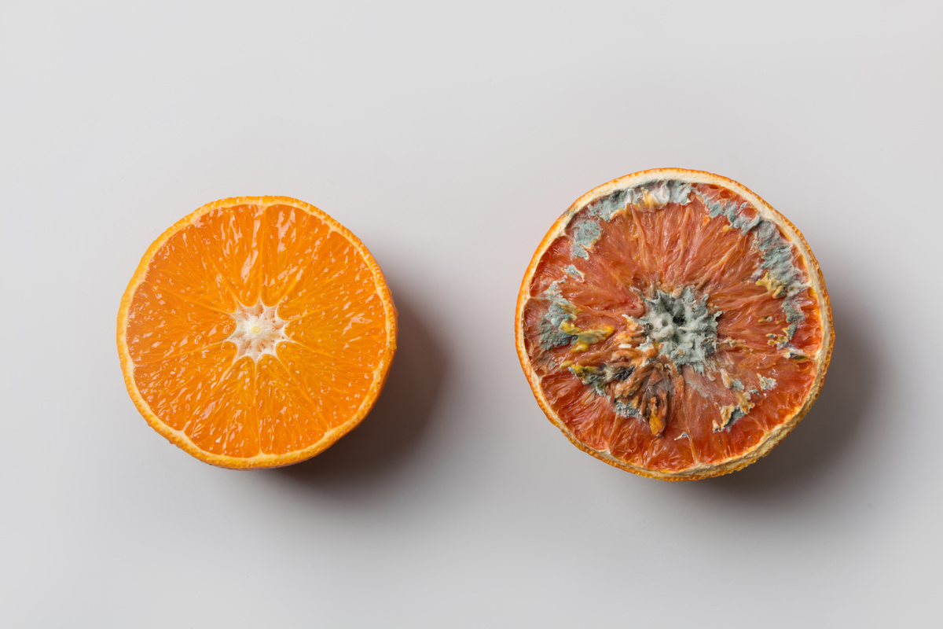




Key Words
decompose
green house gasses
compost
natural resources
Sustainable Development Goals
The United Nations (UN)
Notes:
1 tonne = 1000 kg

Slide 4

Why is throwing food away harmful for the environment?
Notes:
Ask students to tell their partner why food waste is harmful to the environment. Answers (on slide 5) could include: the loss of natural resources; carbon emissions due to production/transportation; methane released from livestock and from decomposition of food.

Slide 5



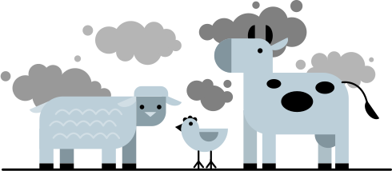
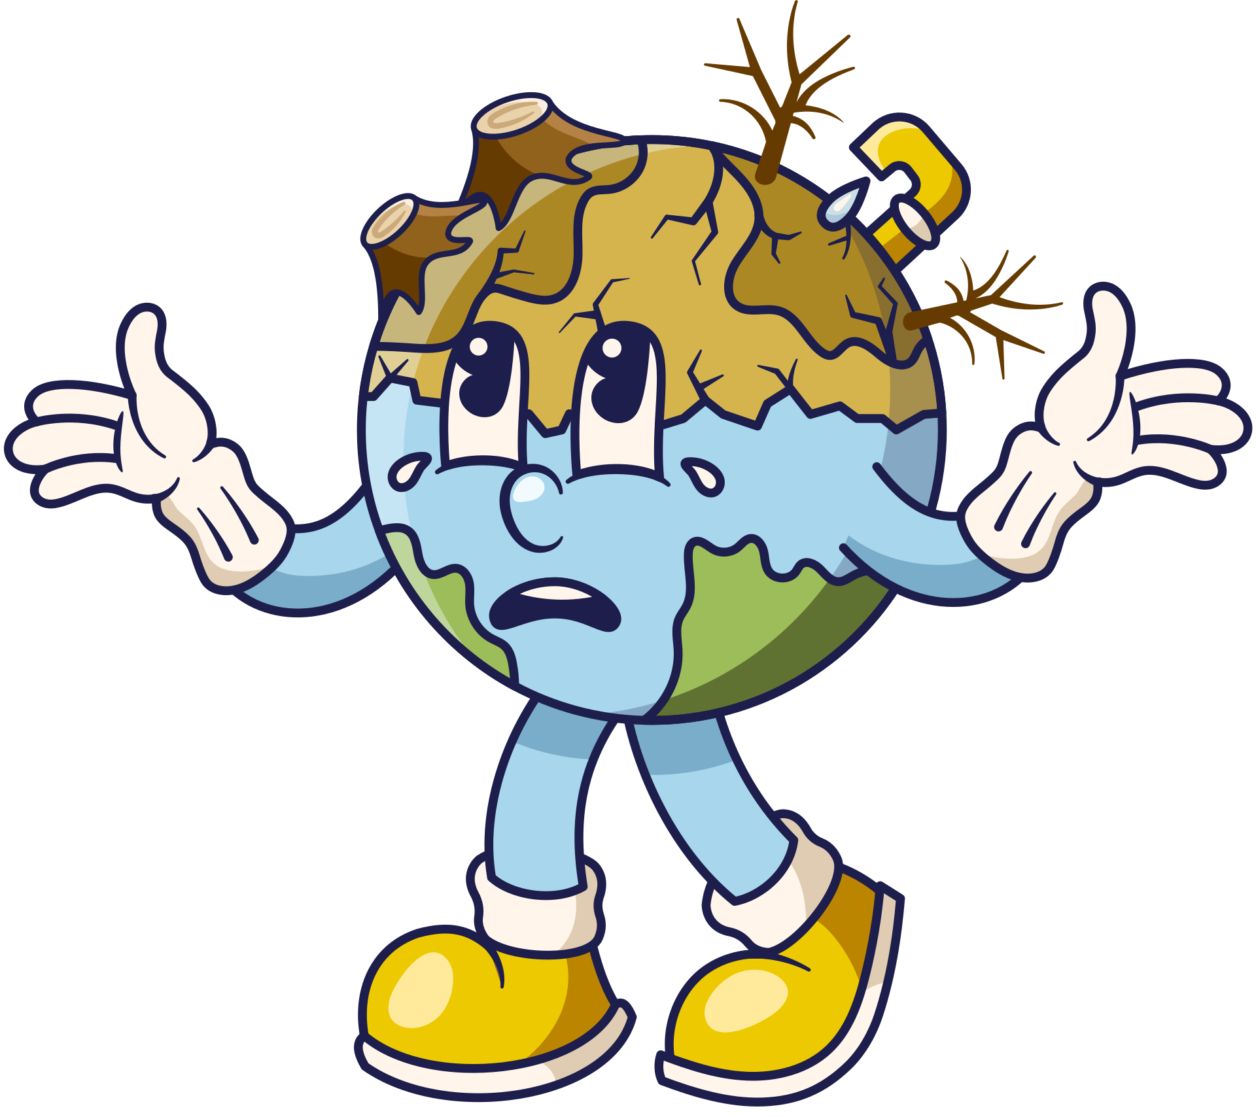
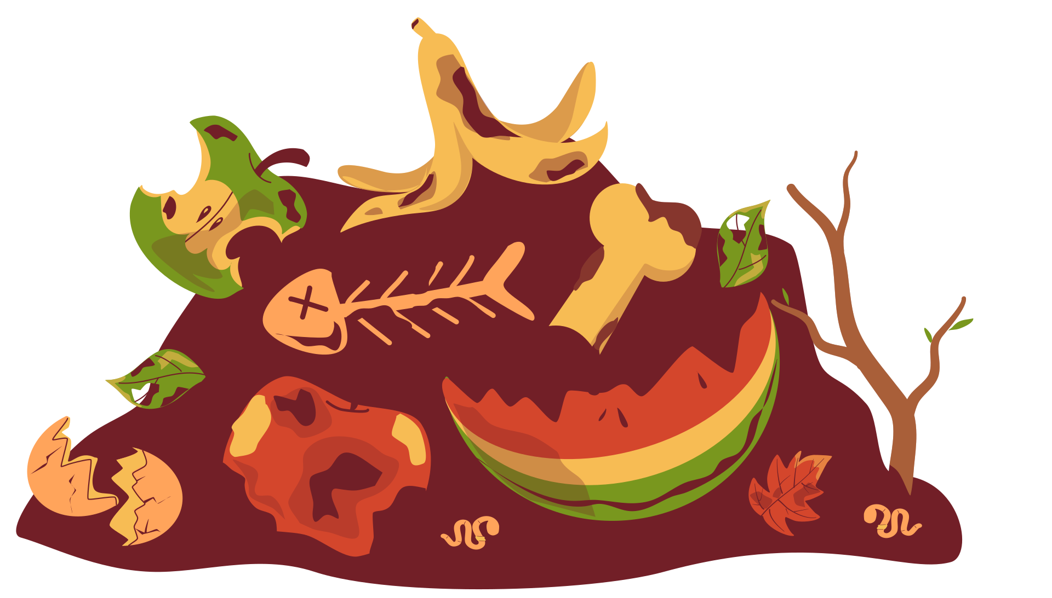
Why is throwing food away harmful for the environment?

Slide 6
The United Nations set a goal of reducing our food waste by half globally by 2030 in the Sustainable Development Goals.
How could we reduce our food waste?
Notes:
The United Nations set goals that they wanted all the world governments to work towards and achieve by 2030. They wanted to reduce our food waste by half!
Allow time for students to discuss how food waste could be reduced.
There may be a discussion why people waste food and often it is because they buy too much, they store it incorrectly, food going mouldy, confusion over use by/best before or imperfect fruit/veg.

Slide 7


Year 3 - 4 task
Create a guide to tell people how to reduce their food waste.
Find out the answers to these questions:
How can you store items correctly?
What examples of low-waste recipes can you find?
What can you do with leftovers?
Where is the best place to put any food waste?
Use these website to help you with your research:
NLWA - Food Waste
Eat Like a Londoner
Friends of the Earth
BBC Bitesize - Food Waste
Notes:
Please note that NLWA are not responsible for the content of the external links. We encourage you to check the content of the links ahead of the lesson.

Slide 8
Year 5-6 task
Create a guide to tell people how to reduce their food waste.
Use these website to help you with your research:
NLWA - Food Waste
Eat Like a Londoner
Friends of the Earth
BBC Bitesize - Food Waste
Notes:
Please note that NLWA are not responsible for the content of the external links. We encourage you to check the content of the links ahead of the lesson.

Slide 9
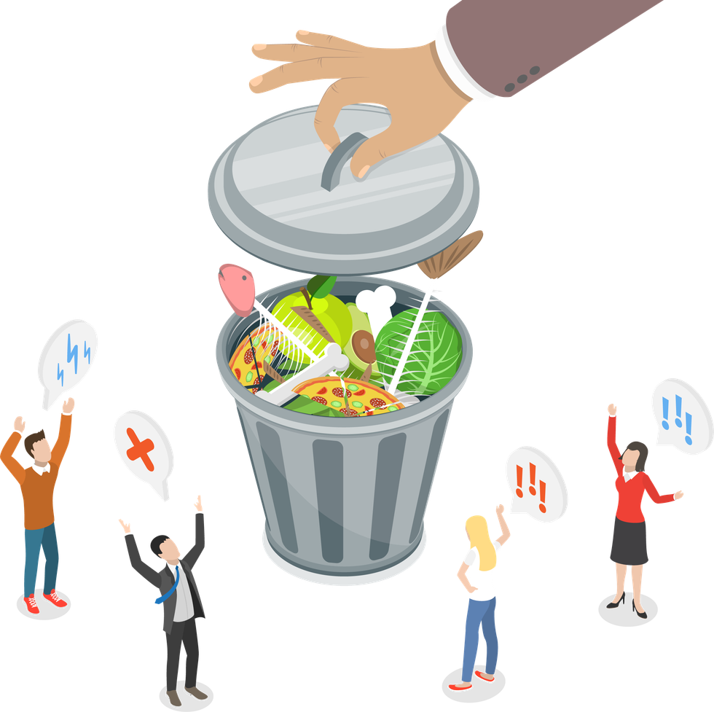
Summary
Tell your partner one way you are going to try and reduce your food waste.
Notes:
Ask students to tell their partner one way they are going to try and reduce their own food waste.

