Slide 1


KS2 Lesson
What is the problem with food waste?

Slide 2
LO: To understand and explain the impact of food waste.
  I can explain what food waste is.
  I can explain the impact food waste has on the environment.
  I can explain why food waste happens.

Slide 3
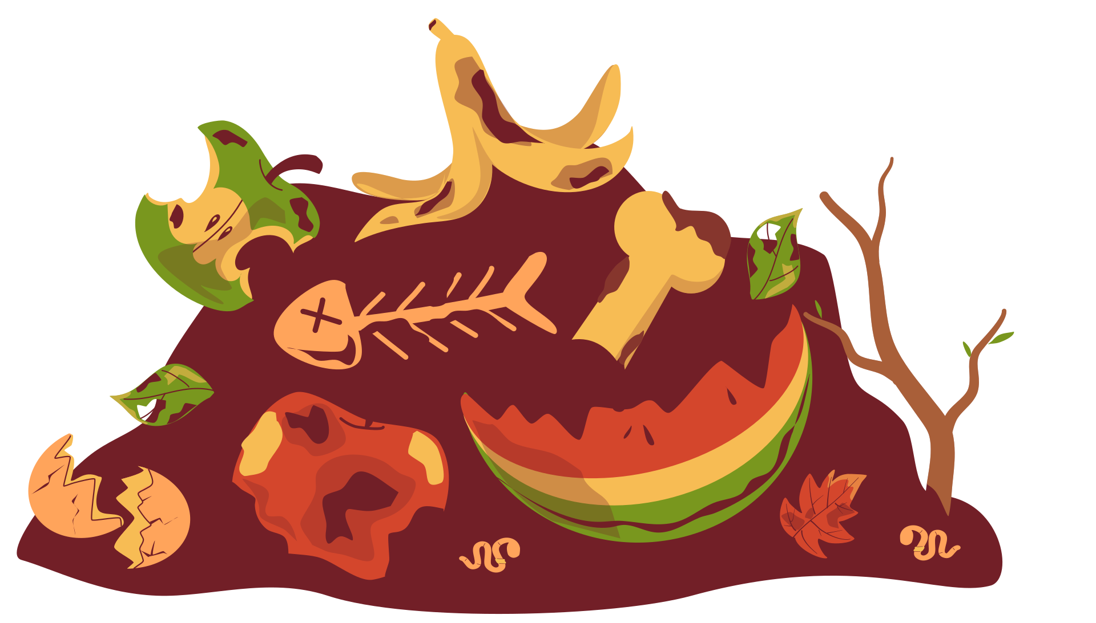




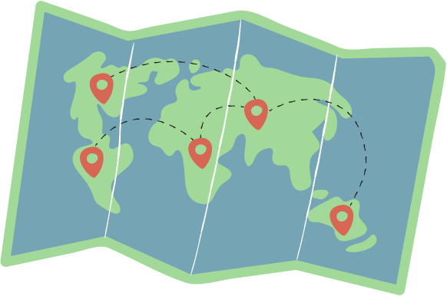
Key Words
decomposes
agriculture
green house gasses
natural resources
tonnes
food miles

Slide 4

How much food was thrown away in the UK in 2021?
10.7 million tonnes
8.5 million tonnes
3.4 million tonnes
Notes:
Either on whiteboards or as partner talk, ask students to consider how much food was thrown away in the UK in 2021.

Slide 5
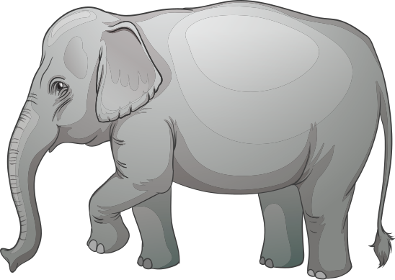
10.7 million tonnes of food was thrown away in 2021. This would weigh more than 2 million elephants!
Source: House of Commons, 2024
Notes:
Explain this is the same weight as more than 2 million elephants. Most of the food waste originates from homes.

Slide 6

Why is throwing food away harmful for the environment?
Notes:
Allow students time to discuss what the impact may be on the environment

Slide 7



Why is food waste harmful to the environment?
Wasting food means wasting all the natural resources that were used in the production.
Agriculture requires a lot of water. It is estimated that farming accounts for 70% of water usage globally.
One glass of milk thrown away is the same as wasting 1,000 litres of water!*
Source: How Does Food Waste Affect the Environment? | Earth.Org
Notes:
*This is due to the amount of water used in the production of milk.

Slide 8



Why is food waste harmful to the environment?
Producing food produces a high amount of harmful gases. Livestock release methane when they fart!
In 2021-22, it was estimated that food waste cause 18 million tonnes of carbon dioxide equivalent. That’s the same as 10 million cars!
Source: SOFEA, 2022
Notes:
Harmful gases include carbon dioxide as a result of transporting food from farm to the production line.
Please note that when food waste decomposes in landfill, it produces methane. However, when it is composted it produces carbon dioxide. This is due to the presence of oxygen in composting.

Slide 9

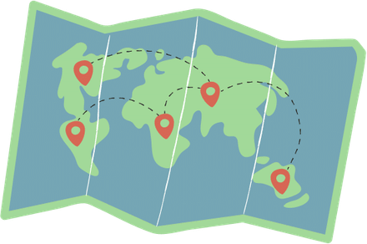

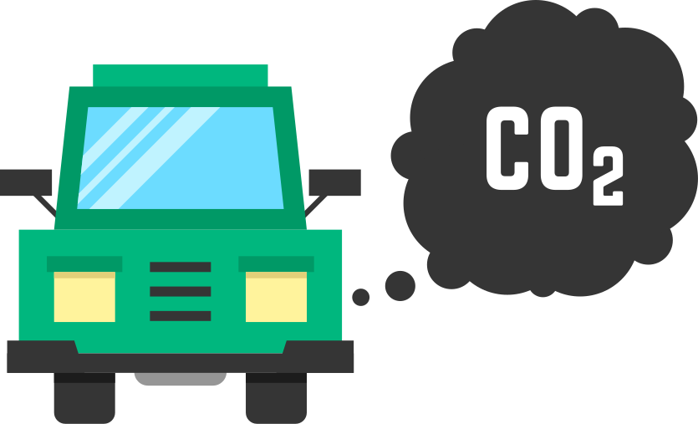
Why is food waste harmful to the environment?
Due to the type of weather and climate some items of food require, they can’t be grown here in the UK.
This means food is often transported across the world. This can be by planes, trucks and boats - all of which use fuel and produce carbon emissions.

Slide 10





In pairs, use the food fact files to find out the answers to these questions:
1) Where is your item of food produced and why?
2) What natural resources are needed to produce this food?
3) What other resources do you need?
Bonus question: How many miles/kilometres would this item of food have to travel to reach your school?

Slide 11

Which item of food would need to travel the furthest?
Which item is the most wasted in the UK?
Notes:
Answers in order of most wasted: bread, milk, lettuce and banana.
Around 1 million bananas, 2.7 million glasses of milk, 170,000 whole lettuces and 25 million slices of bread are wasted.
Ask, why might people throw away lots of food?

Slide 12


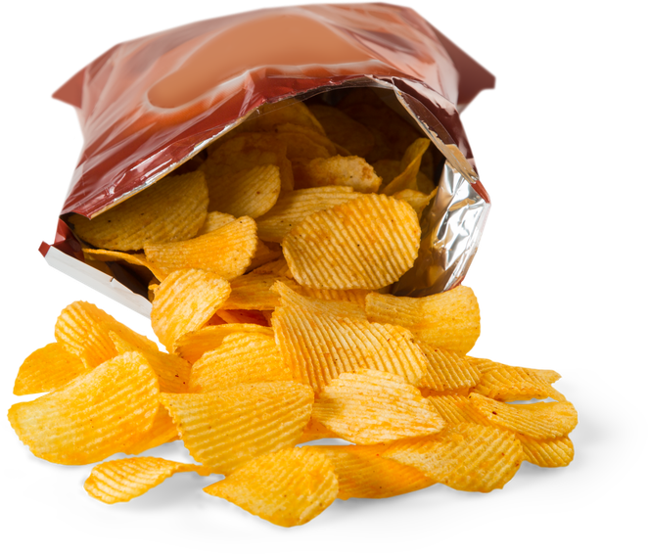
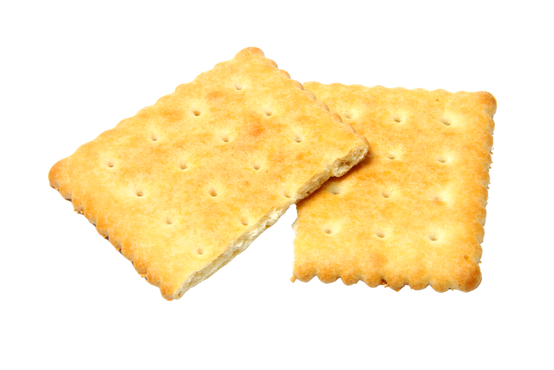
So why does food waste happen?
Often people might buy too much food so the food goes mouldy or is no longer able to be eaten.
Sometimes food can be stored incorrectly, which means it becomes inedible quickly.
Food might not look ‘perfect’ so supermarkets or factories throw it away.

Slide 13
Which statement is incorrect?
A) Food waste creates green house gases when it decomposes.
B) Farming only requires a small amount of natural resources.
C) One of the most wasted foods in the UK is bread.
Notes:
Answer B

