Slide 1




Where does our food come from?
KS1 Lesson - Lesson 1 of 4

Slide 2
LO: To understand that food comes from plants and animals and may travel long distances to reach us.
  I can state places food comes from
  I can name foods that come from plants and animals.
  I can explain why some food travels a long way.

Slide 3






Lesson Prep
Vocabulary
Discussion
Keywords that children need to understand and use during the lesson.
An opportunity for children to practice the knowledge learnt.
Big question
Task
To assess learning and give children time to practise independently.
A central question that sparks curiosity and frames the lesson’s theme.
The knowledge
Extension
Essential facts and concepts children need to know.
Optional tasks to deepen or stretch learning beyond the core lesson.

Slide 4
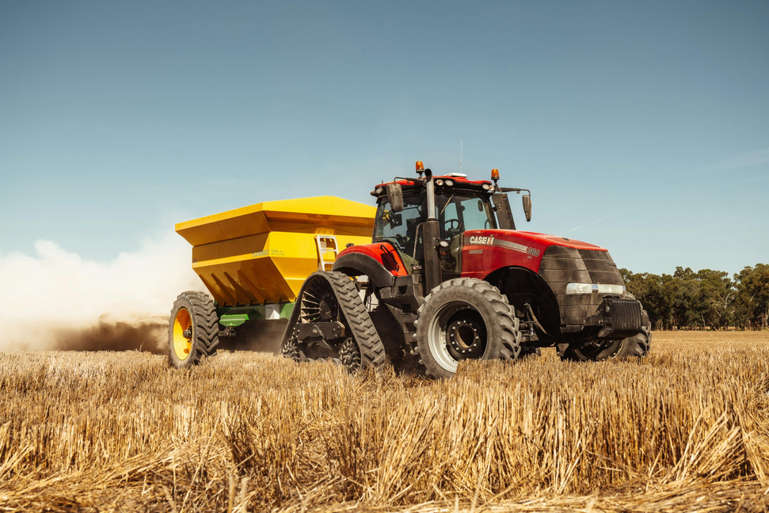
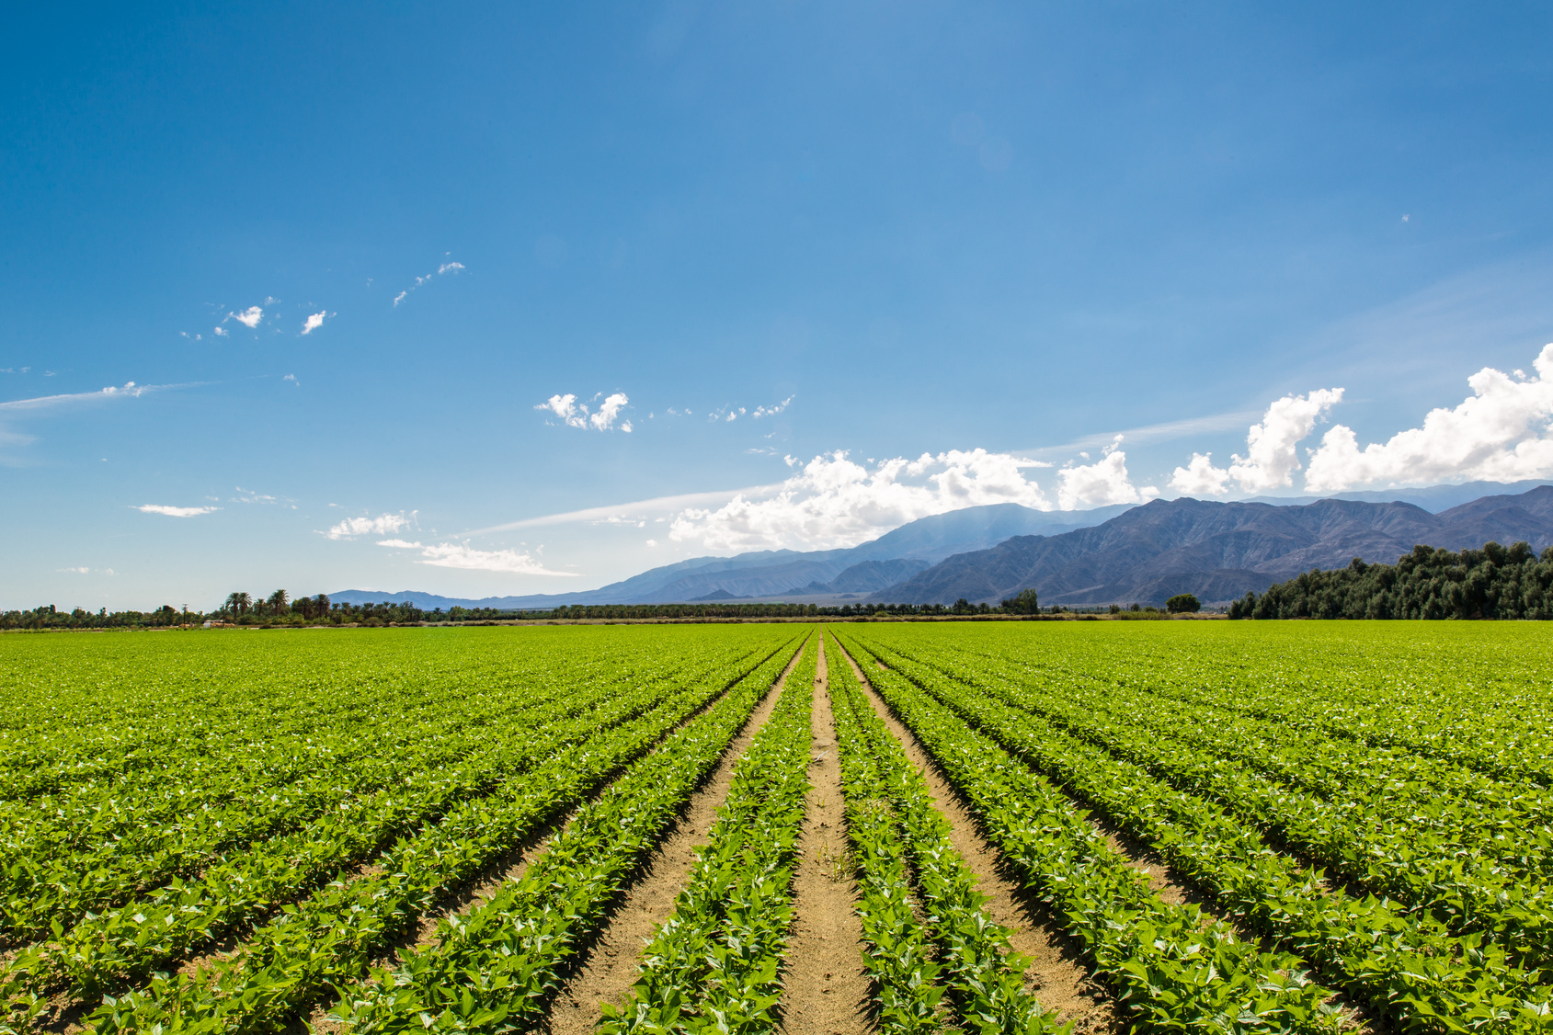
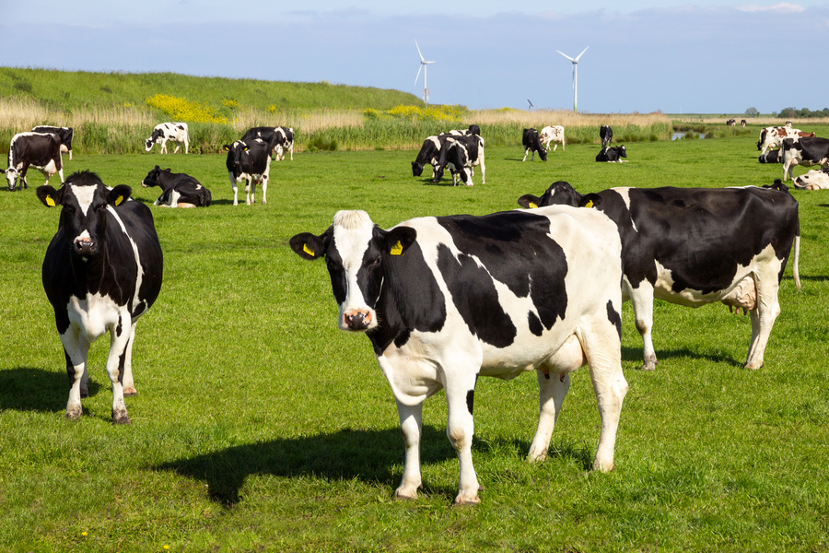
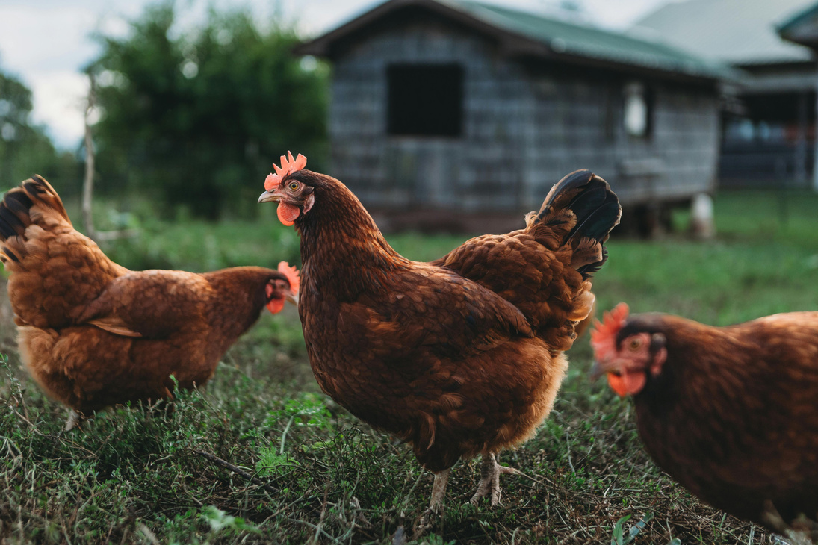

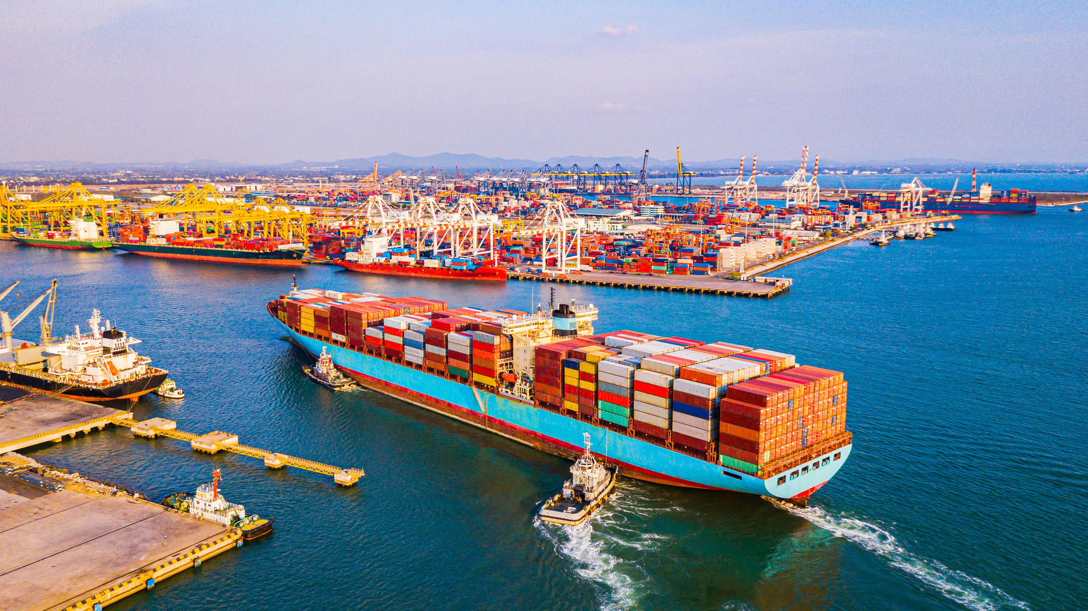
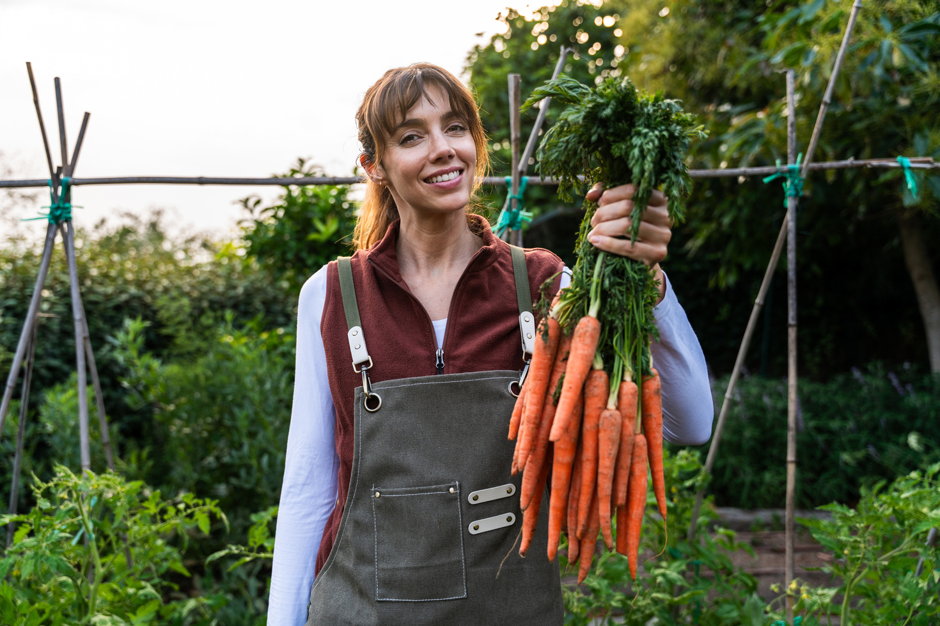
Key Words
farm
plants
animals
local
seasonal
import
Notes:
Farm: a place where people grow food or keep animals.
Plants: living things that grow in the ground, like flowers, trees, and vegetables.
Animals: living things that move, eat, and grow, like cats, cows, and birds.
Local: something that comes from nearby, not far away.
Seasonal: food or things that grow best at certain times of the year.
Import: bringing things from another country to use or sell here.

Slide 5
Vocabulary task
  2. 3. 4. 5. 6.
local
farm
seasonal
import
plant
animal
Challenge: Write a sentence using a new vocabulary word.
Notes:
1 = farm
2 = local
3 = plants
4 = seasonal
5 = animal
6 = import

Slide 6





Hi Ned! Pineapples are my favourite fruit. Do they grow in London?
No Nancy! They grow far away in hot countries. Let’s learn where our food comes from.

Slide 7

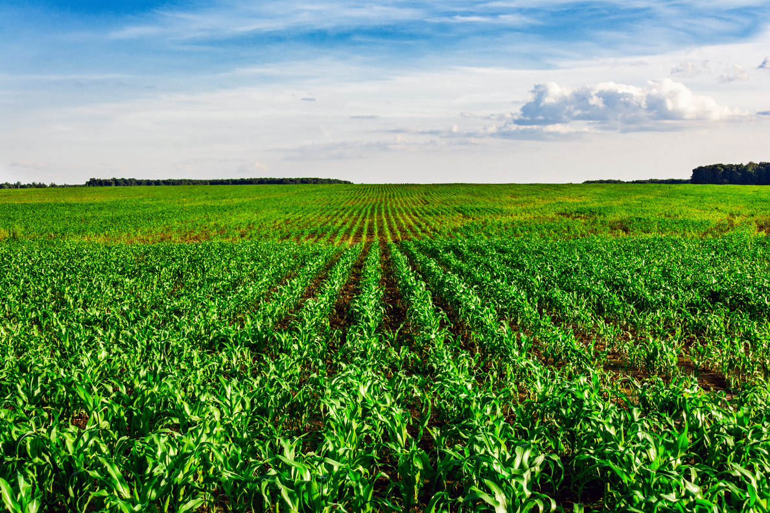
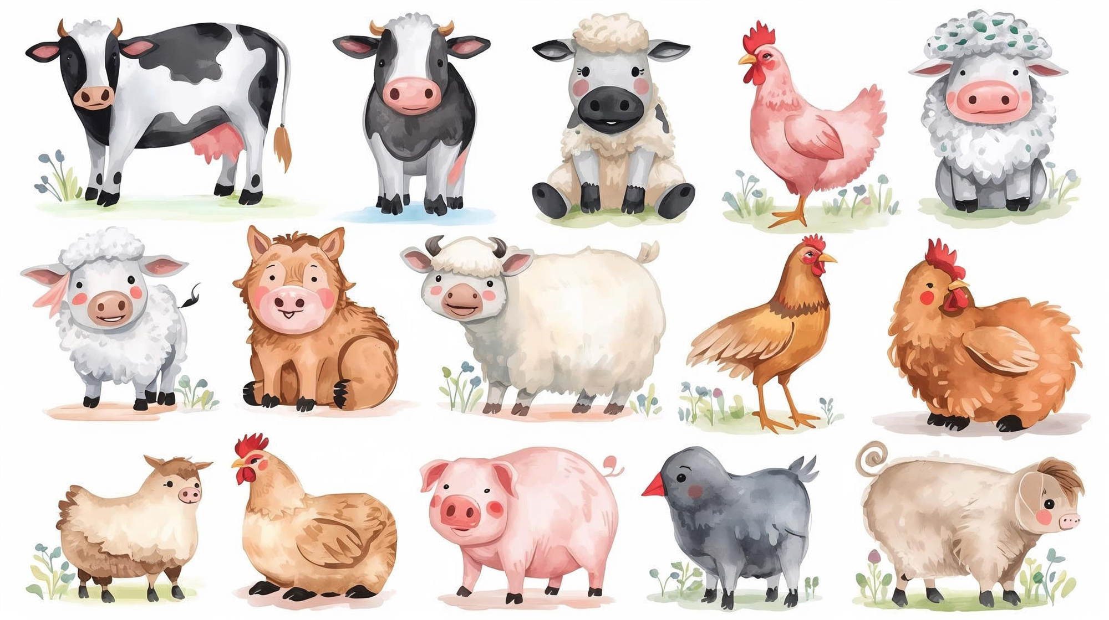

Where does food come from?
the land
animals on the land
factories
the ocean

Slide 8
Where does food come from?
Food comes from ____, ______, ______ and ______.

Slide 9

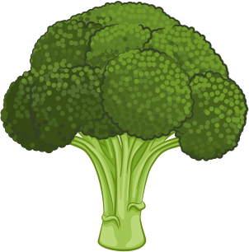


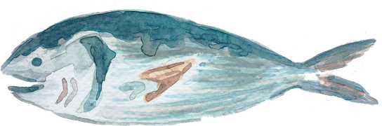

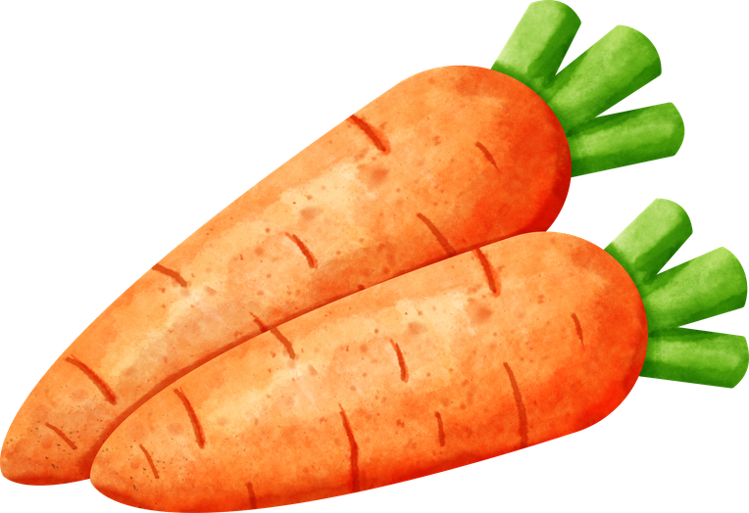



Tell you partner where these foods come from:
the land
animals (on land)
factory
the ocean
Notes:
The land: carrots, broccoli
Animals on the land: steak, sausages, chicken
Factories: bread, chocolate, crisps
The ocean: tuna, fish

Slide 10
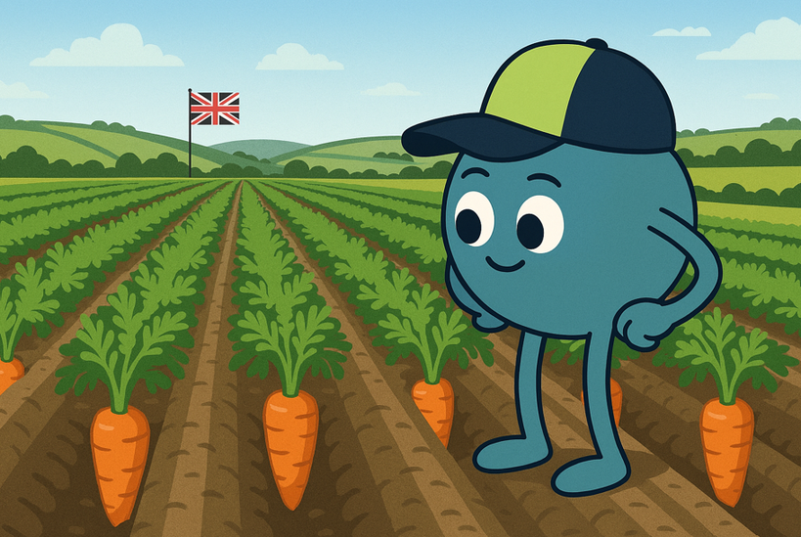
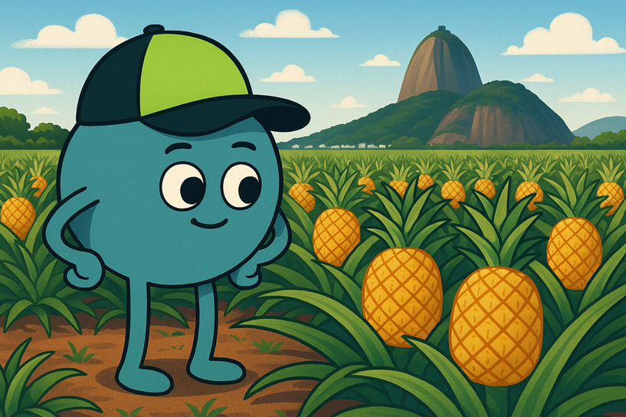
Local vs imported
Local food grows in the UK.
Imported food grows in a different country.

Slide 11
Local vs imported
_____ food grows in the _____.
_____ food grows in a different _____.
UK imported country local

Slide 12
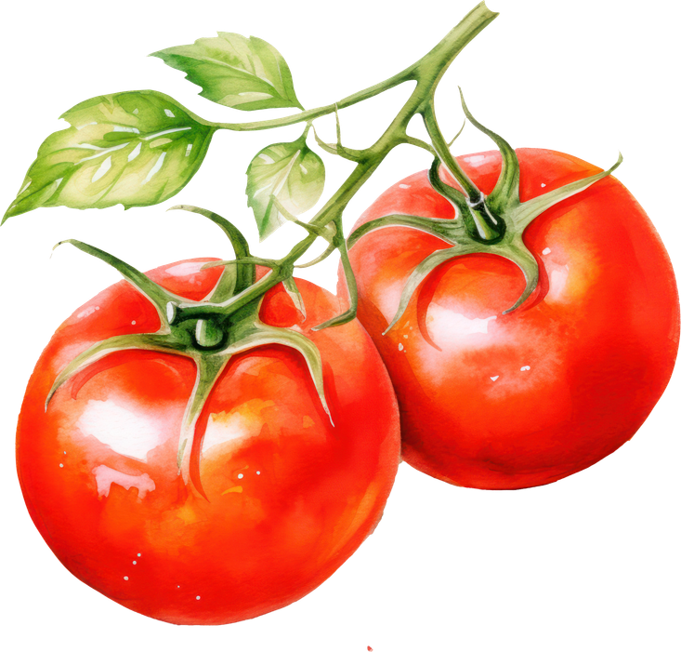
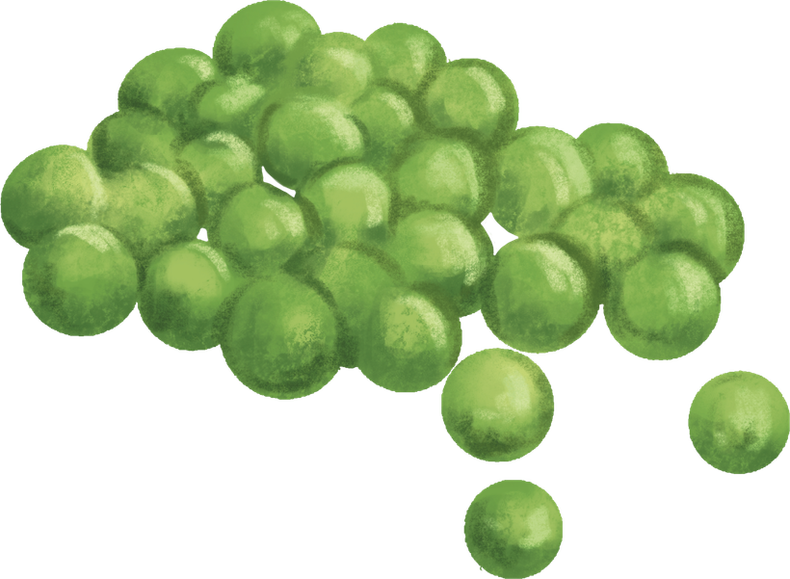
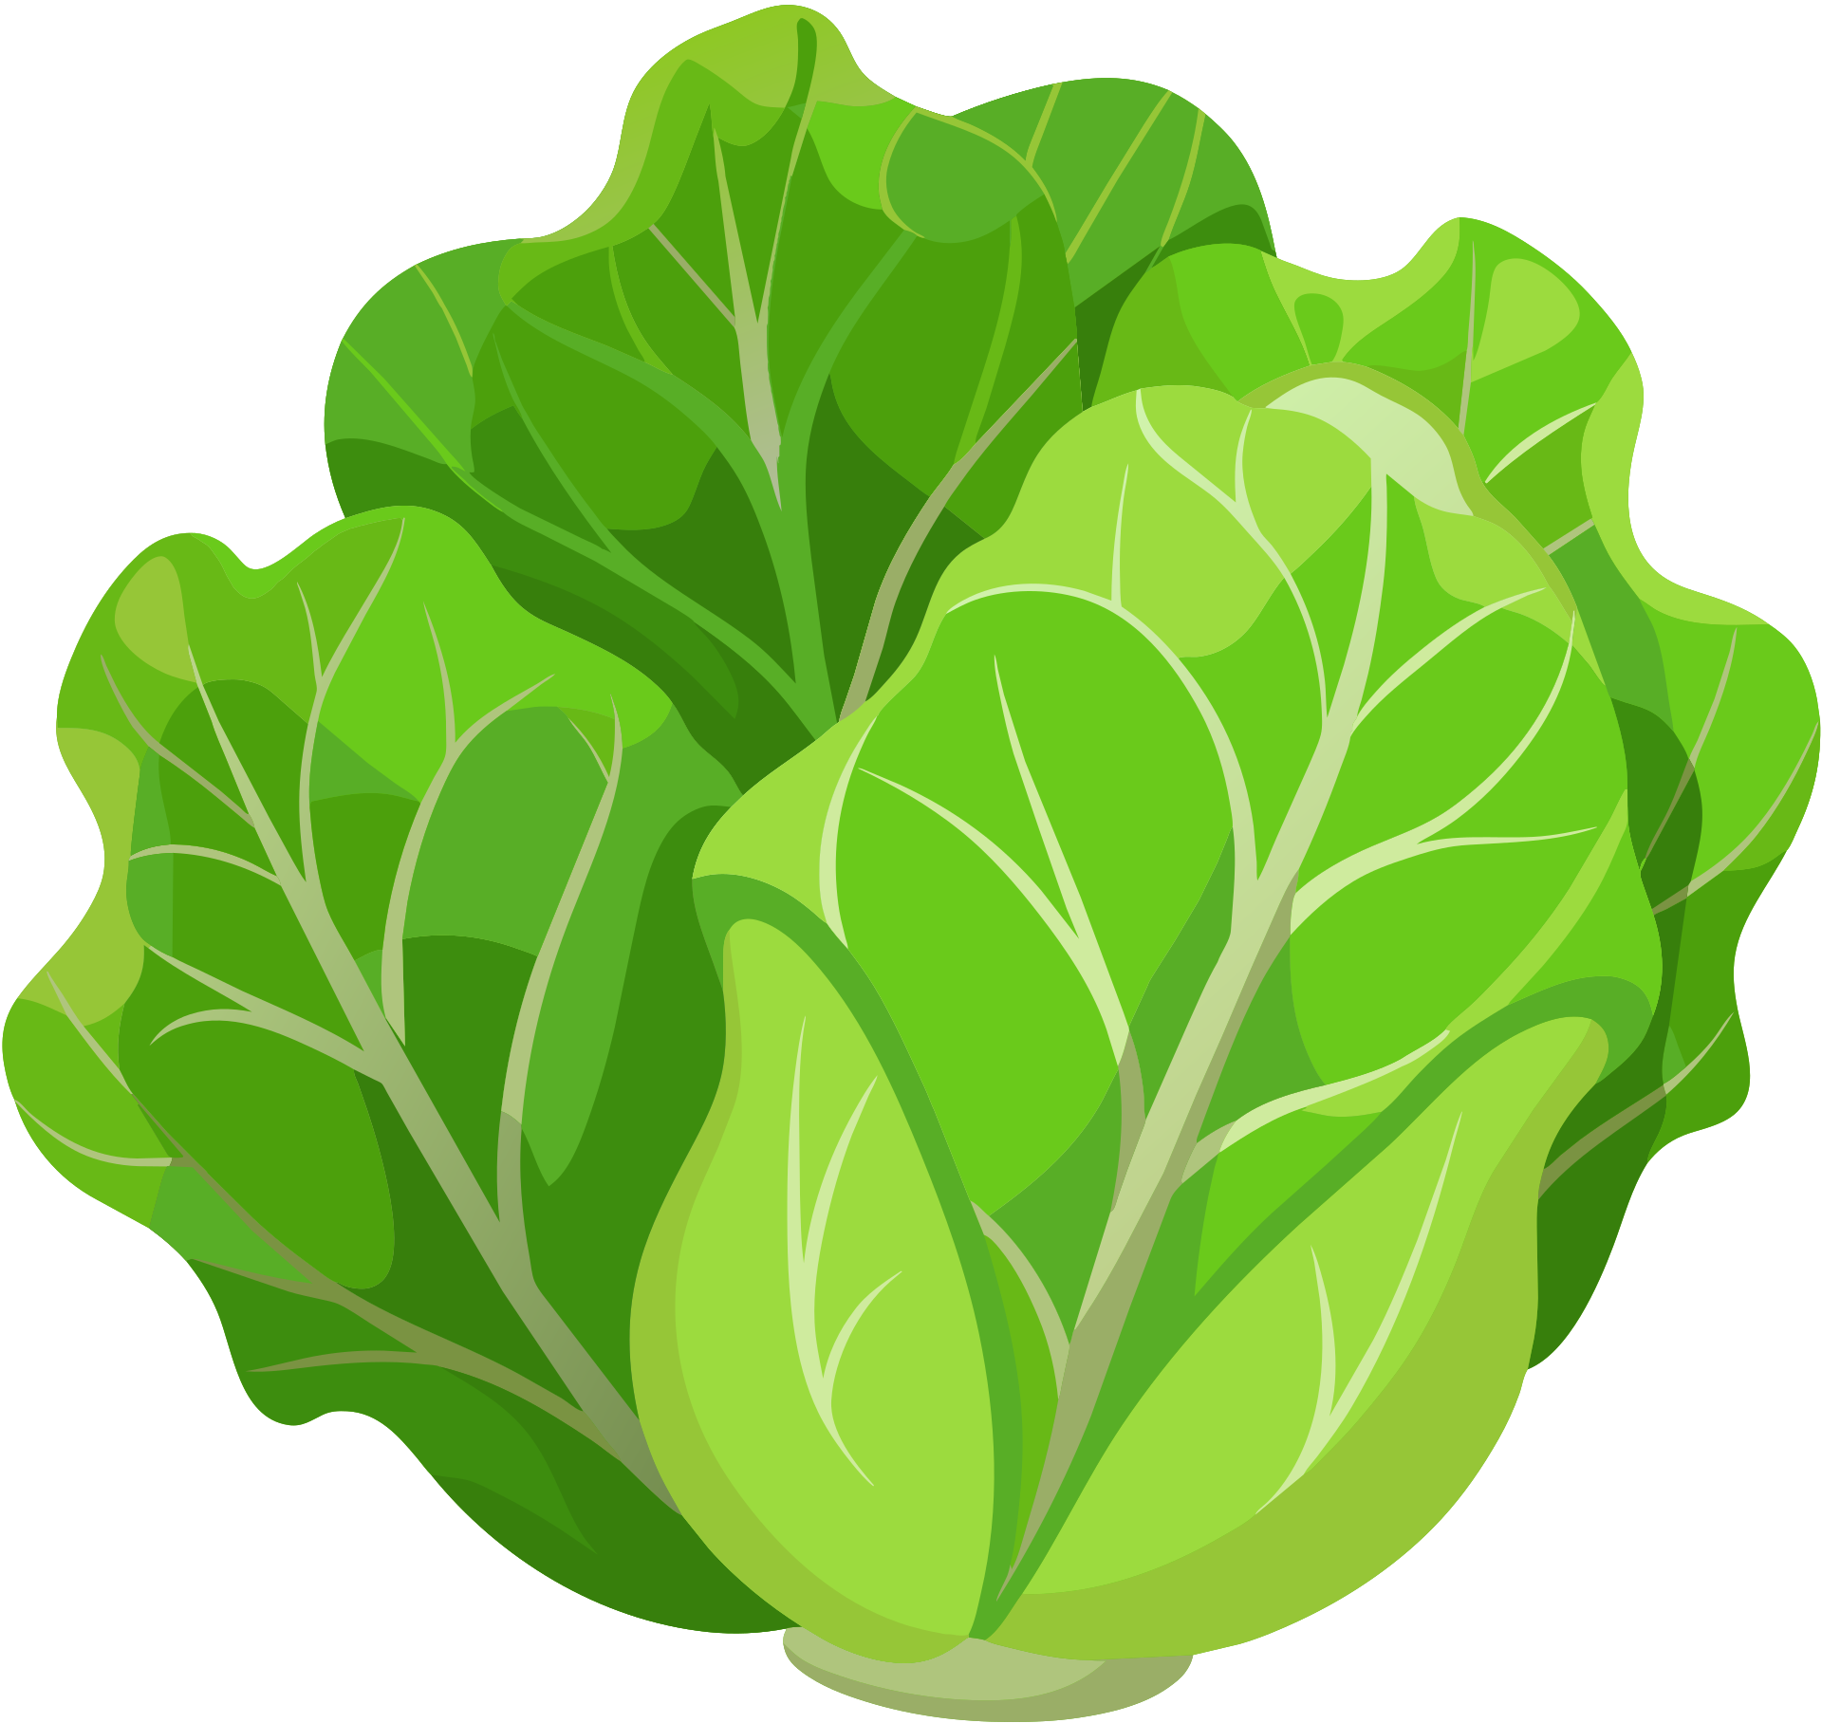
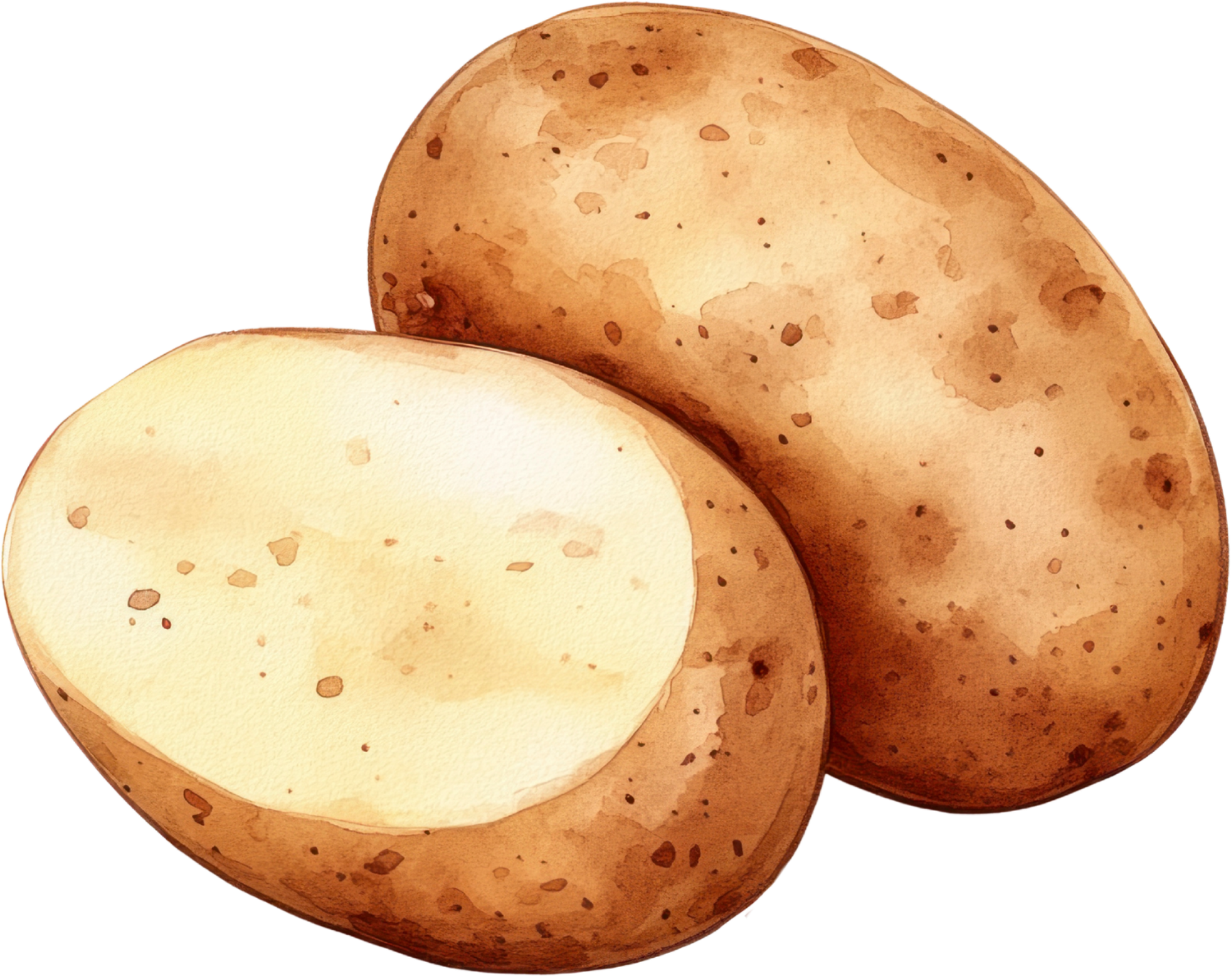
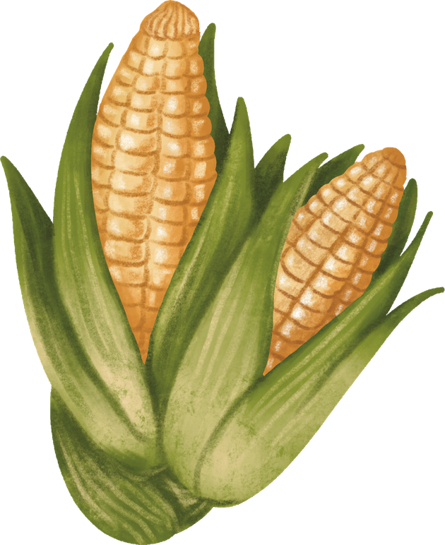
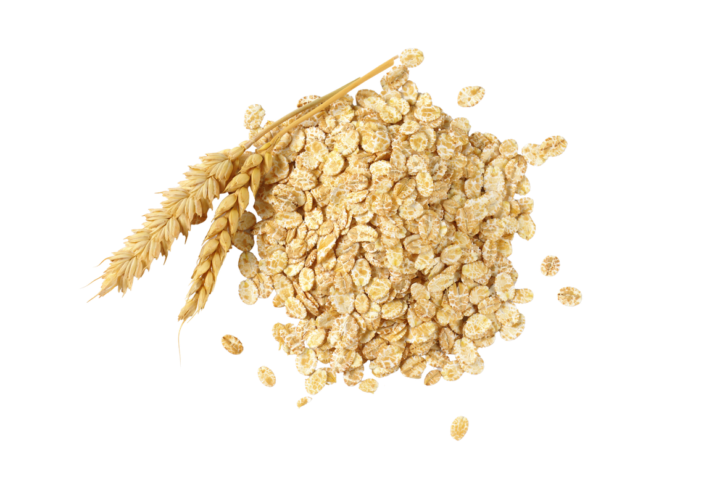
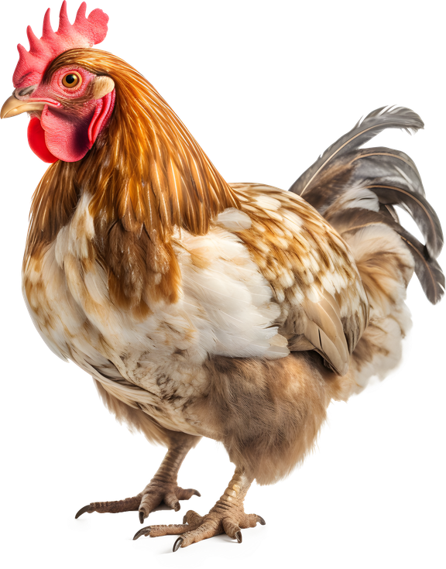
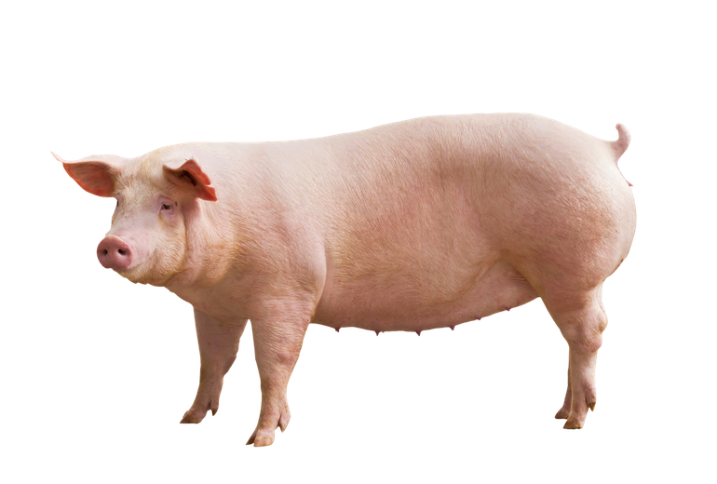
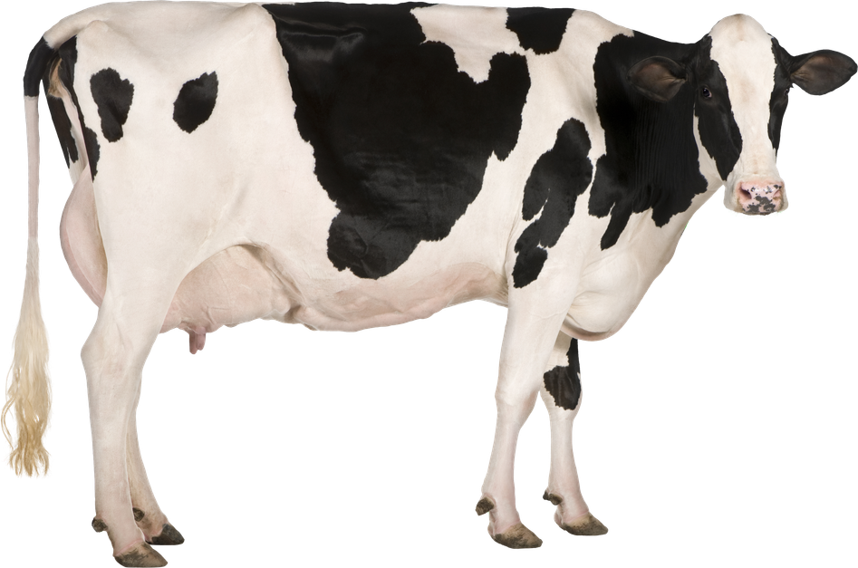
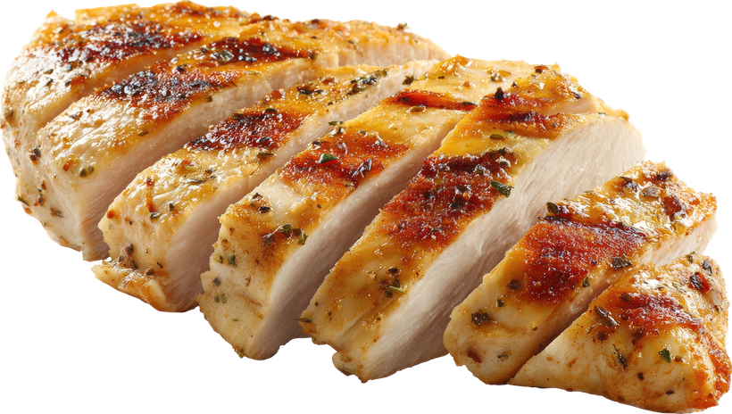
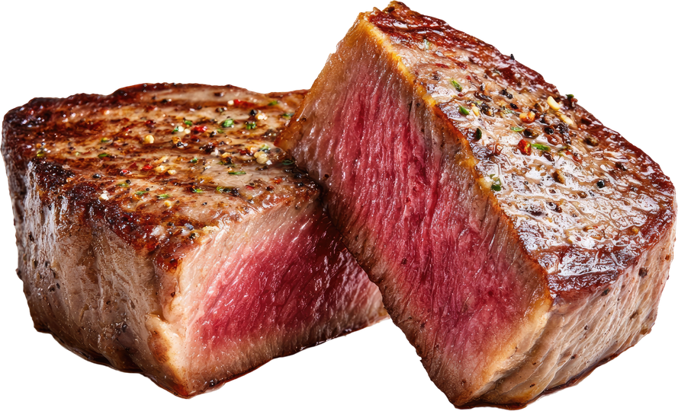
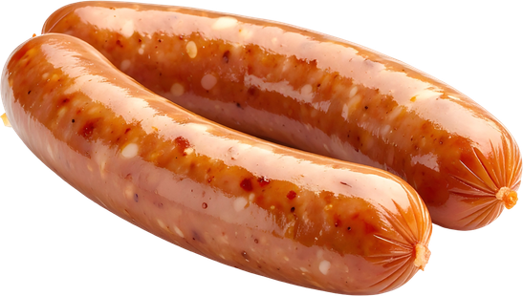
Local food in the UK
All these foods grow in the UK.

Slide 13

Local food in the UK
Some of these foods only grow in our country in the summer. They are seasonal. How do you think we get these foods in the winter?

Slide 14
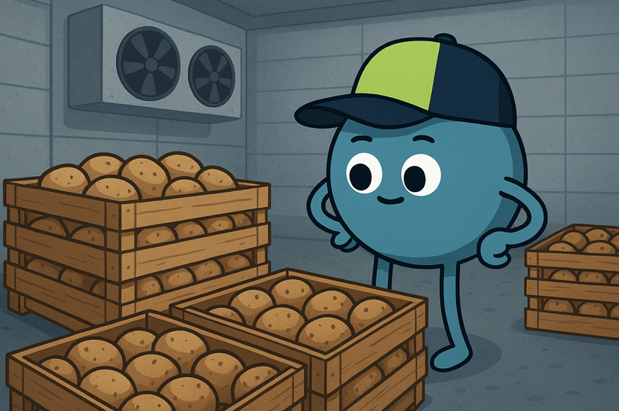
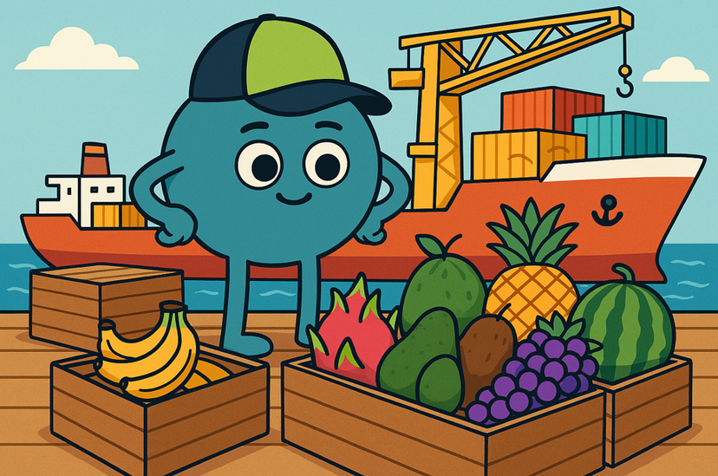
Importing and storing food
Some fruits and vegetables are stored carefully so we can use them in the winter.
Other fruits and vegetables are imported from hotter countries.

Slide 15
Importing and storing food
Some fruits and vegetables are ______ carefully so we can use them in the ______.
Other fruits and vegetables are ______ from hotter ______.
countries stored imported winter

Slide 16


Importing food
We can get fruit all year round.
We can try exotic fruit like pineapples that do not grow in the UK.
The fruit travels a long way which is bad for our environment.
It might not be as fresh.

Slide 17
Importing food
One positive of importing food is _____.
One negative of importing food is _____.

Slide 18
It’s quiz time!

Slide 19
Quiz
  What 4 places can our food come from?
2. What is importing food?
a) growing food in your garden to eat
b) bringing food from other countries into the UK
3. Name a fruit that grows in the UK and not in the UK.
4. Why is it better for the environment to eat food that is local?

Slide 20
Problems...
Food is imported from all over the world.
What do you think is better than importing food from far away places?
What might happen if a country couldn’t get food from another place?
Notes:
Discussion 1
- Read question to children twice
- Give children a moment to think about the question
- In partners, get children to share their thoughts using sentence stem 'To reduce this we can...'
-Give children 2 minutes in partners to discuss their opinions
- Listen in to discussion. Spotlight two children
Repeat with question 2

Slide 21
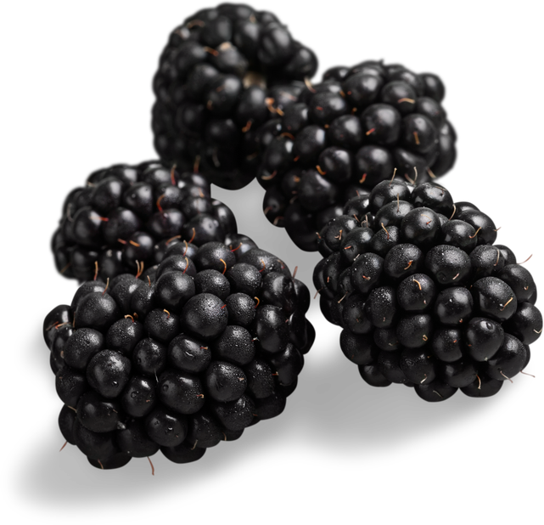
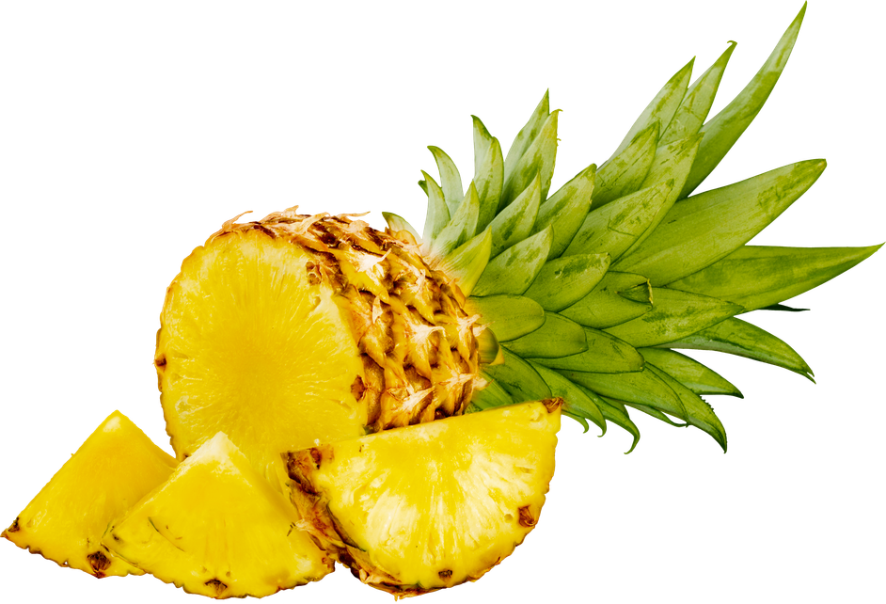
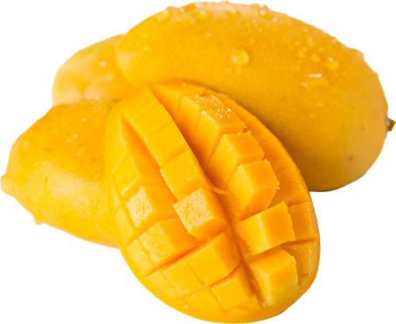

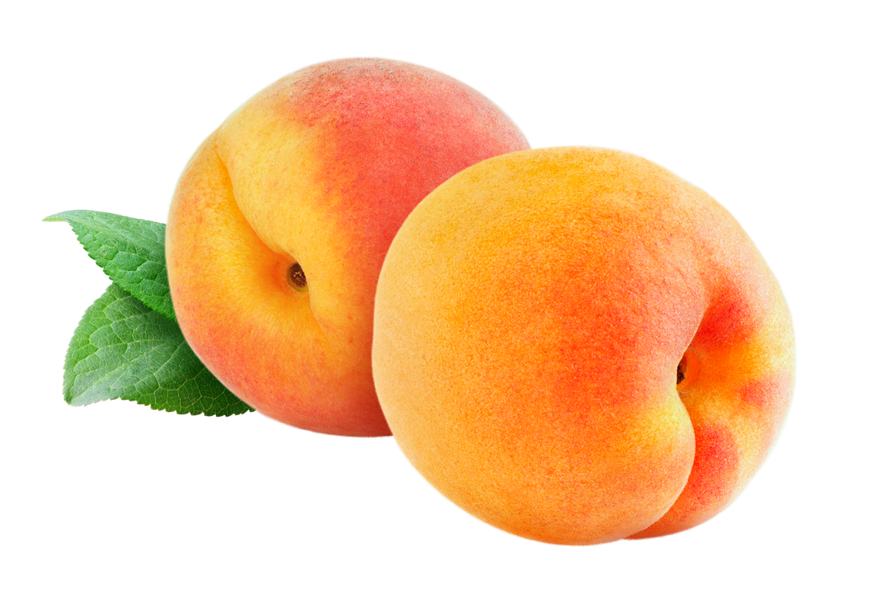
Extension activity 1
  Geography/science activity: Give children pictures of a range of fruit and vegetables. Children to sort them into two piles: local and imported. Children can research on the internet if they need.

Slide 22
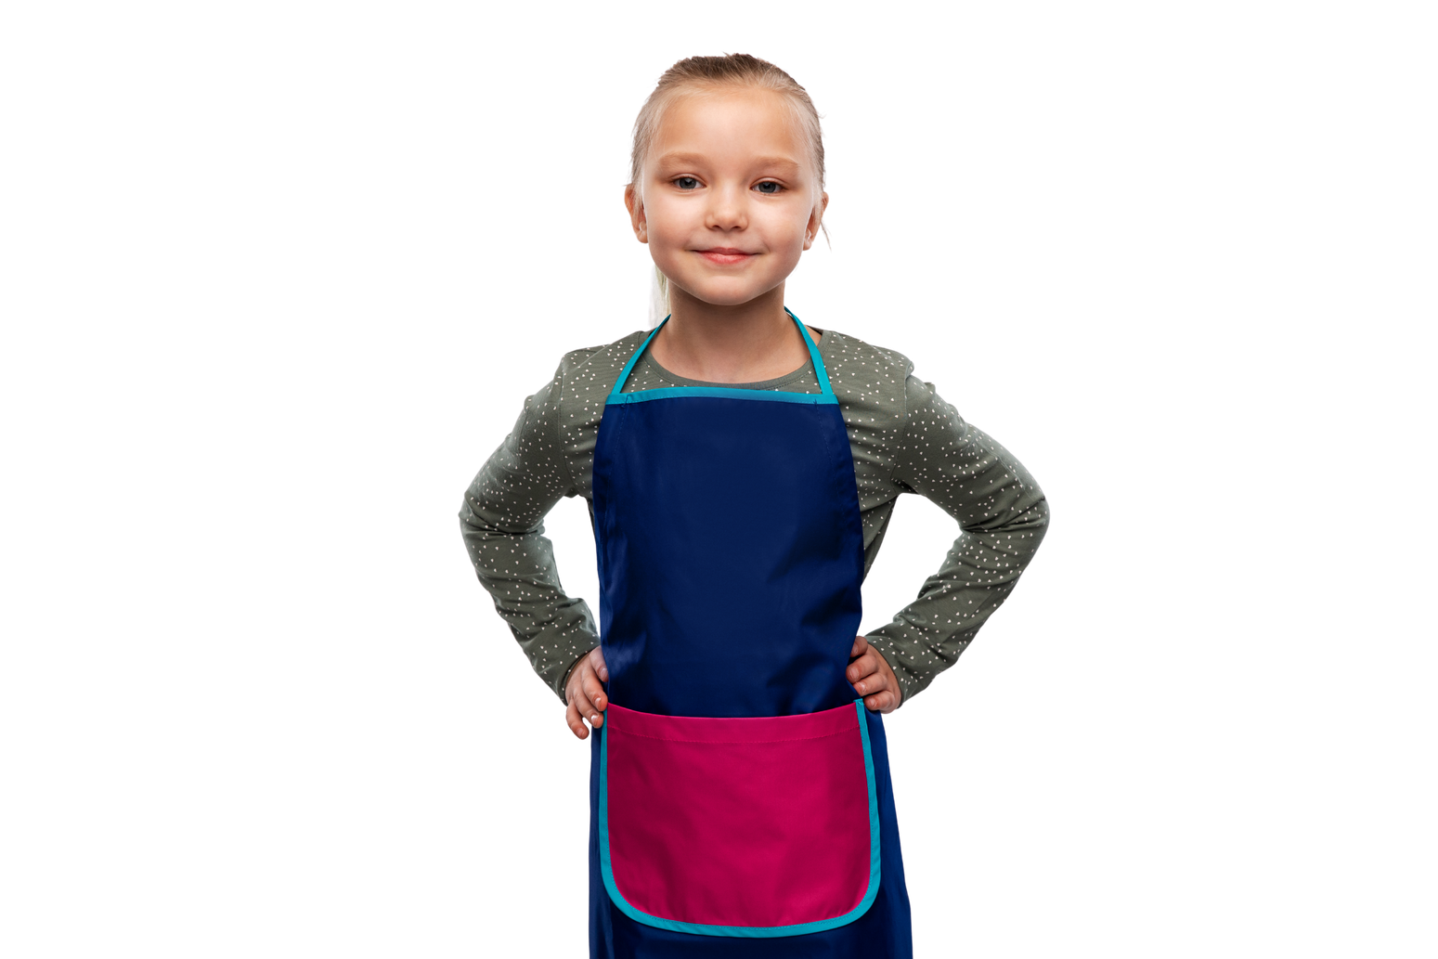
Extension activity 2
  Art/writing activity: Provide children with a list of foods that grow in the UK. Children design a seasonal meal. Children can label the ingredients they have used.

Slide 23
Extension activity 3
Geography activity: Give children a list of food items. Get them to state where this item is grown.

