Slide 1


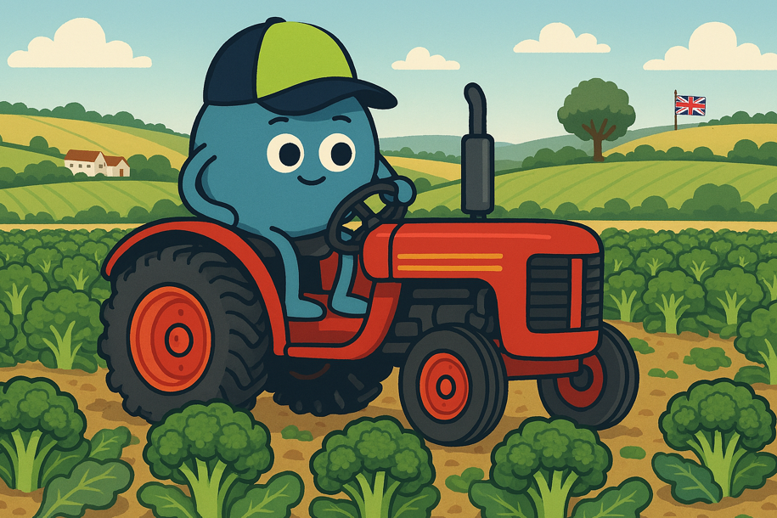

How much energy does my food take to make?
KS1 Lesson - Lesson 2 of 4

Slide 2
LO: To understand that a plate of food needs a lot of energy to make
I can describe the steps food takes to reach us.
I can say what energy is used to grow and move food.
I can compare foods and say which uses more energy to make.

Slide 3






Lesson Prep
Vocabulary
Discussion
Keywords that children need to understand and use during the lesson.
An opportunity for children to practice the knowledge learnt.
Big question
Task
To assess learning and give children time to practise independently.
A central question that sparks curiosity and frames the lesson’s theme.
The knowledge
Extension
Essential facts and concepts children need to know.
Optional tasks to deepen or stretch learning beyond the core lesson.

Slide 4
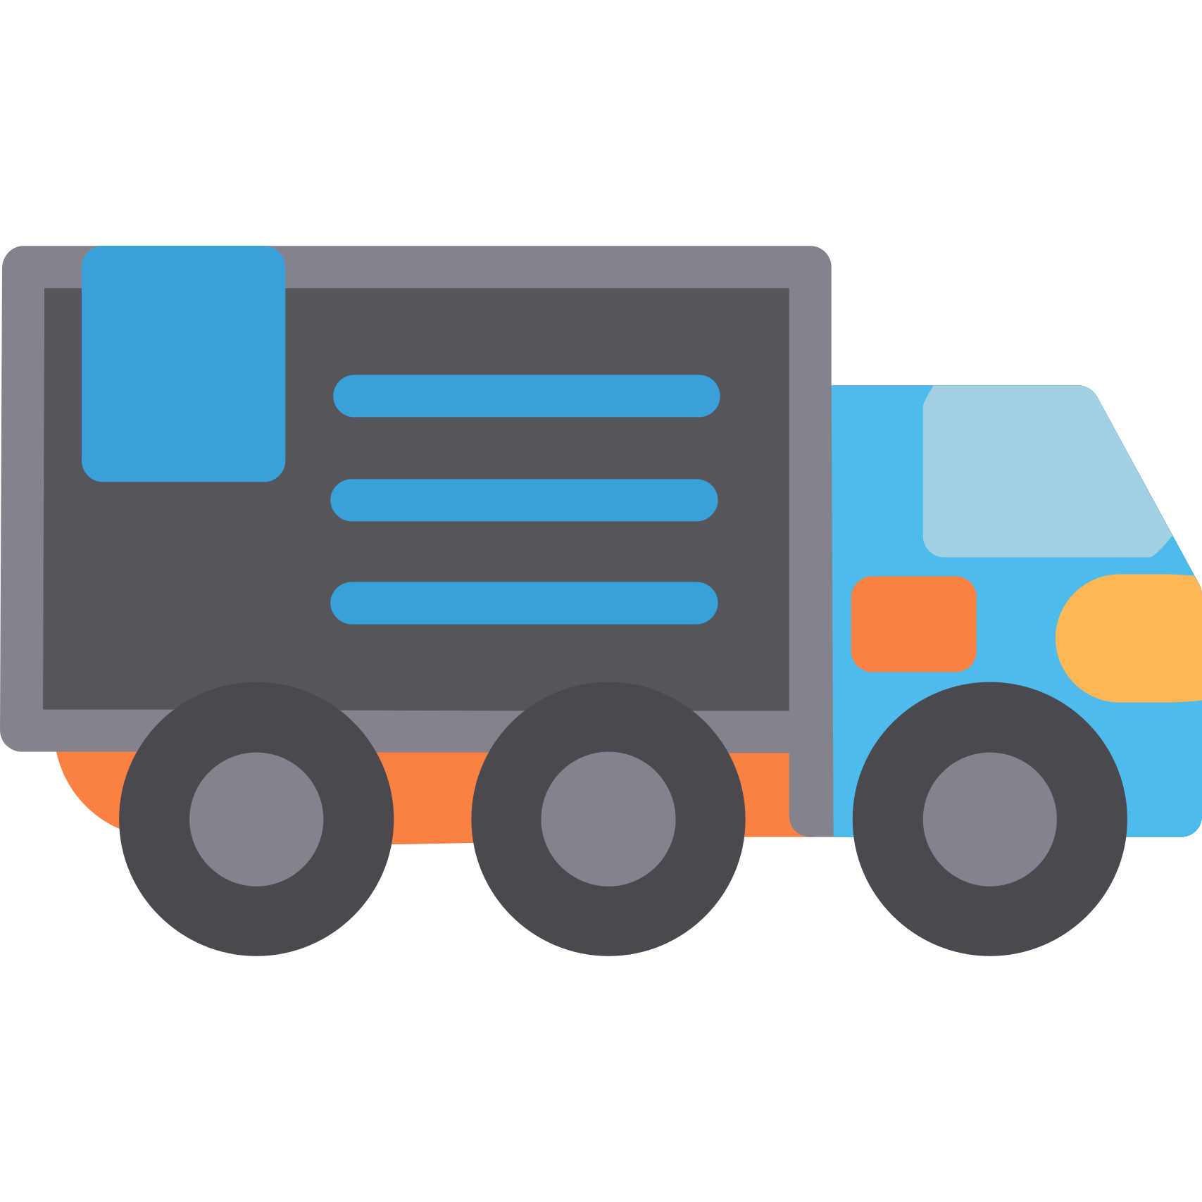
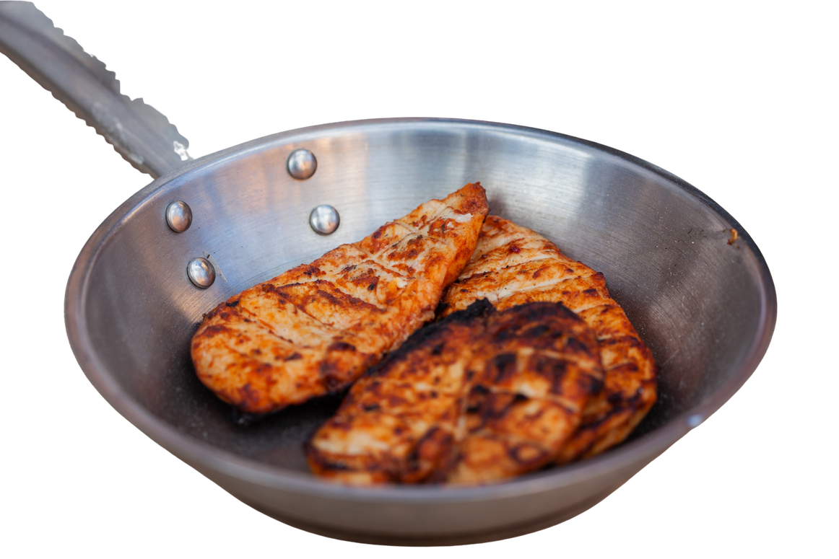

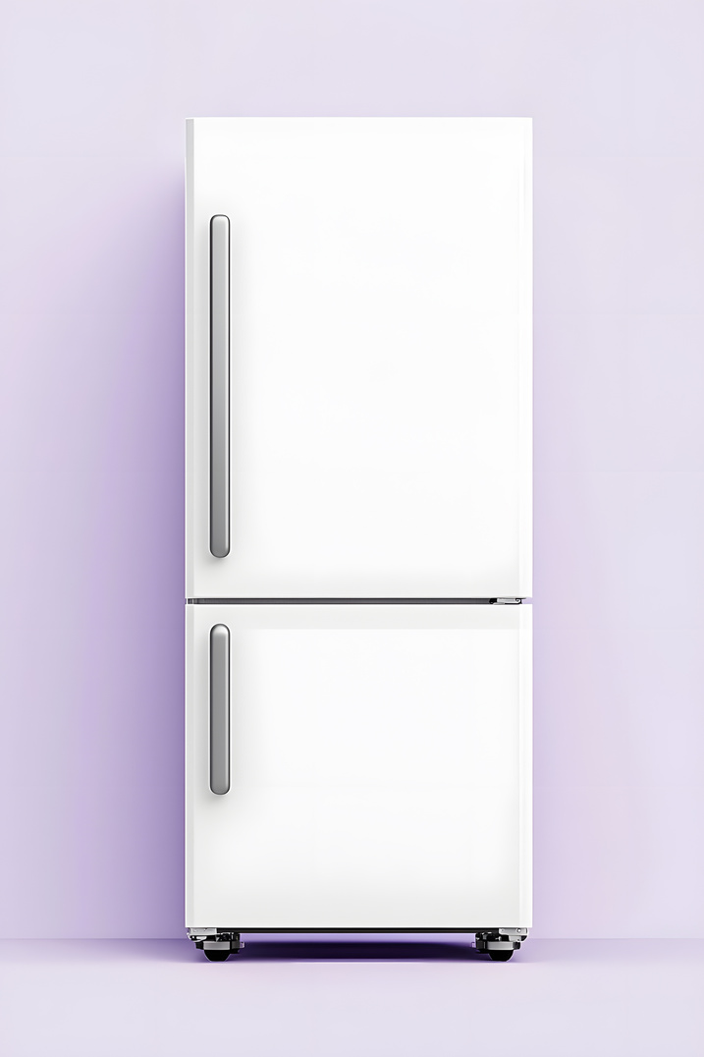
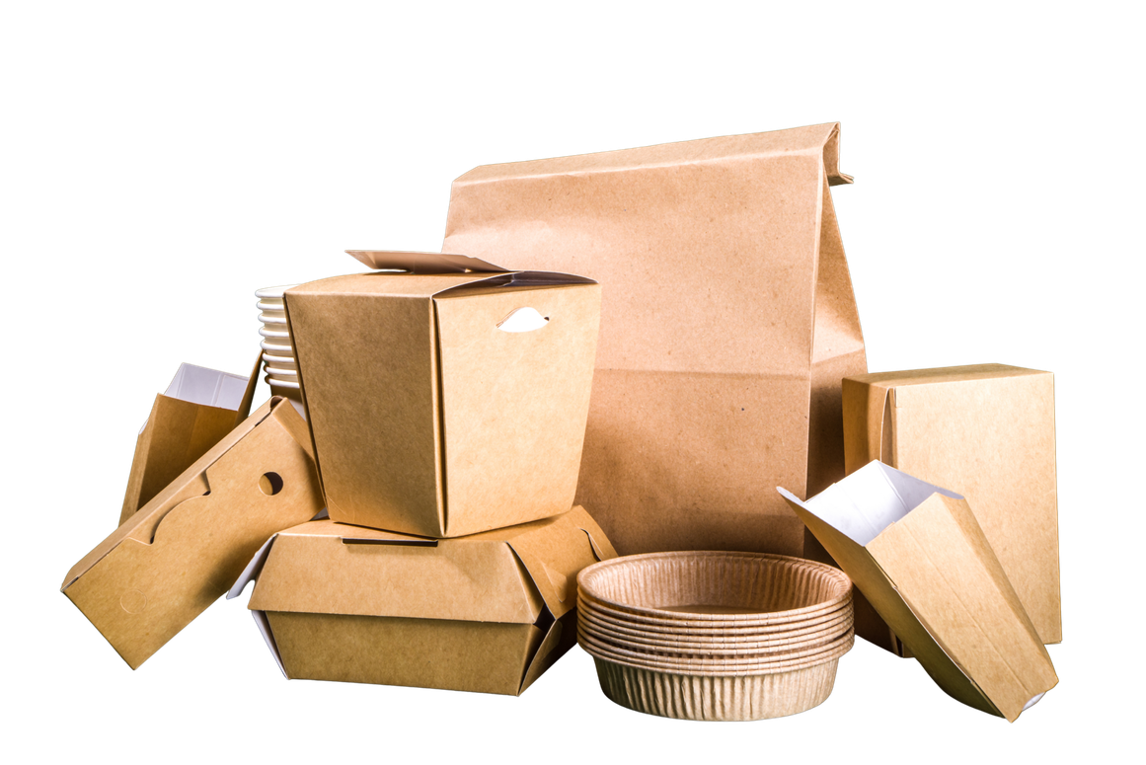
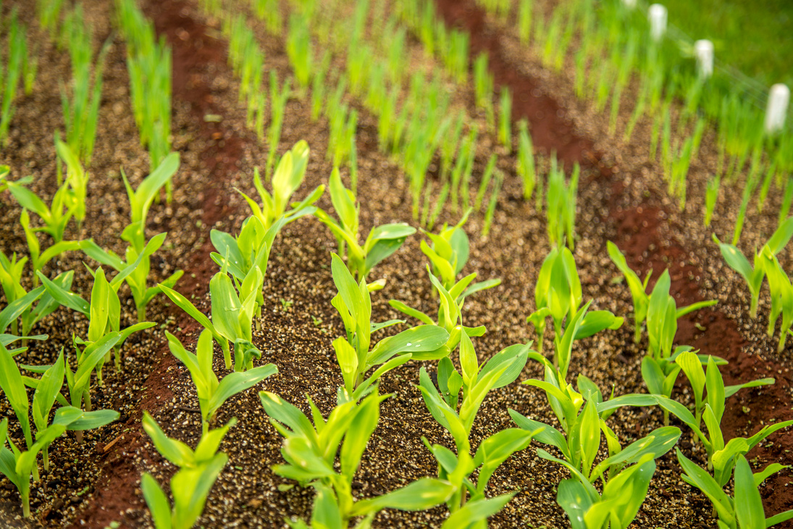
Key Words
energy
transport
cook
grow
refrigerate
packaging
Notes:
Energy: the power we use to make things work, like lights or cars.
Transport: how we move people or things from one place to another.
Cook: to make food hot so we can eat it.
Grow: when something gets bigger
Refrigerate: to keep food cold so it stays fresh.
Packaging: the wrapping or box that keeps things safe and clean before we use them.

Slide 5
Vocabulary task
2. 3. 4. 5. 6.
energy
transport
grow
cook
packaging
refrigerate
Challenge: Write a sentence using a new vocabulary word.
Notes:
1 = grow
2 = energy
3 = transport
4 = packaging
5 = cook
6 = refrigerate

Slide 6

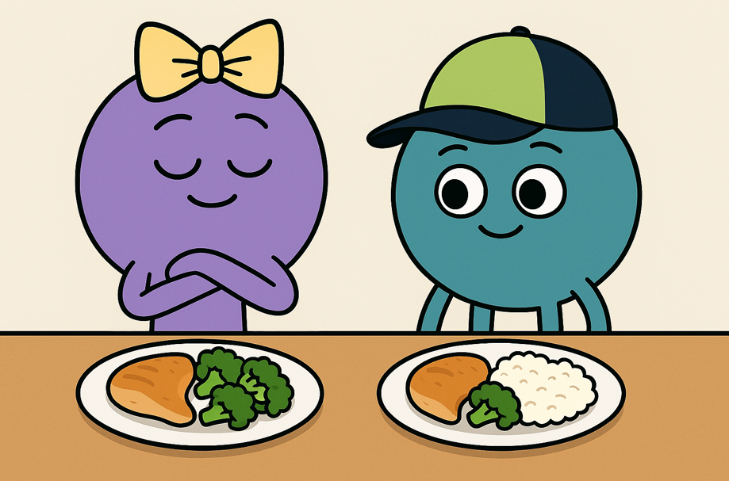
Oh no Nancy! All that food has gone on a long journey. Let’s find out all about it!
Hi Ned! I have chicken, rice and vegetables for dinner. Did this all come from London?

Slide 7
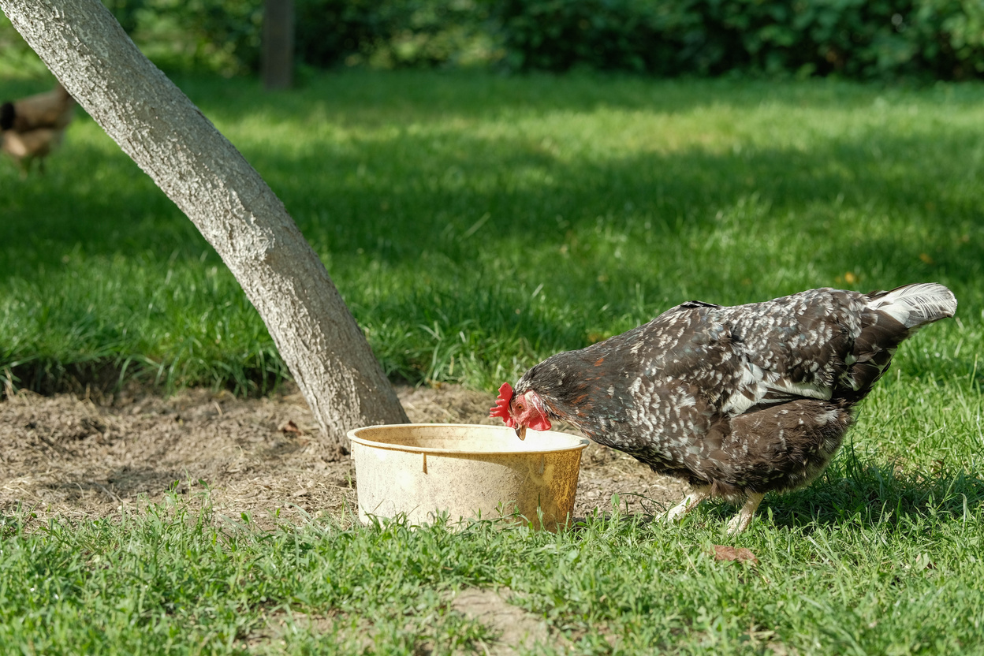
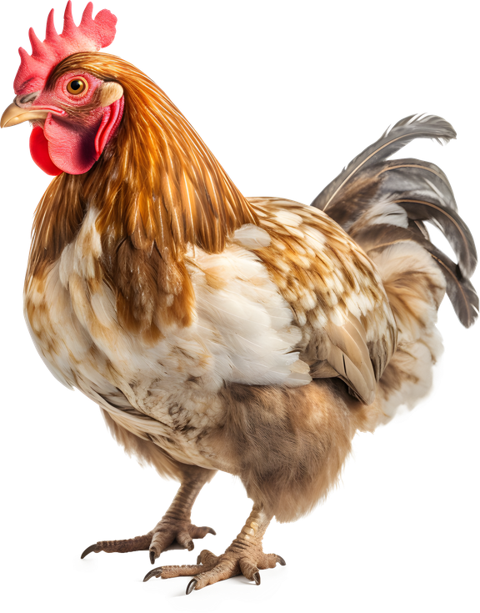

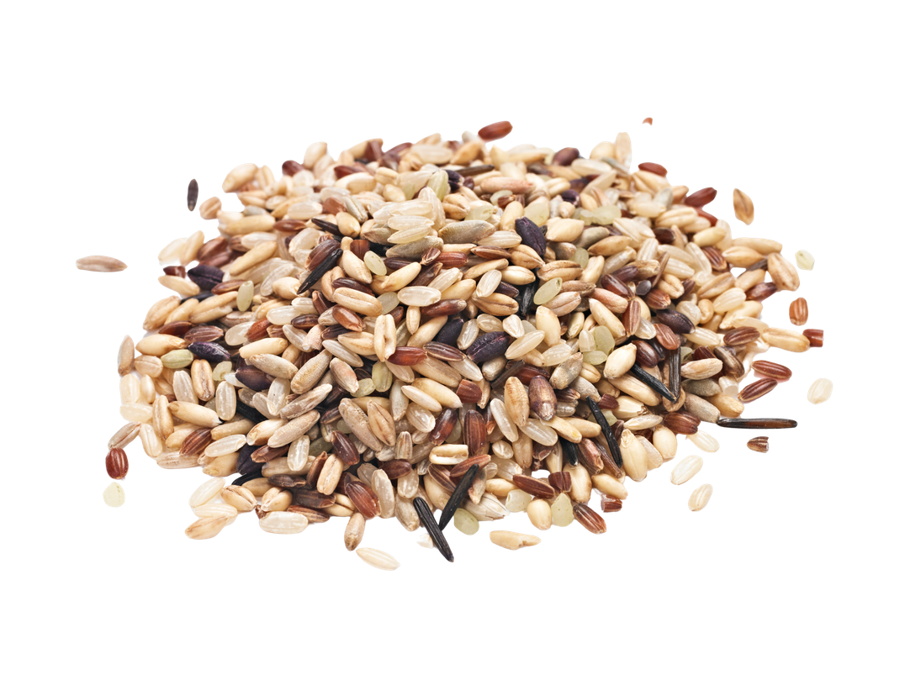
The journey of our food (chicken)
Chickens drink water.
Chickens eat food like grains.
Grains need water and sun to grow.

Slide 8
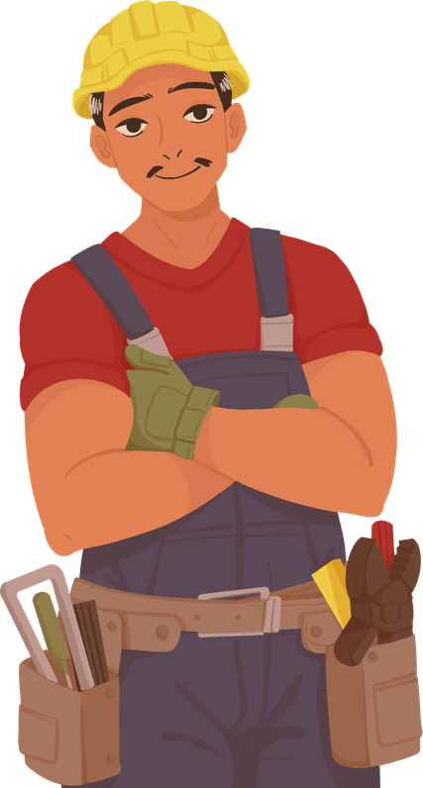
The journey of our food (chicken)
A lorry drives the grown chicken to the factory.
The factory uses electricity.
The factory needs people working.

Slide 9
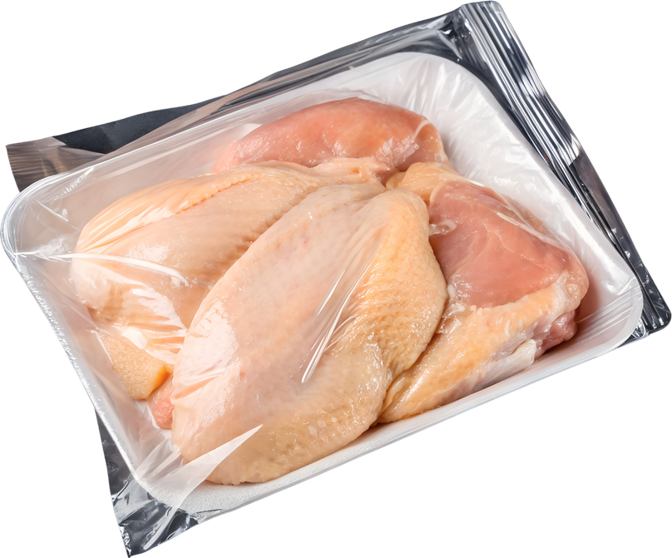
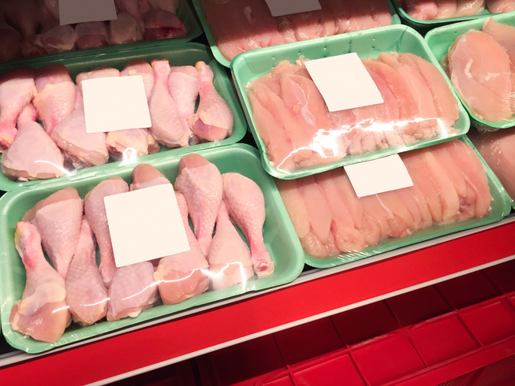
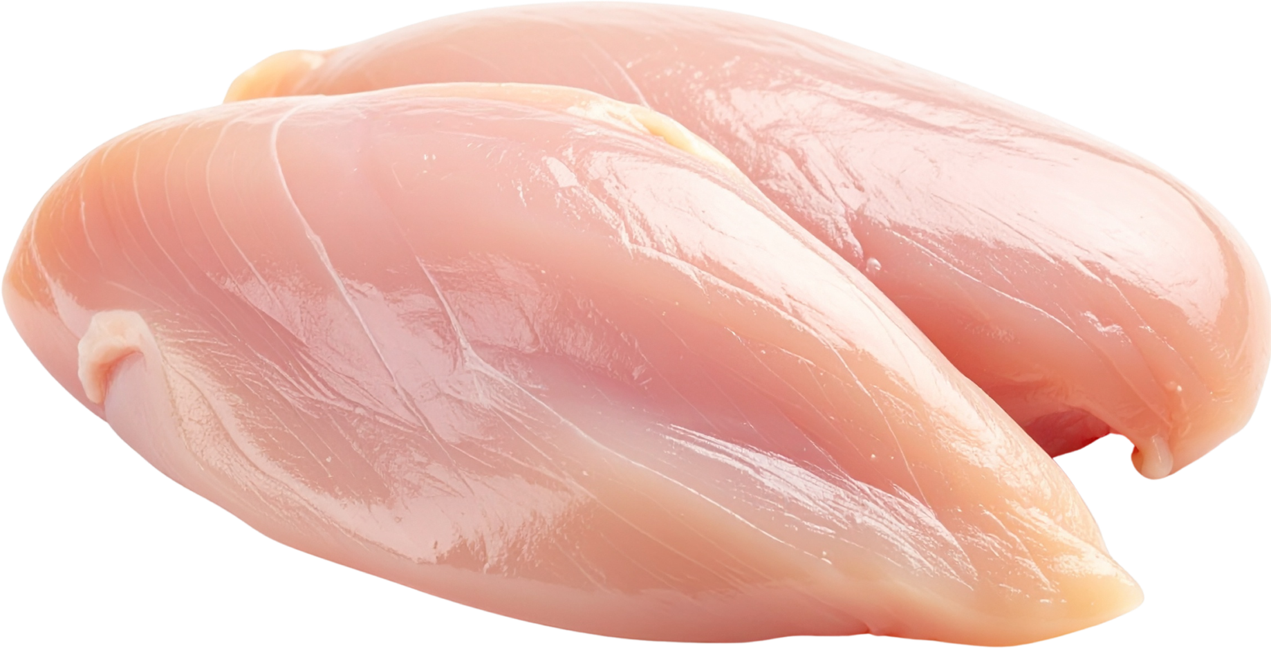
The journey of our food (chicken)
The chicken is prepared.
The chicken is packaged.
The chicken is driven to the shops.
The shops store the chicken.
The chicken always needs to be refrigerated too - this takes a lot of energy!

Slide 10
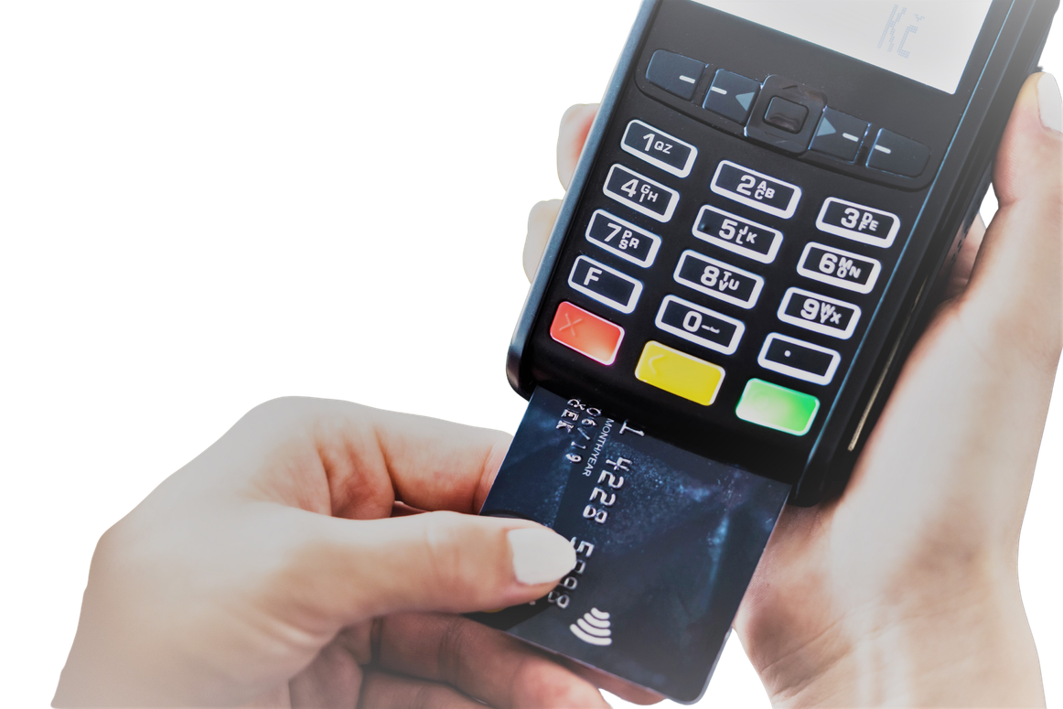
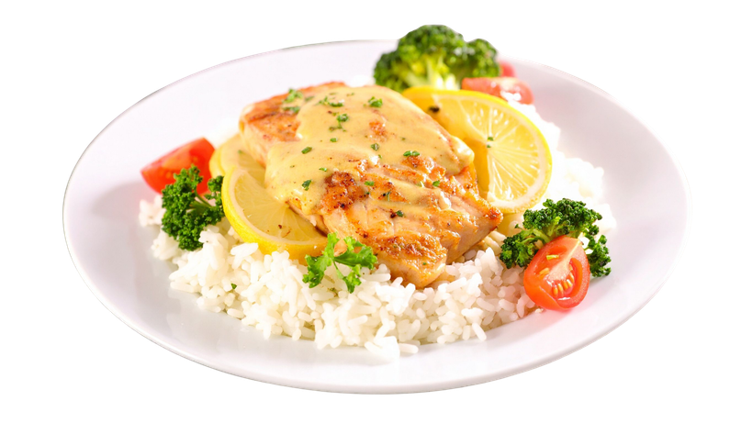
The journey of our food (chicken)
You pay for the chicken.
You cook the chicken
The chicken is ready to eat.

Slide 11
Tell your partner the energy behind our food
Notes:
When I say go, you have 60 seconds to tell your partner the journey of a chicken- go!

Slide 12
Wow, that chicken took a lot of energy to make. I have rice and broccoli on my plate too!
Let’s find out what energy broccoli needs.

Slide 13
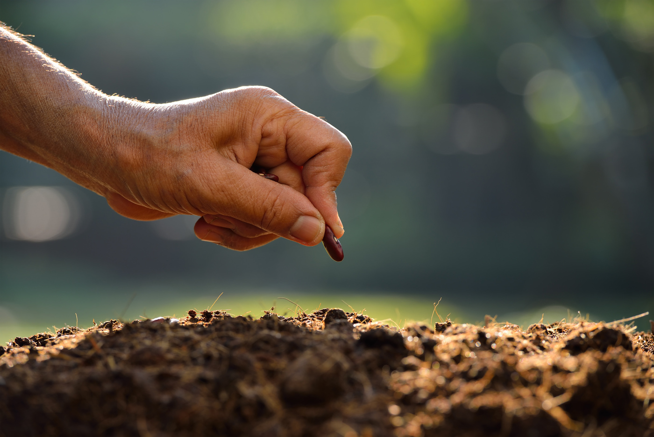

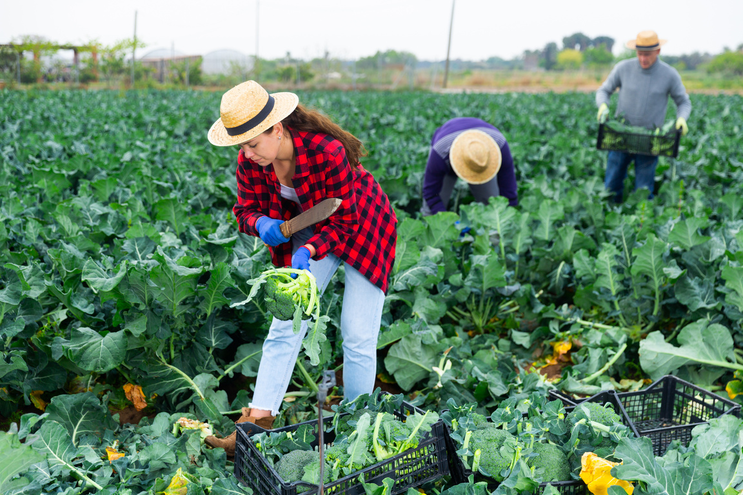

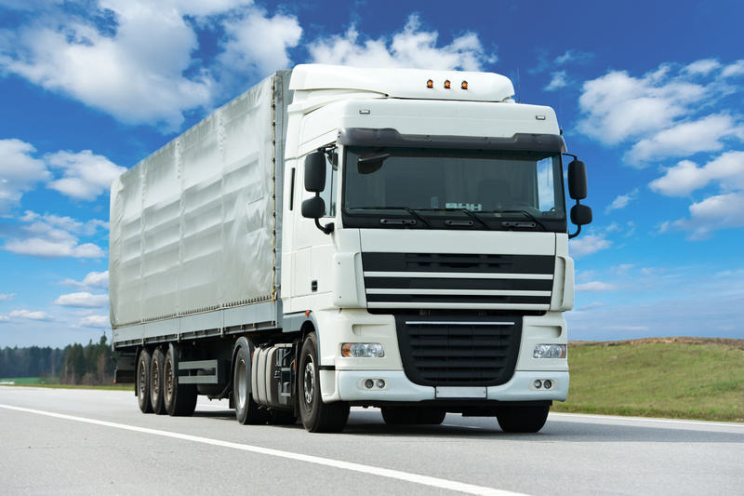
The journey of our food (broccoli)
A farmer plants the broccoli seed by hand or by using a tractor.
The seed needs water, sunlight and care to grow.
The broccoli is harvested (by hand or a tractor).
The broccoli is transported to a factory.

Slide 14
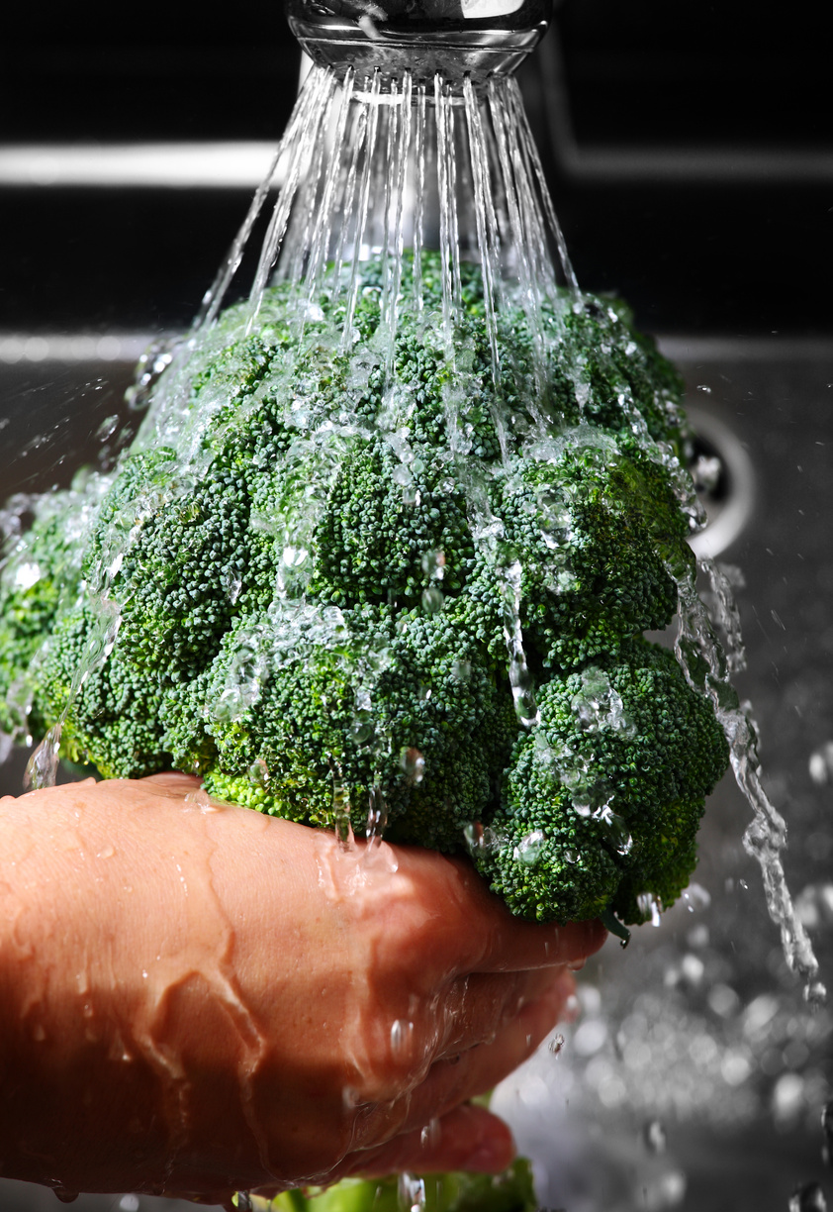
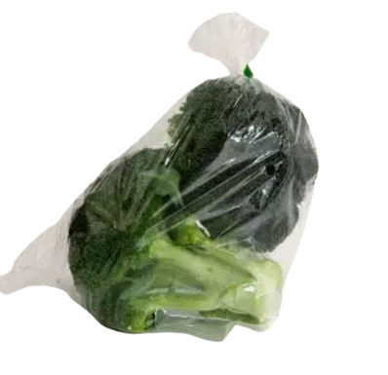
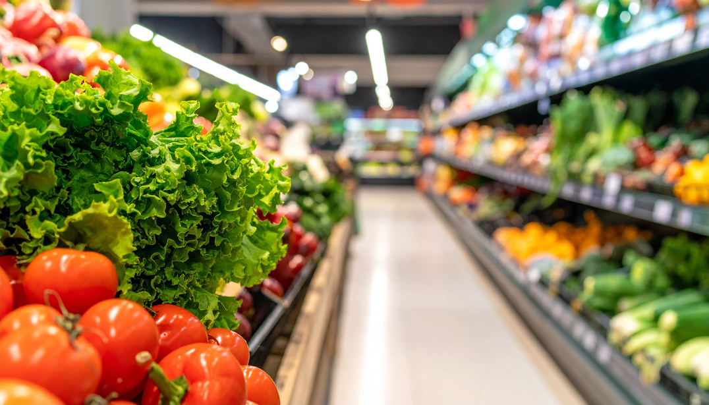
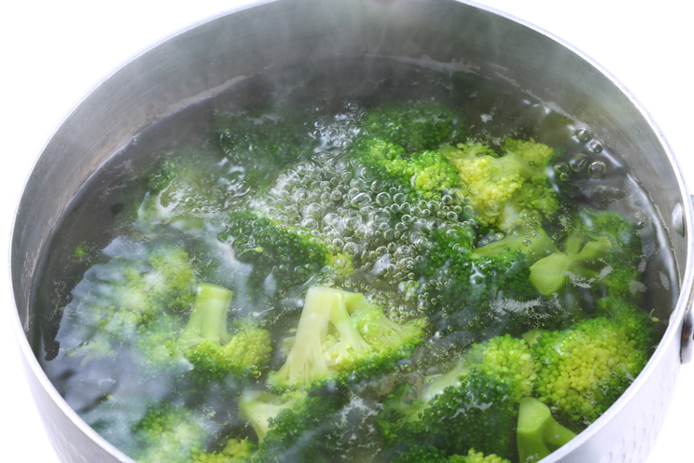
The journey of our food (broccoli)
The broccoli is washed.
It is put into a packet (sometimes!).
The broccoli is transported to the supermarket
The broccoli is bought by a customer.
The broccoli is cooked.

Slide 15
Tell your partner the journey of broccoli
Notes:
When I say go, you have 60 seconds to tell your partner the journey of a broccoli- go!

Slide 16
Ok. The only thing left now is rice. Where does rice come from?
Good question Nancy. Let’s find out.

Slide 17
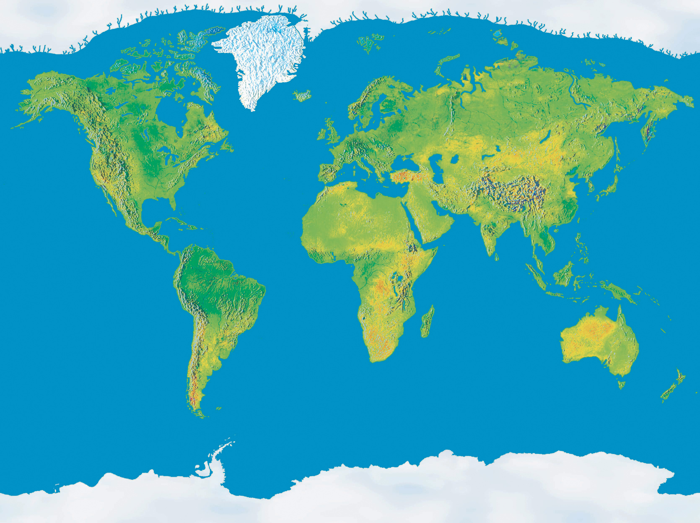

The journey of rice
We don’t have the climate to grow rice in England. Rice comes from far away. Here are 3 countries it can grow.
China
Brazil
India

Slide 18
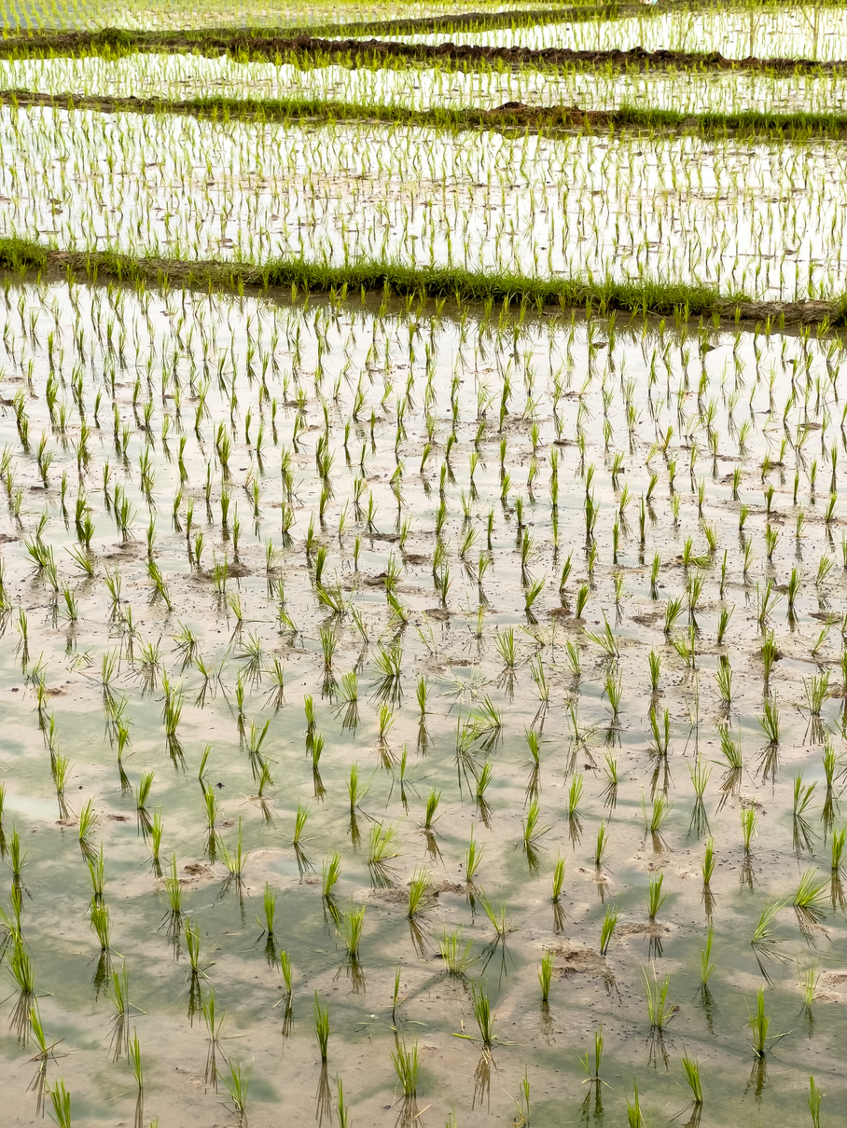
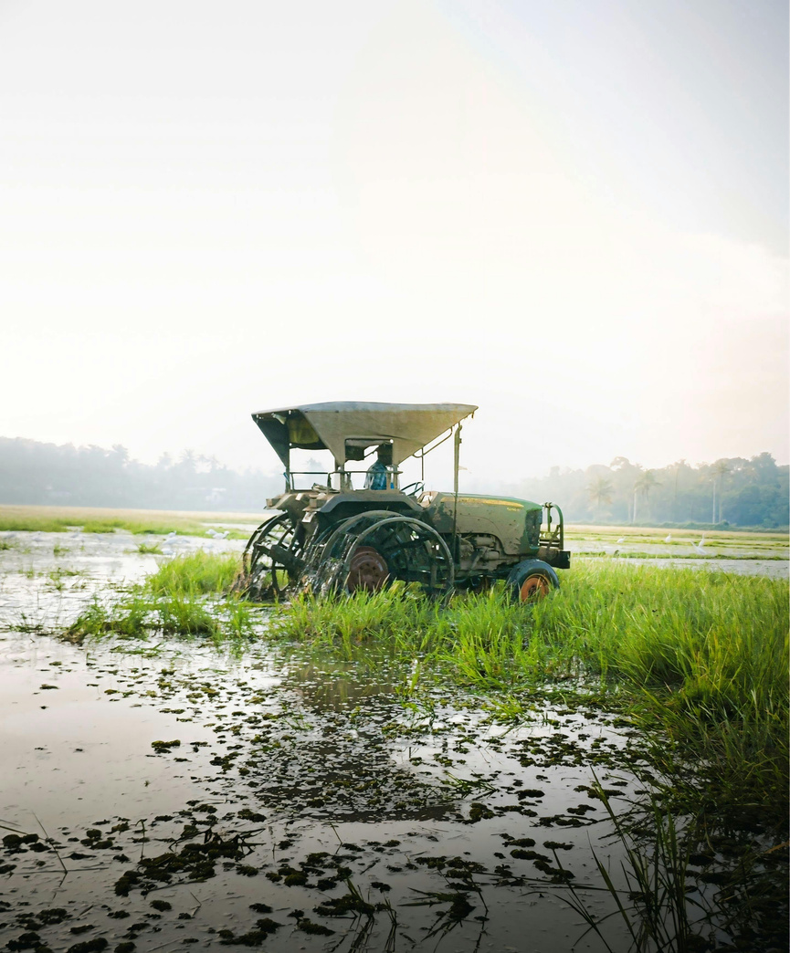
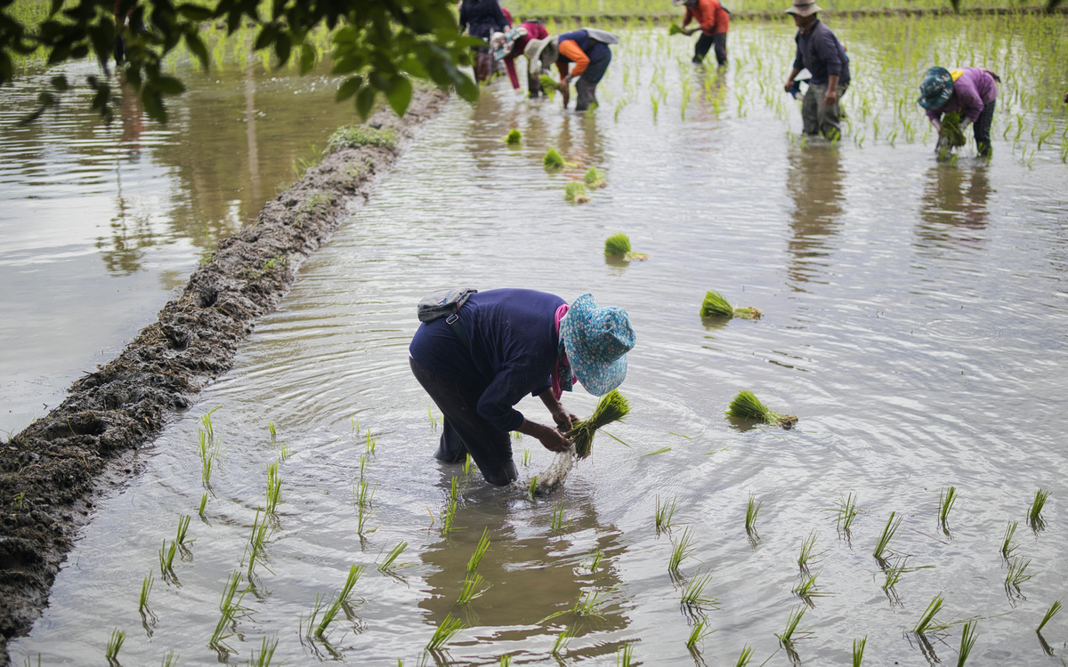
The journey of our food (rice)
The field is prepared.
Water is brought to flood the fields. Rice loves wet places.
The rice seeds are planted.
Sunlight is needed for rice to grow.

Slide 19
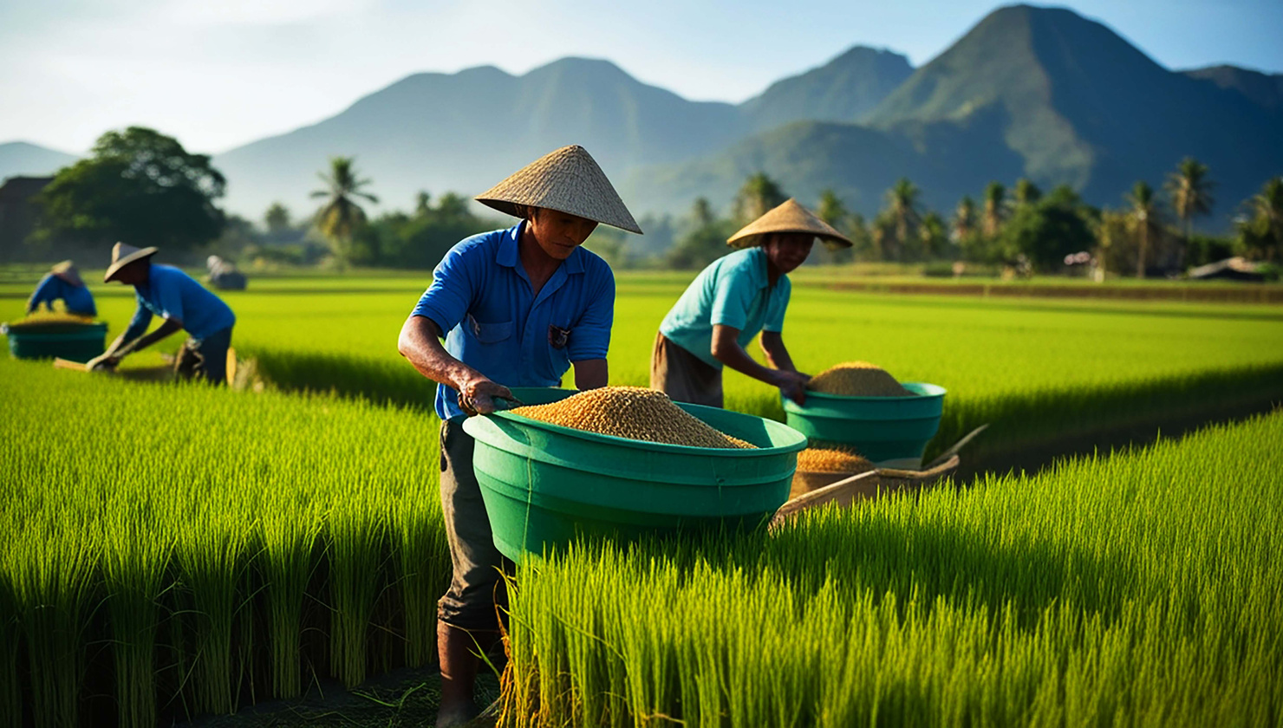
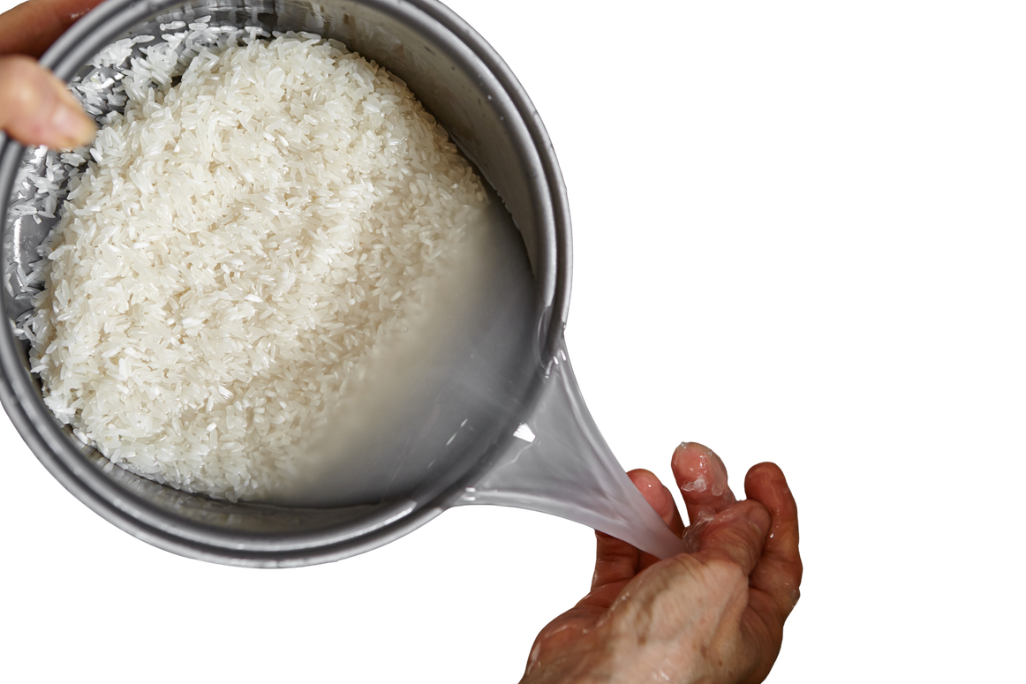
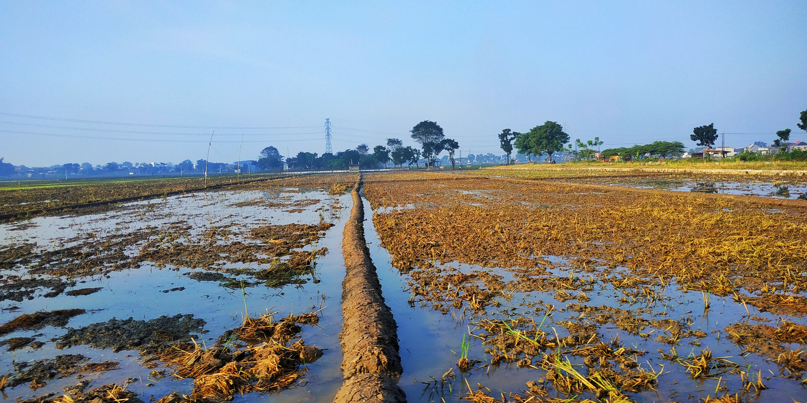
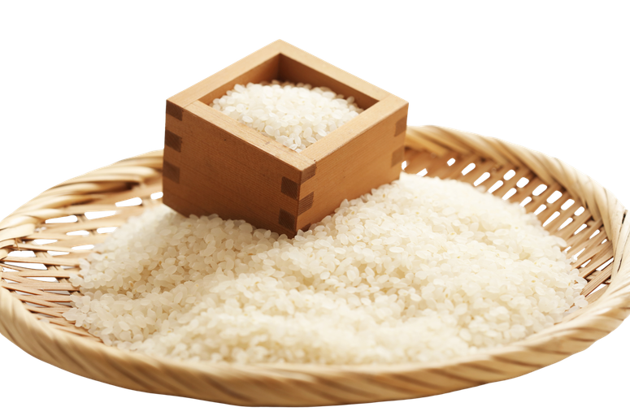
The journey of our food (rice)
The field is drained.
The rice is harvested.
The rice is cleaned.
The rice is dried.

Slide 20
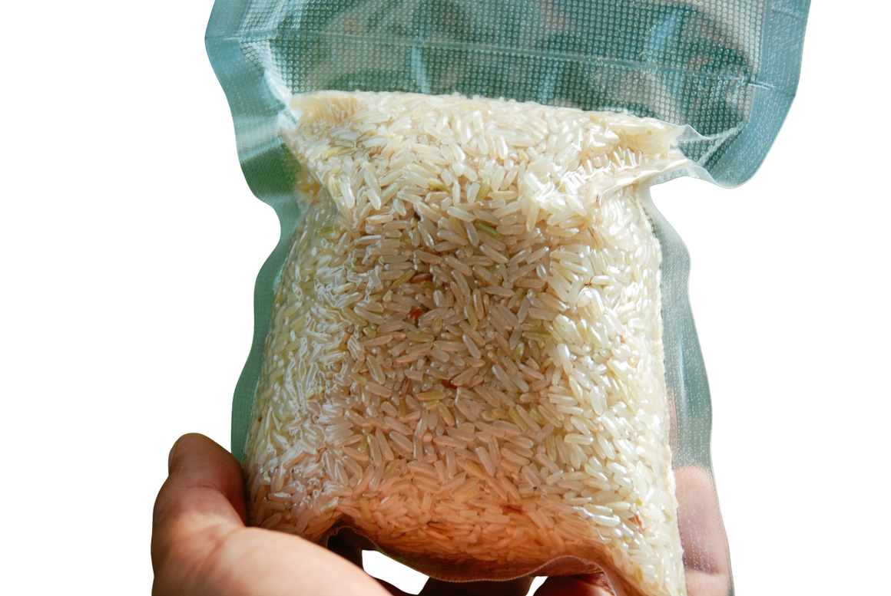
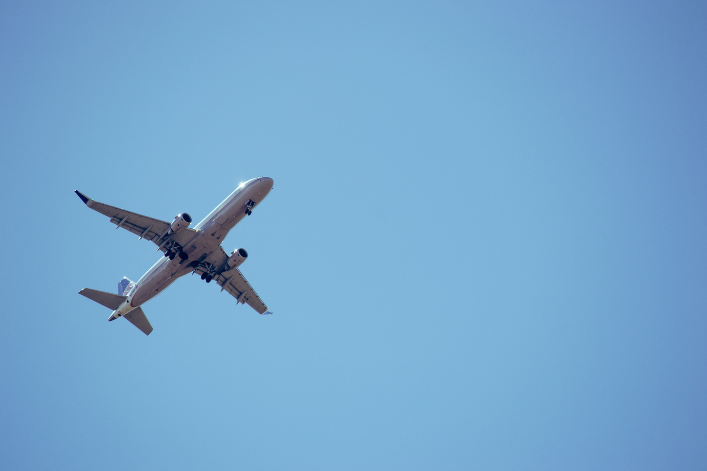
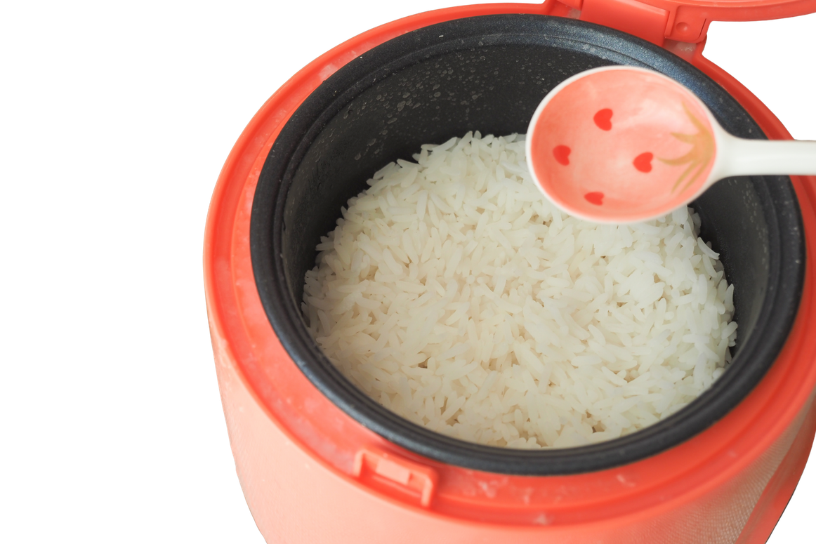
The journey of our food (rice)
The rice is sent to a factory to be packaged.
The rice is flown to London.
It is transported to supermarkets.
It is bought then cooked.

Slide 21
Tell your partner the journey of rice
Notes:
When I say go, you have 60 seconds to tell your partner the journey of a rice- go!

Slide 22
What food item do you think used the most energy?
Why?
Chicken
Rice
Broccoli
I think ______ used the most energy because _________.
Notes:
Potential answers:
Rice: Rice often comes from faraway countries. To get to our plate, it has to travel a long way by plane or ship which uses a lot of energy. This is called air miles.
Chicken: Before we eat chicken, it has to grow. That means it needs food, water, and a warm place to live. The food the chicken eats also takes energy to grow and transport. So raising chickens uses quite a bit of energy too.
Broccoli: Broccoli is a vegetable that can be grown in the UK. If it’s grown nearby, it doesn’t need to travel far, so it uses less energy. But if it comes from another country, it might use more energy like rice does.

Slide 23
Wow. My dinner travelled a long way to get to my plate.
It did Nancy! That is why it is very important not to waste food.

Slide 24







Tips to reduce food waste
Only put on your plate what you can eat
2. Get a little more food when you have eaten everything on your plate (if you are still hungry!)
3. Check where your food comes from. Food from the UK is better as it travels less.
4. Encourage your friends to eat their food too.

Slide 25
What 4 things can we do to reduce food waste?
To reduce food waste we can _______, ________, _______ and __________.

Slide 26
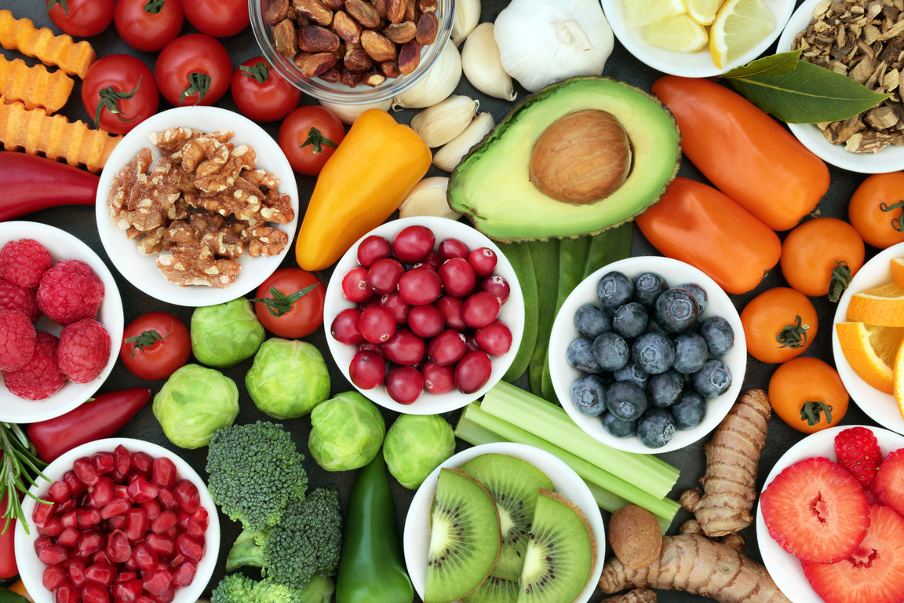
Problems...
Food takes a lot of energy to make.
Where do you think the energy comes from to grow our food?
Do you think food from far away uses more energy than food from nearby? Why?
Notes:
Discussion 1
- Read question to children twice
- Give children a moment to think about the question
- In partners, get children to share their thoughts using sentence stem 'I think energy comes from...'
-Give children 2 minutes in partners to discuss their opinions
- Listen in to discussion. Spotlight two children
Repeat with question 2

Slide 27

Extension activity 1
Writing/art activity: Children create a simple comic strip or story showing the energy that is needed to create a dinner of chicken, rice and broccoli.

Slide 28
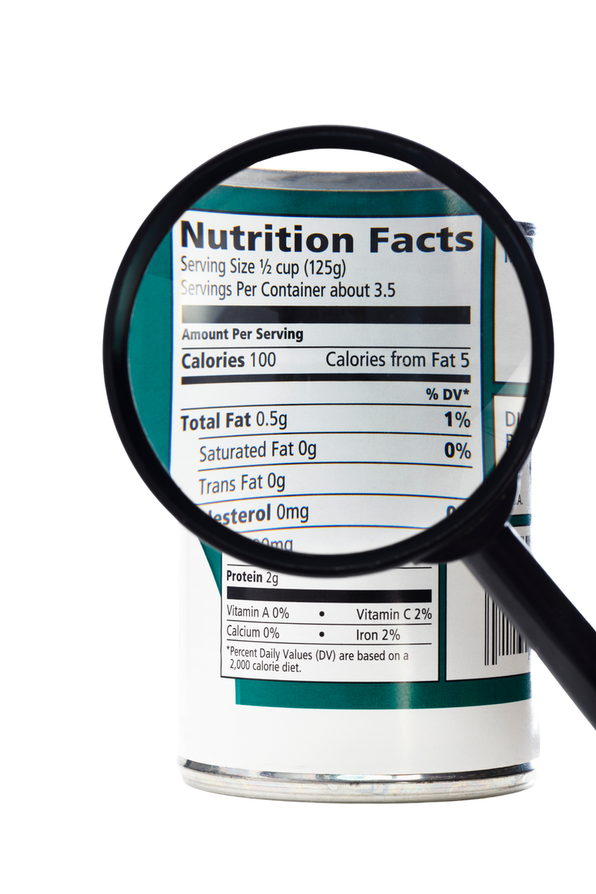
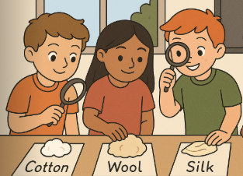
Extension activity 2
Science/geography activity: Set up a table with fruits/grains/vegetables from the shop (must have labels!). Children identify where that food item was grown and to find it on a map.
Challenge:
What food items have travelled the furthest?
Why have these food items come from a different country?

Slide 29
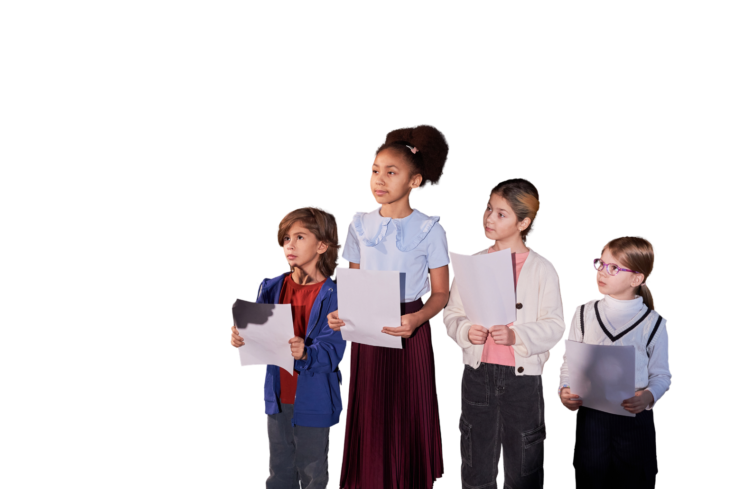
Extension activity 3
Drama activity: Get children into small groups. Children act out the steps for chicken, rice and broccoli growth from farm to plate.
Challenge: Can the children perform it to their class or in assembly?

