Slide 1


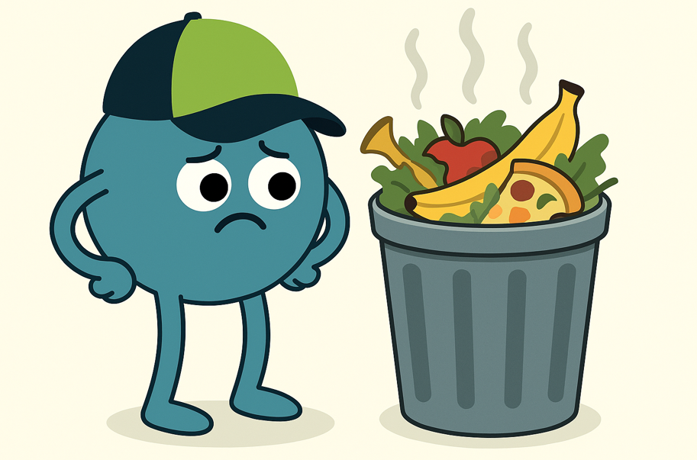

What is food waste and why does it matter?
KS1 Lesson - Lesson 3 of 4

Slide 2






Lesson Prep
Vocabulary
Discussion
Keywords that children need to understand and use during the lesson.
An opportunity for children to practice the knowledge learnt.
Big question
Task
To assess learning and give children time to practise independently.
A central question that sparks curiosity and frames the lesson’s theme.
The knowledge
Extension
Essential facts and concepts children need to know.
Optional tasks to deepen or stretch learning beyond the core lesson.

Slide 3

LO: To explain how we can reduce our food waste.
I can explain why food waste is harmful to the environment.
I can explain different ways to reduce how much food we throw away.
I can create a shopping list for my family.

Slide 4
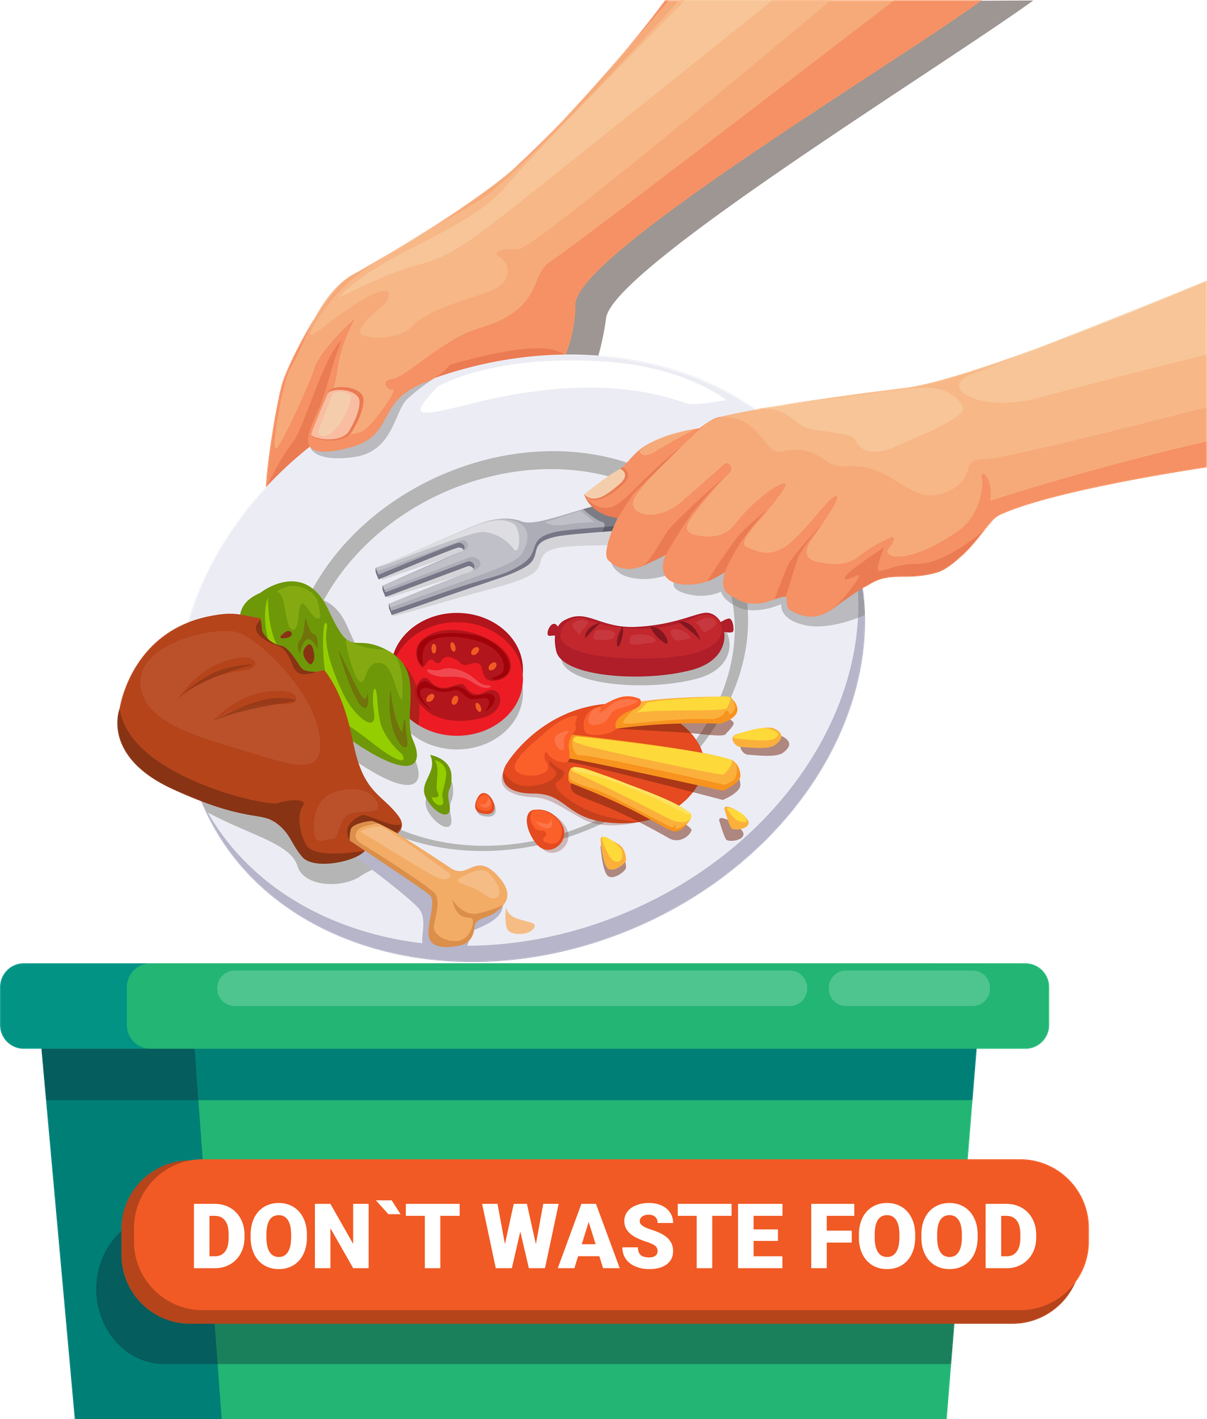
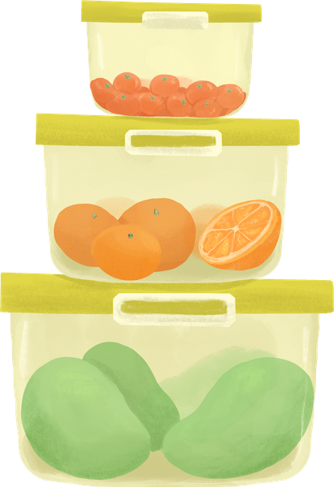
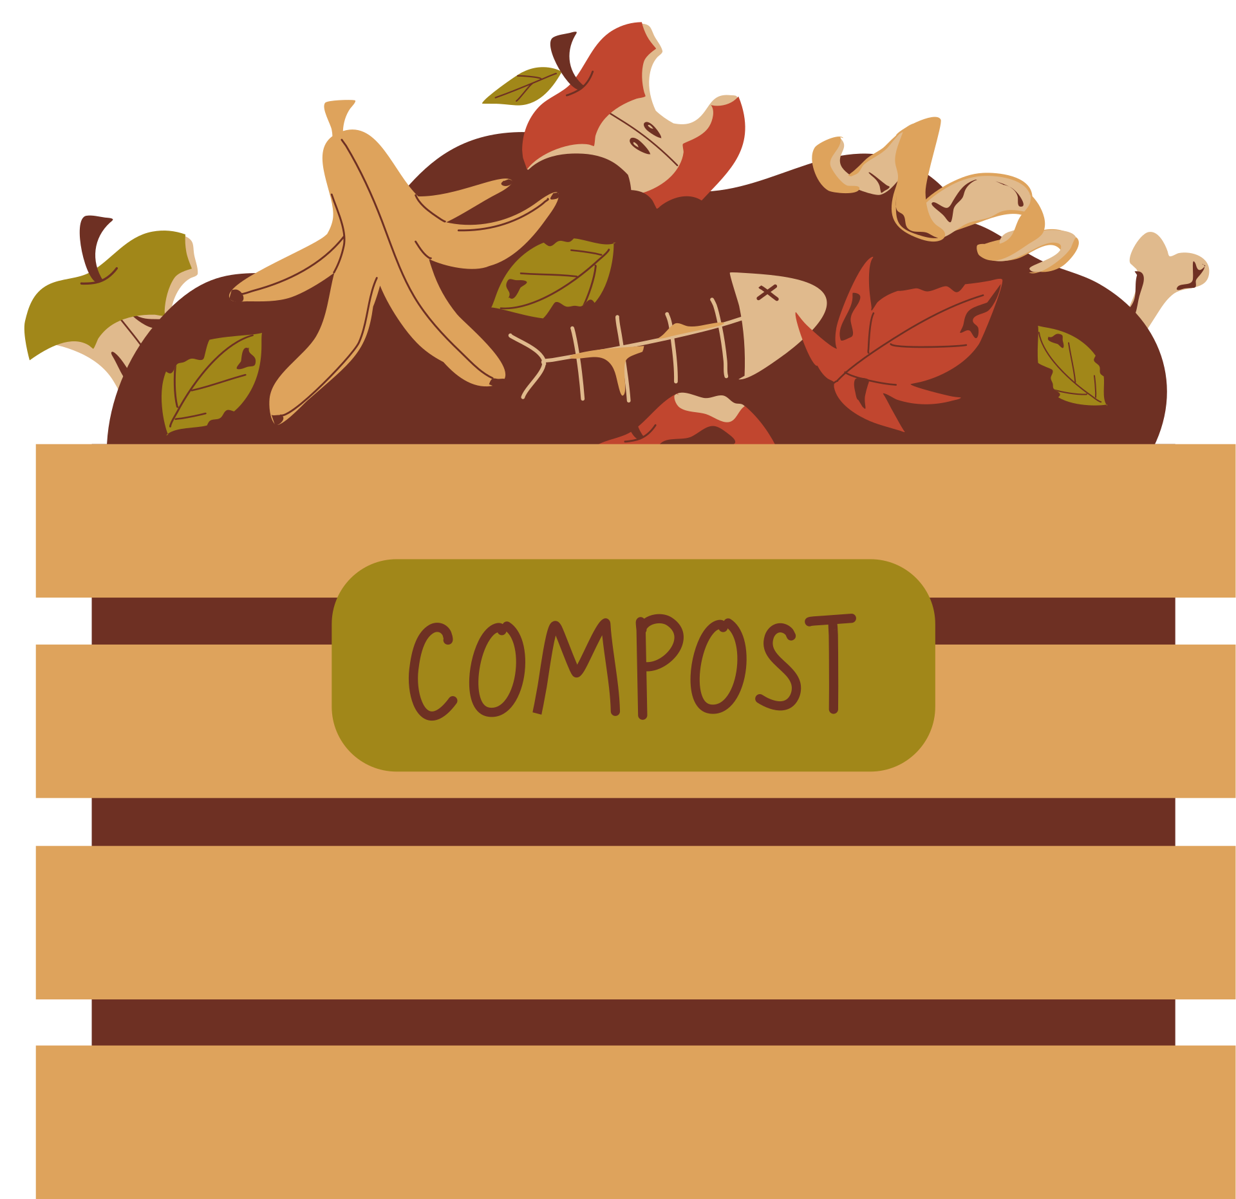



Key Words
food waste
store
compost
mould
recipe
natural resources
Notes:
Food waste: Food that is thrown away instead of being eaten.
Store: To keep something safe until we need it.
Compost: Old food and plants that break down and turn into healthy soil.
Recipe: A set of instructions to help you make food.
Natural resources: Things we get from nature, like water, trees, and sunlight.
Mould: A fuzzy or smelly thing that grows on old food when it goes bad.

Slide 5
Vocabulary task
2. 3. 4. 5. 6.
natural resources
food waste
recipe
store
compost
mould
Challenge: Write a sentence using a new vocabulary word.
Notes:
1 = food waste
2 = recipe
3 = compost
4 = natural resources
5 = mould
6 = store

Slide 6

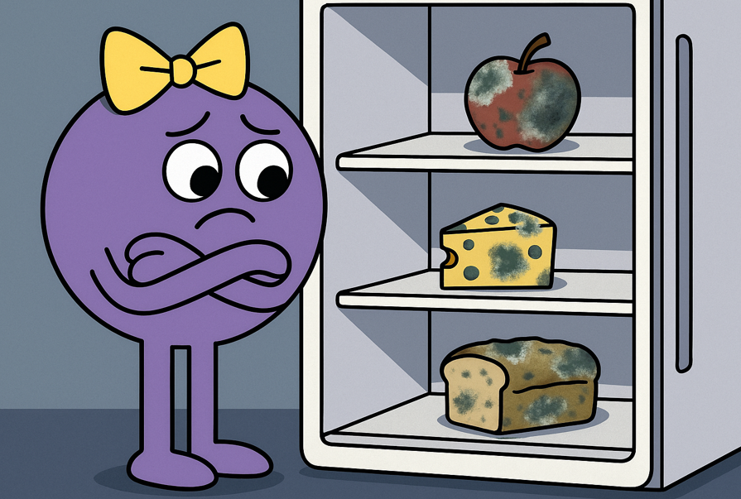

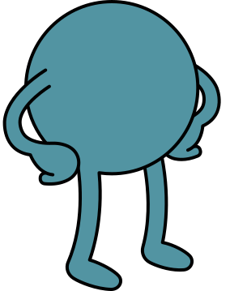

Oh Nancy, that is food waste! Let me teach you what you can do!
Hi Ned, I have so much food going mouldy in my fridge. I need to keep throwing it away!

Slide 7
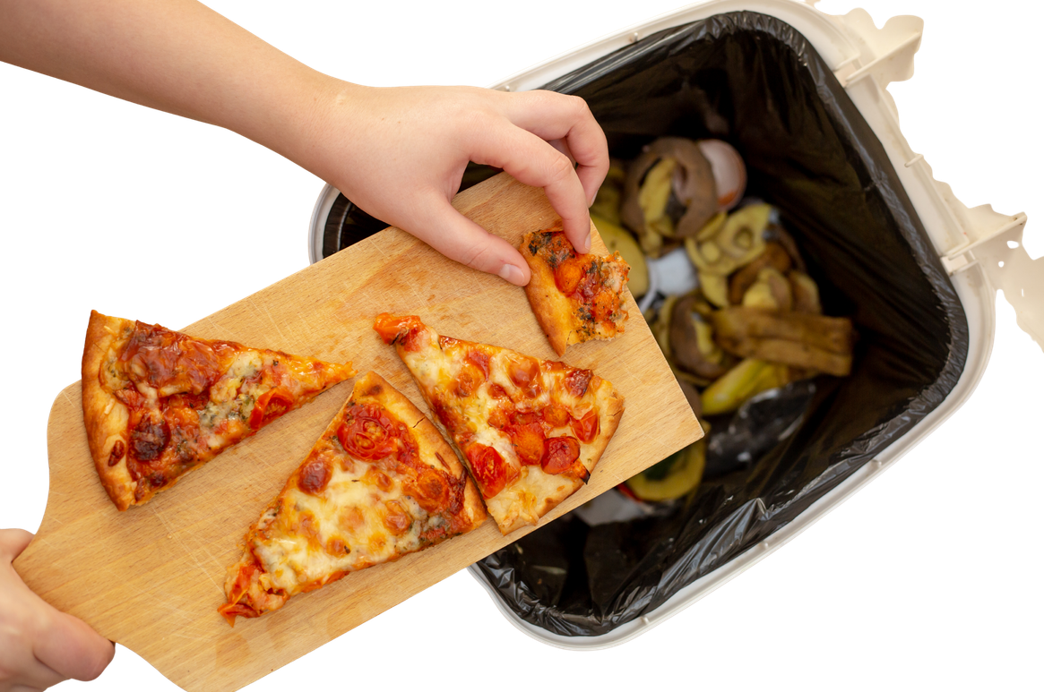
Food waste
Food waste is when good food is thrown away instead of being eaten.

Slide 8
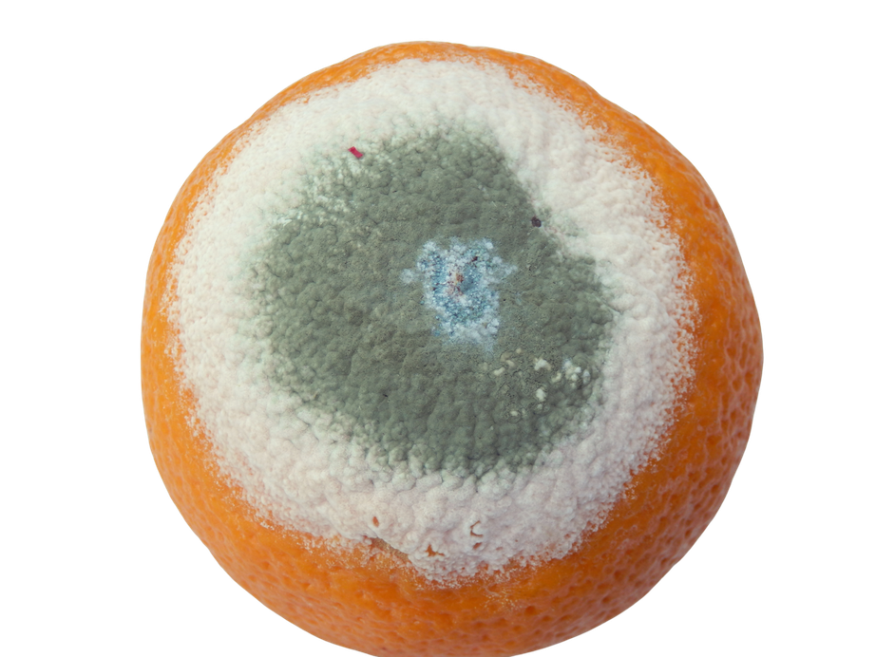


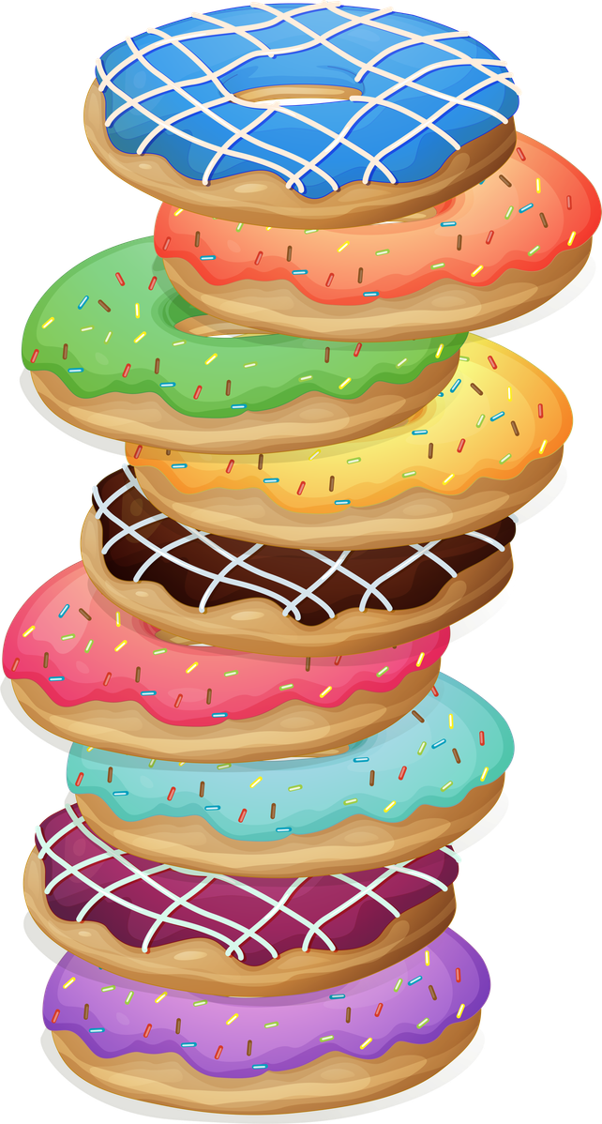
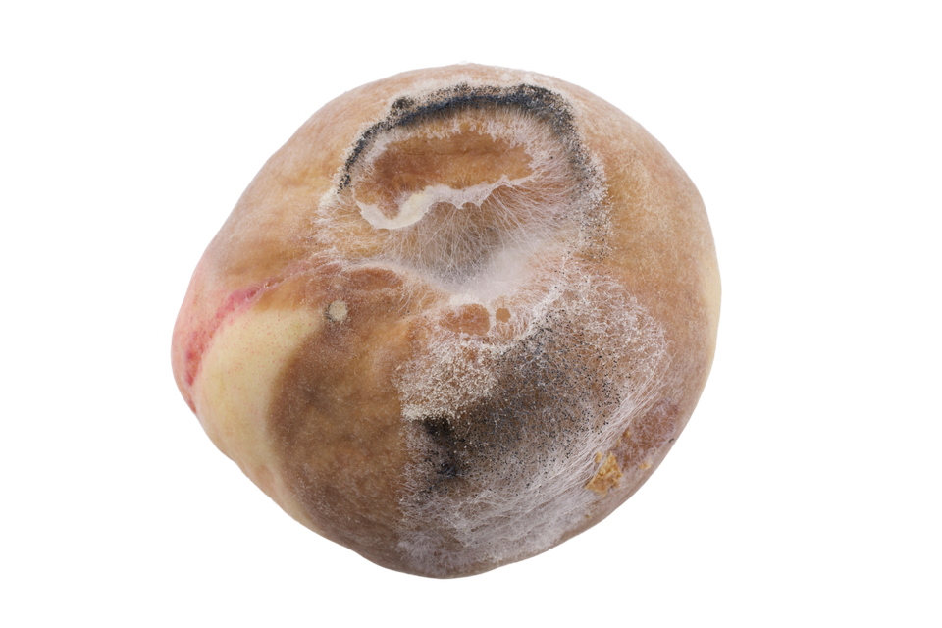

People might throw food away because...
Greeg
It might go off and we can’t eat it
We might take more than we need!
Notes:
Discuss. Do the children have any more ideas?

Slide 9
Why might people throw away food?
Greeg
People might throw away food because _____ and _____.
Notes:
When I say go, you have 30 seconds to tell your partners why people might throw away food. Go!

Slide 10
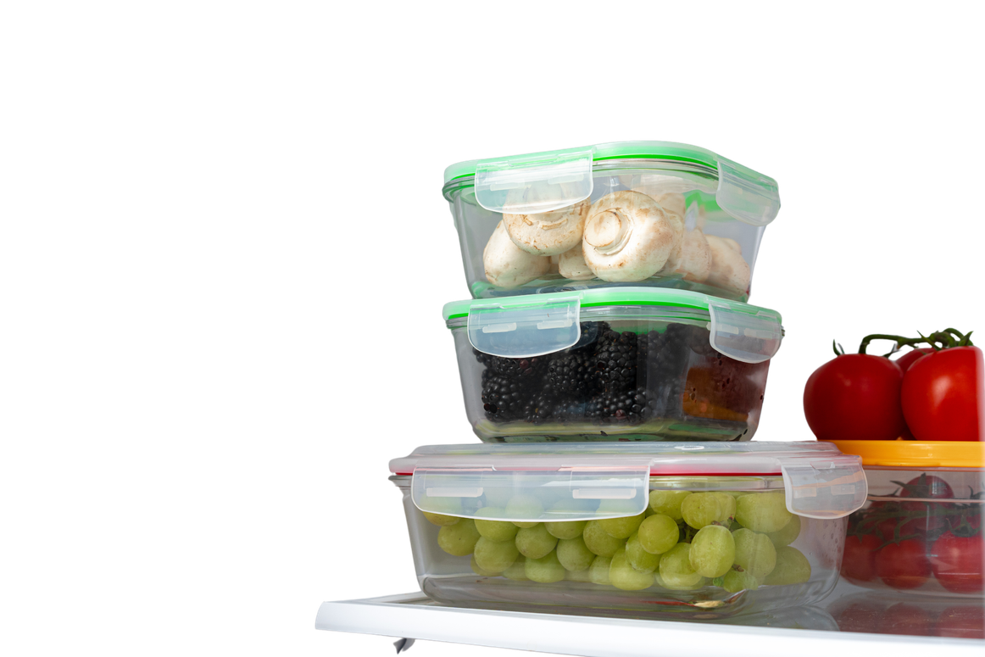
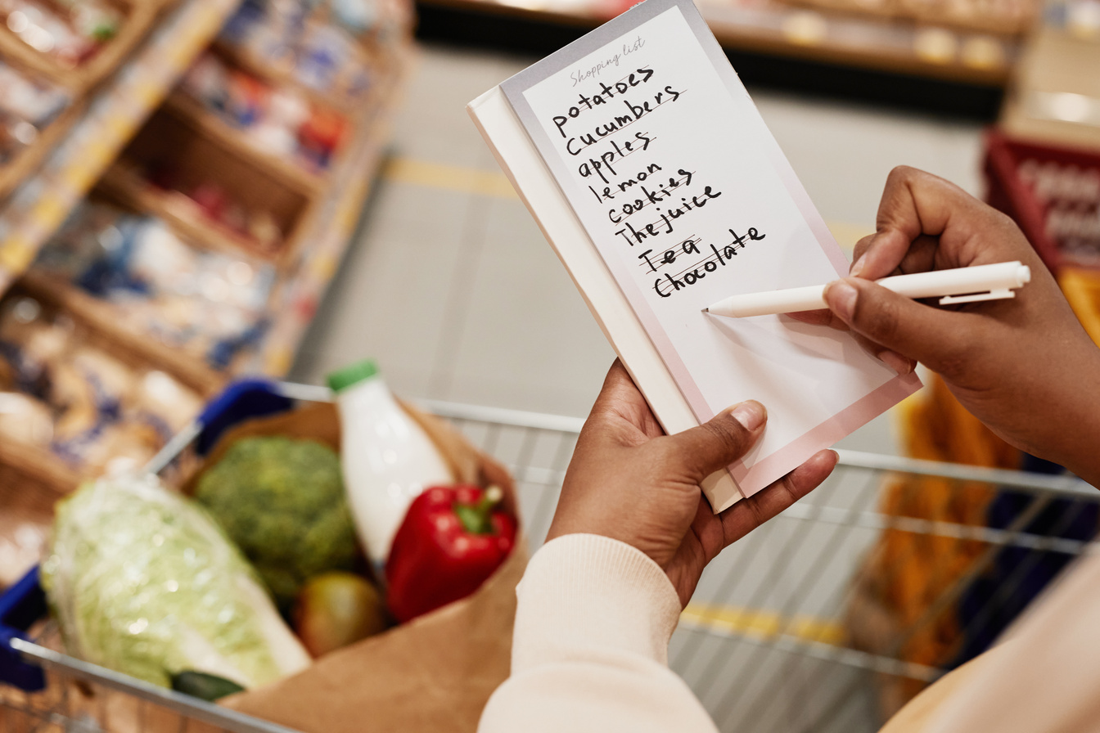

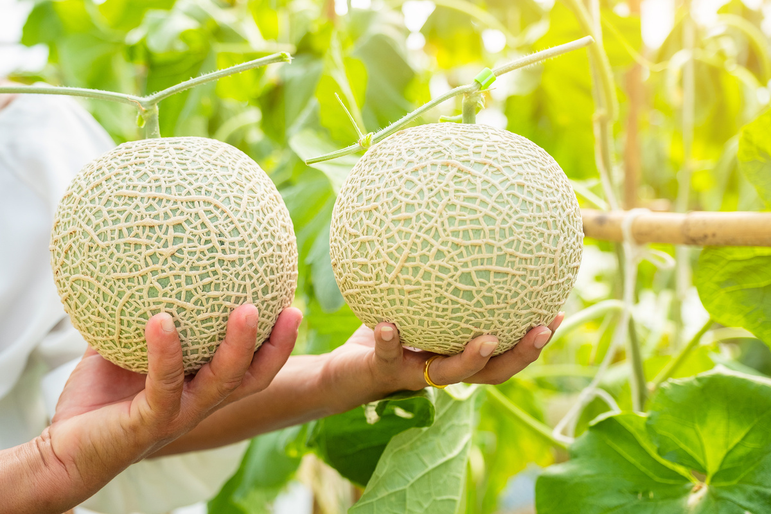
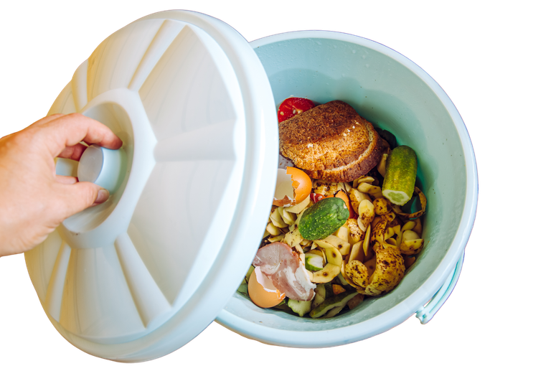
How can we stop food waste?
Store food correctly
Make a shopping list
Take only what we need
Put food waste in a food bin
Notes:
Ned has some ideas to reduce food waste. Explain each method to the students.

Slide 11
How can you reduce food waste?
To stop food waste we can _____, ______, ______ and ______.
Notes:
When I say go, you have 30 seconds to tell your partners how we can reduce food waste. Go!

Slide 12


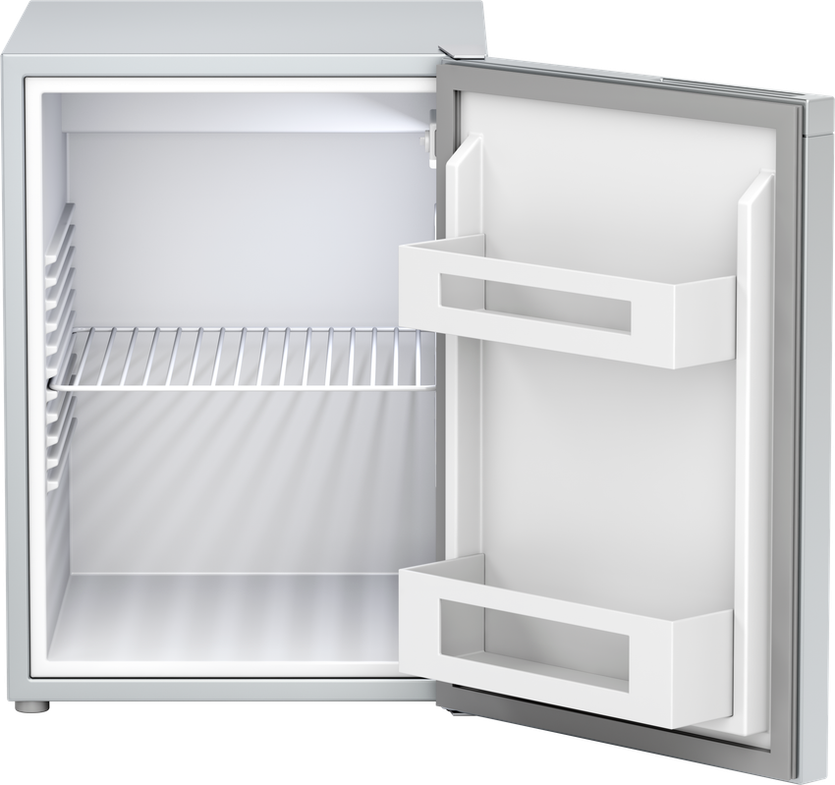

To reduce food waste, we can store food correctly.
Cupboard
Fridge
Freezer
By storing food correctly, it lasts longer.

Slide 13

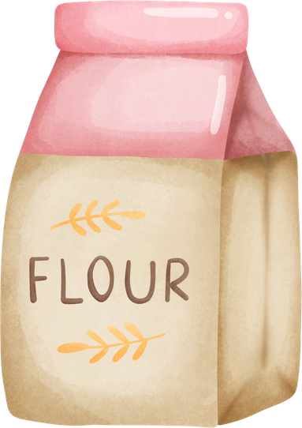
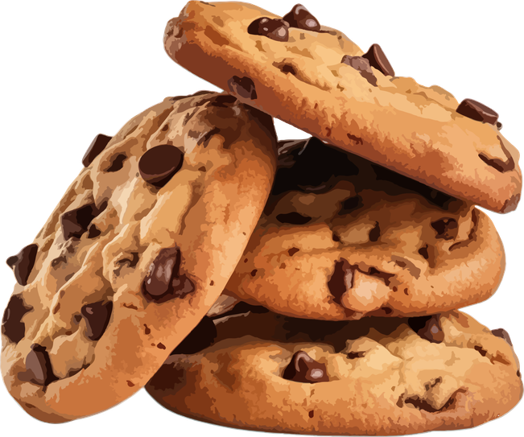




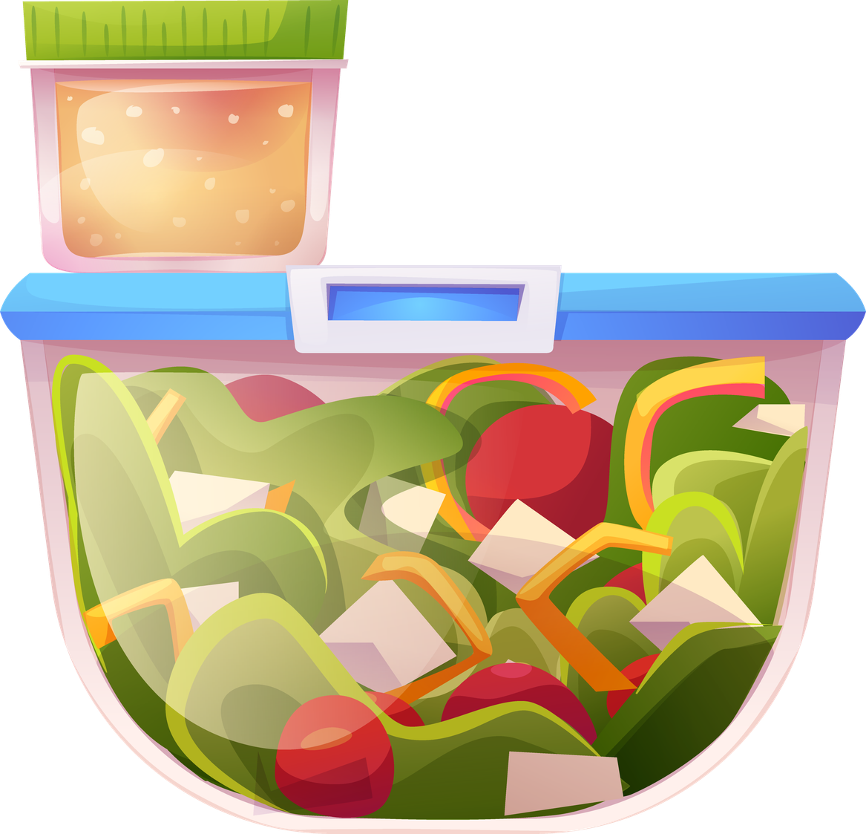
Where do you think these items are stored?
Cupboard
Fridge
Freezer
Notes:
Read out the foods below. Ask children to discuss with their partners where they think these items should be stored.
Answers:
Cupboard
cookies, bread, flour
Fridge
salad, cheese, pizza, bread, milk
Freezer
Pizza, bread, ice lollies
Some items can be stored in more than one place. You can have a discussion about this. What happens to bread when we put it in the freezer? (it lasts longer).

Slide 14
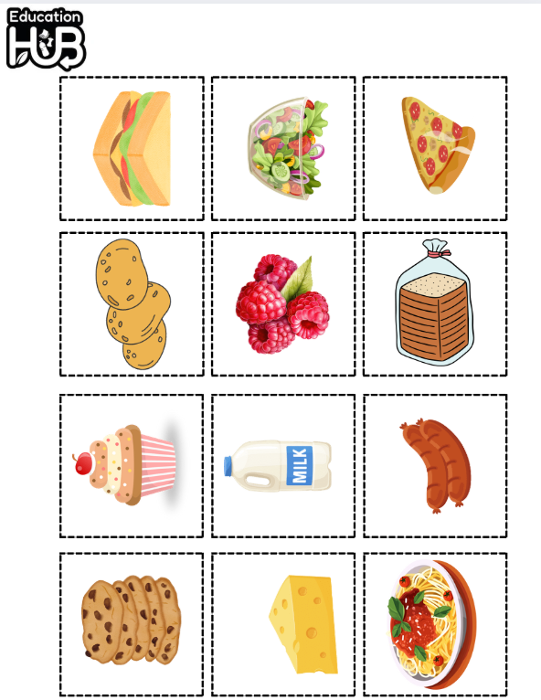
Task: Sort these items into where they should be stored.
Cupboard
Fridge
Freezer

Slide 15
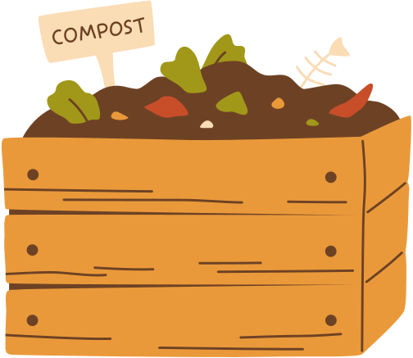


Problems...
Food takes a lot of energy and time to get to our plate.
How can we help our families reduce food waste?
If everyone threw their food waste in the bin, what would happen?
Notes:
Discussion 1
- Read question to children twice
- Give children a moment to think about the question
- In partners, get children to share their thoughts using sentence stem 'To reduce this we can...'
-Give children 2 minutes in partners to discuss their opinions
- Listen in to discussion. Spotlight two children
Repeat with question 2

Slide 16



Top food waste tips!
Only put food on your plate that you know you can finish.
2. Keep extra food in the fridge to eat later instead of throwing it.
3. Eat the oldest food first to stop it going to waste.

Slide 17
What 3 things can we do?
Three things we can do are _______, __________ and __________.

Slide 18
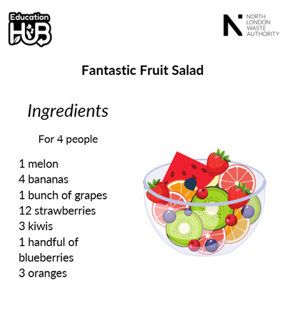
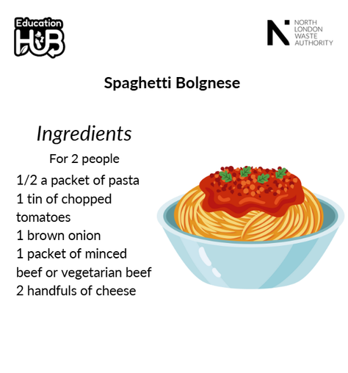

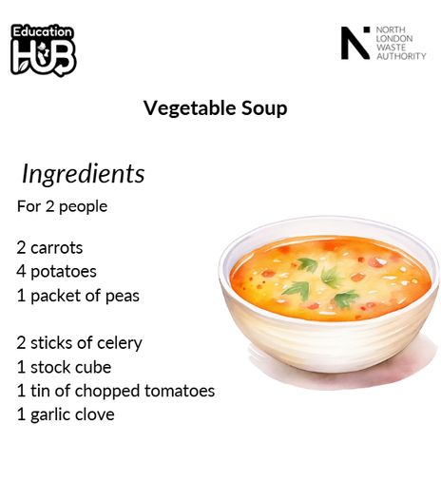
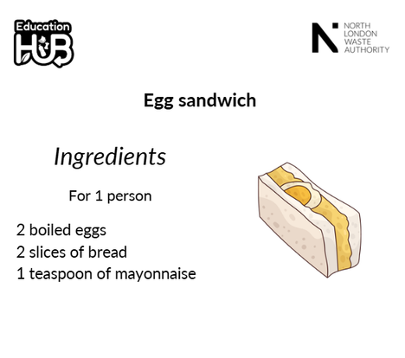
Extension activity 1
Writing activity: Look at all the recipes. Think about what you want to eat for a day. Write a shopping list with all the food you need to buy.

Slide 19

Extension activity 2
Science activity: Children to create a poster to explain to their school how they can reduce food waste at home.

Slide 20
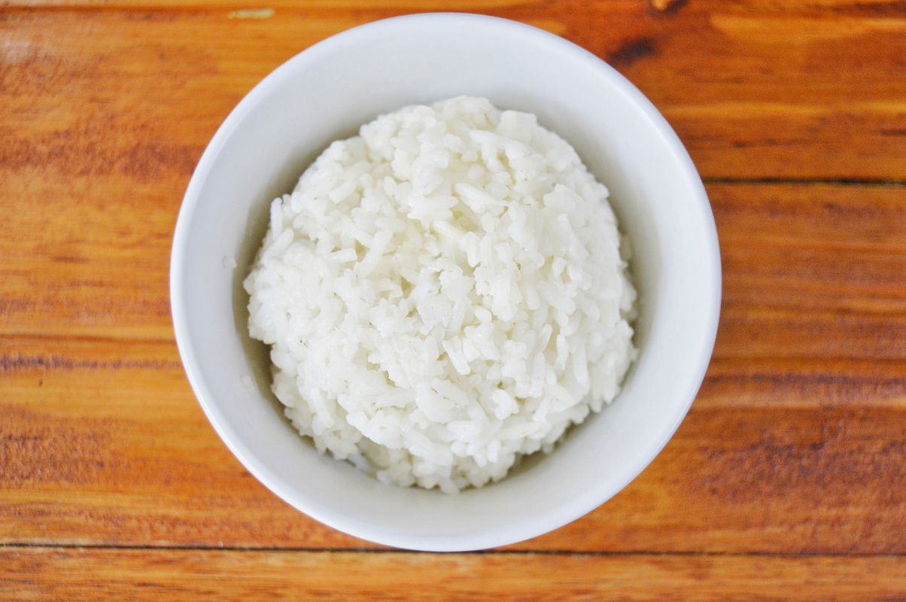
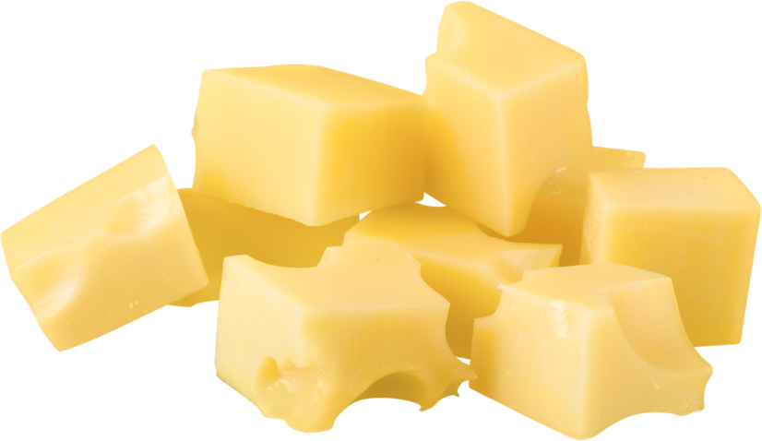
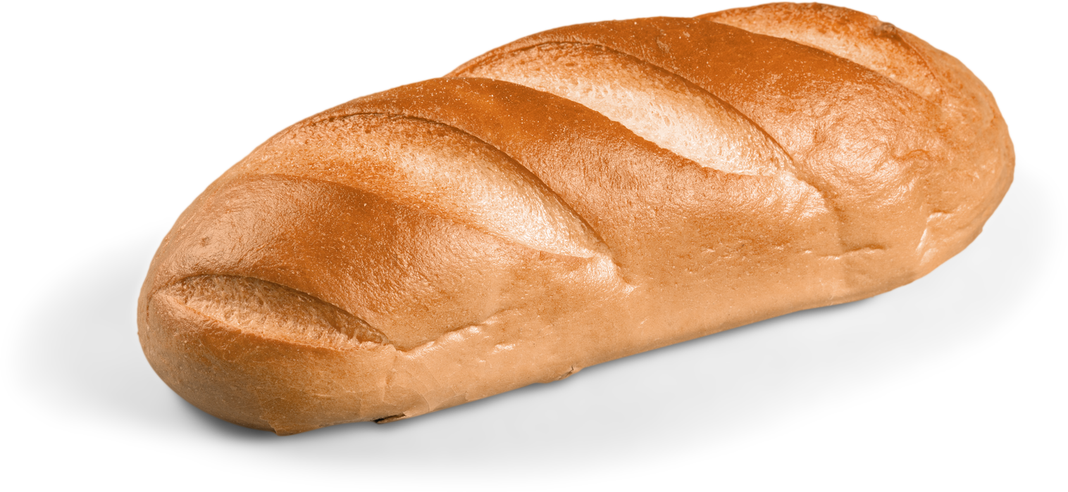
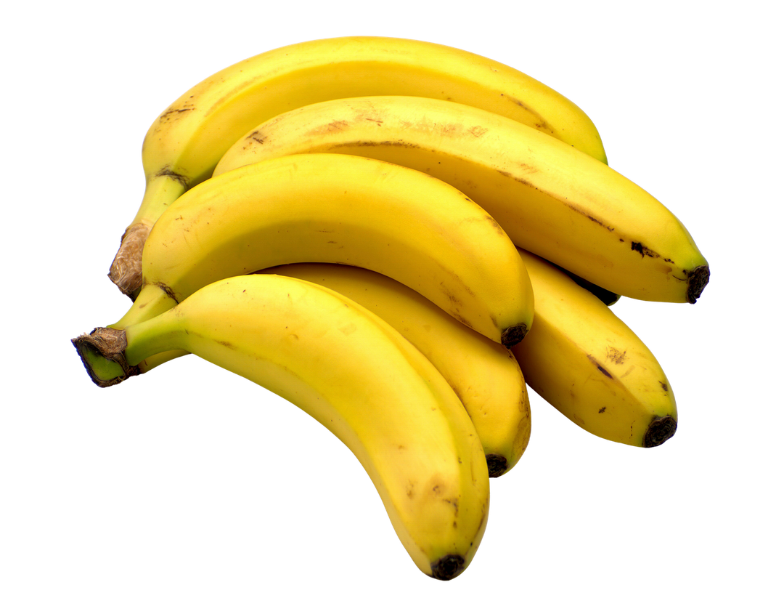
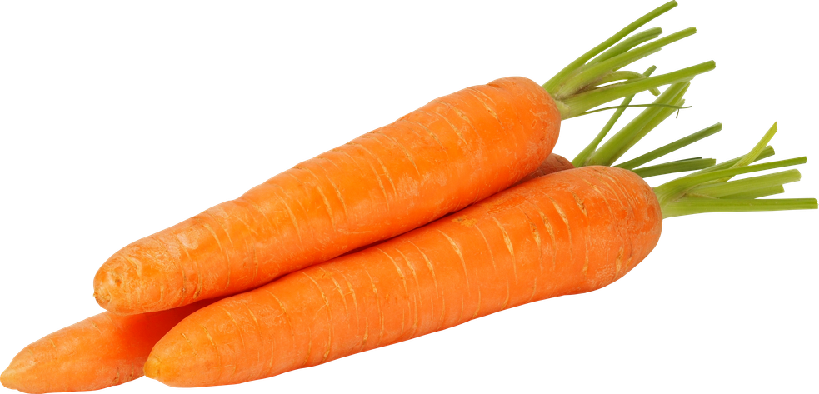
Extension activity 3
DT activity: The below ingredients are about to go off. What could we make with it to save throwing them away? Create instructions

