Slide 1


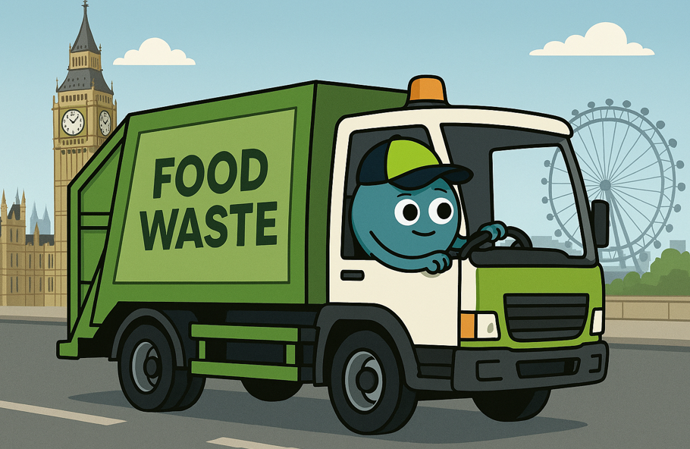

What happens with my food waste?
KS1 Lesson - Lesson 4 of 4

Slide 2
LO: To understand what happens to food waste
Understand what food waste is and why it happens.
Explore where food waste goes after we throw it away.
Learn how food waste can be turned into energy or compost.

Slide 3






Lesson Prep
Vocabulary
Discussion
Keywords that children need to understand and use during the lesson.
An opportunity for children to practice the knowledge learnt.
Big question
Task
To assess learning and give children time to practise independently.
A central question that sparks curiosity and frames the lesson’s theme.
The knowledge
Extension
Essential facts and concepts children need to know.
Optional tasks to deepen or stretch learning beyond the core lesson.

Slide 4
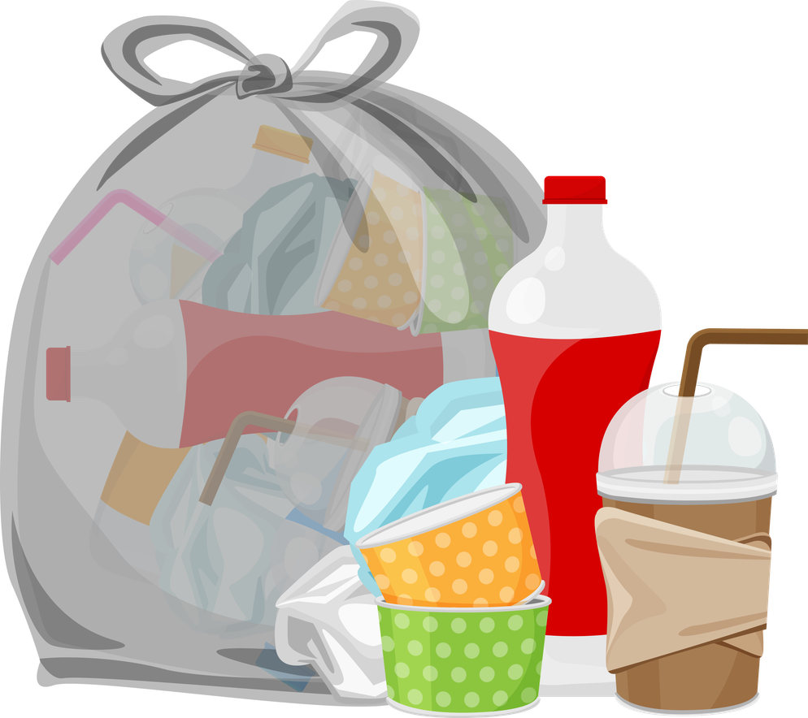
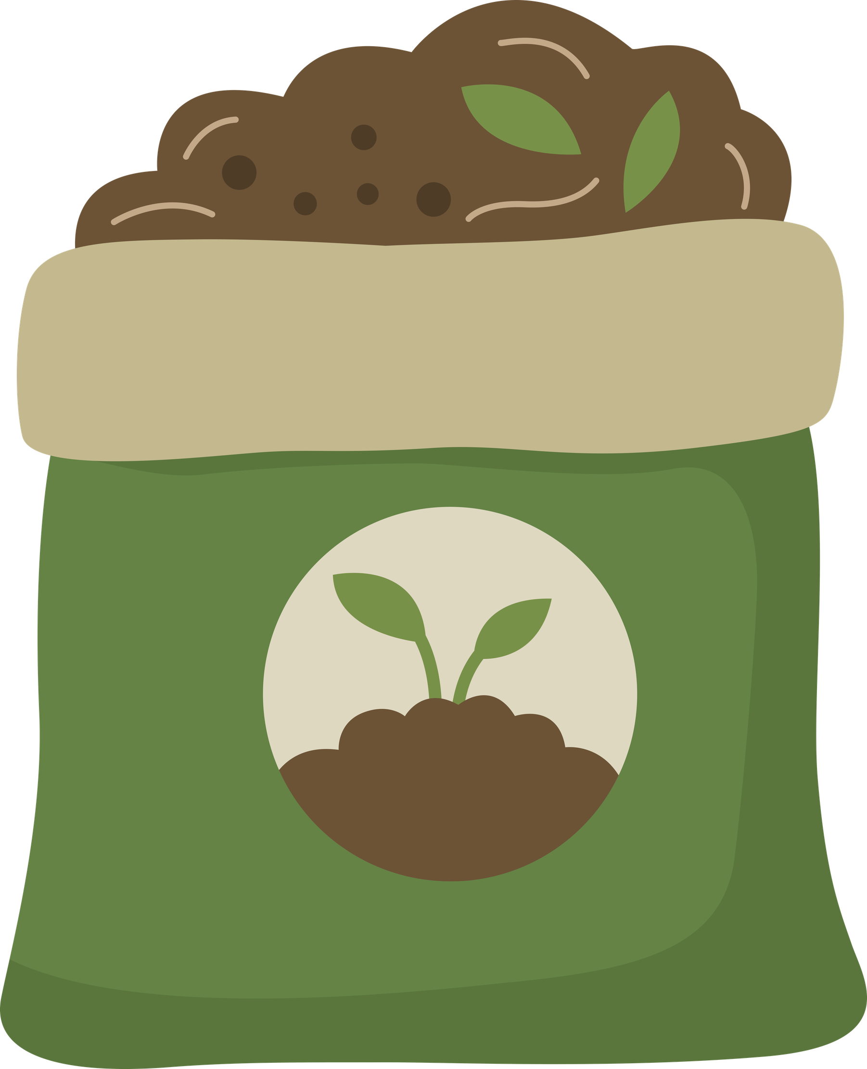


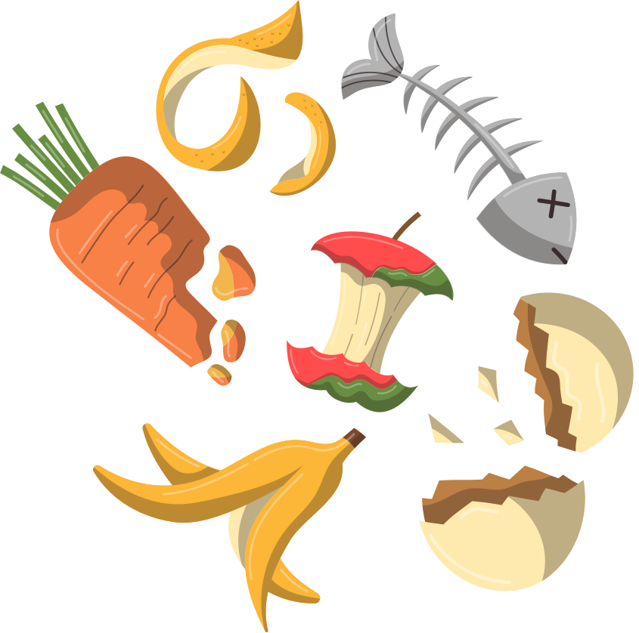
Key Words
waste
fertiliser
energy
food waste
anaerobic digestor
Notes:
Waste: Things we throw away because we don’t need or want them anymore.
Fertiliser: Food for plants that helps them grow strong and healthy.
Energy: Power that makes things work, like lights, TVs, and cars.
Food waste: Leftover food that gets thrown away instead of being eaten.
Anaerobic digestor: A big machine that breaks down food without using air. It turns food waste into gas for energy and a fertiliser for plants.

Slide 5
Vocabulary task
2. 3. 4. 5.
waste
Anaerobic digestor
fertiliser
energy
food waste
Challenge: Write a sentence using a new vocabulary word.
Notes:
1 = food waste
2 = waste
3 = Anaerobic digestor
4 = fertiliser
5 = energy

Slide 6






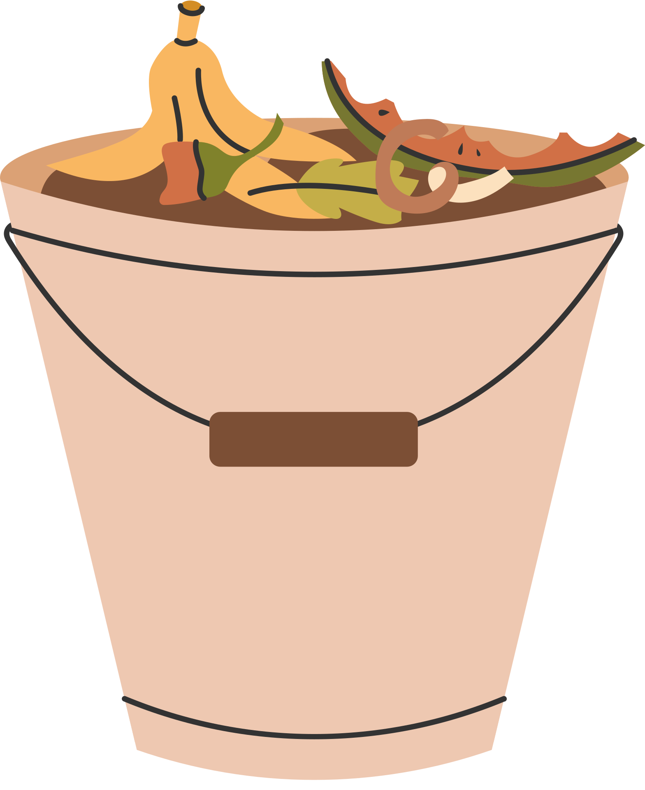

Why do we have food waste bins Ned?
Food waste can be used to make energy and fertiliser. Let’s look at how this is done!

Slide 7
What goes in a food bin?
fruit
vegetables
leftovers
tea bags
eggshells
meat
bones
Notes:
Explicitly teach children what goes in the food waste bin - and nothing else!
You could have an actual bin with examples to bring this to life.

Slide 8
What goes in the food bin?
You can put _______ in the food bin.
Notes:
Explicitly teach children what goes in the food waste bin - and nothing else!
You could have an actual bin with examples to bring this to life.

Slide 9
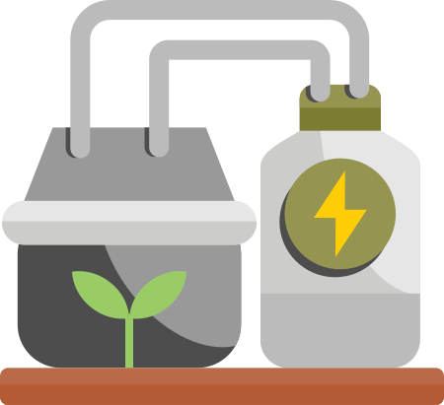
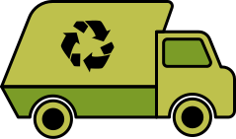

The journey of food waste
Notes:
Food waste is put in the food waste bin by students.
The food waste bin is collected by a lorry.
It is taken to a big tank called an anaerobic digester –which is like a giant stomach.
Inside the tank, tiny microorganisms eat the food waste and make a gas called biogas when they break it down.
This biogas is captured and used to make electricity.
The leftover food mush becomes fertiliser to help plants grow.

Slide 10
What happens to food waste?
biogas
anaerobic digester
fertiliser
First _______.
Then _______.
Notes:
When I say go, you have 30 seconds to tell your partner what happens to our food waste - Go!

Slide 11


What does food waste make?
biogas
Makes energy for our homes
fertiliser
Makes good food for plants
Notes:
When I say go, you have 30 seconds to tell your partner what happens to our food waste - Go!

Slide 12
What does food waste make?
biogas
Makes _____ for our _____
fertiliser
Makes good _____ for _____
food energy homes plants
Notes:
When I say go, you have 30 seconds to tell your partner what happens to our food waste - Go!
Biogas makes energy for our homes.
fertiliser makes good food for plants.

Slide 13

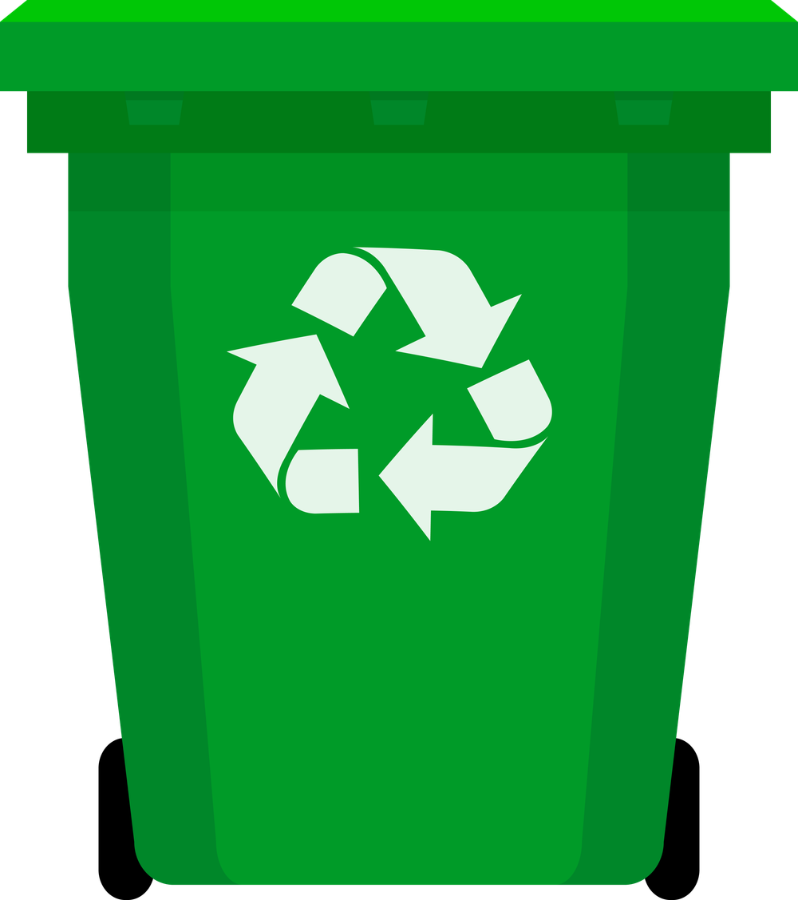





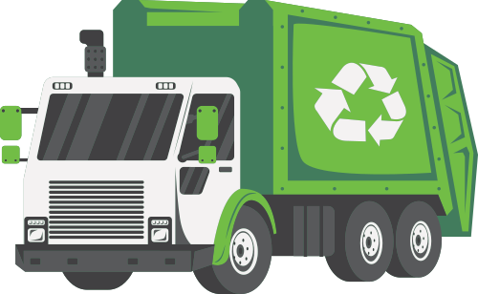
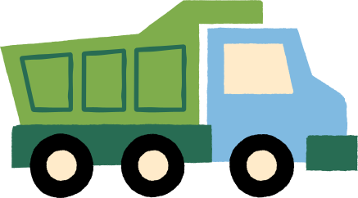
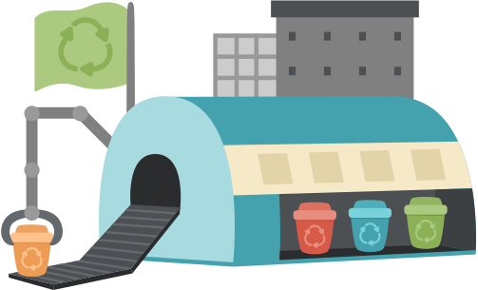
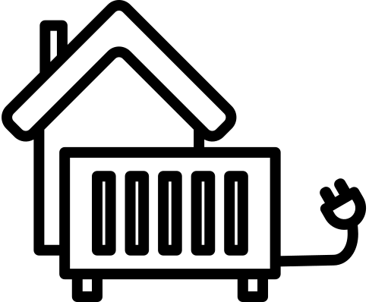
The journey of waste in North London
Recycling goes to a reuse and recycling centre.
Rubbish goes to London Energy.
Food waste goes to an anaerobic digestor.

Slide 14
Where does the waste go?
Recycling goes to a _____ _________________.
Rubbish goes to _______ _________.
Food waste goes to an _________ __________.
reuse and recycling centre
London Energy
anaerobic digestor

Slide 15
I did not know that we got energy from food waste. I am going to get a food waste bin and start straight away!
Brilliant Nancy, that is going to make a great difference!

Slide 16
It’s amazing that in London we can recycle our food waste to make electricity and compost! But we still need to remember that making food uses a lot of energy, water, and hard work so the best thing to do is to eat everything on your plate.

Slide 17


Top food waste tips!
Only put food on your plate that you know you can finish.
2. Store food correctly so it lasts longer.
3. Get a food waste bin at home so any food waste can be reused to make energy and fertiliser.

Slide 18
What 3 things can we do?
Three things we can do are _______, __________ and __________.

Slide 19

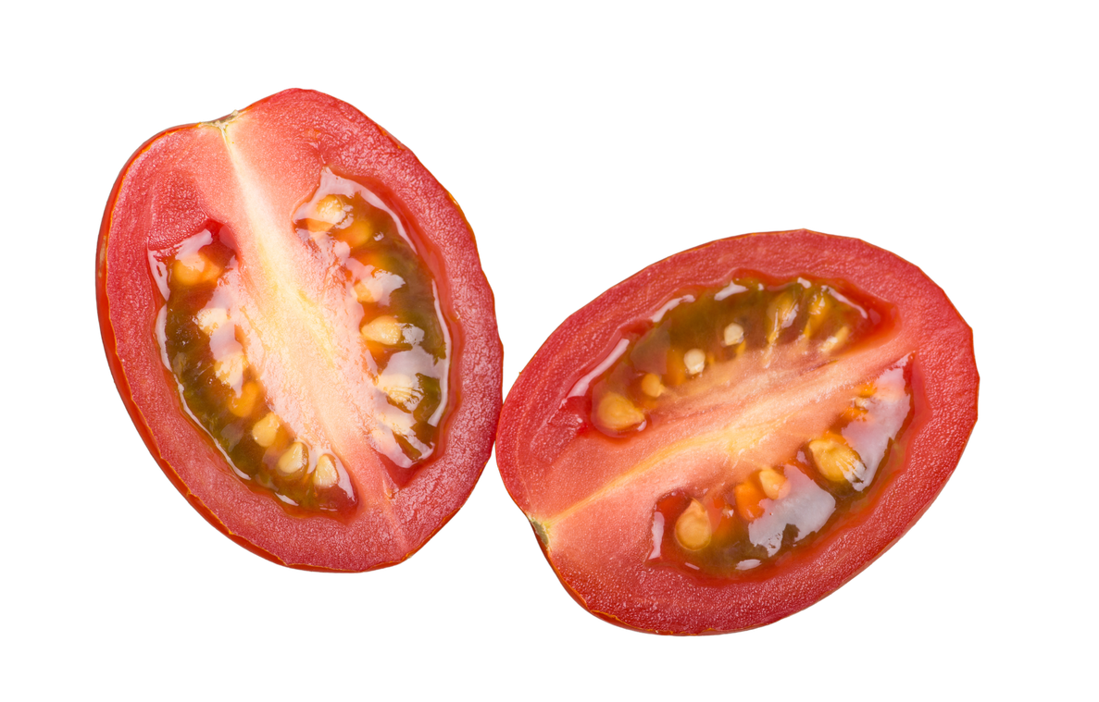
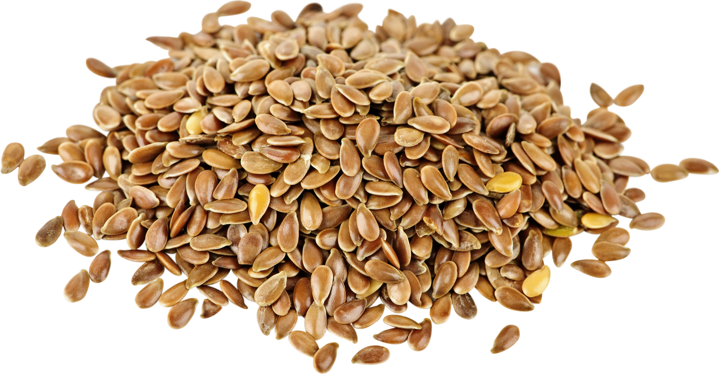

Extension activity
Make tomato seed paper
I love growing new plants from vegetables that have gone bad. It is a great to use the seeds to make new plants!
Notes:
Introduce task and explain we are going to use tomatoes that are over-ripe and may go to waste.

Slide 20
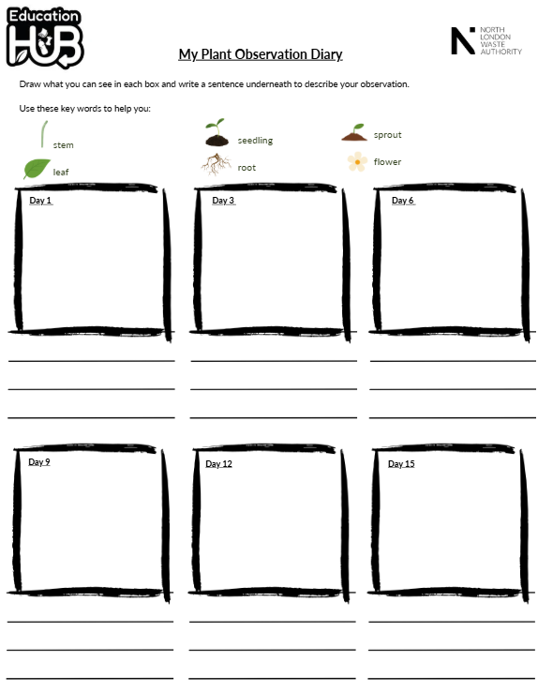
Extension activity
Make tomato seed paper
We are going to record how our tomato seeds from food waste grow over 15 days!
Notes:
Introduce task and explain we are going to use tomatoes that are over-ripe and may go to waste.

Slide 21
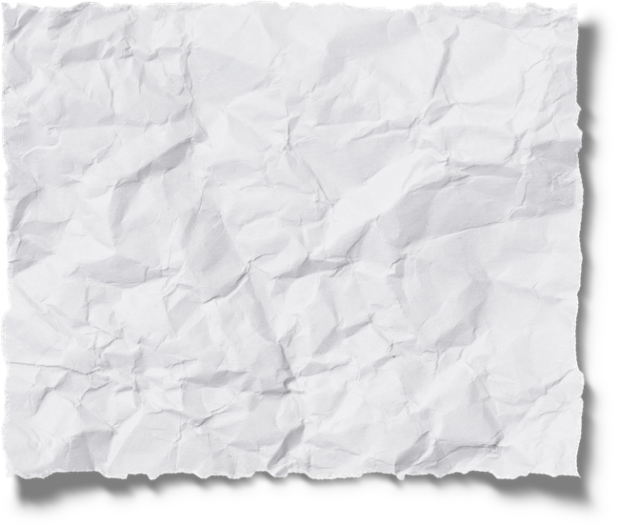

Steps
Place the old tomatoes between two pieces of paper and carefully squish in the palm of your hand.
Carefully peel back the top layer of flesh and remove as much flesh as you can.
Leave the seeds on to dry on the paper on a windowsill.
Notes:
Encourage students to write their names on the paper towel.

Slide 22

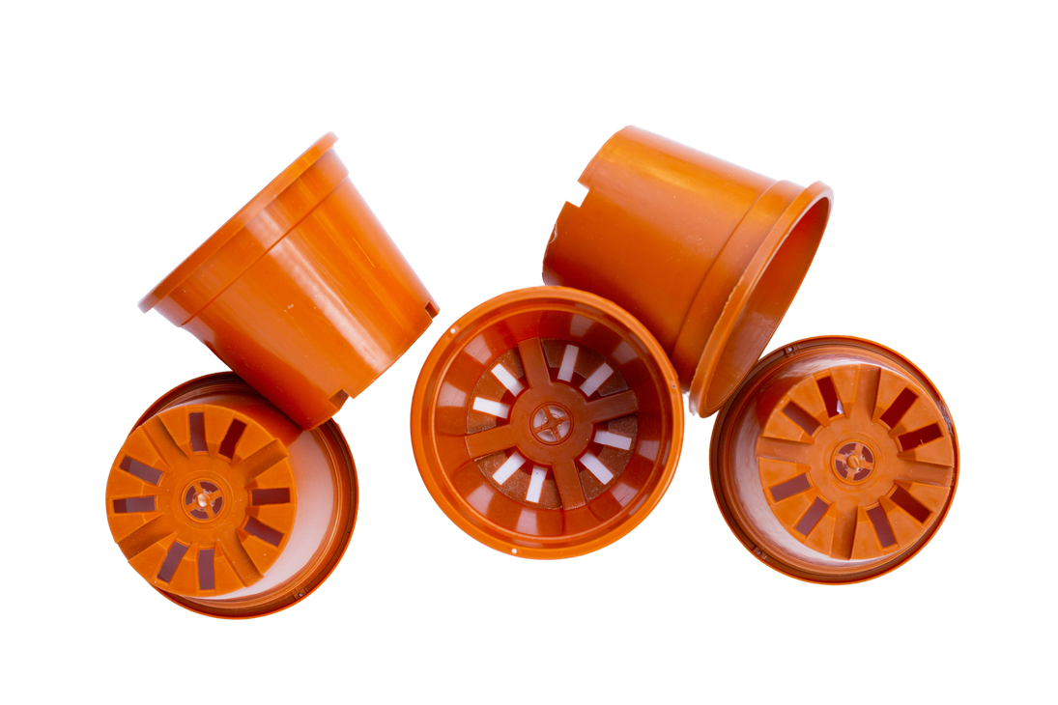
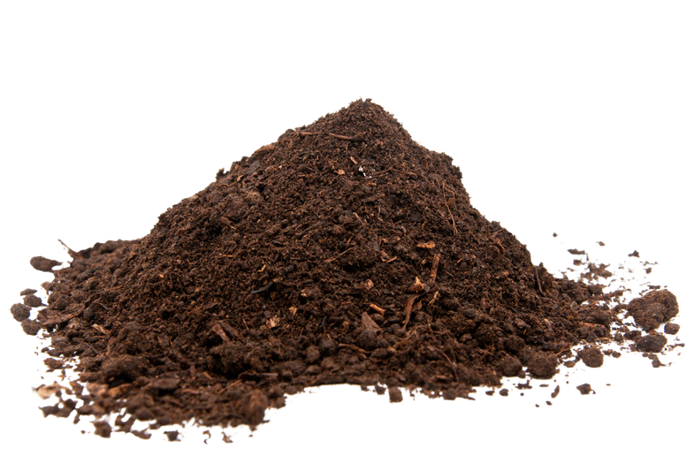

Steps
4. Once dry, cut your seed paper in half.
5. Fill your plant pot with compost.
6. Place your seed paper on top of the compost.
7. Gently cover the seed paper with a light covering of compost.
8. Put it in a sunny place and water regularly.
9. Update your plant diary and record the changes you see.
Notes:
A windowsill is a good place to plant the seeds.

Slide 23

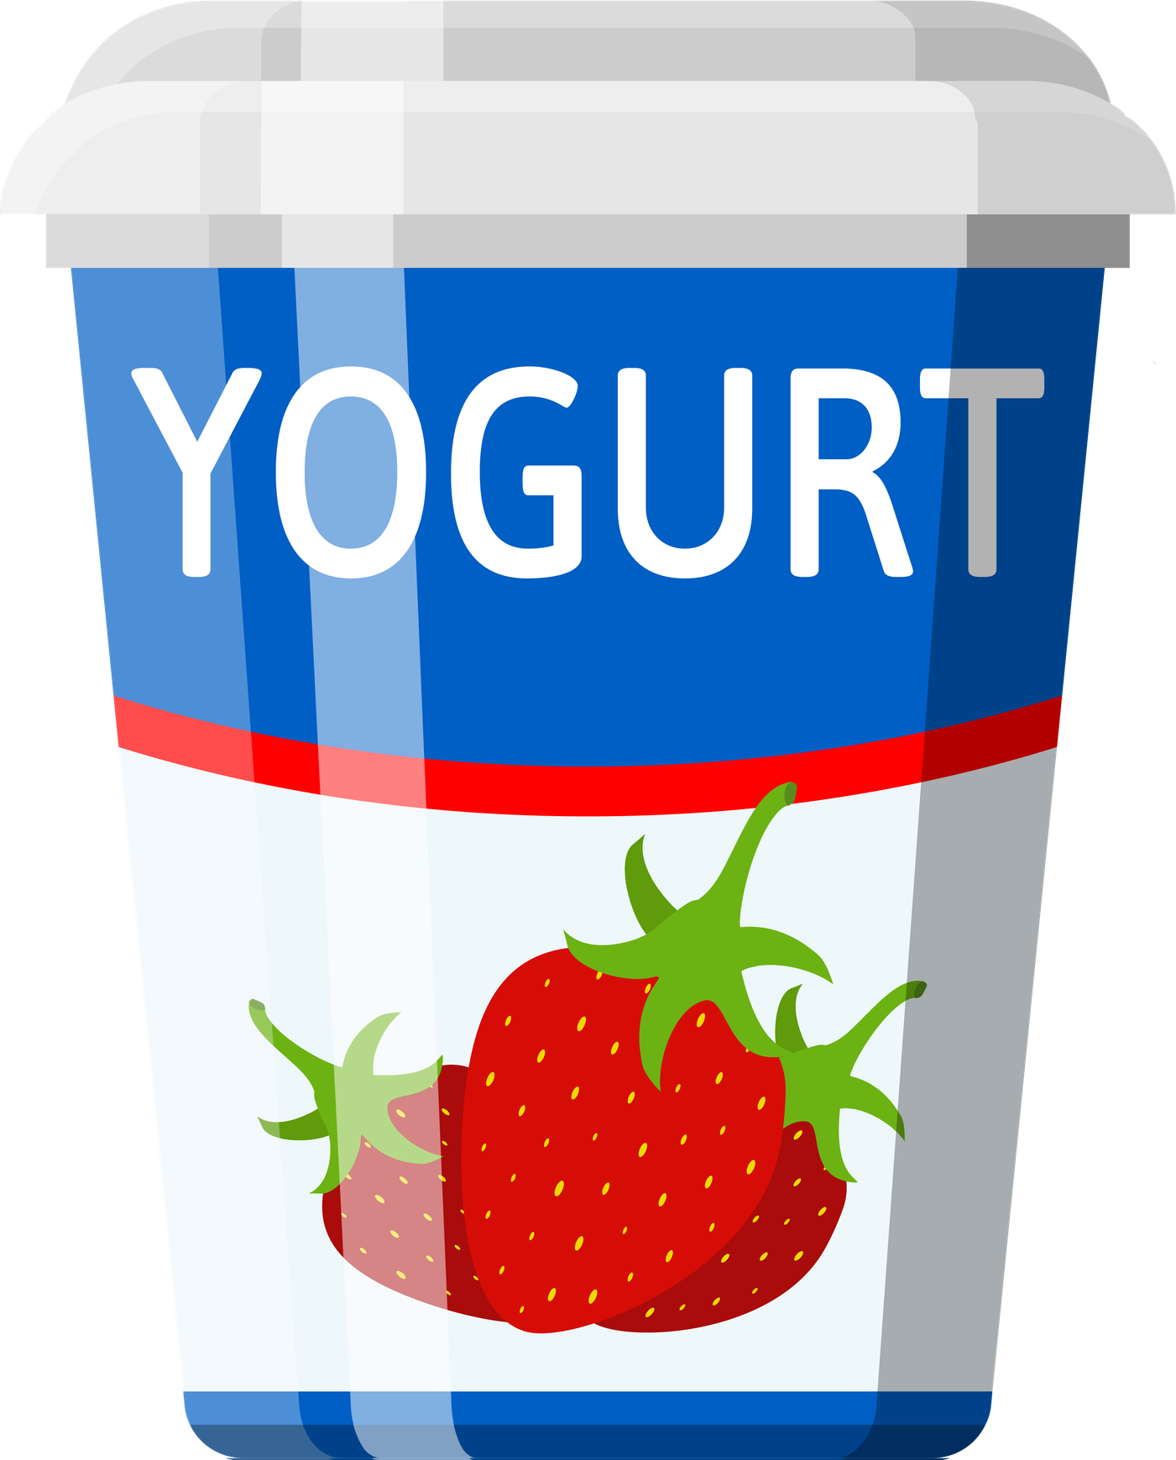

Tell your partner how to grow a new tomato plant

