Slide 1


KS2 Lesson
What happens to food waste?

Slide 2
LO: To investigate how food waste can be turned into compost.
I can explain the impact of food waste on the environment.
I can explain how food waste is managed in north London.
I can explain how to create your own compost from food waste.

Slide 3

In 15 words, tell me the problem with food waste.
Notes:
Ask students to write a 15 word summary of the problems caused by food waste. Answers include: waste of natural resources, decomposition releases methane.

Slide 4
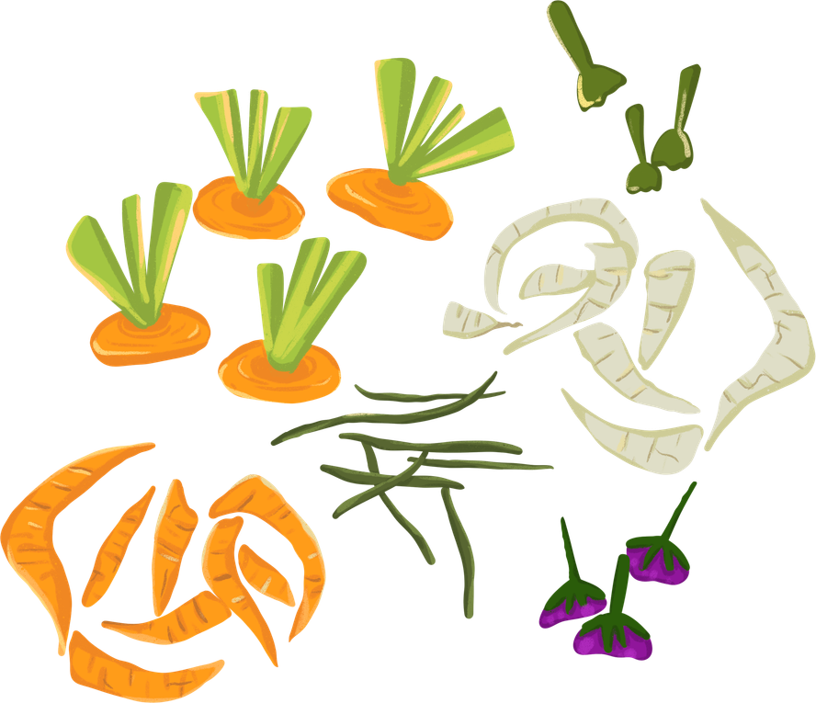
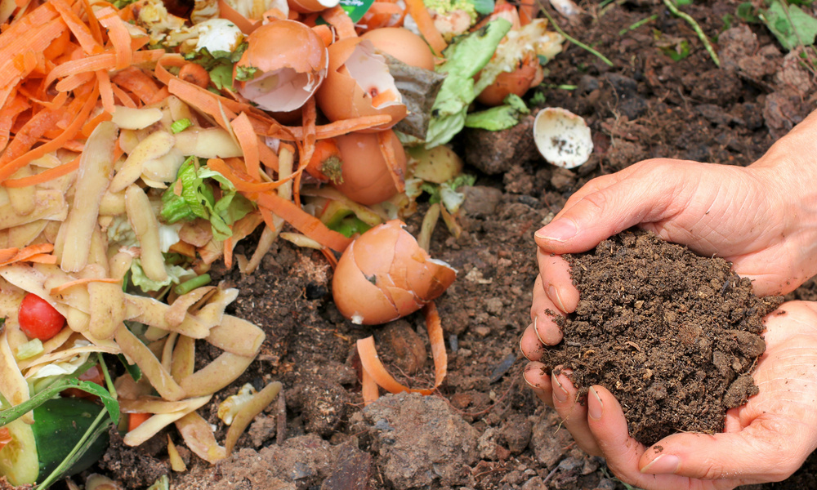
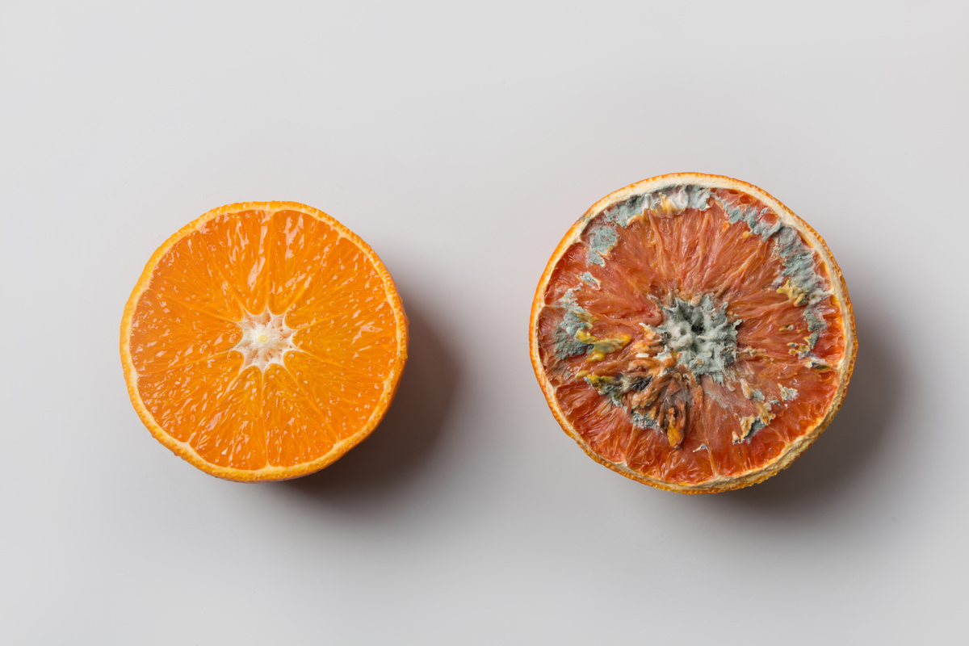

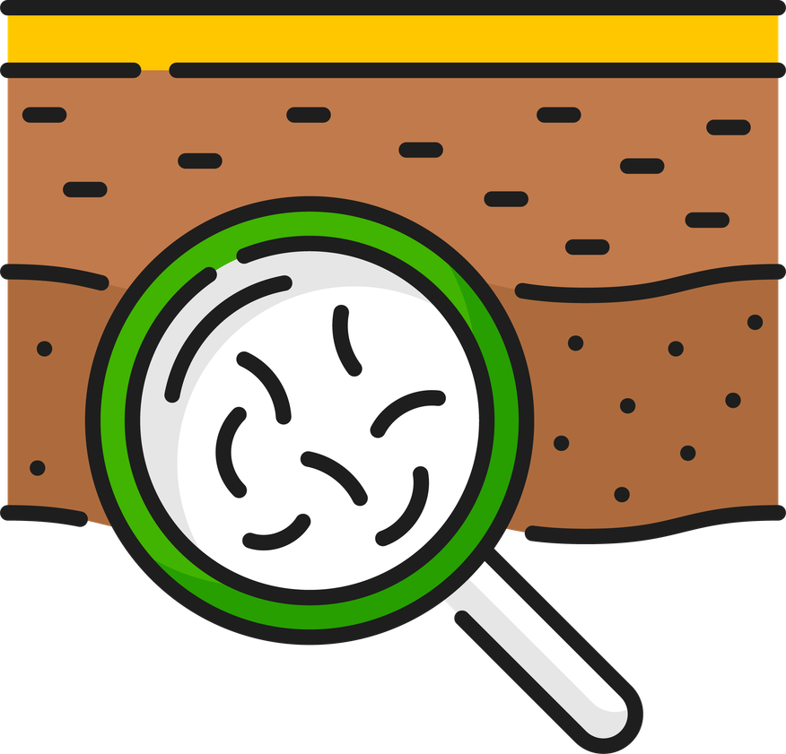

Key Words
compost
decompose
scraps
observe
methane
micro organisms
Notes:
Microorganism is a living thing that can only be seen using a microscope. This includes bacteria and fungi. (California Academy of Sciences, 2024)

Slide 5

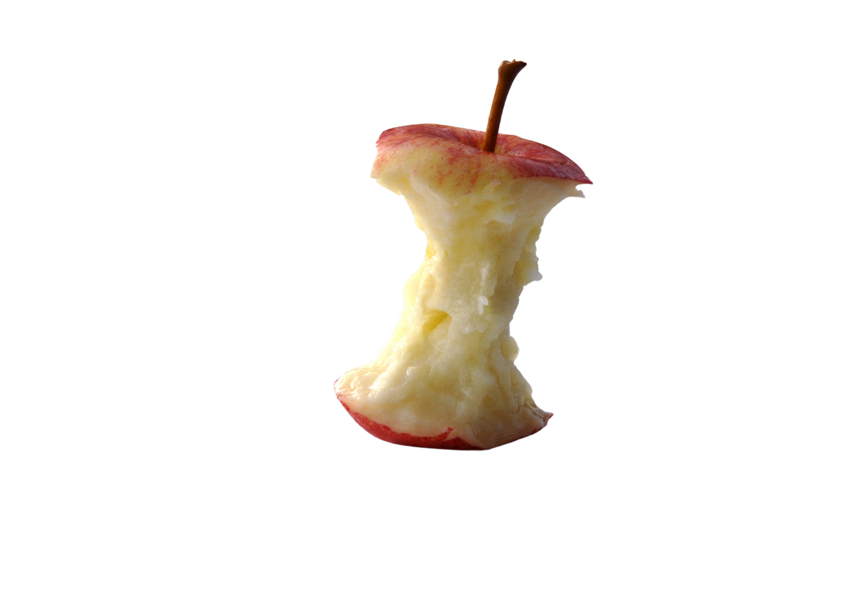
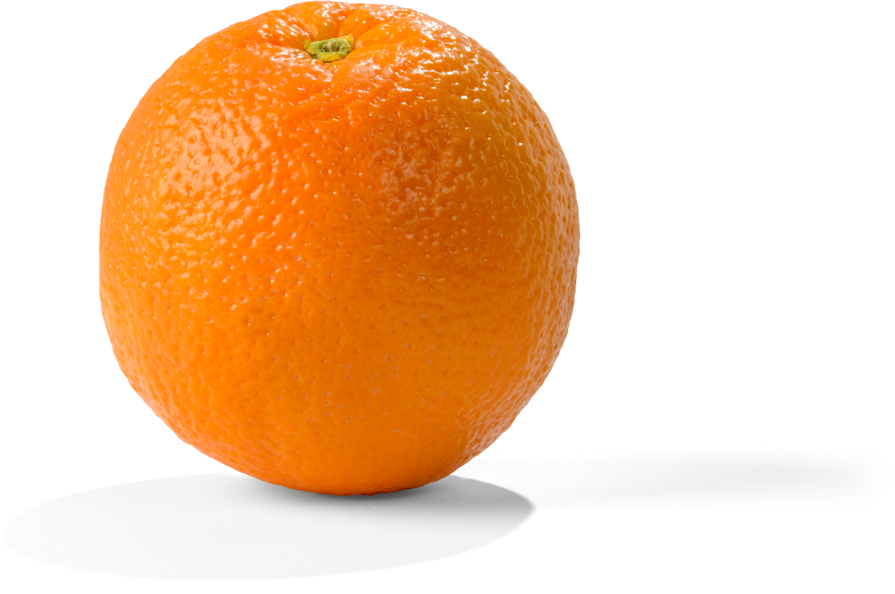
What would happen if you left this for a week?
Notes:
Allow students time to discuss what changes they might observe.

Slide 6
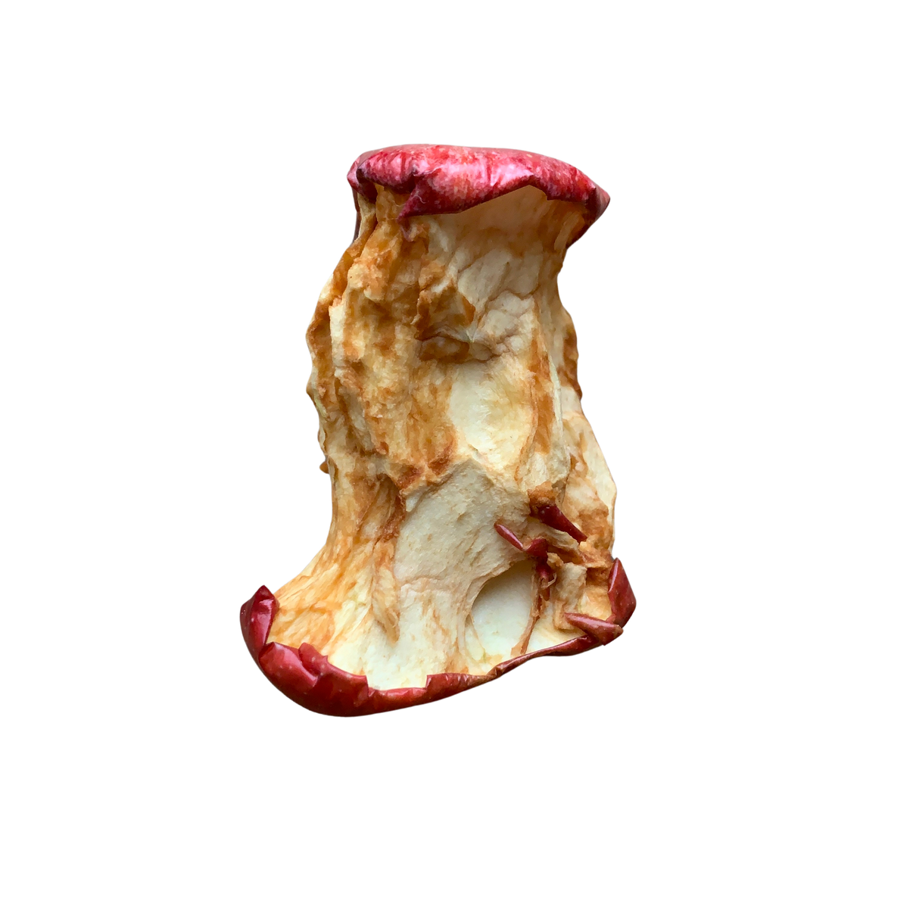

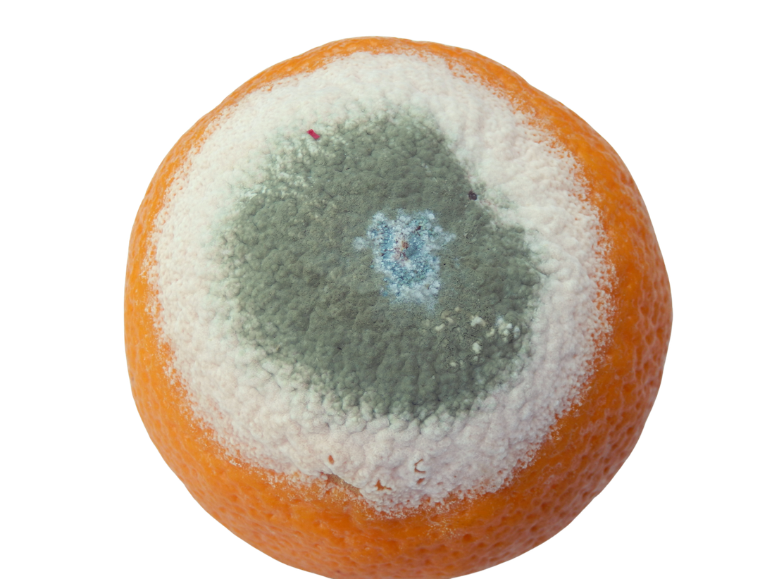


If left, the food will begin to decompose. Mould and bacteria will begin to break the food down.
bacteria
mould
Notes:
Mould is a type of fungi. Fungi and bacteria (micro-organisms) begin to break down the food to turn it back into organic materials. It's a type of natural recycling.
Extension question: what would happen if you put in the playground? Or in the freezer?
Temperature, oxygen and water all speed up the process of decomposition. That's why if you freeze something, it doesn't spoil as it slows down the bacteria and fungi (mould).

Slide 7
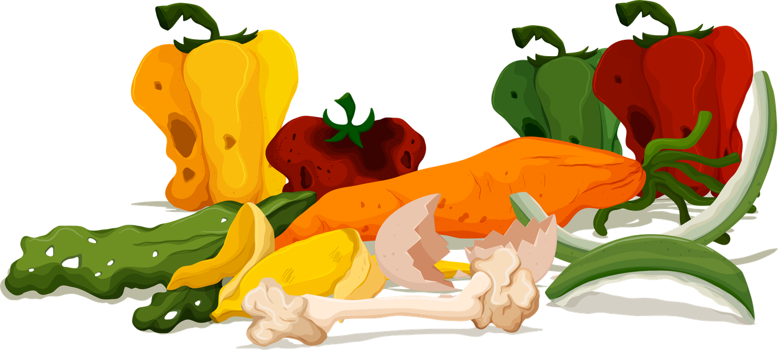
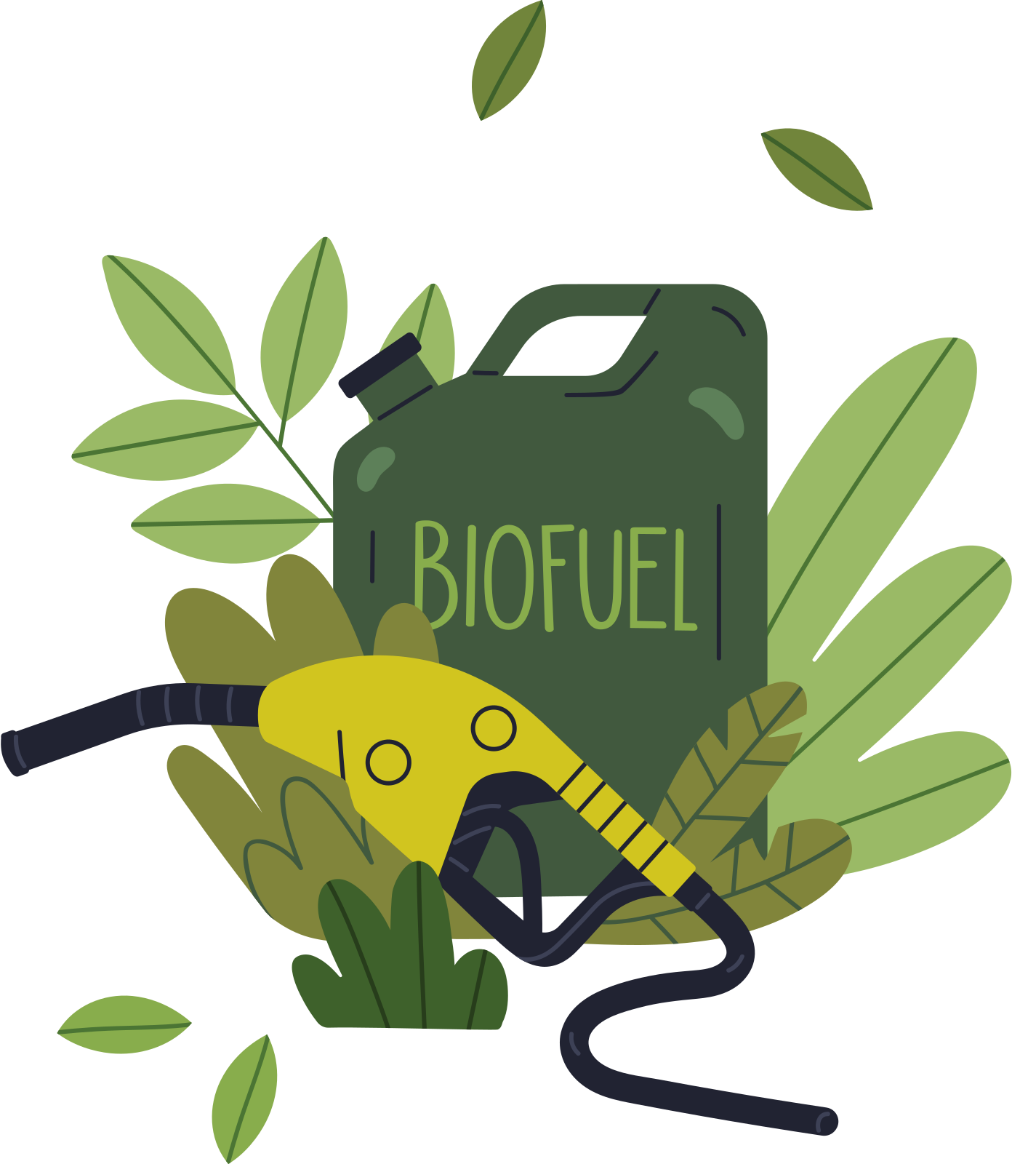

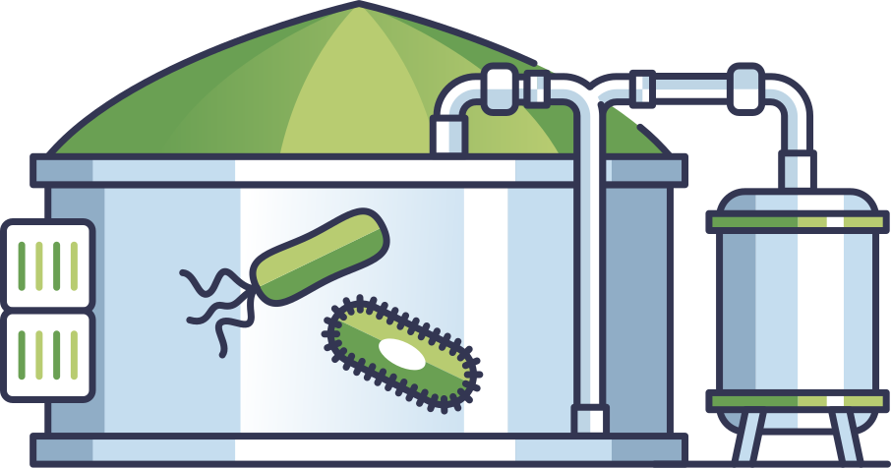


Anaerobic digestion
Green waste
Biogas
Fertiliser
Notes:
We produce a lot of food waste in north London and it makes up around 32% of our black bin waste (NLWA,2023).
If we put all of these food waste into landfill, it would release all the methane into the atmosphere and contribute towards climate change. This is because in landfill, oxygen is removed (due to the waste being compressed) and causes anaerobic composting.
So, food waste and green waste in north London is collected and sent to an anaerobic digestor.
This process removes the oxygen and uses bacteria and microbes to break down the green waste. This releases methane which is turned into biogas and also produces digestate which is used in fertiliser. The fertiliser can be used to improve the soil nutrient levels.

Slide 8

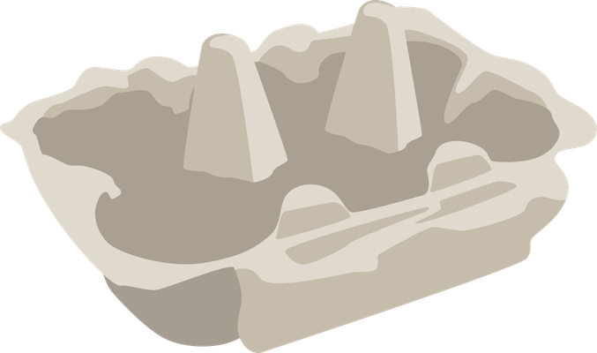
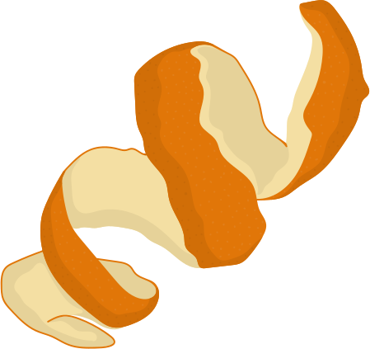


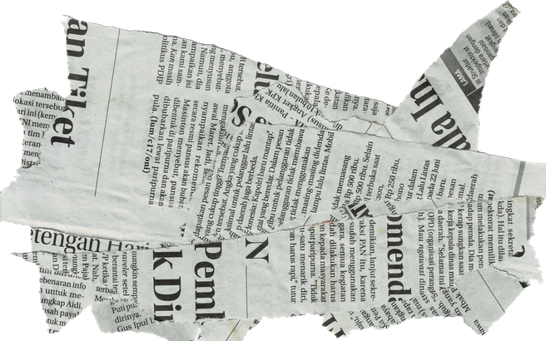
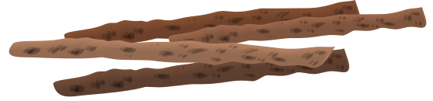
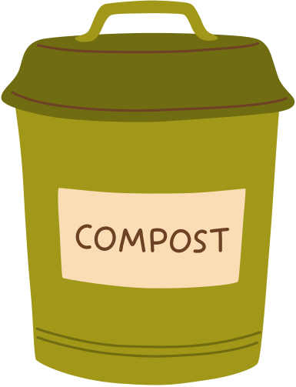
Composting
Green waste
Brown waste
Notes:
Sometimes we might not have food waste collected. Instead, we can create compost.
We use brown waste and green waste to create compost. Brown waste is dry woody material like paper, twigs or leaves. Green waste can be soft, wet, leafy material like vegetable peelings, grass cuttings or even tea bags.
This process uses oxygen so it doesn't produce methane. The micro organisms and bacteria work together to break down the waste to create compost. This compost is full of nutrients which can be used to grow new plants!

Slide 9

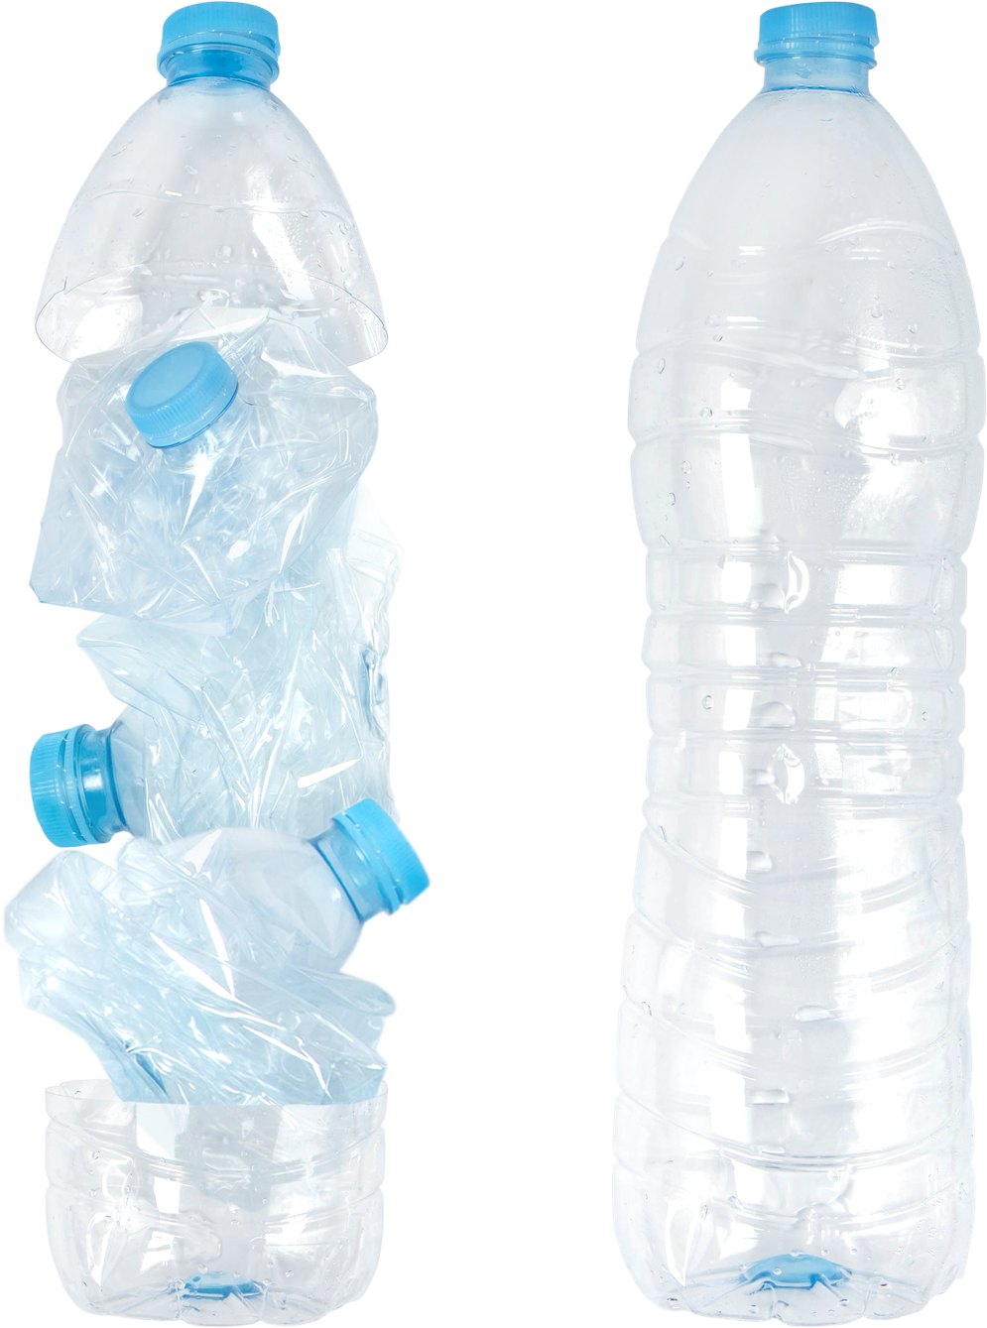





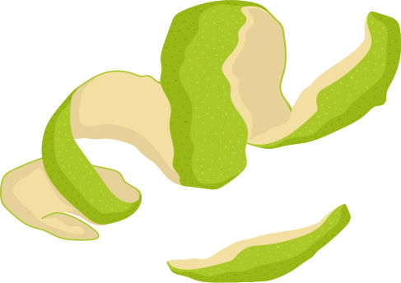


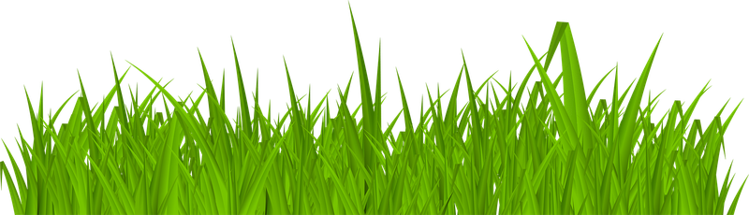
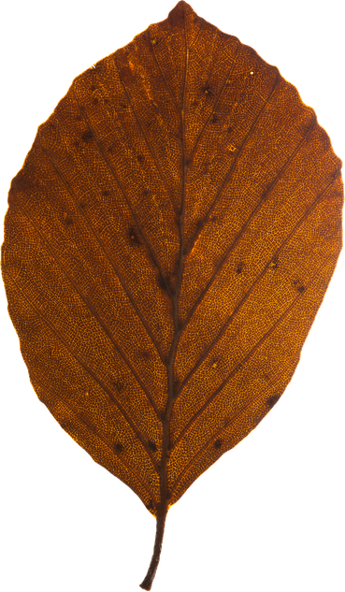
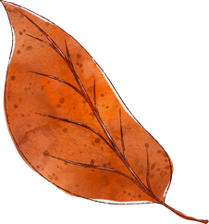

Equipment:
Create your own mini composter!
Predict:
How long will it take for the waste to break down?
What will it look like at the end?
What changes will you see?
Green waste
Brown waste
Notes:
Ask students to record in their books their predications. We have developed a Food Waste Investigation template that you may wish to use.

Slide 10
Step 1
Step 2
Carefully cut the top off your plastic bottle.
Use the pin to poke drainage holes in the bottom of the bottle.

Slide 11

Step 3
Step 4
Place the bottle on a shallow dish and add a layer of brown waste. Then spray with water.
Next, add a layer of green waste and spray with water.

Slide 12

Step 3
Step 4
name
Repeat so you have two layers of each type of waste.
Using a permeant marker, draw lines for each layer of waste. Add your name and the date at the top of the bottle.

Slide 13

Step 5
Step 6
Turn the bottle lid upside down and place in the bottle. Place one piece of folded kitchen on top of the lid.
Leave your mini composter on a sunny windowsill. Record the changes you observe.

Slide 14

Observe and record any changes you see in your mini composter.
Record:
What changes can you see?
What changes can you smell?
Draw:
A labelled diagram of what your mini composter.
The green and brown waste is now slimy and is slightly below the lines. There is condensation on the bottle and liquid in the dish underneath.
Notes:
In the students workbooks, create an observation diary. You can use the resource 'Food Waste Investigation' or create your own version.
Students will need to record their observations and draw a labelled diagram of the changes they observe.
You may need to do this at weekly or fortnightly intervals.
This could also be recorded as a class observation record on as a working wall.

Slide 15
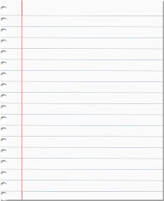
Create a compost fact file
Research these questions and create a compost fact file
What is compost made from?
What should go in your compost?
How is compost created?
What conditions are best for compost?
What can you use compost for?
Useful websites:
Composting for schools / RHS Gardening
Food waste - BBC Bitesize
How to compost with kids | Parents | National Geographic Kids
Composting - Why make compost? | Better Planet Education
Notes:
For the alternative activity to creating a mini composter, students can create their own compost fact file. There are questions and websites to guide their thinking.
Please note, NLWA are not responsible for the content of external links. We encourage checking links before the lesson.

Slide 16

Summary
It is good to put food waste in the general rubbish bin.
Notes:
Ask students whether they agree or disagree with the statement. Ensure they give reasons.
Answer: Disagree because if recycled correctly, it can be used to produce fertiliser and biogas.

